Slide 1

15 IANUARIE 2021
15
Caietul 2
DOSARUL DE LECTURĂ

Slide 2
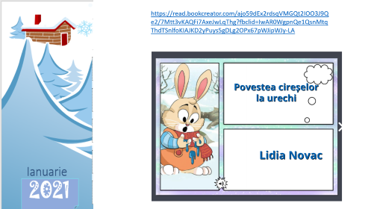



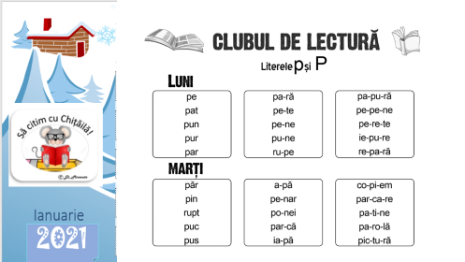
CE FACEM AZI?

Slide 3

”LUCEAFĂRUL”, MIHAI EMINESCU
https://www.youtube.com/watch?v=A4wd_S8r3IQ&t=144s

Slide 4

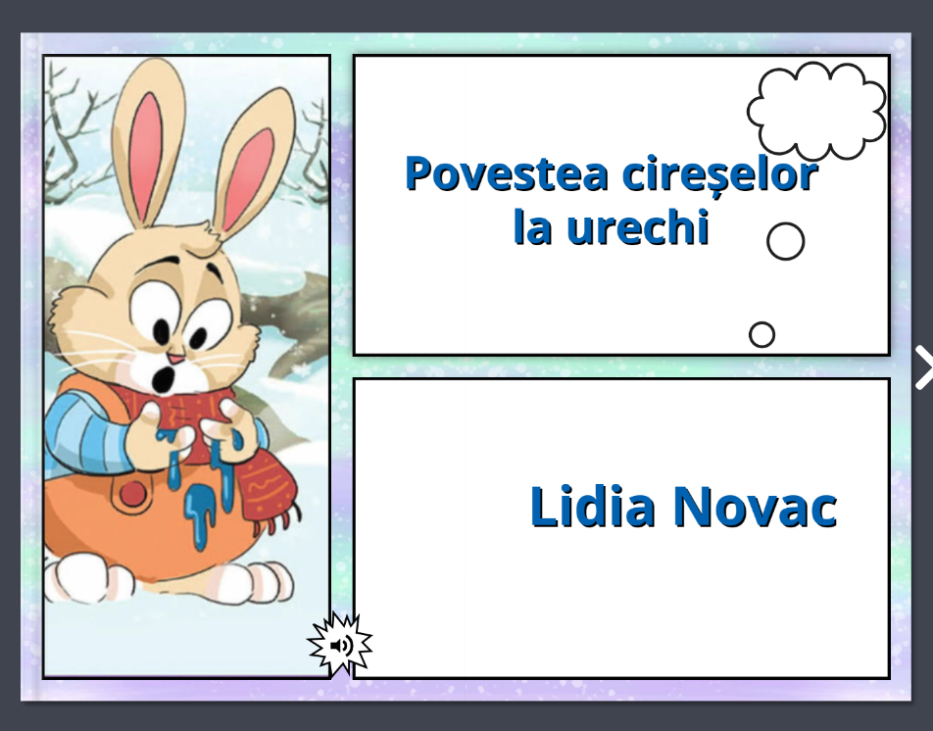
https://read.bookcreator.com/ajo59dEx2rdsqVMGQt2IOO3J9Qe2/7Mtt3vKAQFi7AxeJwLqThg?fbclid=IwAR0WgpnQe1QsnMtqThdTSnlfoKIAJKD2yPuys5gDLg2OPx67pWJipWJy-LA

Slide 5
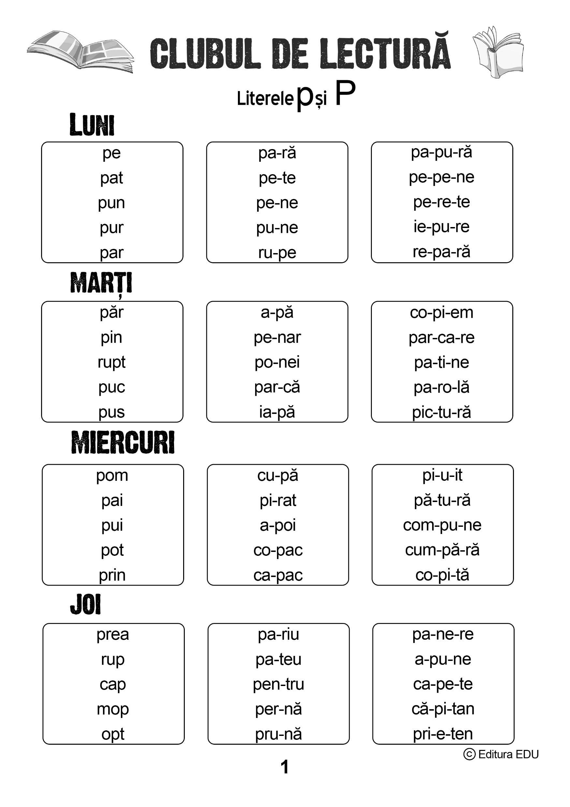







Slide 7
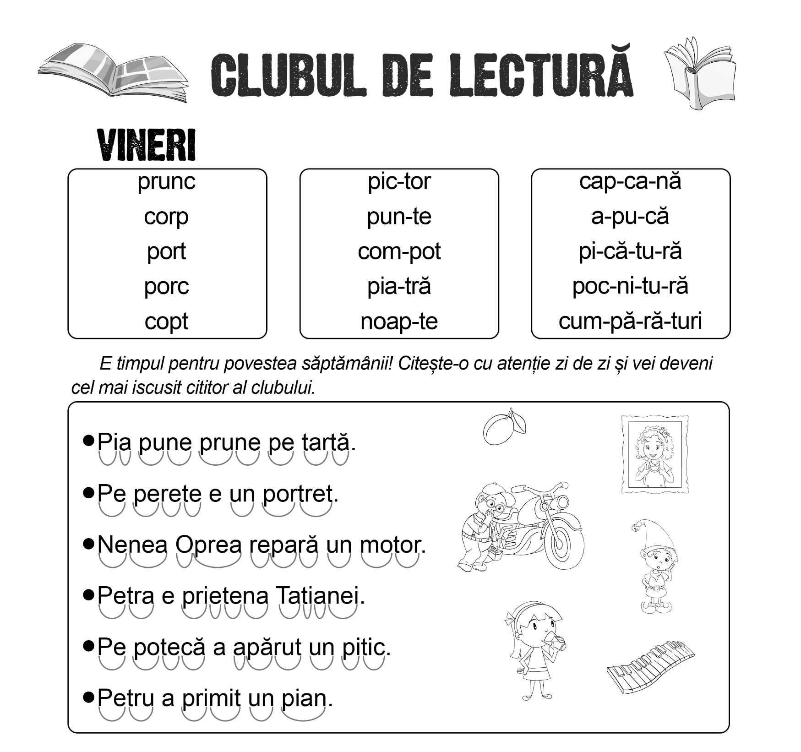
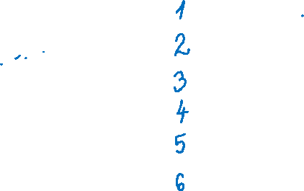

Slide 8

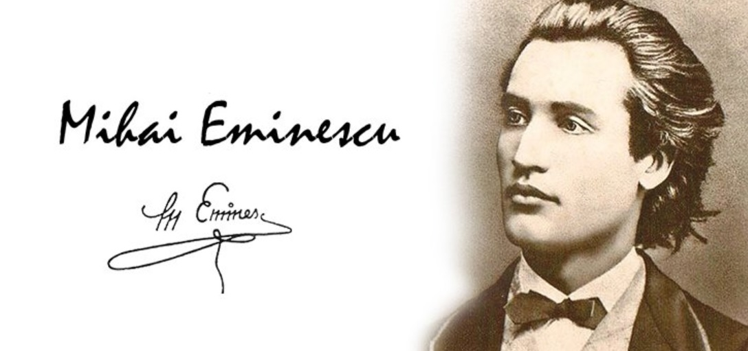
MOMENTUL DE RECITARE

Slide 9

https://create.kahoot.it/details/c1419e72-b190-4f11-b7c9-2542102100bb

Slide 10
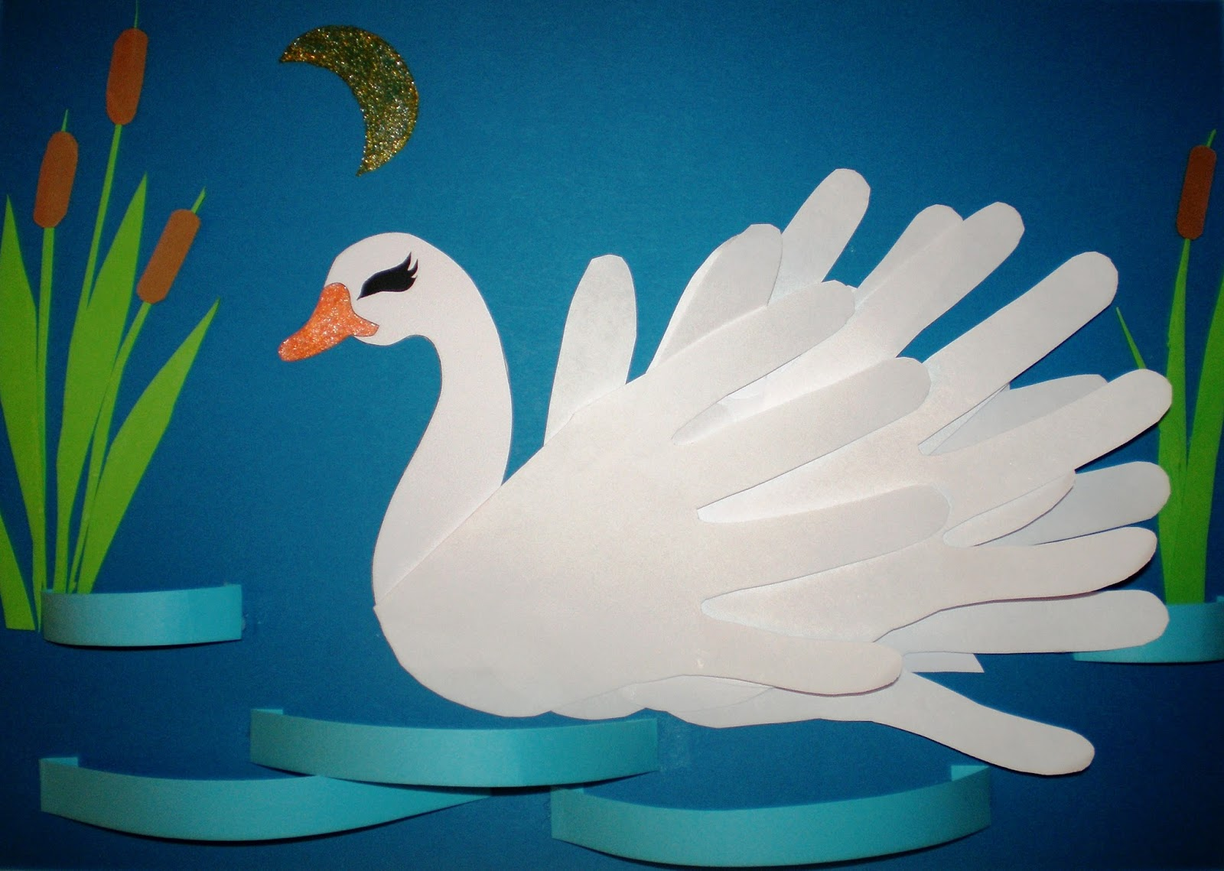
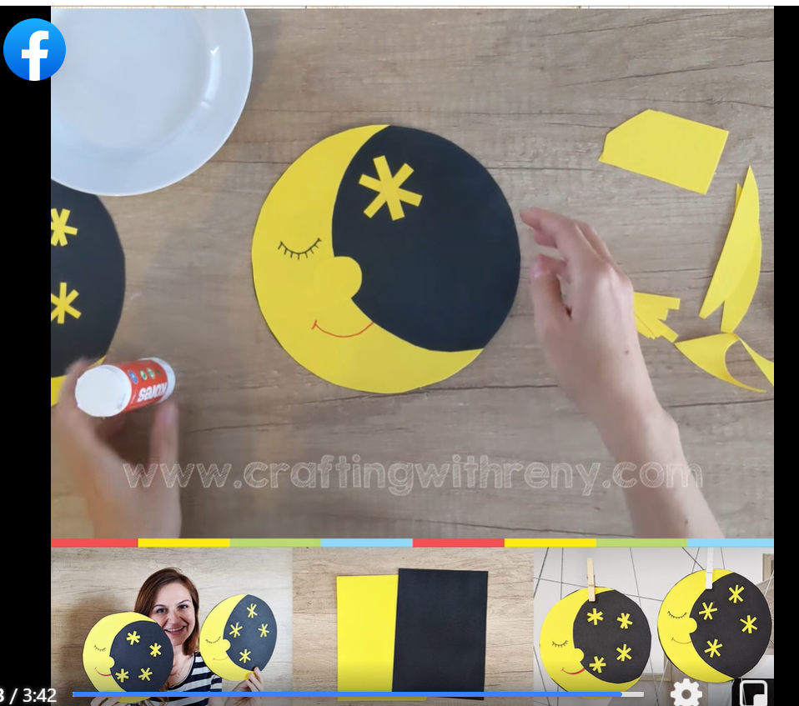
https://www.facebook.com/papermagicreny/videos/1377372219287349
https://wordwall.net/resource/9423894/despre-m-eminescu

