Slide 1
Joia verde 10.04.2025
Prof. Mînecuță Elisabeta

Slide 2
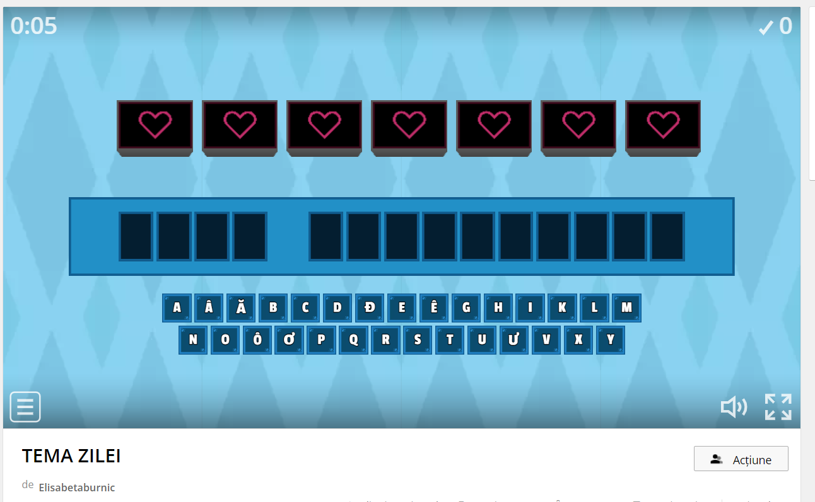
START!
https://wordwall.net/resource/72110046

Slide 3
Table of contents
01
02
04
03
Hora reciclarii
COMPREST
Video
Activitate cu specialiști
3 R
Verificare
Vizionare filme educative
Jocuri digitale

Slide 4
Link-uri
https://www.youtube.com/watch?v=NsfTgHirw48
https://view.livresq.com/view/5eecfbef4099f4181e5d9431/
https://quizizz.com/join/quiz/62443a7619f1a2001da07dd7/start?studentShare=true
https://learningapps.org/view26181603

Slide 5
Să reciclăm!

