Slide 1


CLIFTON RANGERS
CLUB POLICY
Fun Fitness Friendships

Slide 2

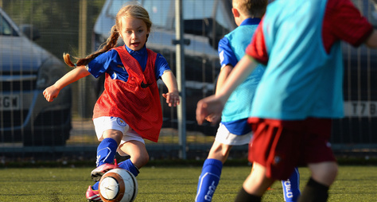

Safeguarding Children Policy and Procedures
Clifton Rangers YFC has a role to play in safeguarding the welfare of all children and young people by protecting them from physical, sexual or emotional harm and from neglect or bullying. It is noted and accepted that The Football Association’s Safeguarding Children Regulations (see The FA Handbook) applies to everyone in football whether in a paid or voluntary capacity. This means whether you are a volunteer, match official, helper on club tours, football coach, club official or medical staff.
Clifton Rangers YFC acknowledges its responsibility to safeguard the welfare of every child and young person who has been entrusted to its care and is committed to working to provide a safe environment for all members. A child or young person is anyone under the age of 18 engaged in any club football activity. We subscribe to The Football Association’s (The FA) Safeguarding Children – Policy and Procedures and endorse and adopt the Policy Statement contained in that document.
We endorse and adopt The FA’s Responsible Recruitment guidelines for recruiting volunteers and we will:
• specify what the role is and what tasks it involves
• request identification documents
• as a minimum meet and chat with the applicant(s) and where possible interview people before appointing them
• where eligible require an FA accepted Enhanced Criminal Record Check (CRC) with Barring List Check
in line with current FA policy and regulations.
The key principles of The FA Safeguarding Children
All Clifton Rangers Club members working in eligible roles, with children and young people - such as managers and coaches are required to hold an in-date FA accepted Enhanced CRC with Barring List check as part of responsible recruitment practice.
If there are concerns regarding the appropriateness of an
individual who is already involved or who has approached
us to become part of Clifton Rangers
Football Club guidance will be sought from The Football
Association. It is noted and accepted that The FA will
consider the relevance and significance of the information
obtained via the CRC Process and that all suitability
decisions will be made in accordance with legislation and
in the best interests of children and young people.
It is accepted that The FA aims to prevent people with
a history of relevant and significant offending from
having contact with children or young people and the
opportunity to influence policies or practice with children
or young people. This is to prevent direct sexual or
physical harm to children and to minimise the risk of
‘grooming’ within football.
Policy are that:
• the child’s welfare is, and must always be,
the paramount consideration
• all children and young people have a right to be
protected from abuse regardless of their age, gender,
disability, race, sexual orientation, faith or belief
• all suspicions and allegations of abuse will be taken
seriously and responded to swiftly and appropriately
• working in partnership with other organisations,
children and young people and their parents/carers
is essential.
We acknowledge that every child or young person
who plays or participates in football should be able to
take part in an enjoyable and safe environment and be
protected from poor practice and abuse.
Clifton Rangers recognises that this is the responsibility of every adult involved in our club.
TheFA.com/football-rules-governance/safeguarding
Let’s make football safe – not sorry

Slide 3

Safeguarding Children Policy and Procedures
Clifton Rangers supports The FA’s Whistle Blowing Policy. Any adult or young person with concerns about a adult in a position of trust with football can ‘whistle blow’ by contacting The FA Safeguarding Team on 0800 169 1863, by writing to The FA Case Manager at The Football Association, Wembley Stadium, PO Box 1966, London SW1P 9EQ, by emailing Safeguarding@TheFA.com or alternatively by going direct to the Police, Children’s Social Care or the NSPCC.
Reporting your concerns about the welfare of a
child or young person. Safeguarding is everyone’s responsibility if you are worried about a child it is important that you report your concerns – no action is not an option.
i.
ii.
If you are worried about a child then you need to
report your concerns to the Club Welfare Officer.
If the issue is one of poor practice the Club Welfare
Clifton Rangers encourages everyone to know about The FA’s Whistle Blowing Policy and to utilise it if necessary.
Officer will either: • deal with the matter themselves or • seek advice from the CFA Welfare Officer
iii. If the concern is more serious – possible child abuse,
Clifton Rangers has appointed a Club Welfare Officer in line with The FA’s role profile and required completion of the Safeguarding Children and Welfare Officers Workshop.
The post holder will be involved with Welfare Officer
training provided by The FA and/or County FA. The
Club Welfare Officer is the first point of contact for all
club members regarding concerns about the welfare of
any child or young person. The Club Welfare Officer will
liaise directly with the County FA (CFA) Welfare Officer
and will be familiar with the procedures for referring
any concerns. They will also play a proactive role in
increasing awareness of Respect, poor practice and
abuse amongst club members.
We acknowledge and endorse The FA’s identification
of bullying as a category of abuse. Bullying of any kind
is not acceptable at our club. If bullying does occur,
all players or parents/carers should be able to tell
and know that incidents will be dealt with promptly.
Incidents need to be reported to the Club Welfare
Officer in cases of serious bullying the CFA Welfare
Officer may be contacted.
where possible, contact the CFA Welfare Officer first, then immediately contact the Police or Children’s Social Care.
iv. If the child needs immediate medical treatment take
them to a hospital or call an ambulance and tell them this is a child protection concern. Let your Club Welfare Officer know what action you have taken, they in turn will inform the CFA Welfare Officer.
v. If at any time you are not able to contact your Club Welfare Officer or the matter is clearly serious then you can either: • contact your CFA Welfare Officer directly • contact The FA Safeguarding Team on
0800 169 1863 or Safeguarding@TheFA.com
• contact the Police or Children’s Social Care • call the NSPCC 24 hour Helpline for advice on
0808 800 5000 or text 88858 or email help@nspcc.org.uk
NB – The FA’s Safeguarding Children Policy and
Procedures are available via – www.TheFA.com/football-
rules-governance/safeguarding – click on ‘Raising
Awareness – Best Practice Downloads’, the Policy and
Procedures document is within the resources area. The
policy outlines in detail what to do if you are concerned
about the welfare of a child and includes flow diagrams
which describe this process. How to make a referral is
also covered in the Safeguarding Children workshop.
Participants are given the opportunity to discuss how
this feels and how best they can prepare themselves to
deal with such a situation. For more information on this
workshop contact your County Welfare Officer.
Further advice on Safeguarding Children matters can
Respect codes of conduct for Players, Parents, Spectators, Officials and Coaches have been implemented by Clifton Rangers
Football Club. In order to validate these Respect
codes of conduct the club has clear actions it will take
regarding repeated or serious misconduct at club level
and acknowledges the possibility of potential sanctions
which may be implemented by the County FA in more
serious circumstances.
be obtained from:
•
Simon Wells
T: 07789 115697
E: cliftonrangersyfc@gmail.com
• Emailing – Safeguarding@TheFA.com
• The FA Safeguarding Children general enquiry line
0845 210 8080
1
The FA’s policy on Disclosure and Barring Service CRCs is
subject to change. CRC information and guidance can be found
at www.TheFA.com/football-rules-governance/safeguarding/
criminal-records-checks
TheFA.com/football-rules-governance/safeguarding
Let’s make football safe – not sorry

Slide 4
Equality Policy
Clifton Rangers YFC is responsible for setting standards and values to apply throughout the club at every level. Football belongs to and should be enjoyed by anyone who wants to participate in it.
Clifton Rangers in all its activities will not discriminate or in any way, treat anyone less favourably on grounds of age, gender, gender reassignment, sexual orientation, marital status, race, nationality, ethnic origin, colour, religion or belief, ability or disability. The club will ensure it treats people fairly and with respect and that it will provide access and opportunities for all members of the community to take part in and enjoy its activities.
Clifton Rangers are committed to a policy of equal treatment of all members and requires all members to abide and adhere to these policies and the requirements of the Equality Act 2010.
Clifton Rangers commits itself to the immediate investigation of any claims when brought to its attention, of discrimination on the above grounds and where such is found to be the case, a requirement that the practice stop and sanctions are imposes as appropriate.
Clifton Rangers will not tolerate harassment,
bullying, abuse or victimisation of an individual,
which for the purposes of this policy and the
actions and sanction applicable is regarded as
discrimination.
This includes sexual or racially based harassment
or other discrimatory behaviour, whether
physical or verbal. The club will work to ensure
that such behaviour is met with appropriate
action in whatever context it occurs.
This policy is fully supported by the Club
Officers who are responsible for the
implementation of this policy.
OUR COMMITMENT is to confront and eliminate discrimination whether by reason of age, gender, gender reassignment, sexual orientation, marital status, race, nationality, ethnic origin, colour, religion or belief, ability or disability and to encourage equal opportunities.
Clifton Rangers are committed to taking positive action where inequalities exist and to the development of a programme of ongoing training and awareness raising events and activities in order to promote the eradication of discrimination and promote equality in football.

Slide 5
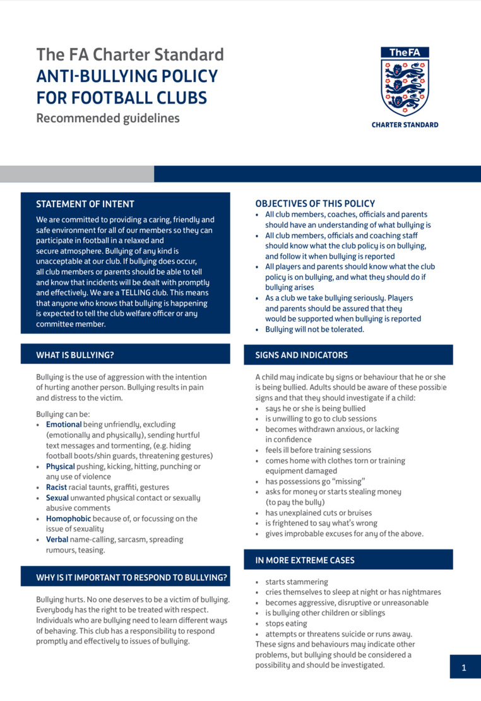
TheFA.com/Footballsafe
1

Slide 6
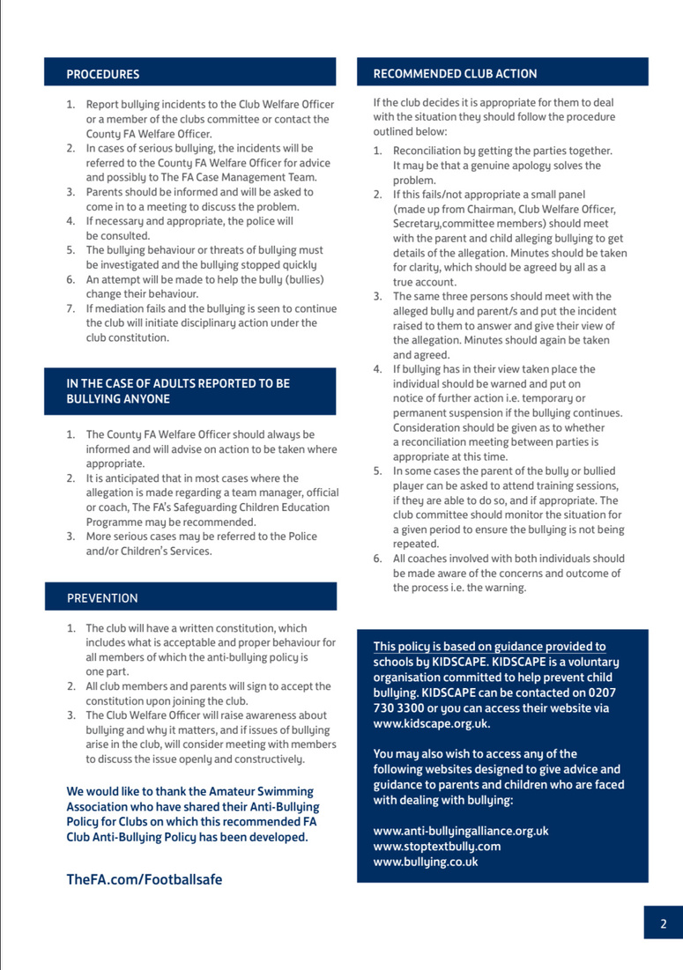

Slide 7

















Slide 8











On and o the ﬁeld, I will: • Always show respect to everyone involved in
When working with players, I will: • Place the well-being, safety and enjoyment of
each player above everything
the game
• Never tolerate any form of bullying
• Ensure all activities are suited for the players’
• Stick to the rules and celebrate the spirit of
the game
ability and age
• Encourage fair play and high standards
• Work with others (e.g. o cials, doctors, welfare
of behaviour
o cers, physiotherapists) for each player’s best
interests
• Always respect the Referee and encourage
players to do the same
• I will make myself familiar with safeguarding
• Never enter the ﬁeld of play without the
practices & review guidance on physical contact
(5.6) & Acceptable Behaviours When Working
With Young People (5.7) documents on the
safeguarding section of EnglandFootball.com
Referee’s permission
• Never engage in, or tolerate o ensive, insulting or
abusive behaviour
• Be aware of the potential impact of bad language
I understand that if I do not follow the Code,
I may be:
• Required to meet with the club committee,
on others
• Be gracious in victory and defeat
• Respect the facilities home and away
league or CFA Welfare O cer
• Suspended by the club from attending matches
• Suspended or ﬁned by the County FA
• Required to leave, lose my position and/or have
my license withdrawn

Slide 9





I will: • Have fun; it’s what we’re all here for! • Celebrate e ort and good play from both sides • Always respect the Referee and coaches and
encourage players to do the same
• Stay behind the touchline and within the
I understand that if I do not follow the Code, I may be:
• Issued with a verbal warning or asked to leave
• Required to meet with the club committee,
league or CFA Welfare O cer
• Obliged to undertake an FA education course
• Requested not to attend future games, be
Designated Spectators’ Area (where provided)
• When players make mistakes, o er them
encouragement to try again next time
• Never engage in, or tolerate o ensive,
suspended or have my membership removed
• Required to leave the club along with any
dependents and/or issued a ﬁne
insulting or abusive language or behaviour
• I will make myself familiar with safeguarding
practices & review guidance on physical contact
(5.6) & Acceptable Behaviours When Working
With Young People (5.7) documents on the
safeguarding section of EnglandFootball.com

Slide 10
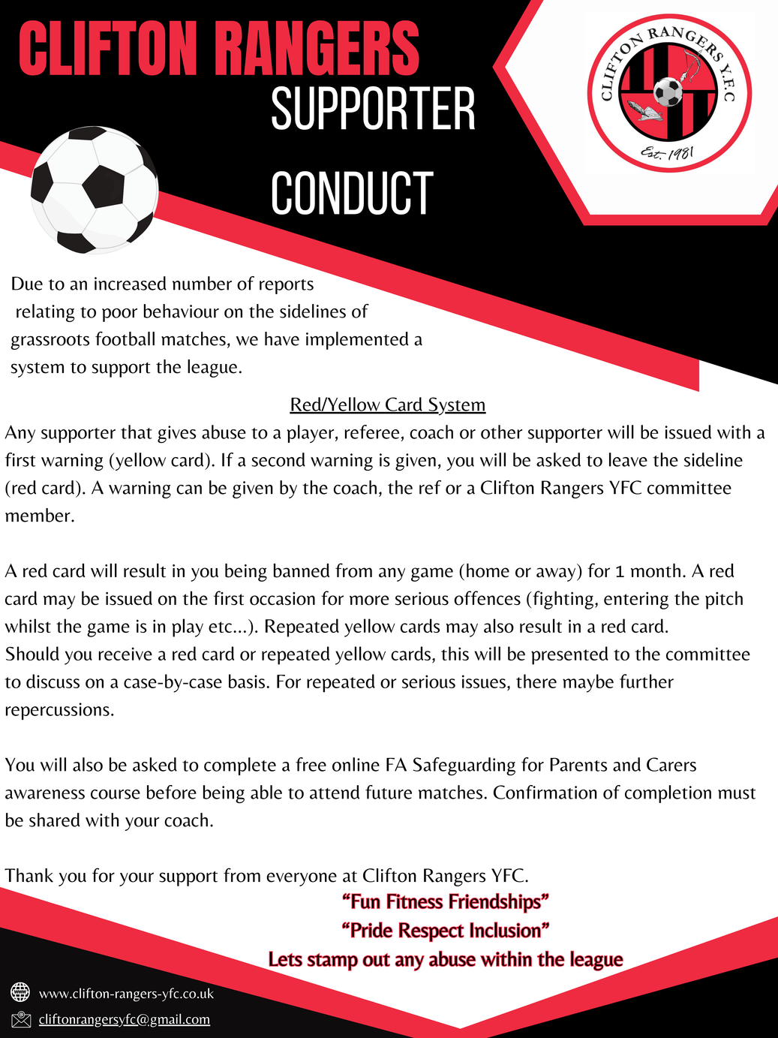

Slide 11


