Slide 1

Literary Theories and Snow White
Feminist Criticism
Exploring women’s redefinition of their identity in writing.
- Snow White’s life with the dwarves as important to her education as a submissive female who learns lessons of service, selflessness, and domesticity.

Slide 2
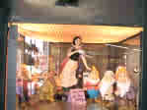
Literary Theories and Snow White
Marxist Theory
Seeing society as
a class struggle.
The role of the dwarves is similar to that of the peasant classes in that it echoes the value of hard work and solidarity needed for survival. These dwarves support the fairytale’s social order.

Slide 3
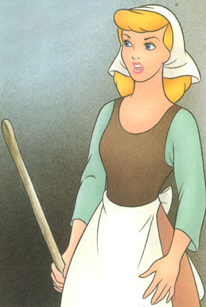
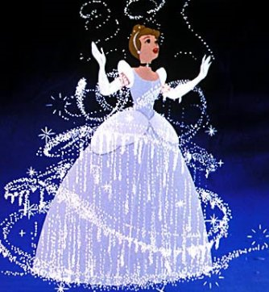
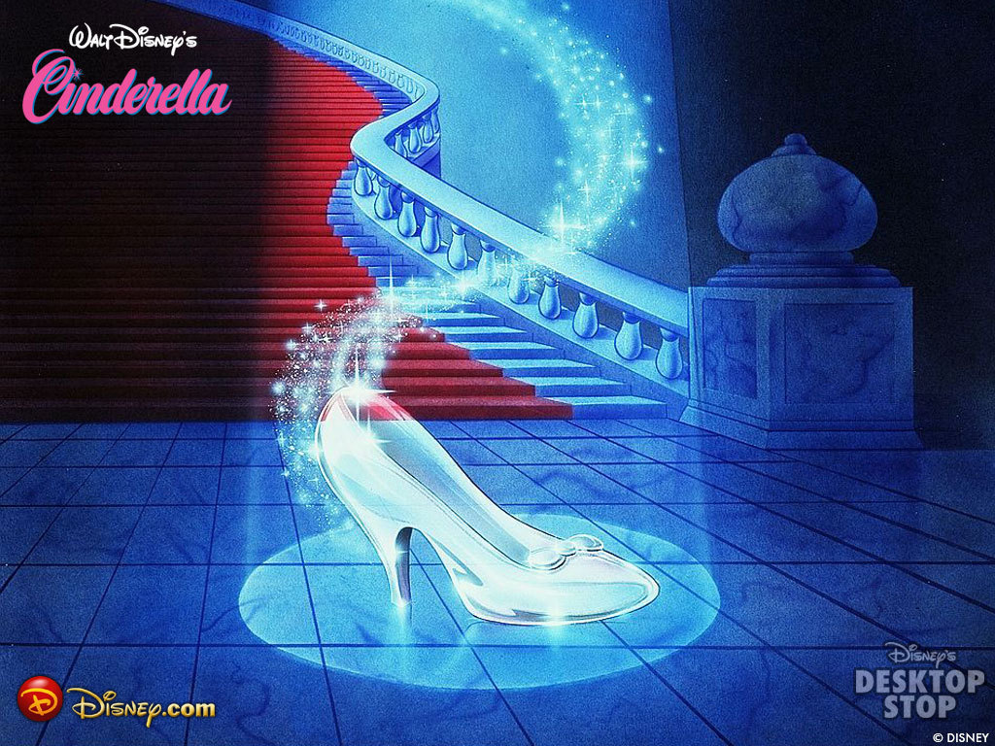
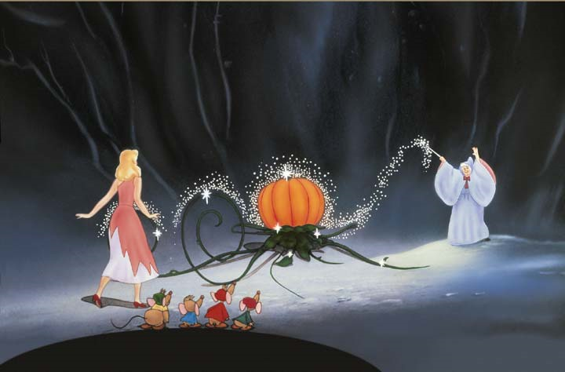
Four Critical Lenses or The Four Faces of Cinderella
Marxist
Feminist
Deconstructionist
Psychoanalytical

Slide 4
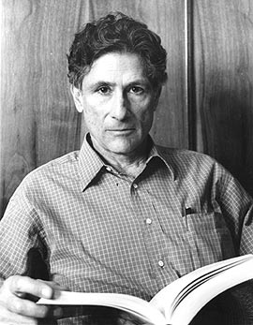
Edward Said
In Said’s famous critical work The World, The Critic, and the Text he claimed there were four ways to read a text:
Literally: By analyzing the words on the page.
Critically: Through the interpretation of literary scholars.
Authorial: Through the biography of an author.
Worldly: Through the way the public has responded to the text.

Slide 5
The Four Faces of Cinderella
The four most popular critical lenses used in literary criticism are: a Marxist lens, a Feminist lens, a Deconstructionist lens, and a Psychoanalytical lens .
We will be using the fairy tale of Cinderella to demonstrate how these lenses can unpack a text.

Slide 6
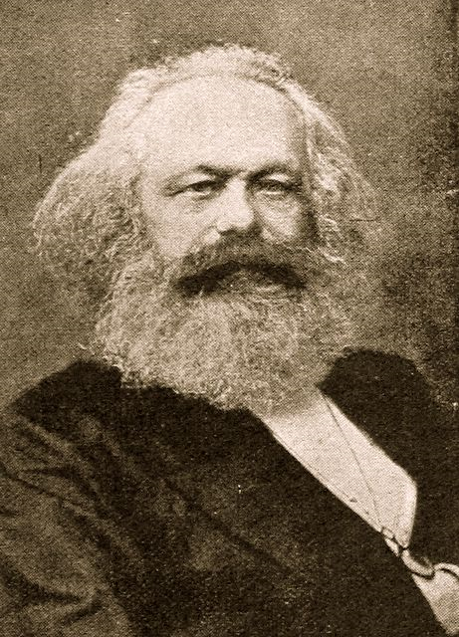
Karl Marx and Marxism
Origins: Karl Marx: 1818 -1883
Founder of Marxism and famous work called Das Kapital which critiqued the economic system of Capitalism.

Slide 7

The Marxist Literary Lens
Thesis: A group of elite people control most of the wealth of the world, leaving everyone else poor and powerless.
Characteristics:
Sympathy for the working class and hatred of the middle and wealthy classes.
Attention to how much material wealth one has.
Class structure in a text.
Characters in opposition to each other because of a power struggle.
Inequalities in society.
Characters who dream of a better life.
Class warfare between the rich and the poor.

Slide 8
A Marxist reading of Cinderella
Cinderella is exploited by her rich relatives.
She exploits the mice, birds, and fairy godmother who help her for no pay.
Cinderella has no wealth and her only hope is to marry the prince.
Class structure with Cinderella (poor) who does all the work, Step Sisters (middle class) who yearn to marry the rich prince, prince (wealthy) who controls the power in the kingdom decides who he will marry.
In the original fable, the animals gouge out the eyes of the step sisters and drive them out of town symbolizing the violent clashes between the rich and the poor.

Slide 9
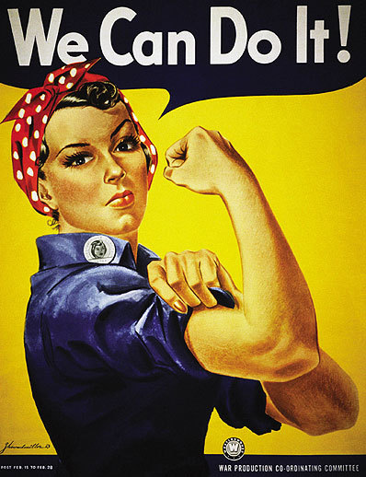
Feminism
Origins: originated in the Women’s Suffrage Movement of the late nineteenth century that fought for the rights for women to vote.
In the 1970’s, the movement shifted to having legal rights for women such as legal abortions, legal birth control, and laws ensuring women had the same rights in the work force as men.

Slide 10
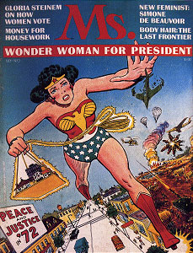
The Feminist Literary Lens
Thesis: Women are dominated by men and thus are stereotyped. Typically male authors include a gender bias in their writing that demeans women.
Characteristics:
Male characters are strong/dominant and female characters are weak/passive.
Negative stereotypes regarding women and sexuality.
Women striving to survive in a male-dominated society.
Power struggle between men and women.

Slide 11
A Feminist Reading of Cinderella
Cinderella’s happiness depends on men.
After Cinderella’s father dies, she is forced to live with the evil step-sisters.
She becomes happy after she marries the prince.
In order to attract the prince, she must impress him with her looks.
The prince only knows her by her beauty and the missing glass slipper.
Without men, Cinderella has no control over her life.

Slide 12
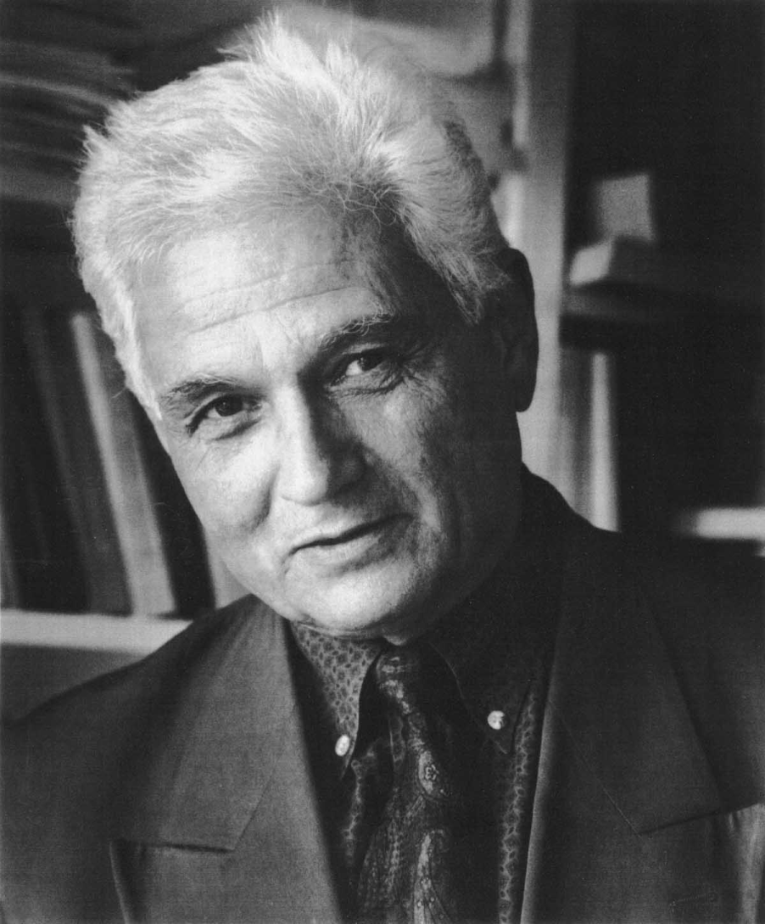
Jacques Derrida and Deconstructionism
Origins: Jacques Derrida : 1930 – 1944.
Jacques Derrida was a French philosopher and literary critic who wrote extensively that texts need to be deconstructed, or torn apart, like a dissection to determine their underlying flaws in logic and structure.

Slide 13

The Deconstructionist Literary Lens
Thesis: We can challenge traditional assumptions by unraveling the ideas that ground those traditions. Furthermore, life is multifaceted and includes many viewpoints to exist.
Characteristics:
The world follows a binary, or oppositional structure: good/evil, rich/poor, male/female, smart/stupid, etc.
Reversal of values approved by society: Batman is evil because he works outside the law, while the Joker is good because he is creative, intelligent, and funny.
Unravel Traditional Beliefs: “The Declaration of Independence” espouses freedoms like freedom of speech and to assemble, however, these were used in opposition to England so the colonist could rebel.
Multifaceted Viewpoints: Howard Zinn writes from the Arawaks’ perspective in The People’s History of the United States to give a voice to a society that had no voice in American history.

Slide 14
A Deconstructionists Reading of Cinderella
Cinderella is not an innocent heroine, but a daydreamer who disobeyed those who had authority over her.
Cinderella is obsessed with appearance, over substance.
The step-sisters had more rights than Cinderella, and with the fairy godmother as an accomplice, disrupted the order in society.
The glass slipper represents Cinderella’s vanity and how her looks superseded everything and everyone else.
Cinderella is portrayed as a positive person, but in reality, is vain, selfish, immature, and power hungry.

Slide 15
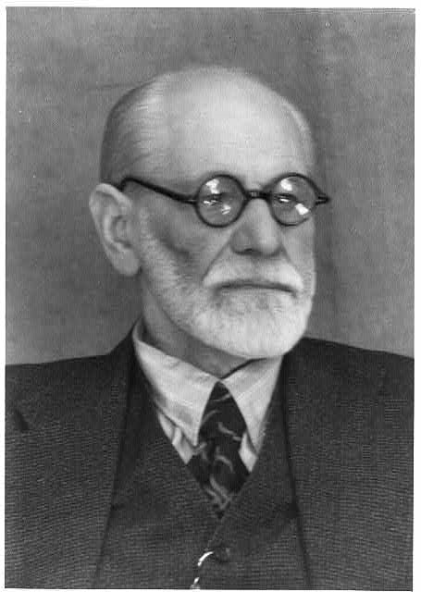
Sigmund Freud and Psychoanalysis
Origins: Sigmund Freud: 1856 – 1939.
Sigmund Freud is known as the founder of psychology which is the study of human behavior. In his famous work The Interpretation of Dreams, Freud argues that humans have a sub-consciousness that controls our desires. Our sub-conscious is divided into the “Id” or uncontrolled desires, the “Ego” the realistic desires or the part of our personality we share with the world, and the “Super Ego” or our critical and moralistic selves.
The common metaphor used to represent this is a person going through a conflict with an angel and devil sitting on each shoulder.

Slide 16
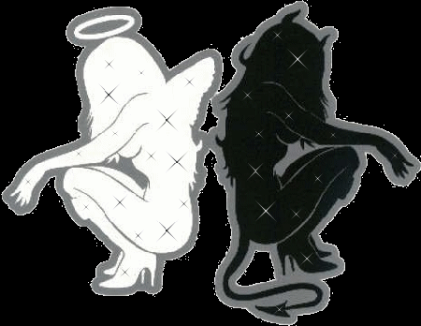
The Psychoanalytical Literary Lens
Thesis: Our sub-conscious desires controls our actions.
Characteristics:
ID: involves basic desires such as food, aggression, and sex. It’s prime motive is survival. Someone influenced by his/her Id is considered less developed.
SUPEREGO: involves morality and is opposed to the Id. It is formed from standards acquired from your upbringing and society. Someone who is acting primarily under the influence of the Superego denies him/herself of pleasure and develops obsessive/compulsive disorders.
EGO: is a healthy balance of the Id and Superego. Someone who is acting primarily on his ego will have his/her desires fulfilled in a manner acceptable to society.
When a psychoanalytical lens is applied to literature, it follows a character’s development throughout a story.

Slide 17
A Psychoanalytical Reading of Cinderella
Cinderella initially is driven by her Superego because she denies her desires in order to please her stepmother and stepsisters.
However, her dreams reflect the Id waiting to come out.
When her fairy godmother grants her wishes, she breaks out of the Superego dominance.
Cinderella gives in to her Id by leaving her job and going to the party, something she was forbidden to do.
Because she fell in love with the prince and got married, this exemplifies the emergence of her Ego because marriage is a socially acceptable relationship.

