Slide 1
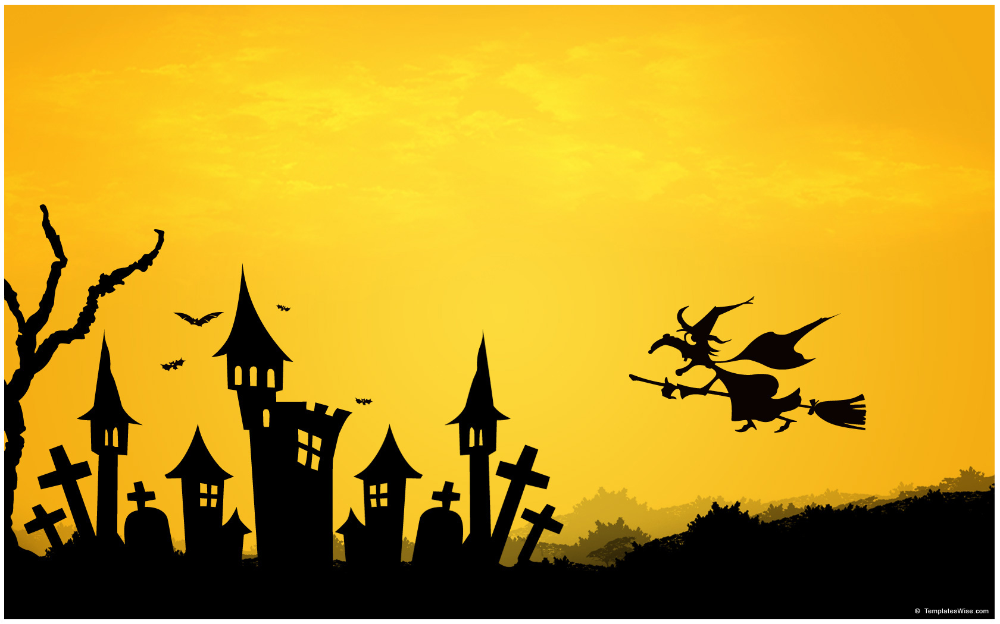
Myth
and Semiotics

Slide 2

Myth
HOW DOES MYTH OPERATE IN THE TEXT YOU HAVE CHOSEN TO TRANSFORM?
HOW WILL YOU DISRUPT THE TEXT BY CHALLENGING MYTH WITHIN IT?
WILL YOU DISRUPT THE MYTH FROM THE PERSPECTIVE OF FEMINISM, MARXISM OR POST COLONIALISM?

Slide 3

Myth
Roland Barthes used this term in Mythologies to describe the way certain stories and images function to shape our perception of reality.
Ideology underpins myth. (Well, ideology underpins everything really – discourse, myth..)

Slide 4
Myth
Myth: Barthes argues that the orders of signification called denotation and connotation combine to produce ideology in the form of myth …… myths operate through codes and serve the ideological function of naturalization.
e.g. myth of motherhood, of childhood, of crocodile, of the noble savage, of hunting and gathering, of beauty, of femme fatale, of black man, of oriental.
At: http://www.aber.ac.uk/media/Documents/S4B/sem-gloss.html#M

Slide 5
Myth
“……'myth' as recurring themes, icons and stereotypes which claim common recognition within a cultural group with a shared ideology……………. Ideology we define as the grid of significations which organizes myths in the legitimation of particular social, economic and political relations.” At: http://ccms.ukzn.ac.za/index.php?option=com_content&task=view&id=625&Itemid=72

Slide 6
Myth
Myths are signs which are all around us in our culture. (mothers, fathers, babies, little girls, little boys, witches, coloured people, orientals, the country, the city …)
Barthes says myths impose upon us the belief that something simply ‘goes without saying’; they create a perception of the falsely obvious. (Hoirihan p12)

Slide 7

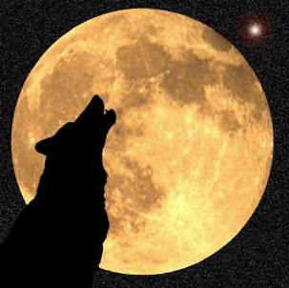
Myth
In modern literary and cultural study, myth refers to a shared way of understanding the world that is activated through representations in texts. E.g. a representation of a wolf activates all kinds of culturally embedded ideas about the nature of wolves as predators and werewolves.

Slide 8
Myth
This kind of myth is related to the signs and categories through which a community view the world, so that knowing the myth is part of what it means to be a member of the culture.
See : http://ceasefiremagazine.co.uk/in-theory-barthes-2/

Slide 9
Myth in your text?
Myth
Many aspects of cultural life are understood through myth. Motherhood, for example, is a powerfully mythologized cultural role. Representations of motherhood in texts often activate ideas to do with nurturing, self-sacrifice, gentleness, femininity, purity, domesticity and more.
The black man(“Noddy”)
The seductress (“La Belle Dame Sans Merci”)
Beauty (“Cinderella”)

Slide 10
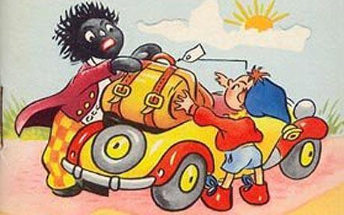
What ideas are activated? What intertextual references contribute to myth? E.g. stories about golliwogs.
See Hourihan p 58-62 for racial myths.

Slide 11
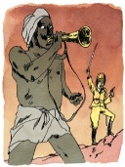
Myth
Question: Who were the British fighting when Gunga Din sacrificed himself so nobly?
Gunga Din: What ideas are activated? E.g. servility, self-sacrifice, lack of education/civilisation.
Is this the myth of the ‘noble savage’? Did you know there was a movie named Gunga Din made starring Gary Grant which may have helped to perpetuate this myth of the Indian ‘native’.

Slide 12
Gunga Din
Of interest:
Dear old Gunga Din who "despite 'is dirty 'ide, 'e was white all white inside, as 'e went to fetch the water under fire." In the Hollywood version, good old white inside Gunga blew the trumpet for the British against his own people, and just how whiter inside could a noble savage be?

Slide 13
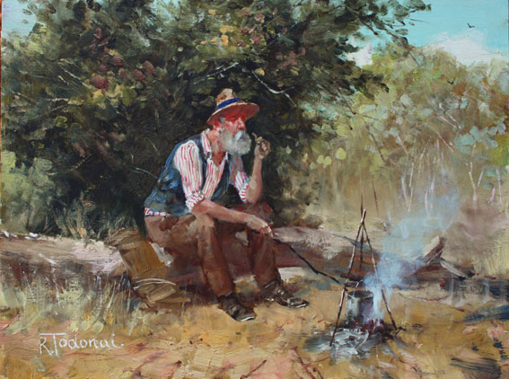
Myth
Walzing Matilda
The Australian swagman:
What are the characteristics of the myth?
A loner
Lives in the open, travels by foot
Lives off the land, performs menial tasks for food and shelter
Lives on the margin of society Impoverished – begs but may be proud
May be unemployed or unemployable
Lives on charity of rural folk
May not be trustworthy
an underclass of transient temporary workers
What ideas are activated?

Slide 14
Myth and Ideology
The jolly swagman is seen as a crook, a vagabond who lives by petty thievery; he respects neither the ruling class of the squatters, nor the law-enforcing agents, the troopers.
The ideology supports the status quo – it is wrong to steal from the wealthy even if you are starving.

Slide 15
Myth of Eve
The temptress – an archetypal character
The cause of the fall of man
Adam as victim of Eve
Eve as by-product – Adam’s rib
Intertextual relationship with Pandora who was also responsible for bringing evil into the world

Slide 16
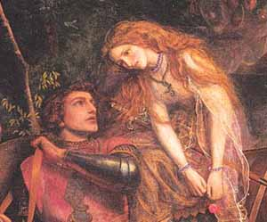
What ideas are activated? What intertextual references are relevant contribute to the myth of the seductress? See Hourihan references to “La Belle Dame Sans Merci”.
.

Slide 17
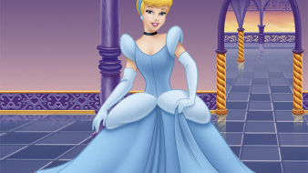
What ideas are activated? What intertextual references are relevant contribute to the beauty myth? E.g. in The Odyssey and the Iliad (Helen of Troy)
See Hourihan references to Cinderella.

Slide 18
Myth
“Cinderella”: How do little girls live up to the beauty myth perpetuated by representations of princesses in fairy tales? How do they react to myths about what it means to be feminine, which is to be passive and subordinate to the masculine?

Slide 19
Myth
A myth is a textual representation of a shared understanding about the world.
Myth is a pre-packaged set of beliefs and practices that seem natural and obvious to members of a culture.

Slide 20
Myth
Consider the myth of the country and an idyllic rural activated in the opening lines of “Out, Out”: the beauty and serenity of nature, the dignity and worth of hard manual labour, the prescribed yet natural gender roles…

Slide 21
Myth
Consider the beauty myth operating in fairy tales.
This ideal is to become a beautiful princess that is fair, youthful, pure, angelic, and precious.
See Naomi Wolf – The Beauty Myth
Also see The Hidden Morals Of Fairy Tales - Dr Zaius

Slide 22
Myth
Texts use combinations of signs (words or images taken from the culture) to invite readers to ‘activate’ or recognize the myth. For example, “Once there was a dear little girl whom every one loved” activates myths of childhood and girls – innocence, virtue, honesty, love, and beauty.

Slide 23
Semiotics
To explain how myth works Barthes uses the linguist Saussure’s concept of the sign.

Slide 24
Semiotics
Signs work in a culture.
Barthes identifies two orders of signification: the first is that of denotation, the second is that of connotation and myth and occurs when the meanings of the sign (e.g. the word ‘princess’) meet the values and established discourses of the culture.

Slide 25
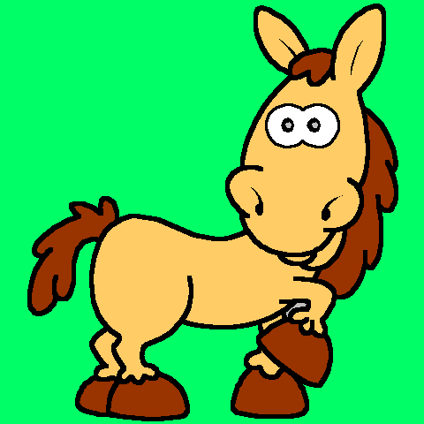
Semiotics
The first order of signification: denotation. This refers to the simple or literal relationship of a sign to its referent. It assumes that this relationship is objective and value-free—for all their differences, the words 'horse', 'steed' and 'nag' all denote the same animal.
The dictionary meaning….

Slide 26
Semiotics
The second order of signification: connotation. This occurs when the denotative meaning of the sign is made to stand for the value-system of the culture or the person using it. It then produces associative, expressive, attitudinal or evaluative shades of meaning.

Slide 27
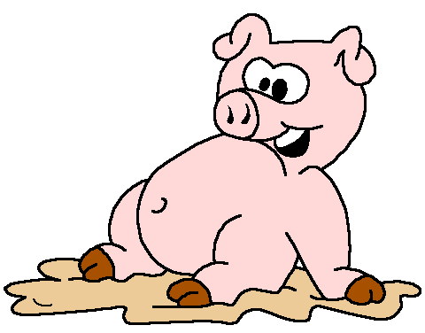
Semiotics
What are the connotations for a pig?
You are evaluating, expressing attitudes and making associations when you construct connotations.

Slide 28
Semiotics and Myth
The second order of signification: myth. Barthes's rather specialized use of the term myth refers to a chain of concepts widely accepted throughout a culture, by which its members conceptualize or understand a particular topic or part of their social experience.
Thus our myth of the countryside, for example, consists of a chain of concepts such as it is good, it is natural, it is spiritually refreshing, it is peaceful, it is beautiful, it is a place for leisure and recuperation.

Slide 29
Myth and Semiotics
The term myth, then, is not to be used in the layperson's sense of a 'false belief', but in the anthropological sense of a culture's way of conceptualizing an abstract topic.

Slide 30
Myth and Ideology
The connotations and myths of a culture are the signs of the culture’s ideology. The way that the varied connotations and myths fit together to form a coherent pattern or sense of wholeness, that is, the way they 'make sense', is evidence of an underlying invisible, organizing principle—ideology.

Slide 31
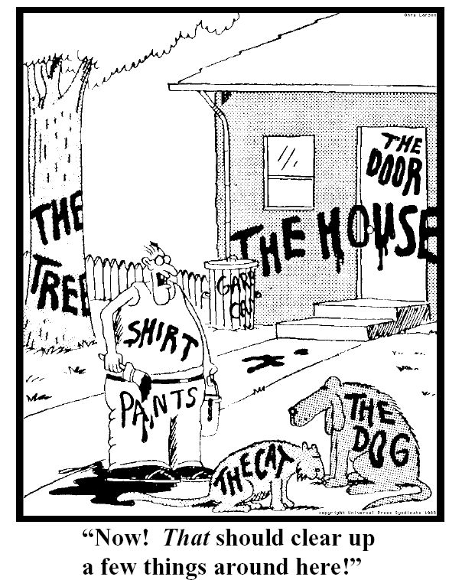
Semiotics

Slide 32
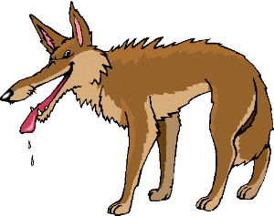
Semiotics
Saussure calls a written symbol (e.g. wolf) a signifier; the signifier evokes a concept, the signified (the reader’s mental idea of a wolf). Therefore, the word, or sign, consists of the signifier and the signified.

Slide 33
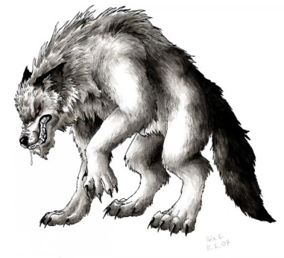
Semiotics
The crucial point is that the signifier (wolf) does not relate to anything in the physical world (any actual animal); it relates to a mental concept which may involve any number of emotional associations.

Slide 34
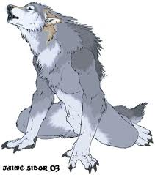
Semiotics
In the case of the ‘wolf’ these associations might include ‘dangerous’, ‘slavering’, ‘predatory’, ‘shaggy’, “huge fangs’, ‘blood-thirsty’ and so on – all the ascriptions which have led to the persecution and extermination of the wolf in many parts of the world, despite the extreme rarity of actual wolf attacks on humans.

Slide 35
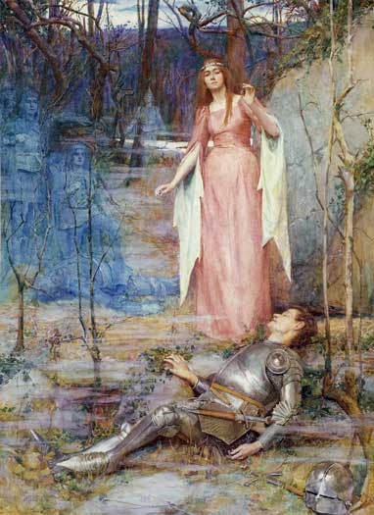
Semiotics
What kinds of associations do we have for signifiers such as dragon, witch, princess, ogre, servant etc? What cultural roles does each fulfill?
What kinds of ideas are activated through the representations in your base text?

Slide 36
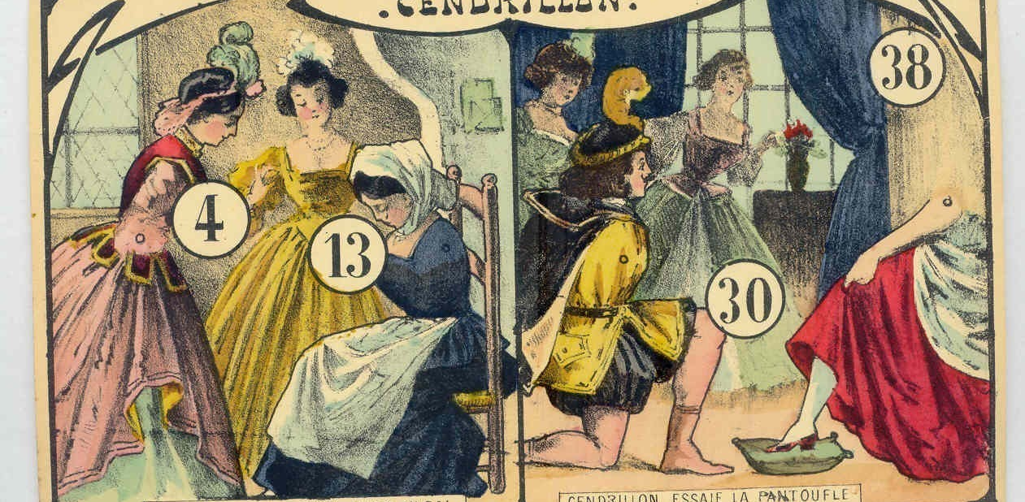
From: Hourihan, Margery, 1997, Deconstructing the Hero, Routledge, London
.

Slide 37
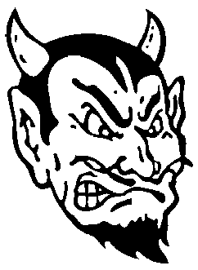
Archetypes

Slide 38
Archetypes
An archetype is a universal symbolic pattern. Examples of archetypal characters are the femme fatale, the trickster, the great mother and father, and the dying god. There are archetypal stories as well. Examples are stories of great floods, virgin births, creation, paradise, the underworld, and a final apocalypse. True to their universal nature, archetypal characters and stories appear again and again in myths across many diverse cultures. Close to myth but applies to literature whereas myth operates throughout a culture.

Slide 39
Archetypes
A femme fatale is a mysterious and seductive woman^{[1]} whose charms ensnare her lovers in bonds of irresistible desire, often leading them into compromising, dangerous, and deadly situations. She is an archetype of literature and art. Her ability to entrance and hypnotize her victim with a spell was in the earliest stories seen as being literally supernatural, hence the most prosaic femme fatale today is still described as having a power akin to an enchantress, vampire, witch, or demon.
http://en.wikipedia.org/wiki/Femme_fatale

Slide 40
Archetypes
The phrase is French for "deadly woman". A femme fatale tries to achieve her hidden purpose by using feminine wiles such as beauty, charm, and sexual allure. In some situations, she uses lying or coercion rather than charm. She may also be (or imply to be) a victim, caught in a situation from which she cannot escape.

Slide 41
Archetypes
In social life, the femme fatale tortures her lover in an asymmetrical relationship, denying confirmation of her affection. She usually drives him to the point of obsession and exhaustion so that he is incapable of making rational decisions.

Slide 42
Archetype
The femme fatale was a common figure in the European Middle Ages, often portraying the dangers of unbridled female sexuality. The pre-mediaeval inherited Biblical figure of Eve offers an example, as does the wicked, seductive enchantress typified in Morgan le Fay.
The femme fatale flourished in the Romantic period in the works of John Keats, notably "La Belle Dame sans Merci" and "Lamia". http://en.wikipedia.org/wiki/Femme_fatale

Slide 43
Cinderella Archetype
naive, carefree innocent girl
Greeks called her child-woman or ‘the maiden’
unaware of her sexual attractiveness and other competencies
the willing symbol of fertility.

Slide 44
Cinderella Archetype
The ‘child woman’ can be described by adjectives like: compliant, harmonizing, nice and sweet, quiet, simplistic, ‘demure, can’t say no, lacking passion, passive, uncertain, kind, receptive, ability to wait, unassuming, ‘good little girl’, little willpower, pleasing everybody, ‘well behaved child’. http://www.9types.com/movieboard/messages/10387.html

Slide 45
Golliwog Archetype
This stereotype gained notoriety through the 1898 children's book The Story of Little Black Sambo by Helen Bannerman. It told the story of a boy named Sambo who outwitted a group of hungry tigers. "Sambo" refers to Black men that were considered very happy, usually laughing, lazy, irresponsible or carefree. This depiction of black people was displayed in films in the 1900s. The original text suggested that Sambo lived in India, but this fact may have escaped many readers. The book has often been considered to be a slur against Africans.^{[6]}

Slide 46
Golliwog Archetype
Blacks are lazy, vicious, and incapable of any serious improvement", said the popular writer Rudyard Kipling in his School History of England (1911). "Niggers are like monkeys [with] their subnormal sloping foreheads and large protruding lips", said G W Stevens in The Land of the Dollar (1897).

