Slide 1
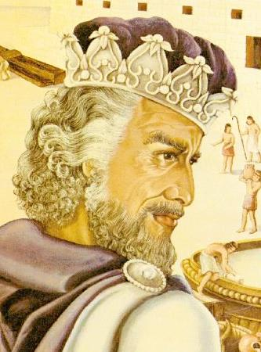
Unpacking Discourse and Ideology
Which ideology could you challenge in your transformed text?

Slide 2
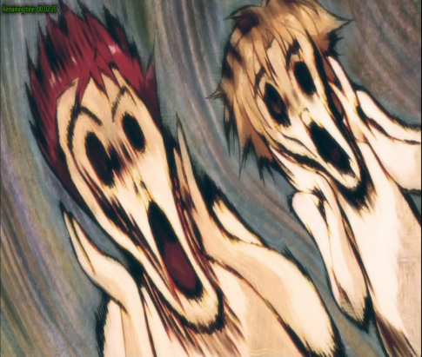
What is meant by ideology?
The body of ideas reflecting the social needs and aspirations of an individual, group, class, or culture.
E.g. patriarchal ideology, classist ideology, bourgeois ideology, racist ideology, colonialist ideology, etc.
Includes values, attitudes, assumptions and beliefs.
See Moon.

Slide 3
Ideology/John Lye
Ideology is a term developed in the Marxist tradition to talk about how cultures are structured in ways that enable the group holding power to have the maximum control with the minimum of conflict.
This is not a matter of groups deliberately planning to oppress people or alter their consciousness (although this can happen), but rather a matter of how the dominant institutions in society work through values, conceptions of the world, and symbol systems, in order to legitimize the current order.

Slide 4
Ideology/John Lye
Briefly, this legitimization is managed through the widespread teaching (the social adoption) of ideas about the way things are, how the world 'really' works and should work. These ideas (often embedded in symbols and cultural practices) orient people's thinking in such a way that they accept the current way of doing things, the current sense of what is 'natural,' and the current understanding of their roles in society.

Slide 5
Ideology/John Lye
This socialization process, the shaping of our cognitive and affective interpretations of our social world, is called, by Gramsci, "hegemony;" it is carried out, Althusser writes, by the state ideological apparatuses -- by the churches, the schools, the family, and through cultural forms (such as literary texts).
See http://www.brocku.ca/english/jlye/ideology.php for fuller explanation

Slide 6
What ideology will you resist?
What do Marxist literary critics do with texts?
They explore ways in which the text reveals ideological oppression of a dominant economic class over subordinate classes. In order to do this a Marxist might ask the following questions:
  Does the text reflect or resist a dominant ideology? Does it do both?
  Does the main character in a narrative affirm or resist bourgeoisie values?
  Whose story gets told in the text? Are lower economic groups ignored or devalued?
  Are values that support the dominant economic group given privilege? This can happen tacitly, in the way in which values are taken to be self-evident.
  http://www1.assumption.edu/users/ady/hhgateway/gateway/Marxistlitcrit.html
“Walzing Matilda”: The swagman is from a lower socioeconomic group in society; his experience and the value of his life are devalued in the poem.
He is not named.
He is depicted in derogatory terms as a thief.
The binaries of up/down, law/criminal, landholder/itinerant labourer suggests that the values of the dominant economic group are privileged.
Capitalist ideology, in which the poor are marginalised, is naturalised in the poem.
Bourgeoisie values are dominant i.e. those of the police and the squatter

Slide 7
What ideology will you resist?
“Out, Out”
The boy is not named, he is not given an individual identity; killed by machine
His limited lifespan is dwarfed against the longevity of nature, represented in the hills
The need to accept death is stressed (‘move on’, no time to mourn, there’s work to be done) – a very useful value which serves the interests of the ‘bosses’ or bourgeoisie class in an exploitative capitalist/industrialist economy (they value work, resilience and perseverance)

Slide 8
Role of literature in reinforcing ideology.
According to Marxists, and to other scholars (literary theorists), literature reflects those social institutions out of which it emerges and is itself a social institution with a particular ideological function. Literature reflects class struggle and materialism: think how often the quest for wealth traditionally defines characters. So Marxists generally view literature "not as works created in accordance with timeless artistic criteria, but as 'products' of the economic and ideological determinants specific to that era" (Abrams 149). Literature reflects an author's own class or analysis of class relations.

Slide 9

What is meant by discourse?
Discourses identify the particular kinds of language and behaviours used by members of a social group and hence the sets of beliefs, values, attitudes and behaviours that define that group in relation to others. Thus you may identify romantic discourse, gender discourse, class discourse or race discourse in your text. These discourses are underpinned by IDEOLOGY. See Moon.

Slide 10
Discourse
What is the discourse in your text that you want to change?
What discourse will you change it to?

Slide 11

Contemporary world-context centred theorists ask:
Whose interests are served by the particular representations in the text? (men/patriarchal interests, whites/colonialist interests, bosses/capitalist interests)
You will be using Marxist, feminist or post-colonial theory to deconstruct your text i.e. Unpack the discourse and ideology.

Slide 12

Theory
You will need to write 1-2 paragraphs explaining the focus/approach of the school of theorists you have selected.
These theorists may examine binary oppositions and myth in texts but they also ask some of the following questions.

Slide 13

Feminists ask:
How do gender discourses dominate the writing in the tale? What beliefs about the role of women in society are promoted within the tale? How does the ideology underpinning the text work to advantage men?
How do discourses of power dominate the writing in the tale?
How does this invited reading of the story serve the interests of a patriarchal society?
How does it serve to ‘keep women in their place’? (post-colonialist theorists ask similar questions).

Slide 14

Reading to identify gender/race discourses – a suggested approach
Note the characters’ names. That is, consider who is named (and who isn’t) and how – by their first name or surname – and the possible implications of this. Consider also characters that are not specifically named but may be referred to generically as the ‘womenfolk’, ‘wood cutters’, ‘soldiers’ and the possible effects of this kind of naming.

Slide 15
Reading to identify gender/race discourses – a suggested approach
Note who speaks; who listens; how speech is tagged. Consider how characters voices are described. For example, what might be the effects of describing voices as ‘deep’, ‘high’, ‘whining’?
Note character descriptions; the particular aspects of appearance, speech, behaviour, and actions that are selected for description.
Note descriptions of characters’ bodies. Note whether body parts which feature in some descriptions do not feature in others and consider the effects, especially in terms of gender. The bodies of which gender/race are described the most and why?

Slide 16
Reading to identify gender discourses – a suggested approach
Jot down the adjectives used to describe a character or group of characters. Are there connections and contrasts that can be made? Can there be connections and contrasts made in terms of gender? With what effects in terms of the reading you are producing?
Make note of verbs used in relation to different characters. What connections and contrasts can you make?
Try to locate significant emotive words which position the reader in relation to women/men/race.
Note the point of view used and the effect this has on gender/race representation.

Slide 17
Reading to identify gender discourses – a suggested approach
Contemporary text-centred strategies:
Consider the gaps in the text. How have you filled the gaps with culturally constructed beliefs and ideas?
Consider the silences of the text.
Reveal binary oppositions - which half is privileged over the other and why?

Slide 18
Useful reading practices for unpacking discourse and ideology
Analyse text for:
Binary oppositions
Myth – semiotic analysis (see notes on myth in Booklet)
You will need to read the David King article to get a grip on how to do semiotic analysis. If applying semiotic analysis, do so in depth.

Slide 19
Other theory based methodologies
Apply understanding of theory- specific terms.
Ask theory-specific questions.
Apply particular reading strategies. E.g. binary oppositions, myth, semiotic analysis, gaps and silences, contradictions and incoherences.

Slide 20
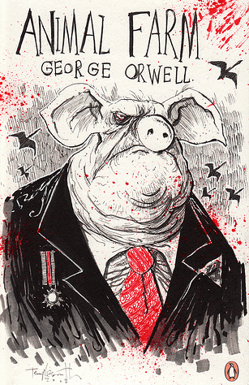
Some Marxist terms
historical materialism surplus value alienation commodification base/superstructure hegemony false consciousness Interpellation division of labour | mode of production proletariat bourgeoisie reification ideological state apparatus

Slide 21
Feminist terms
other sexualisation infantilization objectification male gaze gender phallocentrism androcentrism ‘angel in the house’ difference gynocriticism patriarchy | essentialism ecriture féminine Jouissance 1st, 2nd and 3rd wave feminism biological determinism gender as a social construct oppression
.

Slide 22
Postcolonial literary theory terms
other
hybridity
double consciousness
subaltern
hegemony
masks
alterity
essentialism
stereotype
aporia
orientalism
See http://www.eng.fju.edu.tw/Literary_Criticism/postcolonism/ for good summary of p/c theory.

Slide 23
Transforming your text
Consider what alternative or resistant reading you might want your transformed text to invite. Try the following exercise:
What if the text was different? Intervene in this version of the story so as to ‘recentre ‘ it, thereby deflecting and redirecting the invited reading. Make one subtle and one outrageous intervention. Enact your new version of the tale then explain what you have done and how you have done it. Why did you make those particular interventions? How is the invited reading changed?

Slide 24
What do feminists value?
Important values of feminism include:
mutuality
cooperation
equality
democratic use of power
enjoyment of body and work
peace.
How might this knowledge assist you to transform your text within a feminist context?

Slide 25
Feminists challenge the traditional approaches to the study of families
Feminism reveals harmful effects traditional family roles, economic exploitation, and social inequalities have on women’s general well being.
Focusing on gender as a social construct instead of as a given
Advocating the use of “household” as opposed to “family” due to the term family’s biases
Emphasizing the harmful effects of the traditional family roles, economic exploitation, and social inequalities
Refuting the stereotypes of the women as dependent and economically unproductive
Focusing on the influence of capitalism and patriarchy on the organization of work, including work within the family
Viewing motherhood as an experience as opposed to a role
Challenging the structure of heterosexuality as the norm
Recognizing the public-private dichotomy where men are recognized with public society and women with private family
http://www.csun.edu/~whw2380/542/Feminist%20Family%20Theory.htm

Slide 26
What do p/c theorists value?
Goals of Post-Colonialism
The ultimate goal of post-colonialism is combating the residual effects of colonialism on cultures. It is not simply concerned with salvaging past worlds, but learning how the world can move beyond this period together, towards a place of mutual respect.

Slide 27
What do p/c theorists value?
A key goal of post-colonial theorists is clearing space for multiple voices. This is especially true of those voices that have been previously silenced by dominant ideologies - subalterns.
http://answers.yahoo.com/question/index?qid=20110202215300AA8OFRm

Slide 28
View
Realize: It is not enough to change genre (though you should do this). You need to also change the discourse – to make a discursive shift.

