Slide 1
Multiple Readings of a Picture Book
Quick Summary

Slide 2
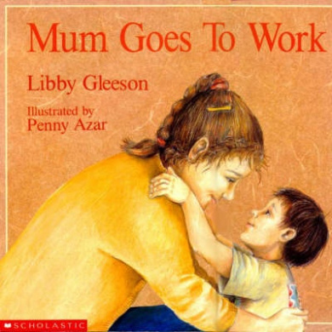
Stated Purpose of article
Provides a demonstration for teachers of how multiple readings of Libby Gleeson’s (1992) picture book Mum Goes to Work can be produced.
Listen to story being read.

Slide 3
Introduction
Textual interpretation was once thought to be generated solely from readers' aesthetic knowledge: a tool for unlocking meaning from inside the text, which in some cases was thought to be intentionally put there by the author.
Teachers and teacher educators are now looking beyond traditional literary theory for new ways of understanding texts with their students.
Language and literacy practices that accompany poststructural literary theory encourage readers to generate meaning at social, ideological and political levels.

Slide 4
New world-context Questions
Whose experiences and what kinds of experiences are given privileged voice in the text?
What cultural and ideological assumptions (discourses) support the text, i.e., what assumptions about gender roles or relationships, social class, age, social customs or cultural identities are implicit in the text?

Slide 5
New Questions
Are the cultural and ideological assumptions on which the text is based consistent or are there traces of conflicting discourses?
What alternative cultural and ideological assumptions have been left out or silenced in the text?

Slide 6
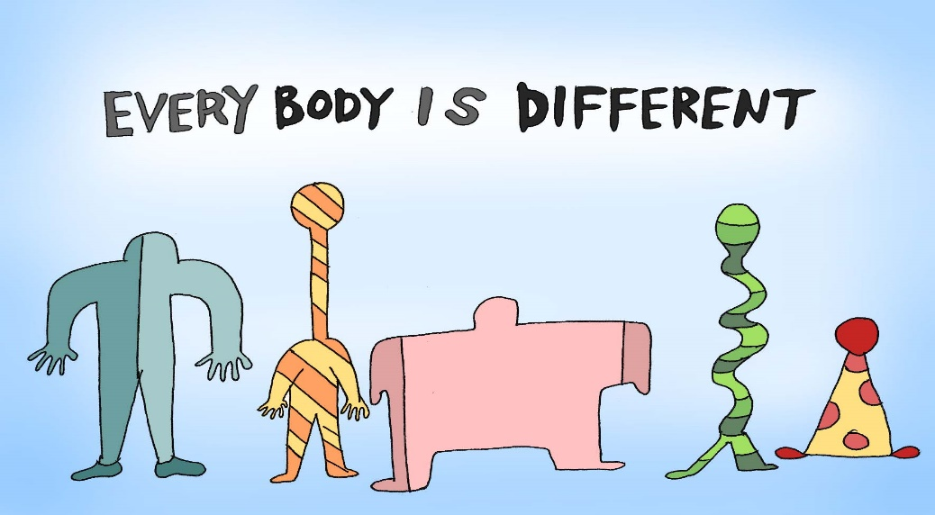
New Questions
How has the text has been shaped by the cultural context in which it was produced?
How does the text position the reader to accept its cultural and ideological assumptions?
How do readers produce multiple readings of texts?
Why is my reading different from someone else's reading?

Slide 7
New Questions
What is a resistant or oppositional reading and what purpose does it serve?
Why does the author's intention not matter when reading using this approach?

Slide 8
Overview of article
Johnson discusses the first three readings of Mum Goes to Work based on author-centred, text-centred and reader-centred approaches respectively.
This discussion facilitates a comparative focus on the fourth, most recent approach to reading texts, a world-context approach, also known as critical literacy.
Each reading offers readers different ways of understanding the text.

Slide 9
Author centred approach
HISTORICAL APPROACH
selected body of canonical texts, have stood test of time
a single preferred reading
literary texts contain thoughts of great writers about human condition
readers discover universal themes which reside in the text and are fixed
well-trained readers find the same themes
read author’s biography for illumination of text
match author’s views outside text with those inside text e.g. read letters, memoir, interview transcripts, academic writing

Slide 10
Author-Centred reading of Picture Book
Gleeson says she is ‘moral person’, ‘feminist’ etc
She says book is about modern, working mothers.
key theme that all mothers offer their children unqualified love and care.
authorially approved reading as it can be linked to the author's public admission of a concern with morality.

Slide 11
Text-centred reading
HISTORICAL APPROACH
meaning linked to reader’s recognition of aspects of textuality. E.g. narrative structure, symbolism
literature therefore becomes a linguistic puzzle
the reader’s knowledge of literary devices and structural organisation of text unlocks text
readers produce preferred or fixed reading which supports universal themes and socially acceptable moral viewpoints
text as ‘verbal icon’ within a literary heritage framework – the canon
readers focus on ‘words on the page’ and NOT on author’s intentions or reader’s perspectives
idea of structural unity are important e.g. circularity, cohesion, resolution

Slide 12
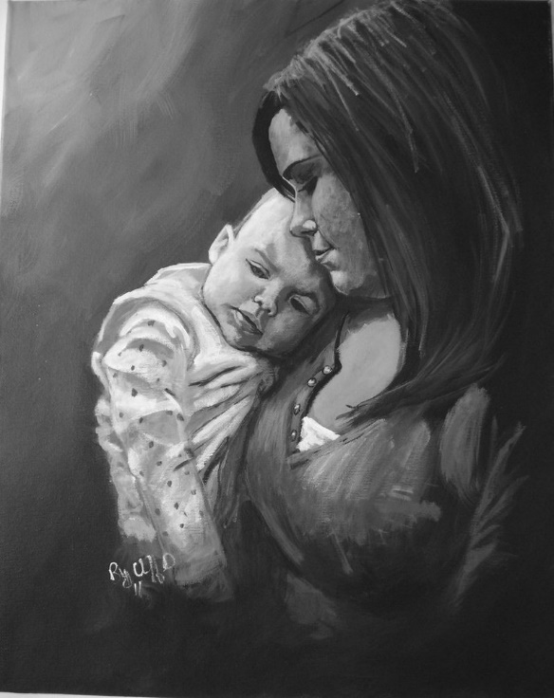
Text-centred reading of picture book
Although Australian mothers come from a variety of ethnic backgrounds they all share a common characteristic. They are active, caring persons at home with their children as they are at work.
This is a reading which essentially supports the universal themes and moral lessons produced in the author-centred reading. That is, that the central value of a mother in family life is to give unqualified love, and that modern mothers have the right and responsibility to work inside and outside the home but are still primarily responsible for their children's well being.

Slide 13
So far
the readings produced are derived from traditional approaches to textual analysis. These readings rely on the reader's acceptance that s/he brings to the text an uncritical acceptance of the author's worldview and/or an understanding of how textual organisation and literary device are used to mould thematic content.

Slide 14
Reader-centred approach
Reader has central role to play in meaning making process
Meaning is no longer locked in text
Rosenblatt (1978) - readers bring their individual experience to the text: they transact with the text in a subjective manner.
Readers actively engage with the text
Readers fill gaps, analogize.
Readers now have a choice to read with the text and/or across it – option to (mildly) disagree with the text
Although readers are encouraged to produce a variety of readings it is also acknowledged that these are limited by groups of readers sharing cultural experiences and methods of readings (interpretive strategies).

Slide 15
Reader Centred approach
The key question that readers ask in this instance is: How does this text relate to my personal, social, cultural and psychological experience?

Slide 16
Reader-centred approach
Within this approach the definition of what actually constitutes literature expands from canonical to the popular, so `quality' literature is no longer the primary motive for textual selection.
Reading helps construct a person’s identity (Holland)
When readers relate to the text positively they produce a preferred reading; when they do not, an alternative reading is the result. E.g. one reading mother supports the previous a-c and t-c readings – “I can easily identify with the mother's experience”; another working mother can ‘not identify even vicariously with the contented Mums in the stories’ because she objects to the myth of the perfect mother.

Slide 17
Reader-centred approach
A reader-centred approach to textual interpretation encourages the reader to become consciously aware of and reflexive about reading practices. E.g. someone reading the story alternatively might write:
While reading I recognised that I was not fulfilling the role of the ideal or the `implied reader' (Iser, 1974) for this text because I could not accept this as a complete happy families story. I could not accept the social and cultural implications and enjoy it as I felt I was supposed to.

Slide 18
Reader-centred approach
The reading strategies included in this approach do not encourage the reader to look beyond agreement or mild disagreement with the perceived textual ideologies.
This approach does not enable the reader to challenge ideological views about which the text is entirely silent. To do so would move the reading from alternative to resistant or oppositional: to read against the textual ideologies.

Slide 19
World-Context Centred Approach
READ AGAINST TEXT, IN OPPOSITION TO TEXTUAL IDEOLOGY
generated from the general principles of poststructuralism, including aspects of Marxist and feminist theories
recognise the way the text privileges certain voices before reading against it
Discourse is an important facet of this reading practice. Through an understanding of and membership in specific discourses (feminism, sexism, Christianity, racism, ageism), readers are able to take up or reject reading positions offered by the text.
Concept of ‘reading position’ is important.
Interrogates representations of power and inequality through a focus on what the text is not saying.

Slide 20
World-Context Approach
produce readings `which are [sometimes] unacceptable in terms of the dominant cultural beliefs, and which challenge prevailing views'
this may mean taking up reading positions that generate support for marginalised Discourses.
Resistant reading of picture book – mothers same, all disempowered in patriarchal society, no celebration of racial difference:
There is no celebration of racial difference, just assimilation into lower-paid, male-dominated jobs and middle-class, white, Australian cultural norms of practising motherhood.
Reader asked to accept hegemonic patriarchal Discourses of femininity and the dominant Discourse of monoculturalism. Resistant reader objects.
While pretending to promote feminist independence and multicultural sympathies. Mum Goes To Work mimics the traditional fairy-tale that plays false homage to feminism and multicultural diversity and harmony.

Slide 21
World-Context centred approach
This fourth approach facilitates readers' explicit awareness of the ways in which readings are produced.
The resistant readings of the picture book offered in the article are based on the reader's opposition to the text's ideological assumptions about gender, race and power.

