Slide 1
Discourse and Ideology in Literary Theory
What are discourses and ideologies?
How do they relate to one another?
How do literary theorists unpack these discourses and ideology?

Slide 2

Discourse and Ideology
These terms are important as they can pop up across a range of contemporary literary theories, especially (w-c) new historicist, Marxist and feminist theory.
See also the accompanying booklet on discourse and ideology.

Slide 3
Discourse
This is the ways in which individuals and groups use language to establish their group membership and to become aware that they are playing socially meaningful roles. Discourses provide ways of using language, being, thinking and acting, so that individuals and groups can identify themselves or have their roles identified in social and cultural networks and require reference to attitudes, beliefs and understanding about the world.
QCA (2002) English syllabus
So, discourse refers to ways of thinking, acting, doing and being in the world. E.g. You are operating within an educational discourse atm.
Do bikie gang members think, speak, act and behave like young Christians or vice versa?
See for a little more explanation of discourse.
https://www.youtube.com/watch?v=qEB4rAZanpM

Slide 4
What is meant by discourse?
Discourses identify the particular kinds of language and behaviours used by members of a social group and hence the sets of beliefs, values, attitudes and behaviours that define that group in relation to others.
These discourses are underpinned by IDEOLOGY.

Slide 5
Discourse
“Discourse …… is always more than just language. Discourses are ways of being in the world, or forms of life which integrate words, acts, values, beliefs, attitudes, social identities, as well as gestures, glances, body position, and clothes.” James Paul Gee
https://en.wikipedia.org/wiki/James_Paul_Gee
Consider the discourses constructed within the professions….e.g. law, medicine, education or within movements

Slide 6
Discourse: ways of being in the world
What are some of the rules for the behaviour of a head of state? To what extent does the following film trailer mildly challenge prevailing political discourses about the role of a democratic leader?
https://www.youtube.com/watch?v=ZyU213nhrh0
Does Donald Trump break the rules of dominant political discourse?
To what extent does comedy break taboos established within a discourse?
Consider the discourse of death and dying (there’s an urn containing Monty Python member, Graham Chapman’s, ashes on the coffee table…) then watch the discourse overturned before your very eyes….
https://www.youtube.com/watch?v=Ox9bcx_LZMs

Slide 7
Michel Foucault said in his essay “What is an author” (1969):
“Writing is not the vehicle for the author’s expression of his/her emotions or ideas …….. but rather writing is the circulation of language itself, regardless of the individual existence of author or reader.”
http://www.Colorado.EDU/English/ENGL2012Klages/1997foucault.html
What could he mean?

Slide 8
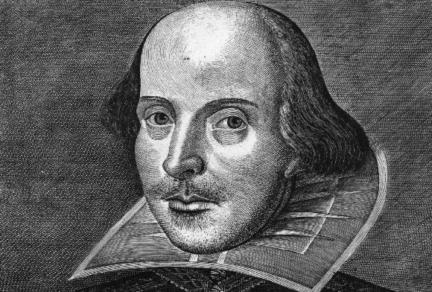
Foucault suggested:
The author is a product of culture; it is not the author but language that speaks. The author dies at the moment of writing. It is now widely understood that it is not possible to “read off” the author’s life and times directly from the text. Instead, it may be possible to trace how competing discourses (and underpinning ideologies) of the times in which the author wrote are played out in the text.
Is this true of George’s letter in the Discourse and Ideology booklet? Think of how he was influenced by the patriotic and religious discourses of 1916 and their underpinning ideologies of self-sacrifice and bravery. Are the dominant discourses ‘speaking’ through George?
Can you trace the competing discourses of Shakespeare’s time in his plays? (You sure can!)

Slide 9
What is meant by ideology?
The body of ideas reflecting the social needs and aspirations of an individual, group, class, or culture within discourses. E.g. patriarchal, classist, bourgeois, racist, colonialist, materialist, humanist, religious, capitalist ideology etc.
Includes values, attitudes, assumptions and beliefs.

Slide 10
e.g. Capitalist ideology
Capitalism is one ideology, within economic discourse, which comes with a range of values, attitudes, beliefs and behaviours.
Capitalism is the dominant ideology underpinning economic discourse in the Western World
CAPITALIST IDEOLOGY
is underpinned by values such as entrepreneurship, individualism, long term planning, thrift, competitiveness and the freedom of individuals to make money, own businesses, sell goods and services and to own property.
Behaviours characteristic of capitalism include capital accumulation by individuals, competitive markets and the use of wage labor.

Slide 11
Patriarchal ideology
Gender discourse may be underpinned to a greater or lesser extent by patriarchal ideology in some societies.
Patriarchy is a social system in which men hold primary power and predominate in roles of political leadership, moral authority, social privilege and control of property.
Therefore, patriarchal societies may promote the belief that one gender is superior to the other and promote sexist behaviours such as discrimination based on gender.

Slide 12
e.g. Patriarchal ideology
Patriarchy is one ideology, within gender discourse, which comes with a range of values, attitudes, beliefs and behaviours.
Patriarchy is said by some feminists to be the dominant ideology underpinning gender discourse world wide, including in the WW.
Patriarchal ideology, in its extreme form, is underpinned by values and beliefs such as the superiority of men, men as authority figures, the right of men to control institutions including the family, church and work and to control women’s property, sexuality and fertility.
Behaviours characteristic of extreme patriarchal ideology include use of stereotypes to suppress women, domestic violence, sexist and restrictive laws, and the inability of women to move freely in society.

Slide 13
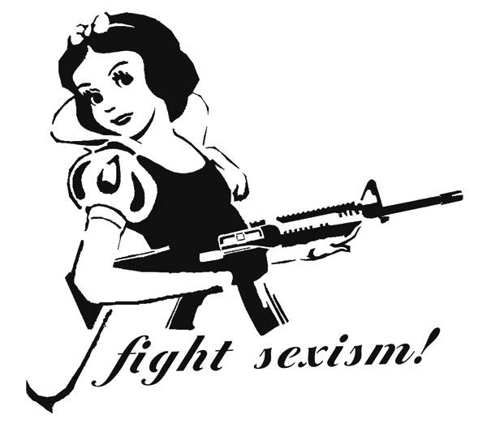
A feminist literary theorist will

Slide 14
Discourses are social practices, and it is through such practices that ideologies are acquired, used, and spread. Secondly, ideologies are usually seen to be inherently social, unlike personal beliefs, and shared by members of specific social groups. E.g.
Educational discourse in Australia is underpinned by the shared values (2005) of care and compassion; doing your best; fair go; freedom; honesty and trustworthiness; integrity; respect; responsibility and understanding; tolerance and inclusion.
National Framework for Values in Australian Schools
http://www.curriculum.edu.au/verve/_resources/Framework_PDF_version_for_the_web.pdf

Slide 15
Educational Discourse in Australia
Educational discourse is reflected in the way participants think, speak, act, dress etc. Look around you…..
Underpinning ideology - shared values of care and compassion; doing your best; fair go; freedom; honesty and trustworthiness; integrity; respect; responsibility and understanding; tolerance and inclusion.
You should note that this was not always the ideology underpinning educational discourse in Australia. For example, in the past, strict discipline, including corporal punishment and after school detentions, was the norm. Discourses change over time as people question and resist …..Homework is under attack atm

Slide 16
Ideology/John Lye
Ideology is a term developed in the Marxist tradition to talk about how cultures are structured in ways that enable the group holding power to have the maximum control with the minimum of conflict.
This is not a matter of groups deliberately planning to oppress people or alter their consciousness (although this can happen), but rather a matter of how the dominant institutions in society work through values, conceptions of the world, and symbol systems, in order to legitimize the current order. E.g. capitalist ideology

Slide 17
Ideology/John Lye
Briefly, this legitimization is managed through the widespread teaching (the social adoption) of ideas about the way things are, how the world 'really' works and should work. These ideas (often embedded in symbols and cultural practices) orient people's thinking in such a way that they accept the current way of doing things, the current sense of what is 'natural,' and the current understanding of their roles in society.
(Something like a pandemic can challenge a dominant discourse like capitalism.)

Slide 18
Ideology/John Lye
This socialization process, the shaping of our cognitive and affective interpretations of our social world, is called, by Gramsci, "hegemony”(power); it is carried out, Althusser writes, by the state ideological apparatuses -- by the churches, the schools, the family, and through cultural forms (such as literary texts).

Slide 19

Read and re-read model responses
See https://www.qcaa.qld.edu.au/downloads/senior-qce/english/snr_english_lit_ext_20_ia3_asr_high.pdf
and past responses to 2011 syllabus Task 3.

Slide 20
Further Reading
Woolaston, E (2016) Discourse and Ideology booklet
Woolaston, E (2014) compilations of notes on feminist and Marxist literary theory
Literary Theory and Schools of Criticism, Purdue University https://owl.purdue.edu/owl/subject_specific_writing/writing_in_literature/literary_theory_and_schools_of_criticism/index.html
This is a fantastic resource for task planning!

