Slide 1
A contemporary text-centred approach
How do contemporary approaches differ from historical approaches?

Slide 2
The Four Approaches
Author – centered
historical
contemporary
Reader- centered
historical
contemporary
Text-centered
historical
contemporary
World-context centered
historical
contemporary
IA1
IA2
EA4
IA1
IA2
EA4
IA3 Any two theories or aspects of theories. We will focus on t-c and w-c c as this will help prepare for EA4.

Slide 3
Approaches to Reading Practices QCAA - revision
Historical text-centered approaches
New criticism – words on the page; structural unity; close objective reading
Structuralism – narratology, semiotics, binary oppositions
What does QCAA identify as historical text-centered approaches?

Slide 4
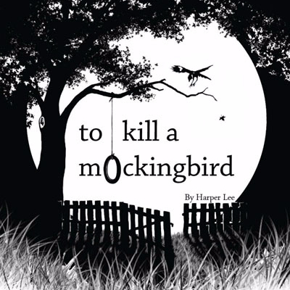
An historical text-centred approach
This looks at how the structure and linguistic organization of a text works harmoniously to encourage all readers to accept a universal theme.
e.g. To Kill a Mockingbird is an exploration of human morality, and presents a constant conversation regarding the inherent goodness or evilness of people.

Slide 5
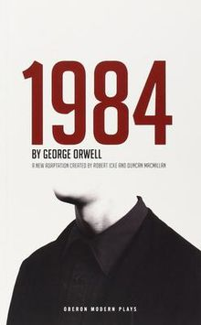
An historical text-centred reading
Finding meaning from textual elements such as character and narrative structure
Recognizing how resolution as component of narrative structure helps manage meaning
Acceptance of a unified, stable text
e.g. Nineteen Eight Four warns us of the dangers of totalitarianism.

Slide 6
Approaches to Reading Practices QCAA - revision
Contemporary text-centered approaches
Deconstruction – multiple meanings; gaps, silences and contradictions; binary oppositions/violent hierarchies.
Semiotics, myth, archetypes
Narratology
Note that some reading practices appear in both traditional and contemporary sections. This means you can compare approaches. E.g. traditional and contemporary applications of binary oppositions.
What does QCAA identify as contemporary text-centered approaches?

Slide 7
A contemporary text-centered approach
This means you re-read the text by questioning the cultural assumptions of an obvious, conventional reading.
It means looking again, using different cultural assumptions (such as contemporary notions of gender equality) and therefore challenging the invited readings by asking again what view of the world is the text based upon and how does the language and structure of the text work to construct this view.
In whose interests is this text written?
How can readers work against this (socially unjust) construction? (Note cross over with w-c centred approaches.)

Slide 8
For example
How socially just is Harper Lee’s representation of the African American Calpurnia in To Kill a Mockingbird? (post-colonial theory)
Or
Is the representation of Julia in Nineteen Eighty Four fair and just? (feminist theory)
Or
Is the central female character in Briar Rose by Anne Sexton an ‘empowered woman’ or further imprisoned in the patriarchal society that the author sought to challenge. (feminist theory)
Or
Does The Great Gatsby perpetuate classist beliefs
by affirming the status quo in capitalist society, rather than simply presenting a critique of the class system? (Marxist theory)

Slide 9
A contemporary text-centered approach
A start is to re-examine the structure and linguistic organisation of the text to see if it does indeed contain traces of views and cultural assumptions (ideological hot spots) that might be developed into a resistant reading of the text.
(ideological hot spots)

Slide 10
In producing a contemporary text-centred reading you might ask the following questions:
What are the incoherences, contradictions and disunities you see as you read the text carefully?
What are the gaps and silences you can see as you ‘harass’ the language of the text?
Does a close analysis of binary oppositions in your reading of the text reveal how one side of the binary is preferred and the other marginalised? Have you revealed any binary oppositions that were hidden when you read from an historical text-centred approach?
How might a non-ideal reader read this text today?
What are the multiple readings that this text might yield?
Which specific elements of language and structure in the text will I focus on to disrupt the invited reading?
(Johnson 2004)

Slide 11
Ask
Whose interests are served by representations of the world in the tale?
How do gender/race/class discourses dominate the writing in the tale? What beliefs about the role of women/workers/other in society are promoted within the tale? How does the ideology underpinning the text work to advantage men/wealthy/white?
How do power relationships dominate the writing in the tale whilst seeming ‘natural’?
How does this invited reading of the story serve the interests of a patriarchal/wealthy/colonialist society?
How does it serve to ‘keep women/workers/the other in their place’?
These kinds of questions could inform your own focus question.

Slide 12
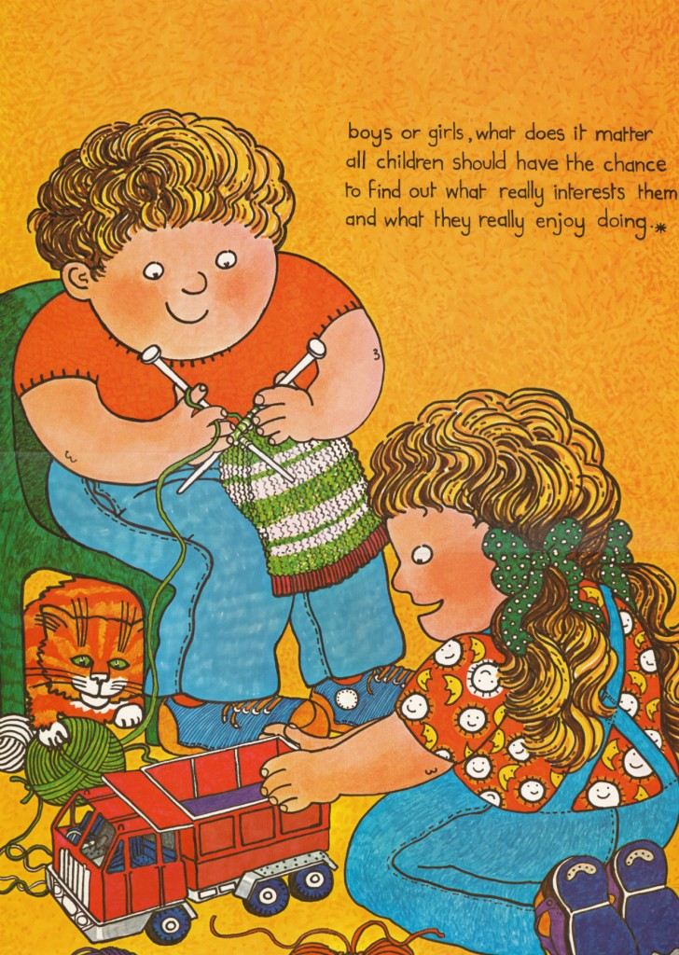
Deconstructing text
What are little boys made of? What are little boys made of? Snips and snails And puppy-dogs' tails That's what little boys are made of What are little girls made of? What are little girls made of? Sugar and spice And all things nice That's what little girls are made of
Nineteenth century nursery rhyme
What binary oppositions are evident?
How might this be read resistantly?

Slide 13
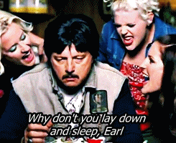
Deconstructing text
Right away Mary Anne flew in from Atlanta
On a red eye midnight flight
She held Wanda's hand as they
worked out a plan
And it didn't take long to decided
That Earl had to die
Goodbye Earl
Those black-eyed peas
They tasted all right to me Earl
You're feeling weak
Why don't you lay down
and sleep Earl
Ain't it dark
Wrapped up in that tarp Earl (Goodbye Earl)
Earl had to die – contradicts established image of
Mary Anne and Wanda and social mores.

Slide 14
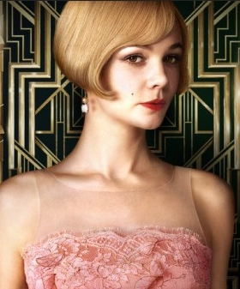
Deconstructing text
Gaps
E.g. In The Great Gatsby there are allusions to criminal activity in Gatsby’s secret world but Nick doesn’t know the details because he does not want to get involved. Readers need to fill the gaps in their own way.
The letter which Daisy holds and which disintegrates in the bathwater also points to a gap. The reader needs to fill the gap themselves. Who writes it? Why?
These gaps allow for these aspects of the novel to be interpreted in different ways. I.e. multiple readings; meaning is unstable

Slide 15
Deconstructing text
Silences
Consider the poem “Out, Out” by Robert Frost
“His sister stood beside them in her apron
To tell them “Supper.””
This poem depicts a man’s world of work and (presumably – I filled the gap on an assumption) a male doctor.
The poem largely silences and marginalizes women’s experience. You will see this again in the story “Indian Camp”.

Slide 16
A contemporary text-centred approach
Looks again at sub-text in order to reveal what is concealed
Uses different assumptions
Challenges invited readings
Asks: What view of the world is the text based on?
How does language and structure work to construct this view?
How can readers work against this construction?

Slide 17
Contemporary Text centered approaches
Overlap with world-context centered approaches
Whose interests are served?
Multiple readings available
Resistant readings possible
Look for ideological hotspots!

Slide 18
In IA2, use a text-centered theory (as well as world-context centered theory) e.g.
Deconstructionist Theory
Jaques Derrida
Michel Foucault
Binary oppositions Claude Levi-Strauss
Narratology
Vladimir Propp
Tzvetan Todorov
Gerard Gennete
Roland Barthes
Semiotics
Ferdinand de Saussure/Charles Peirce
Myth and Archetypes
C.G. Jung/Northrop Frye
You should choose one of these text-centered theories (and associated theorists) and research it until you are an expert.

Slide 19
Reference
Johnson, Greer (2004) A Contemporary Text-Centred Approach, Griffith University
Good site:
Deconstruction Theory (10 minutes) https://www.youtube.com/watch?v=_Uili73qcQ4
See NEST for documents on binary opposition, semiotics, myth and archetypes, denotation and connotation….I continue to build on resources…

