Slide 1
Text-Centered Approaches
Historical structuralism and related contemporary approaches

Slide 2
APORIA – an important deconstructionist term
an irresolvable internal contradiction, a philosophical puzzle, an impasse
Aporia plays a big part in the work of deconstruction theorists like Jacques Derrida, who use the term to describe a text's most doubtful or contradictory moment
“a point of undecidability, which locates the site at which the text most obviously undermines its own rhetorical structure, dismantles, or deconstructs itself” (Derrida)
“An absence of path…..the immobilization of thinking, the impossibility of advancing” (Derrida)
In literature, gaps, silences and contradictions may provide moments of aporia for the reader and open up the possibility of multiple readings of a text.
Attention to aporias enable us to more productively analyse (deconstruct) a text.

Slide 3
Aporia in action: “The Indian Camp”
Usual invited reading – a coming of age story in which a child learns about life and death but continues to feel optimistic.
A possible focus question:
Do you think Hemingway (writing in the 1920s) intended exploration of racial injustice to be a central idea in the story or did he expect his representation of race just to be ‘taken for granted’? How does the application of the Derridian concept aporia assist in answering this question?
As you read “The Indian Camp” by Ernest Hemingway try to identify
gaps in the text which the reader needs to fill (There are at least two partly unanswered question in the story which often lead to disagreement among readers and which allow for multiple readings)
silences which cast doubt on the invited reading of the story (which focuses on Nick’s rite of passage experience)
binary oppositions which reflect power relations and which cast doubt on the invited reading
Highlight any moments of aporia as you listen.

Slide 4
Structuralism (historical approach)
This theory regarded the forms of literature as being akin to the structures of language, and individual texts as elements in a larger system of literature. Thus, a literary structuralist focuses on structures in "literary" texts.
The value of structuralism is that it allows us to 'open up', conceptually, the inner world of humans, to see the relation of human experience to cultural experience, to talk cogently of meaning as something that is structured into our 'selves'.
The self is, like other things, signified and culturally constructed. In fact, both the self and the unconscious are cultural constructs.
For fuller notes, see the document entitled Structuralism Lye on NEST. Highlight ideas which you understand or which particularly resonate with you.

Slide 5
Structuralism (historical approach)
A range of theorists focused in various ways on the broader systems or structures of meaning through which texts were organised:
Levi-Strauss posited that we only understand language by using a system of opposition, the most extreme of which is binary opposition. For example; we cannot conceive of good if we do not understand evil.
In their analysis of prose narratives (narratology/Propp/Todorov/Campbell), some explored recurrent patterns and motifs, identifying narrative structures which they took to be universal.
Some structuralists (de Saussure, Peirce) also interpreted all of culture as systems of signs and undertook a semiotic analysis of the systematic patterning and structuring of cultural texts.

Slide 6
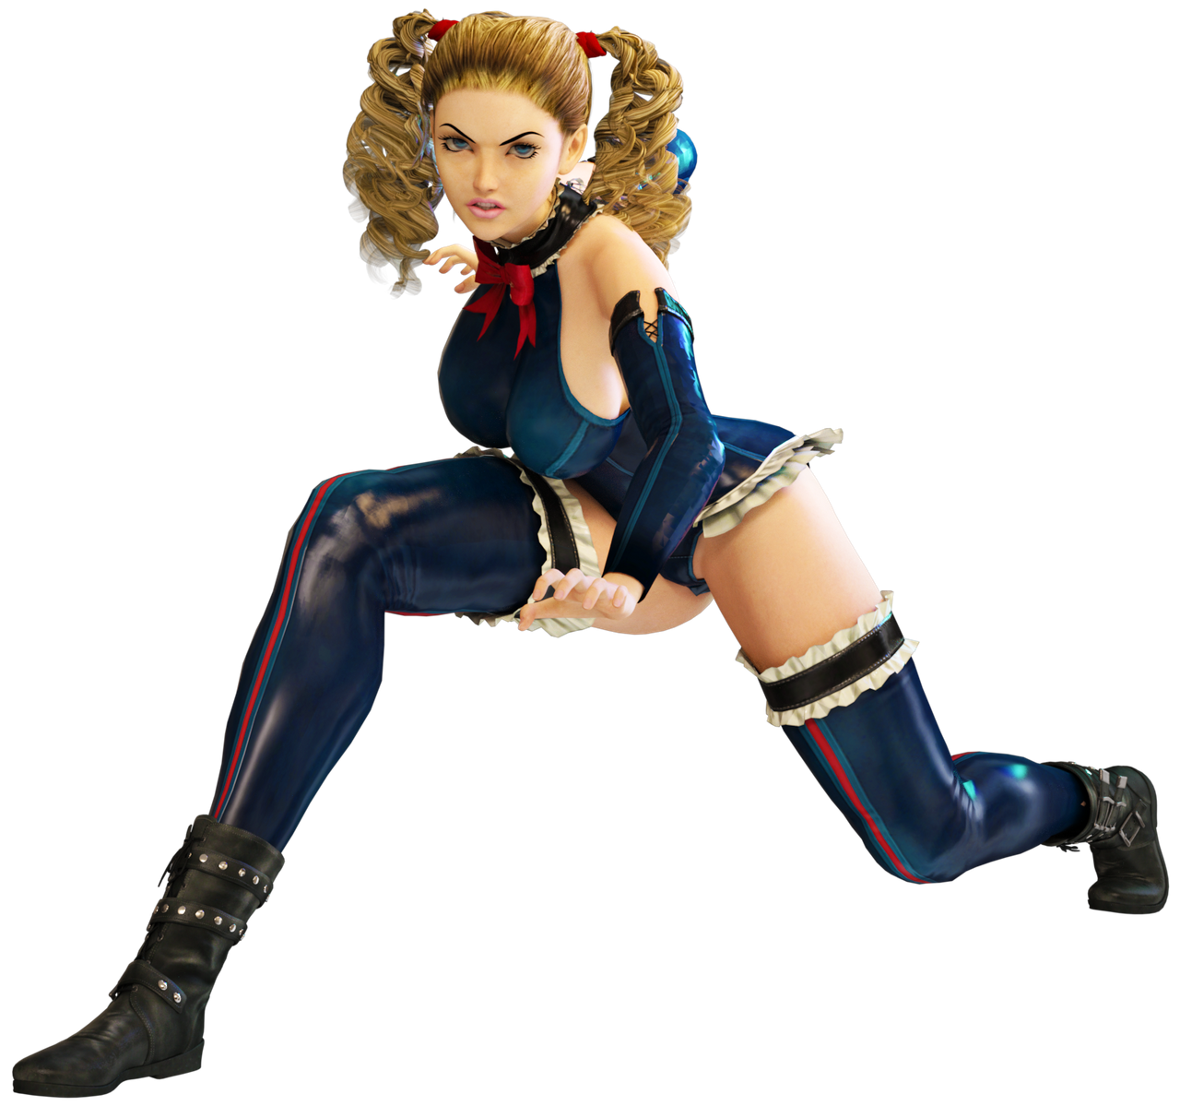
Structuralism (historical) and difference
Meaning occurs through difference, as seen, for example, in binary oppositions.
Meaning is not the identification of the sign with the object in the real world or with some pre-existent concept or essential reality; rather it is generated by difference among signs in a signifying system.
For instance, the meaning of the words "woman" and "lady" are established by their relations to one another in a meaning-field. They both refer to a human female, but what constitutes "human" and what constitutes "female" are themselves established through difference, not identity with any essence, or ideal truth, or the like.
woman lady girl chick bird lass maiden damsel wench broad gal – all mean only in relation to one another
human being, animal, reptile, fish, insect, amoeba only mean in relation to one another
Write your own list of words that mean in relation to one another.

Slide 7
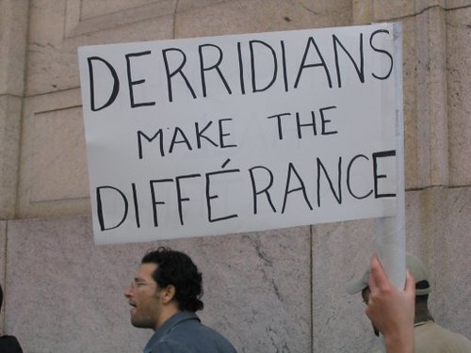
Poststructuralism - differance
There is a subtle difference between difference and differance.
In the philosophy of Jacques Derrida differance is the impossibility of any sign within a system of signs having a fixed meaning; it is the process by which meaning is endlessly deferred from one sign to another within such a system. It is thus a logical extension of Saussure’s ideas.
Derrida coined the neologism différance, meaning both a difference and an act of deferring, to characterize the way in which linguistic meaning is created rather than given.
Derrida thereby argues that meaning does not arise out of fixed differences between static elements in a structure, as the Structuralists argued, but that the meanings produced in language and other signifying systems are always partial, provisional and infinitely deferred along a chain of differing/deferring signifiers.
https://en.wikipedia.org/wiki/Difference_(philosophy)
This poststructuralist term, difference, is a good one to work into your assignment but be sure to compare it to the structuralist notion of difference, ensure that it is relevant to your focus question and to explain it carefully.

Slide 8
Structuralism: binary oppositions
Structuralism notes that much of our imaginative world is structured of, and structured by, binary oppositions; these oppositions structure meaning.

Slide 9
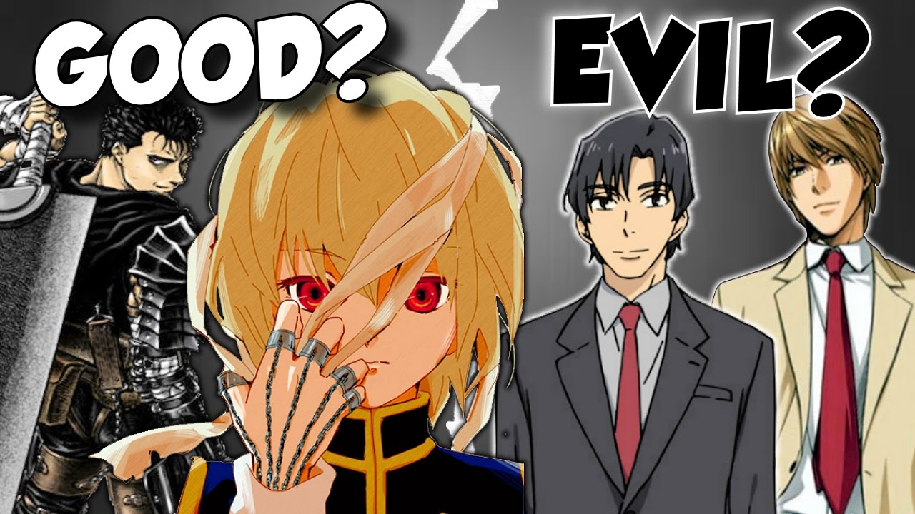
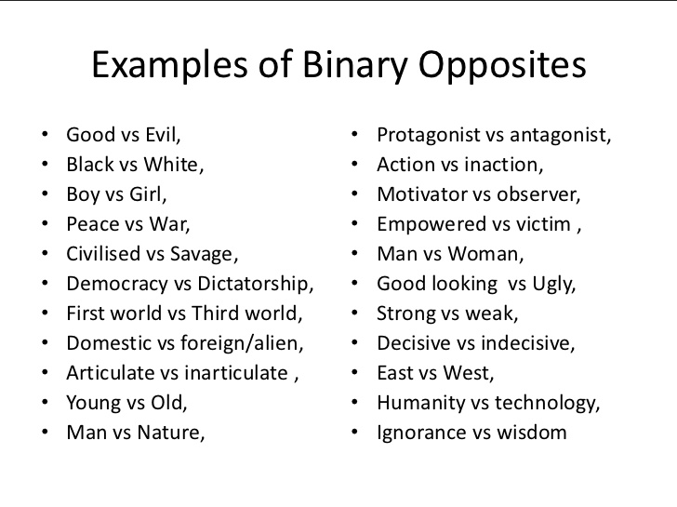
Historical Structuralism - Binary Oppositions
Binary oppositions are patterns of opposing features and concepts. Historically, binary oppositions were seen to be stable and distinct and the values underpinning them were considered to be natural.

Slide 10
Contemporary binary oppositions
Contemporary theorists focus on the binary oppositions, which the Structuralists had taken to be stable and distinct, but which they assert are not mutually exclusive.
The privileged (preferred or central) member of the binary pair depends on the other, marginal, member but needs to deny this dependency to maintain its superiority. Ie there is a hierarchy which is generally accepted.
These hierarchies of meaning form ideologies e.g. patriarchal ideology is supported by the privileging of one half of the binary over the other. man/woman, inside/outside, assertive/passive, work/home

Slide 11
Contemporary - Binary Oppositions
Contemporary theorists suggest we can begin to unpack the ideology of stories by examining the binary oppositions, which are central to them. The qualities ascribed to ‘good’ characters reveal much about what has been valued and what has been regarded as inferior or evil in Western culture. The conceptual centre of hero stories/folk tales consists of a set of binary oppositions: the qualities ascribed to the hero on the one hand and to his wild opponents on the other.
See the document entitled “Unpacking discourse and ideology”, which has been taken from a student’s IA2.
These binaries or dualisms are more than just dichotomies because one of the terms is constructed as superior and the other as inherently inferior in relation to it. The inferiorized ‘other’ is treated in a variety of ways: It may be backgrounded, that is simply regarded as not worthy of notice, as is the case with females in boys’ adventure stories. It may be defined as being radically different, distinct in as many ways as possible from the superior norm, thus underlining its inferiority.

Slide 12
Binary Oppositions
There are a number of crucial, interrelated binary oppositions which effectively reinforce each other, forming a fracture that runs through our culture:
Reason – emotion; civilization – wilderness; reason – nature; order –chaos; mind (soul) – body; male – female; human – non-human; master – slave.
In hero tales of the Christian era ‘good’ is frequently attached to the ‘reason……… master’ side of the dualities and ‘evil’ to their opposites, thus powerfully reinforcing the sense of the innate superiority of civilised, rational, male order as against wild, emotional, female chaos.
Because of their association with copulation and reproduction, women were consistently associated by Christian thinkers with the senses and the body, and hence with nature, rather than with the higher faculty of reason.
You could identify and analyse the use of significant binary oppositions (historical and contemporary) in your complex text as a text-centred methodology but you probably need to extend this analysis to the application of other related terms.
See Hourihan, Deconstructing the Hero for useful and accessible information on binary oppositions.

Slide 13
Possible application of binary oppositions, difference and differance
Begin by explaining both the historical and contemporary notions of binary oppositions. Be very clear about the differences between them; identify relevant theorists.
Apply the concepts (historical and contemporary) of binary oppositions to your text to see what is revealed.
Evaluate the usefulness of binary oppositions (historical and contemporary understandings) to answering your focus question: compare the two approaches, weigh up the strengths and limitations/usefulness of each theoretical approach.
4. Explain how Structuralists link binary oppositions to the concept of difference.
5. Link this explanation to a clear and concise explanation of the way Derrida added a subtly different term, “differance”. Apply this term to the text. What is revealed? Evaluate.
6. You could even then link these concepts to the application of semiotics, myth and/or archetypes.

Slide 14
Structuralism: narratology
A range of theorists, including Propp, Todorov, Jakobson and Barthes explored recurrent patterns and motifs, identifying narrative structures which they took to be universal. E.g.
Narratology: Todorov
1. Equilibrium (everything is as it should be) 2. Disruption (by an event) 3. Recognition of disruption 4. Attempts to repair disruption 5. Return to equilibrium (Tzvetan Todorov 1969)

Slide 15
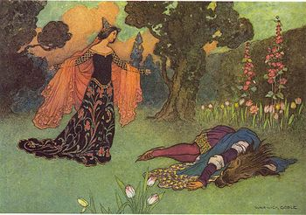
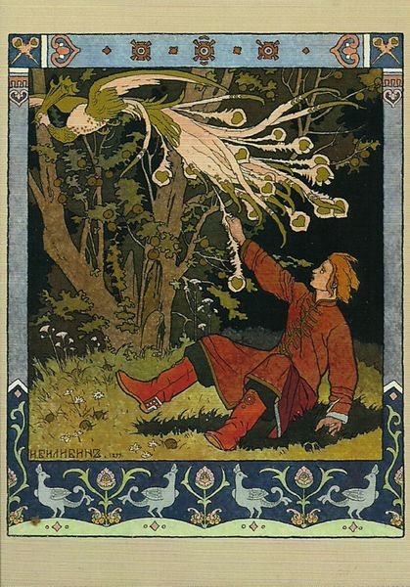
PROPP’S MORPHOLOGY(traditional text-centred approach/structuralist): The basic features of such tales (according to Vladimir Propp, (1968) The Morphology of the Folk Tale, Austin, University of Texas Press) included:
The protagonist is confronted with a prohibition or instruction that he or she violates in some way.
The protagonist departs or is banished, given a task related to the prohibition.
The protagonist encounters (a) a villain (b) mysterious individual or creature who gives the protagonist gifts (c) three different animals or creatures who are helped by the protagonist and promise to repay him or her (d) encounter three different animals or creatures who offer gifts to help the protagonist who is in trouble. The gifts are often magical agents, which bring about miraculous change.
The endowed protagonist is tested and moves on to battle and conquer the villain or other forces.
There is a sudden fall in the protagonist’s fortunes that is generally only a temporary setback. A wonder or miracle is needed to reverse the wheel of fortune.
The protagonist makes use of the endowed gifts to achieve his or her goal. The result is (a) three battles with the villain (b) three impossible tasks that are nevertheless made possible (c) the breaking of a magic spell.
The villain is punished or the forces are vanquished.
The success of the protagonist usually leads to (a) marriage (b) the acquisition of money (c) survival and wisdom (d) any combination of the first three.
A happy ending is the norm.

Slide 16
Structuralism - narratology
You could analyse your complex text from the perspective of narratology through the application of the hero’s journey. You should be able to discuss narratology in both its historical and contemporary forms. View:
https://musingsandbooks.wordpress.com/2015/04/02/archetype-adventure-a-guide-to-archetypes-in-literature/

Slide 17
Structuralism – narratology (this is a more detailed version of the hero’s journey)
You could apply this to your complex text.

Slide 18
Myth and Semiotics
Another structuralist method of analysing texts, attributed to the structuralist Saussure, is semiotics.
The concept of myth is closely linked to semiotics, and also plays an important role in exposing ideology within a text.
These will be covered in more detail later in the week.
These structuralist (text-centred) methodologies could be used to analyse your complex text in AI3 but be aware that each structuralist approach has both an historical and a contemporary component. It is very important to be able to explain the difference between these.
Also, don’t be afraid to use (acknowledged) direct quotes from your sources when explaining theory.

Slide 19
Structuralism
When you discuss aspects of structuralism such as binary oppositions, semiotics and narratology in your assignment, remember to place them in their structuralist context. Ie Briefly explain what is meant by structuralism, naming key theorist/s then move on to the structuralist methodology.

Slide 20
Homework Week 6: Glossary of Terms

