Slide 1
Semiotics
And Myth

Slide 2
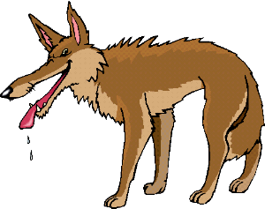
Semiotics: Saussure
Ferdinand Saussure, a structuralist, calls a written symbol (e.g. wolf) a signifier; the signifier evokes a concept, the signified (the reader’s mental idea of a wolf). Therefore, the word, or sign, consists of the signifier and the signified.
Signifier + signified =sign

Slide 3
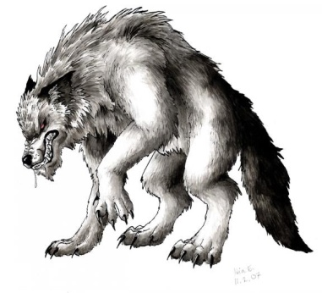
Semiotics: Saussure
The crucial point is that the signifier (the word wolf) does not relate to anything in the physical world (any actual animal); it relates to a mental concept which may involve any number of emotional associations.
For a scholarly explanation by Saussure see https://newlearningonline.com/literacies/chapter-8/saussure-on-signs

Slide 4
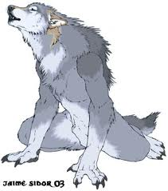
Semiotics: Saussure
In the case of the ‘wolf’ these associations might include ‘dangerous’, ‘slavering’, ‘predatory’, ‘shaggy’, ‘huge fangs’, ‘blood-thirsty’ and so on – all the ascriptions which have led to the persecution and extermination of the wolf in many parts of the world, despite the extreme rarity of actual wolf attacks on humans.

Slide 5
Semiotics: Saussure
”He developed an approach to languages as systems of signs, each sign consisting of a signifier (sound pattern) and a signified (concept), both of them mental rather than physical in nature, and conjoined arbitrarily and inseparably”
https://oxfordre.com/linguistics/view/10.1093/acrefore/9780199384655.001.0001/acrefore-9780199384655-e-385?result=4&rskey=n15Wx6

Slide 6
Semiotics Saussure
With this theory Saussure was rejecting the Western tradition that treats language like an entity or an instrument. For him language is creative action, not a thing.
For Saussure, the signified and signifier were purely psychological; they were form rather than substance. https://en.wikipedia.org/wiki/Signified_and_signifier
“his description of a language as a system whose every element is attached to every other element, and where the content of an element is purely a value generated by its difference vis-à-vis every other element”.
https://oxfordre.com/linguistics/view/10.1093/acrefore/9780199384655.001.0001/acrefore-9780199384655-e-385?result=4&rskey=n15Wx6

Slide 7
Saussure: Semiotics Weaknesses
Saussure’s theory is considered to “lack…theoretical consideration for the social and temporal dimensions of signs”
The Cambridge Companion to Saussure p251 Find online.
“That is, he was not concerned with the social and historical ideas of meaning making – his was just an a-temporal system of logical differences”
If evaluating Saussure, you would need to flesh these ideas out more fully.

Slide 8
Saussure: weakness
The theorist Jakobsen critiques Saussure:
“Those attempts made to construct a linguistic model without any connection to a speaker or a listener and which therefore hypostatize a code detached from actual communication, risk reducing language to a scholastic fiction.”
The Cambridge Companion to Saussure p 251
Be aware that Sausurean semiotic analysis requires supplementary tools in order to reveal ideologies underpinning discourses in texts.

Slide 9
Semiotics/Saussure
Without Saussure's breakdown of signs into signified and signifier, later semioticians, such as Umberto Eco and Roland Barthes, would not have had anything to base their concepts on. https://en.wikipedia.org/wiki/Signified_and_signifier
In your assignment, you could explain Saussure’s ‘pilot’ semiotic model, and apply it to your text and evaluate, before you move on to explain, apply and evaluate, say, Barthe’s or Eco’s theoretical approaches.

Slide 10
Semiotics
The word is the signifier, the mental concept of the object is the signified. Together, they form a sign.
Signifier + signified = sign

Slide 11
Myth/Barthes
Roland Barthes, an early poststructuralist, used the term ‘myth’ in Mythologies to describe the way certain stories and images function to shape our perception of reality.
Ideology underpins myth, revealing a society’s shared values, attitudes and beliefs.
(Well, ideology underpins everything really – discourse, binary oppositions, myth..)

Slide 12
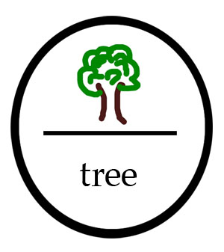
Semiotics/Myth - Barthes
To explain how myth works, Barthes updated Saussure’s concept of the sign by adding a second level where signs are elevated to the level of myth.
See https://en.wikipedia.org/wiki/Mythologies_(book) for more detailed information.

Slide 13
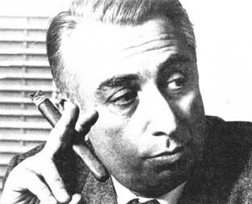
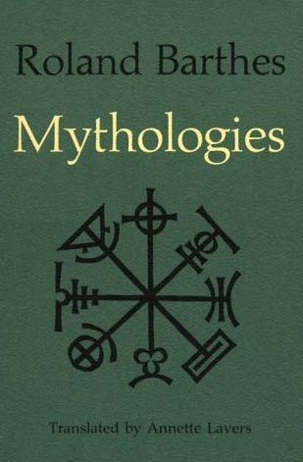
Semiotics/Myth - Barthes
According to Barthes, signs work in a culture.
He identified two orders of signification:
the first is denotation (dictionary meaning),
the second is connotation (and myth)

Slide 14
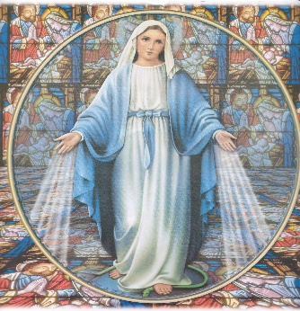
Myth/Barthes
Myth occurs when the meanings of the sign (e.g. the word ‘virgin’) meet the values and established discourses of the culture (gender discourses underpinned by the ideology of the desirability of female innocence and purity). Virgin is a very ‘loaded word’ in many cultures, especially given its religious connotations.

Slide 15
Semiotics/Myth - Barthes
The first order of signification: denotation.
This refers to the simple or literal relationship of a sign to its referent. It assumes that this relationship is objective and value-free—for all their differences, the words woman, lady and female all denote the same meaning.
The dictionary meaning….

Slide 16
Semiotics/Myth - Barthes
The second order of signification: connotation. This occurs when the denotative meaning of the sign is made to stand for the value-system of the culture or the person using it. It then produces associative, expressive, attitudinal or evaluative shades of meaning.

Slide 17
Semiotics/Myth - Barthes
What are the connotations for the word ‘whore’?
You are evaluating, expressing attitudes and making associations when you construct connotations.
There are many heavily (positively and negatively) connoted words to name women. Each word has its own mythic qualities. Feminist theorists may unpack the ideology underpinning these terms in order to reveal harmful gender biases in texts.

Slide 18
Semiotics/Myth - Barthes
So, the second order of signification is myth. Barthes's rather specialized use of the term myth refers to a chain of concepts widely accepted throughout a culture, by which its members conceptualize or understand a particular topic or part of their social experience.
Thus our myth of ‘the countryside’, for example, consists of a chain of concepts such as it is good, it is natural, it is spiritually refreshing, it is peaceful, it is beautiful, it is a place for leisure and recuperation.
What chain of concepts might you associate with the words, ‘city’?

Slide 19
Myth/Barthes
Therefore, Barthes argued that some connotations for words are so widely held that they have reached the level of myth.
Myth is a feature of everyday life; it is not restricted to literature.
The major function of myth, according to Barthes, is to naturalize a concept, a belief. This makes myth a very powerful theoretical concept which can be used to reveal ideology in texts and thus to uncover (gender/race/class/)bias.
NB Barthes concept of myth has nothing to do with stories and legends!

Slide 20
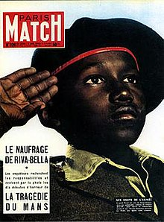
Myth/Barthes
Barthes’ most famous semiotic analysis was of this magazine cover.
Signifier – the saluting soldier
Signified – Frenchness, militariness, ethnic difference
A mythic representation which represents imperial devotion, inclusiveness and the greatness of the French empire.
See https://en.wikipedia.org/wiki/Mythologies_(book)

Slide 21
Myth/Barthes
Myth: Barthes argues that the orders of signification called denotation and connotation combine to produce ideology in the form of myth …… myths operate through codes and serve the ideological function of naturalization.
e.g. myth of motherhood, of childhood, of the noble savage, of hunting and gathering, of beauty, of the femme fatale, of the black man, of the oriental.
At: http://www.aber.ac.uk/media/Documents/S4B/sem-gloss.html#M

Slide 22
Myth/Barthes
HOW DOES MYTH OPERATE IN TEXTS?
When we read these heavily connotated words, images and attitudes are evoked. These images and attitudes are often shared across a culture. E.g. motherhood, teenager, bats, hoons evoke shared images and attitudes.
The connotation of these words have been naturalised, that is, accepted (goes without saying) but they are not natural. Connotations for such words gain strength in a culture over long periods of time. (Different to Saussure)
These words often work to support the status quo or dominant discourses of the age. Resistant readers work to unpack this ideology.
This is a great text-centred way to read your complex text. You will need to locate your own appropriate ‘Barthes quotes’ from reputable sources.

Slide 23
Myth/Barthes
So, myths are signs which are all around us in our culture. (mothers, fathers, babies, little girls, little boys, witches, coloured people, orientals, the country, the city, golden arches …)
Barthes says myths impose upon us the belief that something simply ‘goes without saying’; they create a perception of the falsely obvious. (Hoirihan p12)

Slide 24
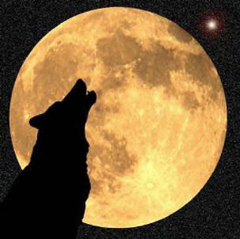
Myth/Barthes
In modern literary and cultural study, myth refers to a shared way of understanding the world that is activated through representations in texts. E.g. a representation of a wolf activates all kinds of culturally embedded ideas about the nature of wolves as predators and werewolves.

Slide 25
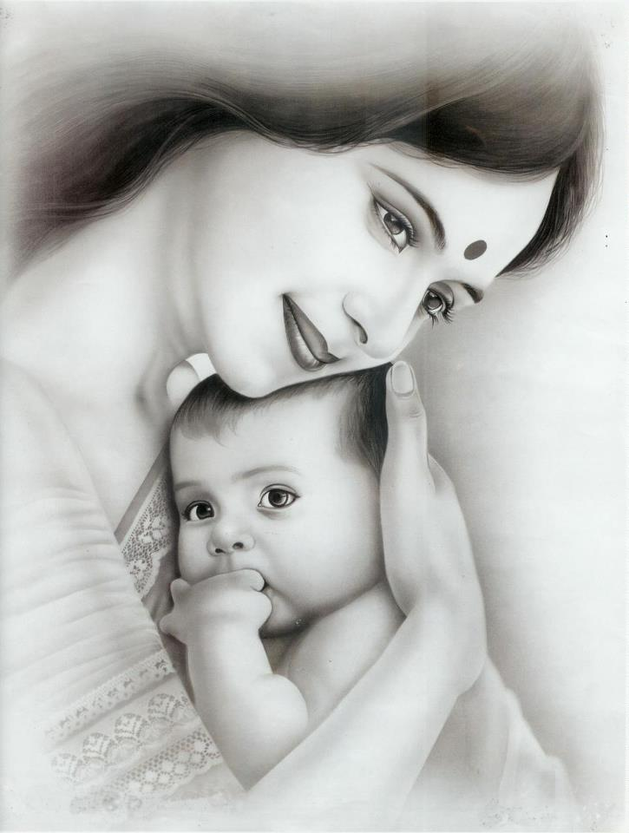
Myth of motherhood
Myth
Many aspects of cultural life are understood through myth. Motherhood, for example, is a powerfully mythologized cultural role. Representations of motherhood in texts often activate ideas to do with nurturing, self-sacrifice, gentleness, femininity, purity, domesticity and more.
Thus, the ideology of this motherhood myth is underpinned by values, attitudes and beliefs that the society accepts. The representation of a mother in fiction, which reflects this myth, also helps to perpetuate the myth as being natural and right.

Slide 26
Racist Myth What ideas are activated about people of colour here? Why do you think the Noddy books and golliwogs were banned for quite a while in Britain?
See Hourihan p 58-62 for racial myths.

Slide 27
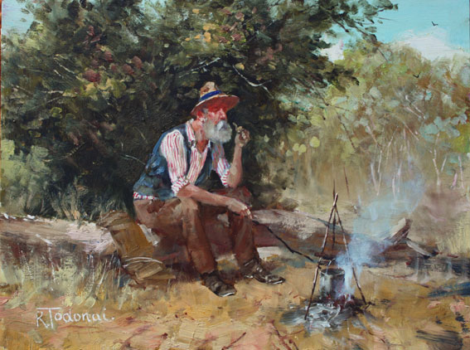
Myth
Walzing Matilda
The Australian swagman:
What are the characteristics of the myth?
A loner
Lives in the open, travels by foot
Lives off the land, performs menial tasks for food and shelter
Lives on the margin of society Impoverished – begs but may be proud
May be unemployed or unemployable
Lives on charity of rural folk
May not be trustworthy
an underclass of transient temporary workers
What ideas are activated?

Slide 28
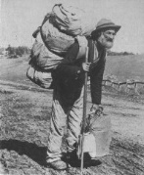
Myth and Ideology
The jolly swagman is seen as a crook, a vagabond who lives by petty thievery; he respects neither the ruling class of the squatters, nor the law-enforcing agents, the troopers.
The ideology supports the status quo – it is wrong to steal from the wealthy even if you are starving.

Slide 29
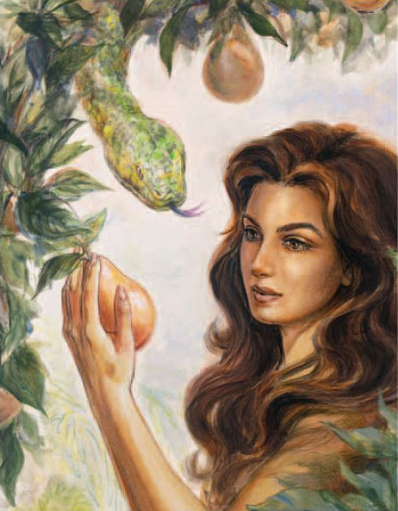
Myth of Eve
The temptress – an archetypal character
The cause of the fall of man
Adam as victim of Eve
Eve as by-product – Adam’s rib
Intertextual relationship with Pandora who was also responsible for bringing evil into the world
Is there an ‘Eve’ in your complex text?

Slide 30
Myth
A myth is a textual representation of a shared understanding about the world.
Myth is a pre-packaged set of beliefs and practices that seem natural and obvious to members of a culture.

Slide 31
What myths are activated in this text excerpt?
La Belle Dame Sans Merci
John Keats
What kinds of ideology underpin the myth?
I met a lady in the meads Full beautiful, a faery's child; Her hair was long, her foot was light, And her eyes were wild.
I set her on my pacing steed, And nothing else saw all day long; For sideways would she lean, and sing A faery's song.
I made a garland for her head, And bracelets too, and fragrant zone; She looked at me as she did love, And made sweet moan.

Slide 32
Myth and Semiotics
The term myth, then, is not to be used in the layperson's sense of a 'false belief', but in the anthropological sense of a culture's way of conceptualizing an abstract topic.

Slide 33
Myth and Ideology
The connotations and myths of a culture are the signs of the culture’s ideology. The way that the varied connotations and myths fit together to form a coherent pattern or sense of wholeness, that is, the way they 'make sense', is evidence of an underlying invisible, organizing principle—ideology.

Slide 34
Myth/Barthes
Exploring the concept of myth, Barthes seeks to grasp the relations between language and power. He assumes that myth helps to naturalize particular worldviews.
According to Barthes, myth is based on humans' history, and myth cannot naturally occur. (Did you notice the difference between Saussure and Barthes?)

Slide 35
What myths are activated in your novel?
What kinds of assumptions do these myths make about class, race and gender?
What ideology is revealed when the myth is analyzed/unpacked?
An effective way of closely reading text (a structuralist t-c approach) could begin with a focused consideration of binary oppositions (historical and contemporary theories), continue with an application of semiotic theory and end with an analysis of the myths activated in the text. Continually compare/contrast and evaluate each theoretical approach.

Slide 36
Myth and Semiotics
You might like to apply a semiotic approach to your complex text in AI3 as one of your theoretical (T-C) approaches.
One of the best places to begin your research is at https://www.cs.princeton.edu/~chazelle/courses/BIB/semio2.htm
Chandler, Daniel “Semiotics for Beginners”

Slide 37
Myths activated in your text ?
BNW – the savage, sexually promiscuous woman, the outsider
1984 – the rebel, Eve, rebellious woman, sexually promiscuous woman, decorative but unintelligent woman
HOD – the noble savage, a dying enigma, the Intended, the wild native woman
Harp – fallen woman, seducer, the good husband, the mother
The Road – mother, motherhood, family, child, the ‘good guys’, savages, cannibals
The Natural Way of Things
heroine, ‘fallen women’, bullies, the outback, Eve,
WH – the outsider, the Gothic villain, Byronic anti-hero, archetypal lovers, the moors

Slide 38
Literary Archetypes
In literature, an archetype is a typical character, an action, or a situation that seems to represent universal patterns of human nature. An archetype, also known as “universal symbol,” may be a character, a theme, a symbol, or even a setting. https://literarydevices.net/archetype/

Slide 39
Archetypes
As these myths occur in literature, we call them archetypes.
See https://nofilmschool.com/12-character-archetypes-for-your-screenplay for types of archetypes and short videos on archetypes.
Also view https://www.youtube.com/watch?v=dvYM4GIbYKg

Slide 40
Archetypes
An archetype is a universal symbolic pattern. Examples of archetypal characters are the femme fatale, the trickster, the great mother and father, and the dying god. There are archetypal stories as well. Examples are stories of great floods, virgin births, creation, paradise, the underworld, and a final apocalypse. True to their universal nature, archetypal characters and stories appear again and again in myths across many diverse cultures.

Slide 41
Archetypes
The term ‘archetype’ applies to literature whereas myth operates throughout an entire culture.

Slide 42
Common Literary Archetypes
A femme fatale is a mysterious and seductive woman^{[1]} whose charms ensnare her lovers in bonds of irresistible desire, often leading them into compromising, dangerous, and deadly situations. She is an archetype of literature and art. Her ability to entrance and hypnotize her victim with a spell was in the earliest stories seen as being literally supernatural, hence the most prosaic femme fatale today is still described as having a power akin to an enchantress, vampire, witch, or demon.
http://en.wikipedia.org/wiki/Femme_fatale

Slide 43
Archetypes
The phrase femme fatale is French for "deadly woman". A femme fatale tries to achieve her hidden purpose by using feminine wiles such as beauty, charm, and sexual allure. In some situations, she uses lying or coercion rather than charm. She may also be (or imply to be) a victim, caught in a situation from which she cannot escape.

Slide 44
Archetypes
In social life, the femme fatale tortures her lover in an asymmetrical relationship, denying confirmation of her affection. She usually drives him to the point of obsession and exhaustion so that he is incapable of making rational decisions.

Slide 45
Archetype
The femme fatale was a common figure in the European Middle Ages, often portraying the dangers of unbridled female sexuality. The pre-mediaeval inherited Biblical figure of Eve offers an example, as does the wicked, seductive enchantress typified in Morgan le Fay.
The femme fatale flourished in the Romantic period in the works of John Keats, notably "La Belle Dame sans Merci" and "Lamia". http://en.wikipedia.org/wiki/Femme_fatale
Is there a femme fatale archetype in your text?

Slide 46
Cinderella Archetype
naive, carefree innocent girl
Greeks called her child-woman or ‘the maiden’
unaware of her sexual attractiveness and other competencies
the willing symbol of fertility.

Slide 47
Cinderella Archetype
The ‘child woman’ can be described by adjectives like: compliant, harmonizing, nice and sweet, quiet, simplistic, ‘demure, can’t say no, lacking passion, passive, uncertain, kind, receptive, ability to wait, unassuming, ‘good little girl’, little willpower, pleasing everybody, ‘well behaved child’. http://www.9types.com/movieboard/messages/10387.html

Slide 48
Joseph Campbell and Carl Jung
An archetype is a recurring pattern of character, symbol, or situation found in the mythology, religion, and stories of all cultures. In the context of archetypes, Campbell defined his work as a search for "the commonality of themes in world myths, pointing to a constant requirement in the human psyche for a centering in terms of deep principles." (Campbell, et al 1988). Jung defined his concept of the archetype as a formula that is the result of "countless experiences of our ancestors. They are, as it were, the psychic residue of numberless experiences of the same type ". Both men felt that the experience of being human can be examined collectively across time, space, and culture, and that our commonality can be traced to the most primitive origins of the human consciousness, where the archetypal themes originate in modern men and women. Archetypes can be thought of as the precursor to conscious thought, existing in the unconscious mind as expressions of psychic happenings, but without a basis in the physical world. Humans didn't "invent" archetypes, but they do express archetypes in the conscious world of art, literature, and religion. http://tatsbox.com/hero/heroques.htm

Slide 49
Archetypes examples
The hero - The courageous figure, the one who's always running in and saving the day. Example: The woodcutter in Little red Riding Hood
The outcast - The outcast is just that. He or she has been cast out of society or has left it on a voluntary basis. Example: The wolf in Little red Riding Hood.
The scapegoat - The scapegoat figure is the one who gets blamed for everything, regardless of whether he or she is actually at fault. Example: Snowball from George Orwell's "Animal Farm"
The star-crossed lovers - This is the young couple joined by love but unexpectedly parted by fate. Example: Rapunzel and her prince.
The shrew - This is that nagging, bothersome wife always battering her husband with verbal abuse. Example: Rapunzel’s mother
DON’T FORGET ARCHEYPAL SITUATIONS and symbols

Slide 50
Archetypes Jung
Begin by watching the video on Jung and archetype at https://nofilmschool.com/12-character-archetypes-for-your-screenplay
In your task, you could apply Barthes’ concept of myth, Jung’s concept of archetype and Campbell’s monomyth (the hero’s journey) to explore the representation of a central character. This may work with WH and The Road. Compare/contrast findings with a psychoanalytical reading.

Slide 51
Possible Task Structure
Focus on character/What are you able to reveal?
Structuralism
Saussure – semiotics Explain/apply/evaluate
Barthes - myth Explain/apply/evaluate Jung - archetypes Explain/apply/evaluate
Psychoanalytic theory
Freud/Lacan/Kristeva Explain/apply/evaluate (one theorist)
(or post colonial theory or feminist theory or Marxist theory)

Slide 52
See also
King, D (2005) “Reading the word: two contemporary text-centred approaches to literary analysis”, Wordsworth Vol 38 No 2
Notes on Myth, Denotation and Connotation and Archetypes on NEST.
Find your own reputable sources and quote from them when explaining theory. E.g. https://en.wikipedia.org/wiki/Mythologies_(book)
To excel, dig deeper into the theory than I have in this introductory ppt. Use specialist terms employed by Barthes and others in your explanations. There will be concepts within the over-arching concept of myth which may be applied to your text. Dig deep – become an expert! Don’t forget to research strengths and limitations of theory in order to compare and contrast in your evaluations.
Also, if you are interested in archetypes you could profitably explore Jung’s conception of archetype within psychoanalytical theory.

