Slide 1
Literary Theory
Some Central Ideas -
Revision

Slide 2
The Problem of Meaning in Literature
There are several (overlapping) ways to approach this:
1. The meaning is what is intended by the author (author-centered reading)
2. The meaning is created by and contained in the text itself (text-centered reading)
3. The meaning is created by the reader (reader-centered reading)
4. Discourses construct the reader and the text (world-context centered reading)

Slide 3
Previously
You have applied theoretical aspects of the three of these approaches (reader-centred (AI1), author-centred (AI1), text-centred) to a range of literary texts in order to understand that different meaning may be constructed from the same text depending on who is reading the text, where they are reading it, the purpose for reading and the approach adopted.

Slide 4
Terms and concepts you may have now encountered:
Terms from literary criticism e.g. symbolism, imagery, irony etc.
structuralism, New Criticism, Reader Response Theory, narratology
semiotics, binary oppositions, myth
gaps, silences
ideology and discourse
invited reading, resistant reading
implied author, implied reader
narrating persona
values, attitudes and beliefs
horizon of expectations
intentional fallacy

Slide 5
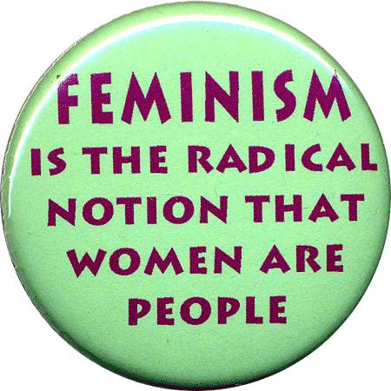
These approaches include feminist, Marxist and post-colonialist literary theory.
WORLD-CONTEXT Centred Approaches to Reading

Slide 6
"an emphasis on theory tends to undermine reading as an innocent activity” Raymond Seldon 1985
Central idea: Reading is not an innocent activity!
http://www.ed.psu.edu/englishpds/Articles/LiteratureStudy/Balancing%20Reader%20Response.htm

Slide 7
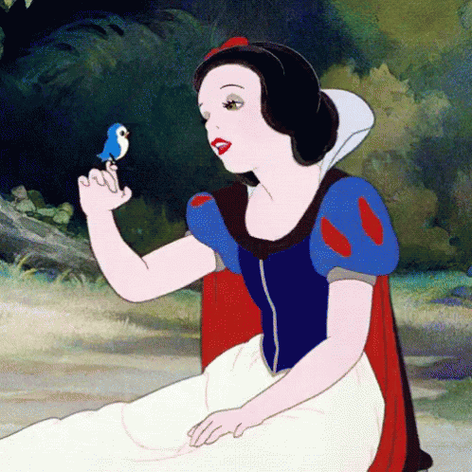
Consider the ideology underpinning this seemingly innocent text…..
https://www.youtube.com/watch?v=Gs9eWIpthcU
Why might my daughter-in-law object to this being shown to her four year old daughter?

Slide 8
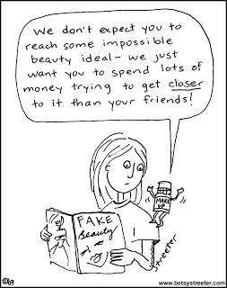
Ideology underpinning Snow White
Beauty Myth
Binaries
Women and girls need to be beautiful to be valued.
Male/female – women need to beautiful and submissive towards male characters
Passive/active - suggests men are heroic saviours while women are passive and weak
Evil/good – often older or ugly women are represented as being evil in fairy tales
Youth/age – only the young can be beautiful

Slide 9
Why bother with literary theory?
Readers may believe that theories and concepts will only deaden the spontaneity of their response to literary works. They may forget that so called 'spontaneous' responses to literature, such as those experienced in book clubs and some classrooms, are unconsciously dependent on the theorizing of older generations. Their talk of 'feeling', 'imagination', 'genius', 'sincerity', and 'reality' is full of (dated) theory which is sanctified by time and has become part of the language of ‘common sense’.
http://www.ed.psu.edu/englishpds/Articles/LiteratureStudy/Balancing%20Reader%20Response.htm Bill Corcoran.

Slide 10
Premises shared by contemporary literary theorists (poststructuralists)
Meaning is assumed to be created by difference, not by presence. All meaning is only meaning in reference to, and in distinction from, other meanings; there is no meaning in any stable or absolute sense. Meanings are multiple, changing, contextual.
For instance, the word girl only means in a difference field which may contain other words like woman, lass, boy, youth, teenager and so on. Hot only has meaning in relation to cold (warm, cool etc.), not its own intrinsic meaning.

Slide 11
Important Terms - Derrida
Differance (with an a!)
Words and signs can never fully summon forth what they mean, but can only be defined through appeal to additional words, from which they differ. (Binary oppositions are an important element of difference.)
Deferral
Thus, meaning is forever "deferred" or postponed through an endless chain of signifiers. (sigh….)
https://en.wikipedia.org/wiki/Diff%C3%A9rance
Don’t worry if you don’t quite get these terms. 99.99% of people share your bewilderment.

Slide 12
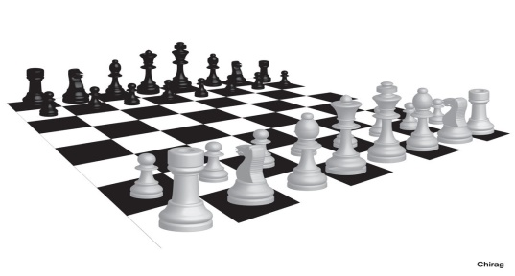
Differance
Saussure offers an analogy between language and chess: "The respective value of the pieces depends on their position on the chessboard just as each linguistic term derives its value from its opposition to all the other terms. . . . Language is a system of interdependent terms in which the value of each term results solely from the simultaneous presence of the others . . . .Signs function, then, not through their intrinsic value but through their relative position.“
http://www.webpages.uidaho.edu/~sflores/saussure.html

Slide 13
Truth?
Poststructuralist theorists posit that there is no foundational ‘truth’ or reality in the universe. There are only local truths generated by human groups through their cultural systems in response to their needs for power, survival and esteem. Consequently, values (ideology) and identity are cultural constructs, not stable entities.

Slide 14
Discourse and Ideology
We have seen that discourses (e.g. gender, race and class) in societies are underpinned by values, attitudes and beliefs (world views, ideologies) which are inscribed in language. The means by which ideology underpins texts can be seen for instance, in gaps, silences, incoherencies, foregrounding, contradictions, binary oppositions and myth.

Slide 15
Ideology underpins Text
All texts are deliberate constructions……. composed in a particular cultural, social and historical context …… they will reflect a certain world view or version of reality, conveying a particular set of assumptions, attitudes, and messages which may be understood as the ideology of the text.

Slide 16
Ideology Underpins Text
Therefore, ‘a large part of any book is written not by its author but by the world its author lives in’. Hourihan, M (1997) Deconstructing the Hero, Routledge, London. p4.
In fact, as you have seen, the ideology underpinning our very own speech and thought is culturally constructed.

Slide 17
Truth, Ideology
It is language itself, not some essential humanness or timeless truth, that is central to culture and meaning. The world we occupy is a construction of ideology which is revealed in language through, for example, binary oppositions and myth.

Slide 18
Binary Oppositions
Layers of meaning in texts are created, shaped and reinforced by binary oppositions.
Barthes and Levi-Strauss noticed an important feature of the 'binary opposites': that one side of the binary pair is always seen by a particular society or culture as more valued over the other. E.g. man/woman, black/white, country/city
Binary oppositions are patterns of opposing concepts or ideas, which work to produce a set of beliefs or values.
Dominant ideologies are therefore reinforced by a culture’s perception of the relative worth of each side of the binary.

Slide 19
Binary Oppositions
We can begin to unpack the ideology of texts by examining the binary oppositions, which are central to them. The qualities ascribed to ‘good’ characters reveal much about what has been valued and what has been regarded as inferior or evil in Western culture. The conceptual centre of hero stories/folk tales consists of a set of binary oppositions: the qualities ascribed to the hero on the one hand and to his wild opponents on the other. (ibid. p 17)

Slide 20
Binary Oppositions
Reason – emotion; civilization – wilderness; reason – nature; order –chaos; mind (soul) – body; male – female; human – non-human; master – slave.
In hero tales of the Christian era, ‘good’ is frequently attached to the ‘reason……… master’ side of the dualities and ‘evil’ to their opposites, thus powerfully reinforcing the sense of the innate superiority of civilised, rational, male order as against wild, emotional, female chaos. (ibid. p 17)

Slide 21
You can analyse binary oppositions
when applying most t-c and wc-c literary theories…..just make sure your explanation of the concept is spot on!

Slide 22
Myth
A myth is a textual representation of a shared understanding about the world. E.g. wolf, princess, motherhood
(not the usual meaning of myth)
Myth is a pre-packaged set of beliefs and practices that seem natural and obvious to members of a culture.

Slide 23
Myth
In modern literary and cultural study, myth refers to a shared way of understanding the world that is activated through representations in texts. E.g. romantic love, childhood, prince, vampire
This kind of myth is related to the signs and categories through which a community view the world, so that knowing the myth is part of what it means to be a member of the culture.

Slide 24
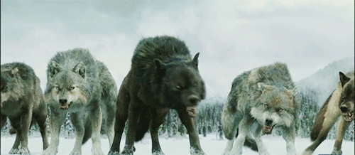
Myth
Texts use combinations of signs (words or images taken from the culture) to invite readers to ‘activate’ or recognize the myth. For example, the words “the big, bad wolf” activates myths of the ‘wolf’ whose associations might include ‘dangerous’, ‘slavering’, ‘predatory’, ‘shaggy’, ‘huge fangs’, ‘blood-thirsty’ and so on.

Slide 25
Myth
The successful operation of myth lies in its apparent lack of construction -- its innocence.
For Barthes, myths are omnipresent signs, which impose upon us the belief that something simply ‘goes without saying’; they create a perception of the falsely obvious.

Slide 26
Myth and Ideology
The connotations and myths of a culture are the signs of the culture’s ideology. The way that the varied connotations and myths fit together to form a coherent pattern or sense of wholeness, that is, the way they 'make sense', is evidence of an underlying invisible, organizing principle—ideology.

Slide 27
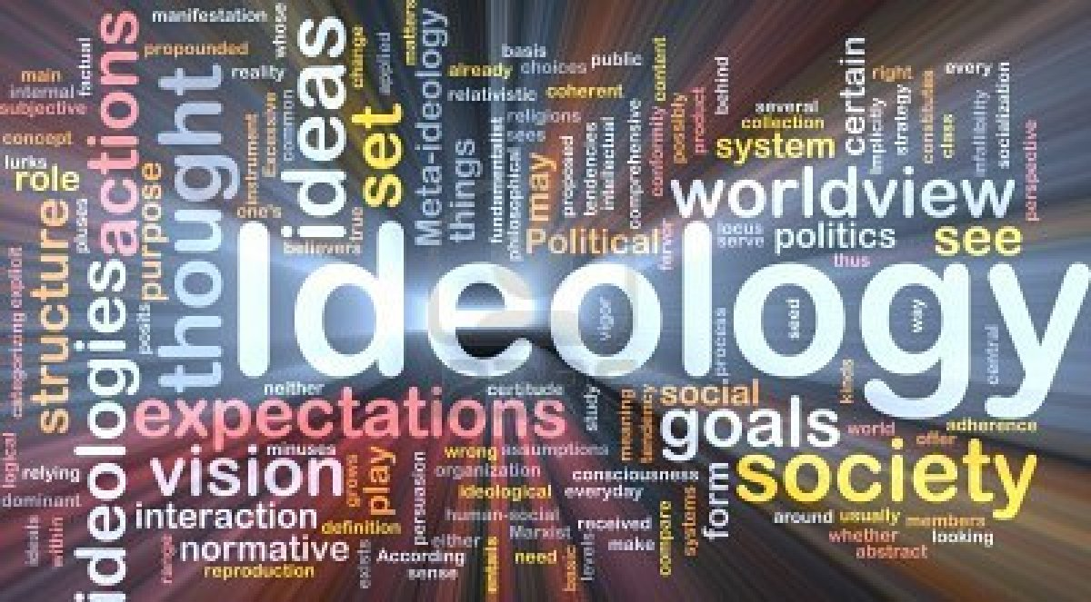

Slide 28
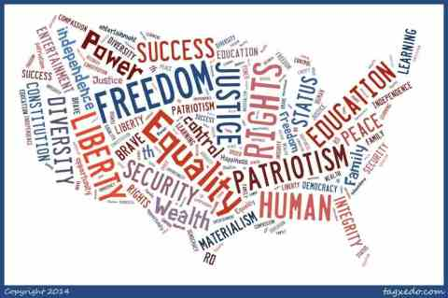
Ideology
When we talk about the ideology of a text we are talking about the complex sets of beliefs, values and ways of thinking which are reflected in, endorsed or produced by the text.
American values and beliefs?

Slide 29
Ideology
Ideology is also a Marxist term developed to talk about how cultures are structured in ways that enable the group holding power to have the maximum control with the minimum of conflict.
This is not a matter of groups deliberately planning to oppress people or alter their consciousness (although this can happen), but rather a matter of how the dominant institutions in society work through values, conceptions of the world, and symbol systems, in order to legitimize the current order. E.g. the way capitalist and consumerist ideologies permeate the Western World

Slide 30
Ideology

Slide 31
Ideology – to recap
Briefly, this legitimization is managed through the widespread teaching (the social adoption) of ideas about the way things are, how the world 'really' works and should work. These ideas (often embedded in (myth, binaries) symbols and cultural practices) orient people's thinking in such a way that they accept the current way of doing things, the current sense of what is 'natural,' and the current understanding of their roles in society.

Slide 32
Ideology
This socialization process, the shaping of our cognitive and affective interpretations of our social world, is called, by Gramsci, "hegemony;" it is carried out, Althusser writes, by the state ideological apparatuses -- by the churches, the schools, the family, and through cultural forms (such as literature, rock music, advertising, sitcoms, etc.) Marxist theorists…

Slide 33
Marxist Theory

Slide 34
Powerful Political Ideology
"Democracy is the political system most in keeping with the nature and needs of humans; history has been an evolution of political forms towards democracy; once states have all reached democracy, all they have to do is avoid reverting, there is no 'farther' to go in terms of political organization."
We assume that democracy is the political system best suited to the nature and aspirations of humans, we see history as a movement towards democracy, we assume that once all nations have achieved democracy they will continue to be democracies forever, unless they erode. These assumptions are part of (Western) ideology. This ideology is not shared by other cultures (e.g. Asian cultures) and has not always been the aspiration of cultures across time. Some cultures assume strong leaders are preferable to democracy.
Lye, John, Ideology Handout 1997 http://www.brocku.ca/english/jlye/ideology.html

Slide 35
Ideology
Ideology serves to maintain hierarchical structures in discourses such as gender, race and class but does so primarily from consent as opposed to use of force.
https://faculty.washington.edu/mlg/courses/definitions/Ideology.html
Think about the ways girls and women embrace the ideology underpinning the beauty myth, for instance, or the way citizens embrace the ideology of nationalism or the way customers embrace the ideology of consumerism.

Slide 36
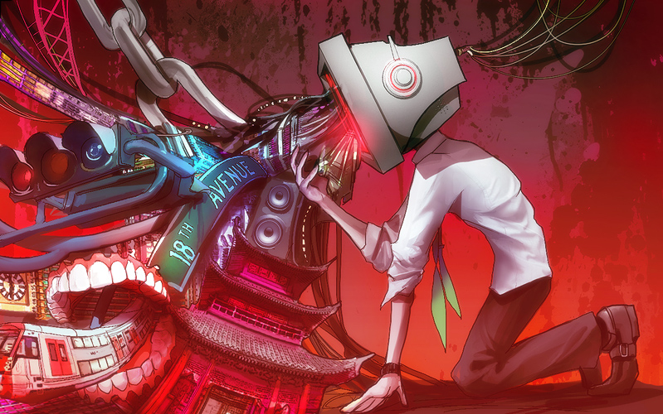

Slide 37
And now….
We will explore world – context reading practices, so called because the world context (historical, cultural etc.) of an author and of a reader are considered critical to the meaning making process as each is a product of …….
Ta Da…….
discourse and ideology

Slide 38
The
End

