Slide 1
Introduction to Literary Theories
Which will you choose?

Slide 2
Text-centered Approaches: Structuralism
Structuralism focuses on structures in "literary" texts.
Theorists:
Levi-Stauss – binary oppositions
Propp, Todorov, Campbell – narratology
Saussure – semiotic analysis
Terms:
Binary oppositions
Difference and difference
Semiotics
Signs, signified signifier
Myth, archetype

Slide 3
Contemporary text-centered approach: Deconstruction
This is a poststructuralist theory mainly based on the writings of the French intellectual Jacques Derrida. Deconstruction posits that meaning, as accessed through language, is indeterminate because language itself is indeterminate.
It is a system of signifiers that can never fully “mean”: a word can refer to an object but can never be that object. Used as a method of literary critique, deconstruction refocuses attention on a work as open-ended, endlessly available to interpretation, and far beyond the reach of authorial intention.
Deconstruction traces how language generates meaning both within a text and across texts, while insisting that such meaning can only ever be provisional.
https://www.poetryfoundation.org/learn/glossary-terms/deconstruction
Terms:
Multiple meanings
Aporia
Binary oppositions
Gaps and silences
Contradictions
Violent hierarchies
Logocentrism
Discourse and ideology
differance

Slide 4
How to Deconstruct a Text
Identify the binary and destabilize it.
2. Expose the textual subconscious, where meanings are expressed that contradict or destabilize the surface meaning.
3. Fix upon the surface features of the words and make them important to overall meanings.
4. Analyse one passage so intensely that the language explodes into multiplicities of meaning
5. Look for shifts, breaks, inconsistencies, and silences
(“aporia”) in the text.
6. Show that the text is disunified.
See https://www.academia.edu/3188387/PPT_on_Literary_Theory_5_Deconstruction
Especially note positive and negative elements of deconstruction.
See also https://www.slideshare.net/HafsaAwan5/deconstruction-theory-by-jacques-derrida for concise notes on deconstruction.

Slide 5
Remember
To apply one or more text-centered approaches in your academic research paper. For instance:
Possible application of binary oppositions, difference and difference:
Begin by explaining both the historical and contemporary notions of binary oppositions. Be very clear about the differences between them; identify relevant theorists.
Apply the concepts (historical and contemporary) of binary oppositions to your text to see what is revealed.
Evaluate the usefulness of binary oppositions (historical and contemporary understandings) to answering your focus question: compare the two approaches, weigh up the strengths and weaknesses/usefulness of each theoretical approach.
Explain how structuralists link binary oppositions to the concept of difference.
Link this explanation to a clear and concise explanation of the way Derrida added a subtly different term, “differance”. Apply this term to the text. What is revealed? Evaluate.
You could even then link these concepts to the application of semiotics, myth and/or archetypes.

Slide 6
Remember
To apply one or more text-centered approaches in your academic research paper. For instance:
Narratology:
See Vladimir Propp, the structure of fairy tales at https://www.youtube.com/watch?v=V5RyV-s0yhU (12 mins) for an introduction to narratology.
This may not be the most useful methodology for reading a complex text; this works better for formulaic texts like James Bond novels and Starwars movies.
If you are really keen, perhaps Joseph Campbell’s hero’s journey approach may apply to your novel. See: Campbell, Joseph. (1949) Hero with a Thousand Faces (in book box) and https://www.youtube.com/watch?v=d1Zxt28ff-E (3 min) and https://www.youtube.com/watch?v=GNPcefZKmZ0 (11 mins) and https://blog.reedsy.com/heros-journey/. It could possibly be applied to HOD, WH and The Road.

Slide 7
Remember
To apply one or more text-centered approaches in your academic research paper. For instance:
Semiotics (you could also include myth and archetype).
Explain the theory, name key theorists, situate the theory among other theories generationally. Explain your purpose in applying the methodology to your complex text. What do you hope to achieve?
Apply the methodology to your text. Evaluate – strengths and weaknesses, usefulness, limitations etc

Slide 8
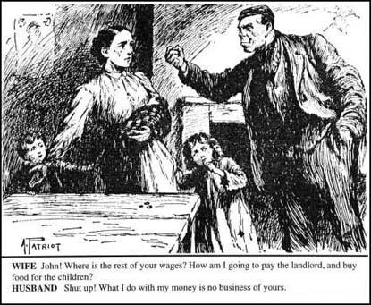
Contemporary world-context centred theorists ask:
Whose interests are served by the particular representations in the text? (men/patriarchal interests, whites/colonialist interests, bosses/capitalist interests)

Slide 9
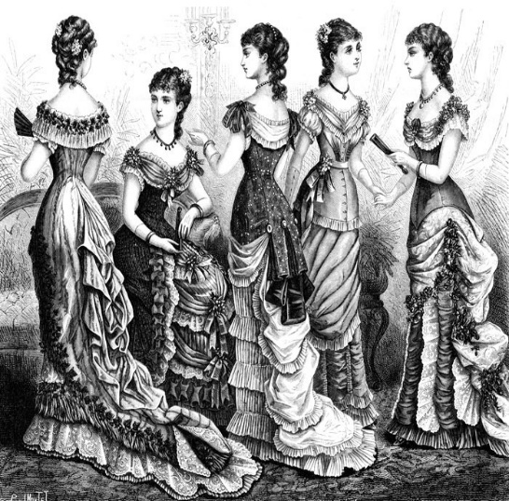
Marxist Literary Theory
Broadly, this is a sociological approach to literature that views works of literature or art as the products of historical forces that can be analysed by looking at the material conditions in which they were formed.
In Marxist ideology, what we often classify as a world view (such as the prudishness of the Victorian age) is actually the articulations of the dominant class.
A Marxist might also view capitalist ideology (world view) as the expression of the desire of the dominant classes for wealth accumulation.

Slide 10
How might a Marxist resist ideology in a literary text?
What do Marxist literary critics do with texts?
They explore ways in which the text reveals ideological oppression of a dominant economic class over subordinate classes. In order to do this a Marxist might ask the following questions:
Does the text reflect or resist a dominant ideology? Does it do both?
Does the main character in a narrative affirm or resist bourgeoisie values?
Whose story gets told in the text? Are lower economic groups ignored or devalued? E.g. How are servants represented in Jane Austen novels?
Are values that support the dominant economic group given privilege? This can happen tacitly, in the way in which values are taken to be self-evident. E.g. the way wealth is unquestioningly valued in Jane Austen novels
http://www1.assumption.edu/users/ady/hhgateway/gateway/Marxistlitcrit.html

Slide 11
How might a Marxist resist ideology in a literary text?
“Walzing Matilda”: The swagman is from a lower socio-economic group in society; his experience and the value of his life are devalued in the poem.
He is not named.
He is depicted in derogatory terms as a thief.
The binaries of up/down, law/criminal, landholder/itinerant labourer suggests that the values of the dominant economic group are privileged.
Capitalist ideology, in which the poor are marginalised, is naturalised in the poem.
Bourgeoisie values are dominant i.e. those of the police and the squatter

Slide 12
Role of literature in reinforcing ideology.
According to Marxists, and to other scholars (literary theorists), literature reflects those social institutions out of which it emerges and is itself a social institution with a particular ideological function. Literature reflects class struggle and materialism: think how often the quest for wealth traditionally defines characters. E.g. Great Expectations. So Marxists generally view literature "not as works created in accordance with timeless artistic criteria, but as 'products' of the economic and ideological determinants specific to that era" (Abrams 149). Literature reflects an author's own class or analysis of class relations.
There are many different branches of Marxist literary theory. You do not need to know about them all.

Slide 13
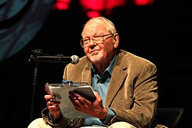
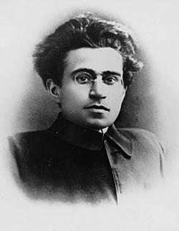
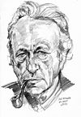
Suggested Marxist literary theorists
See also the Literary Theory Fact sheet on NEST.
Louis Althusser
Antonio Gramsci
Fredric Jameson
See following site for questions Marxists ask:
https://owl.purdue.edu/owl/subject_specific_writing/writing_in_literature/literary_theory_and_schools_of_criticism/marxist_criticism.html

Slide 14
Some Marxist terms
historical materialism surplus value alienation commodification base/superstructure hegemony false consciousness interpellation division of labour | mode of production proletariat bourgeoisie reification ideological state apparatus
See notes on Marxism on NEST for further information

Slide 15
What do feminists value?
Important values of feminism include:
mutuality - the sharing of a feeling, action, or relationship between two or more parties.
cooperation
equality
democratic use of power
enjoyment of body and work
peace.
There are many different branches to feminist theory.

Slide 16
Feminists ask:
How do gender discourses dominate the writing in the tale? What beliefs about the role of women in society are promoted within the tale? How does the ideology underpinning the text work to advantage men?
How do discourses of power dominate the writing in the tale?
How does this invited reading of the story serve the interests of a patriarchal society?
How does it serve to ‘keep women in their place’? (post-colonialist theorists ask similar questions).

Slide 17
Feminists challenge the traditional approaches to the study of families
Feminism reveals harmful effects traditional family roles, economic exploitation, and social inequalities have on women’s general well being.
Focusing on gender as a social construct instead of as a given
Advocating the use of “household” as opposed to “family” due to the term family’s biases
Emphasizing the harmful effects of the traditional family roles, economic exploitation, and social inequalities
Refuting the stereotypes of the women as dependent and economically unproductive
Focusing on the influence of capitalism and patriarchy on the organization of work, including work within the family
Viewing motherhood as an experience as opposed to a role
Challenging the structure of heterosexuality as the norm
Recognizing the public-private dichotomy where men are recognized with public society and women with private family
http://www.csun.edu/~whw2380/542/Feminist%20Family%20Theory.htm

Slide 18
Suggested feminist literary theorists
Elaine Showalter
Sandra Gilbert and Susan Gubar
Judith Butler
Second and third wave feminists
Julia Kristeva
See https://owl.purdue.edu/owl/subject_specific_writing/writing_in_literature/literary_theory_and_schools_of_criticism/feminist_criticism.html for great introduction to feminism and examples of questions they ask of texts.

Slide 19
Feminist terms
See also the Literary Theory Fact sheet on NEST.
.
other sexualisation infantilization objectification male gaze gender phallocentrism androcentrism ‘angel in the house’ difference gynocriticism patriarchy | essentialism ecriture féminine Jouissance 1st, 2nd and 3rd wave feminism biological determinism gender as a social construct oppression

Slide 20
What do p/c theorists value?
Goals of Post-Colonialism The ultimate goal of post-colonialism is combating the residual effects of colonialism on cultures. It is not simply concerned with salvaging past worlds, but learning how the world can move beyond this period together, towards a place of mutual respect.
There are many different branches of postcolonial theory.

Slide 21
What do p/c theorists value?
A key goal of post-colonial theorists is clearing space for multiple voices. This is especially true of those voices that have been previously silenced by dominant ideologies – subalterns e.g. people of colour who have been colonized by Europeans.
http://answers.yahoo.com/question/index?qid=20110202215300AA8OFRm

Slide 22
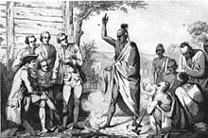
Suggested post-colonial theorists
Homi Bhabha
Edward Said
Gayatri Spivak
See this site for typical questions asked by post-colonial theorists:
https://owl.purdue.edu/owl/subject_specific_writing/writing_in_literature/literary_theory_and_schools_of_criticism/post_colonial_criticism.html

Slide 23
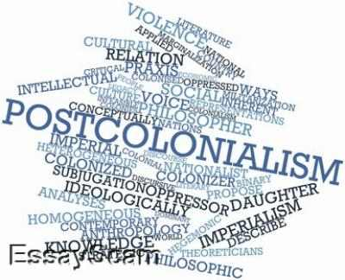
Postcolonial literary theory terms
other
hybridity
double consciousness
subaltern
hegemony
masks
alterity
essentialism
stereotype
aporia
orientalism
See http://www.eng.fju.edu.tw/Literary_Criticism/postcolonism/ for good summary of p/c theory.

Slide 24
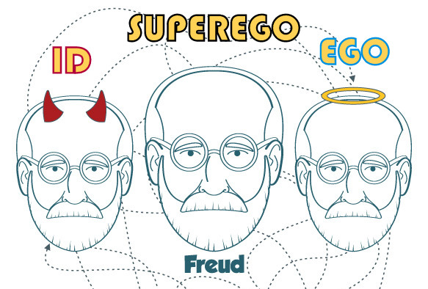
Psychoanalytical Theory
Main theorists:
Sigmund Freud
Carl Jung
Jacques Lacan
Slajov Zizek
Julia Kristeva
Luce Irigaray
Gilles Deleuze
Felix Guattari

Slide 25
What kinds of questions do psychoanalytical theorists ask?
How can characters’ behaviour, narrative events, and/or images be explained in terms of psychoanalytic concepts of any kind (for example: regression, crisis, dreams, projection, fear of or fascination with death, the abject (Kristeva), sexuality as a primary indicator of psychological identity or the operations of the ego-id-superego (Freud) and/or the symbolic-imaginary-the real(Lacan))?
How are Lacan’s law of the father and Freud’s superego translated into a character's own psychic economy and how do such prohibitions manifest themselves in the literary work?

Slide 26
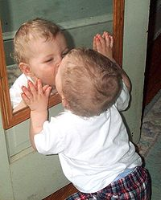
Psychoanalytic Theory
Terms
ego/id/superego
unconscious
the abject
displacement
condensation
oral/anal
the pleasure principle
libido
Oedipus complex
See Literary Theory Fact Sheet on NEST
Terms
subject/subjectivity
mirror stage
imaginary/symbolic/ real
the other
lack
phallus/phallic symbol
phallogocentric
regression

Slide 28
WHEN YOU APPLY LITERARY THEORY TO a Complex TEXT in AI3:
Choose a complex text (one only suggested)
Choose two theories or aspects of theories (These theories may be drawn from different theoretical approaches, or from the same theoretical approach. Choose at least one text-centred theoretical approach.)
Ask theory-specific questions (such as those on the Purdue University website or in Tyson)
Apply understanding of theory - use specific theorists names, ideas and associated terms.
Ask – What reading strategies did these theorists use? How did they use them?
Apply these particular reading strategies to your own complex text to answer the question you have posed.
Don’t forget to both analyse the text and evaluate literary theories. Do they clash or complement one another? Which application is more revealing?

