Slide 1
Approaches to Reading
Applied to “The Survivor” (Stimulus 1)

Slide 2
Re-read “Survivor”
In small groups, discuss your interpretation of the story. Refer to evidence in the story to support your reading.
Write your theme statements – aim for clarity and concision.
You might begin:
The main idea conveyed in this story is………..
OR you might opt for:
The (genre) (title) is about ………..and reveals that…………
Share your statement with the class.

Slide 3
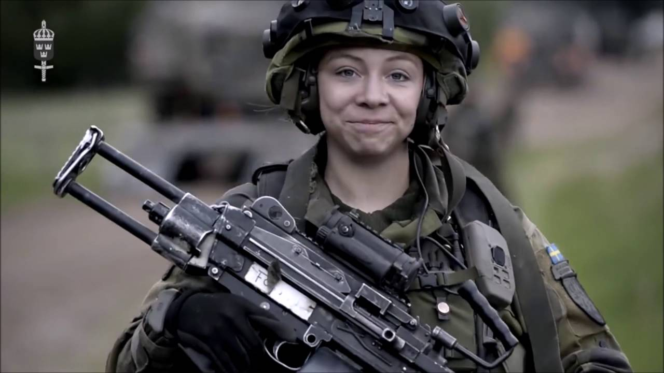
External Exam Requirements
“Theoretical underpinnings of their reading” - You will need to enter the exam room armed with knowledge and understanding of both text-centered and world-context centred theoretical approaches.
Memorize the lists provided in the QCAA document
Unit 4: Text-centred and world-context-centred strategies for short literary texts (and on the next slides)

Slide 4
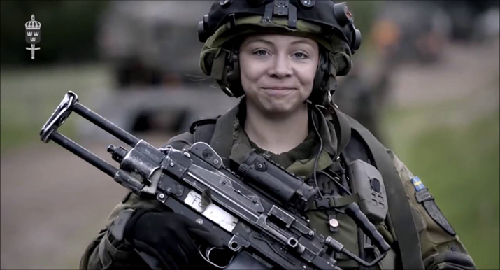
How Might You Prepare?
Memorize and have a thorough knowledge of these text-centred strategies:
Generic conventions, binary oppositions, methods of narration, symbols and metaphors, stylistic features and literary techniques (dialogue, imagery and figurative devices, characterisation, text structures, rhetorical devices)
VIP - Every one to construct notes on binary oppositions as these are applicable to all texts. Binary oppositions provide access to a text’s ideology. You should identify and analyse binary oppositions first after you have read the text. Identify the discourse related to each binary then unpack the ideology revealed through the binary. E.g. gender discourse wherein the emotional/rational binary privileges masculine rationality over female emotion. This might reveal harmful patriarchal ideology which underpins the text. There are, however, more subtle binaries which may nevertheless assist in constructing the invited meaning.

Slide 5
How Might You Prepare?
Memorize and have a thorough knowledge of the suggested world-context-centred approaches mentioned in the QCAA strategies document:
Some strategies that students could use to produce a world-context-centred reading include focusing on:
• representations — How does the text construct representations of people, groups, places or ideas?
• ideology — What cultural beliefs, values and attitudes that reinforce particular power structures in society underpin the text? How does the text challenge or reinforce dominant worldviews?
• cultural ideas — Consider how the text upholds or resists prevalent cultural ideas related to topics such as - race - gender - class - sexuality - age - the environment
QCAA Unit 4: Text-centred and world-context-centred strategies for short literary texts

Slide 6

How Might You Prepare?
You may also like to use specialist terms like myth and archetype.
Myth, together with binary oppositions, is a very powerful theoretical concept which can be used to reveal ideology in texts and thus to also uncover (gender/race/class/) bias.
Archetypes also tend to normalise shared understandings of characters; they can be unpacked to reveal underpinning ideologies in texts.
See separate list of handy terms.

Slide 7
Contemporary Binary Oppositions - questions
Are there key binary oppositions that underpin and structure the text?
Who or what is privileged and marginalised?
How do these binary oppositions underpin representations and ideologies reinforced in the text?
What discourses are operating in the world depicted in the text? What ideology underpins these discourses?
Is the reader positioned to reject the ideology prevalent in the fictional society depicted through the analysis of binary oppositions?
Does the text position you to reject the ideology of a central character or group? (This does not mean you are reading resistantly – the text is positioning you to adopt the invited reading by positioning you to disagree with the character’s ideology. E.g. as in “Survivor”)

Slide 8
Binary Oppositions
A binary opposition can be treated as a structuring principle that stabilises meaning in the text (Saussure), or as a false dichotomy whose instability undermines the unity of the text (Derrida)
QCAA
You need to focus on the significant binary oppositions in the text and ask which term in the binary is privileged. This may not be the term which the central character would privilege. E.g. A story depicts a violent first person narrator husband whose own values, attitudes and beliefs justify his use of violence. The text, however, positions you to accept a different, more caring and compassionate, set of values, attitudes and beliefs through, for instance, the representation of the husband’s actions and the reactions of the wife.

Slide 9
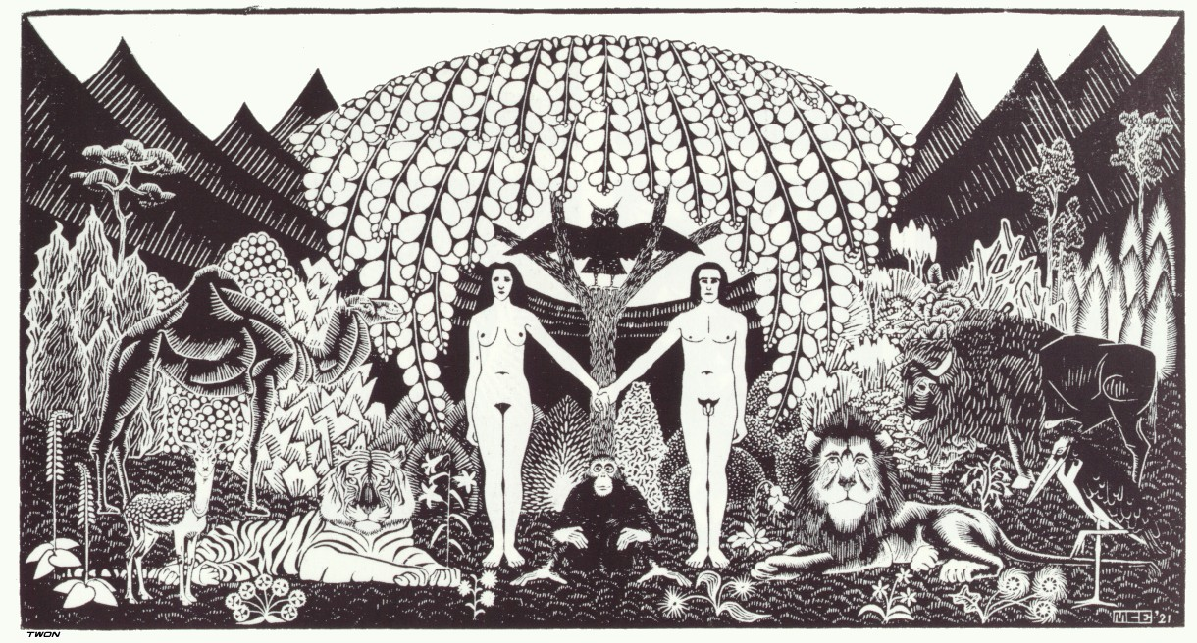
Binary Oppositions
Seeing the hierarchy of terms in a binary allows us to deconstruct the way in which one term in the pair has been privileged and the other suppressed - the way in which one of the pair is assumed objectively to be the norm while the other is assumed to be the exception.
man/woman
man/beast
heaven/earth
tame/wild
good/evil
light/dark
together/apart
clothed/naked
How many violent hierarchies are activated in this drawing?

Slide 10
Reread Stimulus 1: “The Survivor”
Pause: Analyse binary oppositions according to historical theory. What main binary oppositions are present? Underline words and phrases that alert you to the activation of binaries.
Invited meaning?
In an example of situational irony, a man named Junior has made a terrible lapse of judgement, for which the world has paid a high price, in saving a girl who grows up to be “history’s bloodiest villain”. He is caught in a conundrum – he must only observe and he must not change history but if he fails to save the girl, history will be changed.
This theme statement could be extended into a central idea which unifies the essay but this statement refers more to plot than to ideas.
How might the meaning be constructed with greater discernment?
Binary Opposition | Stable Meaning
nature/industry | These are just opposites…
man/woman | This is the natural way of things…
reason/emotion | These terms are different…

Slide 11
Reread Stimulus 1: “The Survivor”
Pause: Analyse binary oppositions according to contemporary theory. What main binary oppositions are present?
How do these binary oppositions underpin representations and ideologies reinforced in the text? What is your reading of the text?
Binary Opposition | Privileged Meaning
nature/industry | Nature holds the privileged position
past/present | The past seems more attuned to the natural world
human/machine | Humanity is privileged over the coldness of machinery
emotion/reason | Care for human beings is privileged

Slide 12
Reading “The Survivor”
The author constructs a dominant ideology in the context (a future society) by focusing on Junior’s thought processes which are underpinned by values, attitudes and beliefs. An analysis of binary oppositions positions the reader to question Junior’s ideology.
Binary Opposition | Privileged member | Ideology
Past/present | past | The past is a time more attuned to nature.
Reason/emotion Cruel/kind | emotion | Junior’s lack of empathy is to be deplored.
Nature/industrialization | nature | Man has been desensitized by his over-reliance on technology.
Theme statement: A central theme running through the short science fiction text, ‘Survivor’, is the dehumanising effects of technology.
This theme statement could be extended into a central idea which unifies the essay.

Slide 13
Reading “The Survivor”
An even more astute reading of “Survivor”: The author constructs a dominant ideology in the context (the future) by focusing on Junior’s thought process which is underpinned by values, attitudes and beliefs. The reader is positioned to question Junior’s ideology.
Theme statement: The main idea promoted in the narrative is that man has lost his capacity to care for other human beings in a society that prefers rational, scientific responses to emotional, caring human responses.
Another possible theme statement: (This one is more grounded in the text.)
The story emphasises how Junior and his reactions have been largely determined by the dominant ideologies of his own context, which favour instrumental knowledge and technological advancement over concern for human well-being. The fact that the Department of History has sent Junior back in time just to observe a child dying in a car accident, and so add to their own knowledge of what occurred in the past, reflects a privileging of the desire for knowledge over a desire to collect information in an ethical way.

Slide 14
Reading “The Survivor”
Other less significant binaries:
mind/body,
fast/slow,
clean/dirty,
quiet/noisy,
calm/anger
You need to be able to differentiate between significant binaries and less significant binaries. Ask: Which binaries are integral to your reading? Which pair of the binary is privileged? What does this tell me about possible the meaning/s of the story?

Slide 15
Reading “The Survivor” Resistantly
Pause: Now analyse the binary oppositions according to contemporary feminist theory. What ideology underpins these binaries?
Binary Opposition | Privileged member | Ideology
hero/villain | hero | The man is trying to behave heroically; the woman becomes a villain by virtue of her over-reliance on emotion (grief, guilt, fear)
man/woman | man | The man is the active protagonist of the story, the ‘girl’ the passive onlooker(in the past). The male is the agent of change.
reason/emotion | reason | The man applies reason/thought to the situation, following and breaking rules; the girl is unreasonably emotional and unhinged. The accident is the ‘seed of her madness’.
What resistant reading may be constructed? Write a new theme statement.
The woman is unfairly portrayed as an over-emotional girl and then ‘history’s bloodiest villain’. These negatively connotated representations activate and perpetuate the patriarchal myth of the deranged, irrational woman.

Slide 16
Choosing between readings
Which reading encompasses most evidence in the story? Which is best suited to allowing you to write a five-six paragraph essay?
Does this feminist reading allow you to draw on a wide range of evidence from the story?
Probably not e.g. How would you use the significant nature/technology related evidence or references to the future? Does a feminist reading draw in references to the dystopian science fiction genre? Does it allow you to refer to Junior’s hybrid cyborg body?
To read the story resistantly from a feminist point of view, you would need to discard most of the evidence.

Slide 17
Binary Opposition paragraph Cloze
The key binary opposition that ………..this text is between an ………. future time, and a ‘present’ that resembles our own time. The future is ………. as a highly industrialised and technologically advanced place, in ………. to the more naturalistic present. This ………. is shown in the first paragraph, in which Junior notices the air carried ‘humidity and the smell of organic matter’ so different ‘from the industrial atmosphere of his own time.’ Junior’s cyborg body, and the fact that he has travelled through a wormhole, further ………. this opposition. The ………… to the organisation that Junior works for, the Department of History, as well as Junior’s constant bringing to mind of protocols – a word that the typical reader associates with bureaucratic systems of authority – gives the ……….. that the future is one in which instrumental reason is highly valued, perhaps over ‘soft’ human emotions. Even Junior’s name is important in this respect: it is ………. and demeaning, and it reflects that those who have placed the ………… in his cyborg body and sent him into the past see him more as an object to be ………. and used than as a human being.
distinction underpins protagonist unspecified contrast reinforce reference impression infantilising manipulated represented
Construct your own binary opposition paragraph in relation to past/future, nature/technology and reason/emotion drawing on your own evidence from the text.

Slide 18
Binary Opposition paragraph Cloze
The binary oppositions nature/technology, past/future and emotion/reason point to the ………. position ………. in “Survivor” which ………. that futuristic technology has impacted on man’s humanity. Early in the story, the ………. that the fleeting sensory beauty of nature is preferable to technology and machinery is ………. through significant comparisons. Junior senses that “the air carried….the smell of earth after rainfall – so different from the industrial atmosphere of his own time.” These words do not occur by chance; there is a deliberate ………. on the nature/industry ………. which demonstrates that the past is preferable to the future. This impression is ………. as the narrating persona reveals the rules, in the form of protocols, which ………. future ideology. “You are only here to observe” and “Do not change the past” are quite chilling given that Junior has come to observe a traumatic and deadly car accident. His human emotions are suppressed in his decision to save the girl from the car wreck, dooming a small child to certain death. When “ a male infant screamed in terror” Junior was merely “fascinated” which is hardly a compassionate, humane response. These binaries assist in the ……… of meaning: futuristic man has lost hos ability to empathize; reason has trumped emotion.
ideological construction constructed idea privileged emphasis strengthened underpin suggests dualism

Slide 19
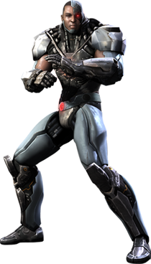
Re-read survivor
Ask:
What issues and concepts are explored? List them.
What idea is being conveyed through the exploration of these concepts and issues? Write a theme statement.
Underline evidence in “The Survivor” which supports your reading.

Slide 20
Reading Survivor
Ask:
What concepts or issues are explored? E.g. the future, technology, the nature of humanity, bureaucracy, rules and protocols, hybridity, nature, gender relations
What idea is being conveyed through the exploration of these concepts and issues? E.g. Because of an imbalance between nature and technology, humans have been hybridized into less compassionate human beings who are conditioned to follow rules rather than to empathize with their fellow man.

Slide 21
Reading the Survivor
What is the specific genre?
Dystopian science fiction – use of scientific terms – ‘cyborg’, ‘wormhole’, new term – ‘event horizon’, references to a fictional future, references to tyrant
Purpose?
to entertain, to provoke thought
Structure? conventional narrative structure with orientation, complication, rising action, climax and resolution. Past/present dichotomy.
Ask: What kind of conflict? What does the protagonist learn? How do they change? How is the conflict resolved? All of these will contribute to your construction of meaning.
Kinds of conflict?
internal – Junior’s decision making process
interpersonal – between Junior and the girl
external – between man and nature ie the exploding car
Junior changes a little as he acts rather than observes in clear contravention of the relevant protocol. His action results in the death of a small child. He seems unmoved by this death, merely assessing his options and breaking one protocol “to follow another”.
The reader is positioned to view Junior as lacking in humanity. He is symbolic of the uncompassionate, scientific values, attitudes and beliefs of the future society.
The author seems to be critiquing this bleak dystopian future where technology trumps nature and the history department exists only to maintain rigid protocols.
Something to think about - significance of names?
‘girl’ is not given a name, ‘girl’ activates a myth – young/silly/emotional
‘Junior’ is privileged white male American name
‘male infant’ – emphasis on male, not named

Slide 22
Reading the Survivor
Narration? — How is the text narrated in order to position the audience? Consider how point of view (e.g. first person vs. third person), focalisation and voice position the reader in relation to perspectives, ideas and reliability of the characters or narrator in the text.
How is the story narrated? How does this method of narration position the reader to view Junior’s character and his ideology? Which quotes most alienate us from Junior’s perspective?
Third person narration focalizing on the male character…..Junior’s account of traumatic events resulting in the death of an infant positions the reader to be repulsed by the thought process of the narrator rather than to sympathize with him. In rejecting Junior’s world view, we accept the meaning constructed in the text – the technological society of the future has succeeded in dehumanizing Junior, who symbolizes future man.
Evidence. E.g. “….a male infant screamed in terror. Fascinated, Junior approached the sedan” and “Assessing his options…” “Don’t change the past, he reminded himself.”
He is cold, dispassionate as he makes life and death decisions.

Slide 23
Reading the Survivor
Symbols and metaphors — What are some key symbols and/or metaphors that significantly contribute to meaning in the text? Underline them. Consider symbols and metaphors that are repeated and/or developed in a text to shape representations and ideas in the text.
e.g. Junior and his cyborg shell symbolise future society and it’s dehumanizing ideology
“flame - haired sister” – colour used to symbolize temperament?
“the seed of the girl’s madness” – metaphor comparing state of mind to a seed.
“anger poisoned her voice”
It is worth noting that the writing is characterised by a lack of symbol, metaphor and other figurative devices. It is written dispassionately, in an unemotional, rational, and impartial manner. This is worth noting given that the narrative is focalised on a machine-like man who lacks empathy and warmth.

Slide 24
Reading The Survivor
Stylistic features and literary techniques — How are stylistic features and literary techniques used to shape meaning? What comments could you make about how the author has used:
Dialogue – sparsely used but very dramatic
imagery and figurative devices – used to develop representations of setting and character; only comment on those that support the development of your central idea
characterization – how are characters described? What are their dominant personality traits? Draw a mind map of adjectives which describe Junior’s character traits. Why do you think he is as he is?
text structures e.g. the shock of the climactic death of an innocent child, the surprise in the last sentence
rhetorical devices e.g. the repetition of ‘don’t change the past’ and the hyperbole in “escape the coming inferno”
Remember to provide evidence in the form of quotes, refer in detail to the text to support your ideas. Ensure analysis contributes to the development of your central idea.

Slide 25
Reading the Survivor using Myth and semiotics. What are the (shared) connotations of significant signs?
Semiotics – the name/sign ‘Junior’ connotes American culture so we assume this is a futuristic representation of American society. ‘Junior’ Also connotes male privilege and/or the infantilization of the character.
‘cyborg body’ –connotes masculinity
‘lone survivor’ –connotes a tragic event
Semiotics/Myth activated in “The Survivor” –
‘male infant…curly black hair’,
‘villain’,
‘emotional, vengeful woman’,
‘calm, rational man’,
‘the idealized past’
Underpinned by naturalised ideology….just the way things are….goes without saying…..myth accepted unquestionably in a culture.
It would be beneficial to identify the activation of myth in a text, especially myth which normalises (unjust) ideology. You may not need to use the word ‘semiotics’ but do discuss the connotations of words.

Slide 26
Reading the Survivor
W-C-C Approaches
World-context-centred strategies
Some strategies that students could use to produce a world-context-centred reading include focusing on:
• representations — How does the text construct representations of people, groups, places or ideas?
• ideology — What cultural beliefs, values and attitudes that reinforce particular power structures in society underpin the text? How does the text challenge or reinforce dominant worldviews?
• cultural ideas — Consider how the text upholds or resists prevalent cultural ideas related to topics such as - race
- gender
- class
- sexuality
- age
the environment.
From QCAA reading strategies document

Slide 27
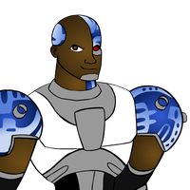
Reading The Survivor – W-C-C Approaches
Representations — How does the text construct representations of people, groups, places or ideas?
People: Junior lacks any emotional response when witnessing the distress of the trapped children.
Places: The future is represented as a highly industrialised and technologically advanced place, in contrast to the more naturalistic present.
Ideas: We are positioned to shun Junior’s inhumane ideology and, by extension, the ideology of future humans. It is implied that futuristic practices involving time travel and transplanting human consciousness into cyborg bodies, causes individuals to lose aspects of their humanity.
You obviously need to provide evidence from the text to support your assertions.

Slide 28
Reading The Survivor – W-C-C Approaches
Ideology — What cultural beliefs, values and attitudes that reinforce particular power structures in society underpin the text? How does the text challenge or reinforce dominant worldviews?
The dominant worldview: The reference to the organisation that Junior works for, the Department of History, as well as Junior’s constant bringing to mind of protocols – a word that the typical reader associates with bureaucratic systems of authority – gives the impression that the future is one in which instrumental reason is highly valued, perhaps over ‘soft’ human emotions.
Challenge to worldview: The story implies that ideology’s hold on Junior is not complete. Junior’s actions in disobeying one protocol to fulfil another can be read as a type of critique of the ideology of his cultural context. He does, however, quite coldly preside over the death of a child in order to obey ‘protocols’ ,so he is far from being a rebel.

Slide 29
Reading the survivor: w-c-c approaches
Race does not seem relevant except that Junior is half cyborg….
Gender – the representation of the girl activates/upholds the myth of the emotional, irrational woman. This biased representation may be challenged by feminist literary critics.
Class does not seem relevant unless you refer to the ruler and the ruled in the future of the story – the girl holds the power in a class hierarchy.
The myth of innocent childhood is activated.
The dominance of nature over industry in the past is romanticized as being preferable to the world in the future.
Cultural ideas — Consider how the text upholds or resists prevalent cultural ideas related to topics such as
race
gender
class
sexuality
age
the environment.

Slide 30
A peek at deconstructive strategies
Contradictions: ‘His flame-haired sister, also restrained by a seatbelt, offered a calmer demeanour.’ ….’She screamed’.. ‘Her initial smile at her rescuer became a scream..’ ‘Disbelief and anger poisoned her voice.’ The girl seems quite unstable.
Aporia/gap Why is Junior sent to the past, as an historian, if the risks are so great and the protocols contradictory? Why is History, a social science, so elevated in the future if is a despot?
Silence: Only male perspective offered; woman silenced except for (understandable) emotional outbursts.
Violent hierarchies (Derrida) male/female, hero/villain, rational/emotional

Slide 31
A Peek at Feminist Perspectives
Although ‘the girl’ later becomes a despotic ruler, and thus empowered, the use of language in the story is underpinned by patriarchal values. French feminists may view the writing itself is phallocentric, or male-oriented, as a calm and logical male perspective is adopted, as in Junior calmly adjusting to his surroundings and “assessing his options”. It is also the male who acts and the female who reacts in “The Survivor”.
This is complemented by the activation of the harmful myth of the irrational and unhinged woman in “The Survivor”. This points to the angel/madwoman archetypes so prevalent in canonical literature and to the way these stereotypes have been internalized and perpetuated in Western culture. They posit that there are three trajectories for women in literature: marriage, death/suicide, and madness. They also critique the angel/madwoman binary. For example the angel is selfless and compliant while the madwoman/’girl’ of the story ‘refuses to stay in her place’, acting autonomously, to the detriment of society.

Slide 32
A Peek at A Psychoanalytical perspective
The representation of the ‘girl’ is a prime example of Freud’s tripartite psyche concept which is comprised of the id, the ego and the superego. The id is our reserve of animal instincts which seeks to gratify prohibited desires; the superego is our social programming, a mechanism for telling us what we should and what we should not do; the ego mediates between the id and the superego, channeling the desires of the id into socially acceptable behaviour. Freud postulates that these are constantly at war with one another. This tension is evident in the girl as initially, in the past, her superego urges her to seek help for her brother but “the seed of the girl’s madness” is already evident. After her brother’s death, in the future, she swings violently into id mode, satiating her desire for power and revenge.

Slide 33
A Peek at the Feminist Psychoanalytical perspective
The ‘girl’ in “The Survivor” is in a state of transformation at the end of the story, moving from being a loving sister to a vengeful bloody “villain”. Julia Kristeva’s concept ‘the abject’ refers to a place where meaning collapses as ‘the abject’ threatens life and can take the form of, for example, death, murder and decay. When we are propelled into the world of the abject, our imaginary borders disintegrate and the abject becomes a tangible threat because our identity system and conception of order has been disrupted. The horrific and explosive death of her young and innocent brother propels ‘the girl’ into a different mindset, setting her on a course to villainy.
If you want to bring in poststructuralist readings, ensure that your poststructuralist insight contributes to/relates to your thesis statement.

Slide 34
Poststructuralist Readings
It may not be necessary to apply poststructuralist theories explicitly, as you will see from the QCAA model response.
If you do apply one of these approaches, you need to be able to fit the reading into your overall central idea.

Slide 35
Points to remember
Memorize the lists of strategies provided by QCAA in Unit 4: Text-centred and world-context-centred strategies for short literary texts
In the exam, you could use a reciprocal teaching strategy (predict from title, circle unfamiliar vocabulary, note unanswered questions, summarize content in one sentence) to begin to access meaning.
Write down a ‘gut feeling’ about meaning. Refine your initial reading by:
Ask: What issues and concepts are explored? What ideas are conveyed about these issues and concepts?
Look for binary oppositions first when reading, as these will help you construct meaning.
Consider how the method of narration positions the reader.
Other pointers to meaning are the way in which conflict is resolved and what characters learn/how they change. (narrative structure)
The representations of people, places and things will also position you in certain ways. This is also a good key to meaning.
How do symbol, metaphor, stylistic features and literary techniques position you/construct meaning.

Slide 36
Your Essay
Begin your essay with a central idea/thesis statement which you develop throughout the essay.
Apply t-c strategies to construct meaning, providing plenty of evidence from your close reading of the text. E.g. method of narration, symbols and metaphors, stylistic features and literary techniques. Ensure topic sentences link back to your central idea.
Apply w-c-c strategies by identifying ideologies (values, attitudes and beliefs) within the discourses of the narrative (of characters) then identify the ideologies underpinning the text. i.e. the values and attitudes of characters will probably differ from those underpinning the text. E.g. Junior’s values are not those supported by a close reading of the text.

Slide 37
Your Essay
Note: These two approaches to reading (t-c and w-c-c) do not need to be applied in separate paragraphs of your essay.
For instance, you will need to mention the ideology (w-c-c) underpinning the binaries (t-c) in the same paragraph.
You may analyse the way characters, places and ideas are represented (w-c-c) in conjunction with the analysis of symbol, metaphor, stylistic features and literary techniques (t-c).
DO NOT MENTION THE WORDS TEXT-CENTRED OR WORLD-CONTEXT-CENTRED in your essay!

Slide 38
Introduction
Establish central idea
Inverted pyramid structure here, beginning with a broad ‘thematic’ interpretation and progressing towards a more specific interpretation. Identify genre and conventions of genre.
Body Paragraphs
Topic sentence identifies an aspect of the text, and the specific theoretical lens through which it will be explained. Choose those strategies that are appropriate to the text and to supporting your central idea.
Binary oppositions
Narrative voice and focalisation
Symbol and metaphor
Stylistic features and literary techniques - dialogue, imagery and figurative devices, characterisation, text structures, rhetorical devices.
Representations – how does the text construct representations of characters of people, groups, places and ideas
Ideology - What cultural beliefs, values and attitudes that reinforce particular power structures in society underpin the text? How does the text challenge or reinforce dominant worldviews?
Cultural ideas – consider how the text upholds of resists prevalent cultural ideas related to race, gender, class, age, sexuality, the environment
Conclusion should conclude with a clincher, referring back not only to the overall interpretation from the introduction, but to elements of the close reading.
Each paragraph’s theoretical focus should link back to the overall interpretation.
You are allowed to read the text resistantly but you must ensure you have sufficient evidence from the text to support your reading.

Slide 39
Points to remember
Mention the terms ‘binary oppositions’, representation, positioning and ideology at least once.
Write 5-6 paragraphs including introduction and conclusion.
The last paragraph of the body could be devoted to w-c-c reading (but that doesn’t mean it won’t be touched upon elsewhere in your essay).
You need to write 800-1000 words in the exam (but not in the skeleton essay!).
Peruse the skeleton essay template.

Slide 40
Writing a Skeleton Essay
Use the skeleton essay template provided to handwrite a skeleton essay.
Construct or revise your own opening paragraph to an analytical essay on “Survivor”. (10 minutes)
2. Peer appraisal of paragraphs. (See next slide for criteria) (10 minutes)
3. Email revised paragraph to me.
4. Complete the skeleton essay under ‘test’ conditions. (You may refer to the ppt presentation on “Survivor” for ideas.) (1 hour)
Topic sentence: title, genre, universal theme statement
Expand/explain: content/concepts/precis of plot/conventions of genre (1-2 sentences)
Reiterate theme statement adding references to text

Slide 41
Peer Appraisal of Opening paragraph
Is there a clearly stated universal theme statement or central idea?
Has the title and genre been mentioned?
Has a relevant precis of content/plot been included?
Has the theme statement been reiterated with greater specificity? i.e. References to the text.
Is expression concise and precise?
Is there unnecessary repetition?
Are sentence structures grammatically correct? Spelling?
Work on one person’s paragraph at a time i.e. five minutes on each

Slide 42
“Survivor” - Binaries Paragraph
In pairs, place the topic sentences in order of merit by placing the numbers in the ‘correct’ order.
How do we evaluate what makes an effective topic sentence?
Compile a list.
1 | Binary oppositions are an important theoretical tool used to unpack the ideology of a text.
2 | An analysis of the ‘violent hierarchies’ in “Survivor” makes resistant reading and multiple meanings possible as the girl now appears to be the victim rather than the victor.
3 | The binary oppositions within the text allow the reader to understand more thoroughly the ideologies that underpin the values and attitudes within the text .
4 | The key binary opposition that underpins this text is between an unspecified future time, and a ‘present’ that resembles our own time.
5 | The binary oppositions nature/technology, past/future and emotion/reason point to the ideological position constructed in “Survivor” which suggests that futuristic technology has impacted on man’s ability to empathize with his fellow man.

Slide 43
“Survivor” – Binary Oppositions
How might you support this (QCAA model) topic sentence? What evidence from the text could you use?
TS: The key binary opposition that underpins this text is between an unspecified future time, and a ‘present’ that resembles our own time.
Expand: The future is represented as a highly industrialised and technologically advanced place, in contrast to the more naturalistic present.
Evidence: This distinction is shown in the first paragraph, in which Junior notices the air carried ‘humidity and the smell of organic matter’ so different ‘from the industrial atmosphere of his own time.’ Junior’s cyborg body, and the fact that he has travelled through a wormhole, further reinforce this opposition. The reference to the organisation that Junior works for, the Department of History, as well as Junior’s constant bringing to mind of protocols – a word that the typical reader associates with bureaucratic systems of authority – gives the impression that the future is one in which instrumental reason is highly valued, perhaps over ‘soft’ human emotions.
Conclude/Link: Even Junior’s name is important in this respect: it is infantilising and demeaning, and it reflects that those who have placed the protagonist in his cyborg body and sent him into the past see him more as an object to be manipulated and used than as a human being.

Slide 44
“Survivor” – Binary Oppositions
Write or revise your own paragraph (topic sentence, expand/explain, evidence/analysis, conclude/link.) (10 minutes)
E.g.
TS: The binary oppositions nature/technology, past/future and emotion/reason point to the ideological position constructed in “Survivor” which suggests that futuristic technology has impacted on man’s humanity.
Expand/Explain: Early in the story, the idea that the fleeting sensory beauty of nature is preferable to technology and machinery is privileged through significant comparisons.
Evidence/analysis: Junior senses that “the air carried….the smell of earth after rainfall – so different from the industrial atmosphere of his own time.” These words do not occur by chance; there is a deliberate emphasis on the nature/industry dualism which demonstrates that the past is preferable to the future. This impression is strengthened as the narrating persona reveals the rules, in the form of protocols, which underpin future ideology. “You are only here to observe” and “Do not change the past” are quite chilling given that Junior has come to observe a traumatic and deadly car accident. His human emotions are suppressed in his decision to save the girl from the car wreck, dooming a small child to certain death. When “ a male infant screamed in terror” Junior was merely “fascinated” which is hardly a compassionate, humane response.
Conclude/link: These binaries assist in the construction of meaning: an over-reliance on technology has robbed future man of his ability to empathize with his fellow man; reason has trumped emotion.

Slide 45
“Survivor” - Narration
Unscramble this paragraph by placing the numbers in correct order:
1 | The cold and understated style of narration used to describe the plight of the two children who are trapped likewise shows that Junior lacks any emotional response when witnessing the distress of the trapped children:
2 | “The police report indicated a single survivor, the girl sitting behind the driver. Her younger brother was supposed to have died. Walking around the car so he could see through the windows, Junior saw the boy, with his curly black hair, struggling against the child restraint. His side of the car was closest to the ground”.
3 | The distinction between the two times is most emphasised when it comes to describing Junior’s reactions to the car accident that he encounters in the story.
4 | This narrative technique has allowed the author to emphasise the lack of humanity and compassion in Junior’s response to the children who are trapped in the car.
5 | Even though the story is written using third-person, non-diegetic narrator, the narration is focalised through Junior’s perspective.
6 | After he hears a girl’s voice and the male infant screaming, Junior’s reaction is described as being ‘fascinated’ rather than horrified or upset.

Slide 46
“Survivor”
Read the English & Literature Extension marking guide and response
Sample external assessment 2020
Pay particular attention to EAMGs

