Slide 1
Preparing for External Assessment
Errors to Avoid
Reading of Text
Gradual Release of Responsibility: I do, we do, you do

Slide 2

Errors to Avoid in EA
Do not refer to the words text-centred or world-context centred anywhere in the essay!
Why do you think this is?
No need to explain these terms
Not in model responses
Not used in previous research task (AI3)
Just don’t do it!

Slide 3
Errors to Avoid
Do not list reading strategies anywhere in the essay
Why do you think this is?
The focus should be on introducing and developing ideas, not on the reading strategies.
“A close reading should be structured around a thesis that presents an interpretation of the selected text.”
“This thesis should be supported by arguments and evidence in the form of analysis of particular textual features of a literary text and how these position the reader.” QCAA
I.e. The essay focuses on ideas. Reading strategies, or the ways of analyzing particular textual features, are a means of unpacking/supporting the ideas.

Slide 4

Refocus on essay structure
You response should:
- demonstrate logical and discriminating development of a complex and valid central idea in response to the stimulus
- provide purposeful and discriminating sequencing of relevant ideas around a central argument that introduces, develops and draws astute and valid conclusions on the interpretation of the stimulus
QCAA Criterion 2

Slide 5
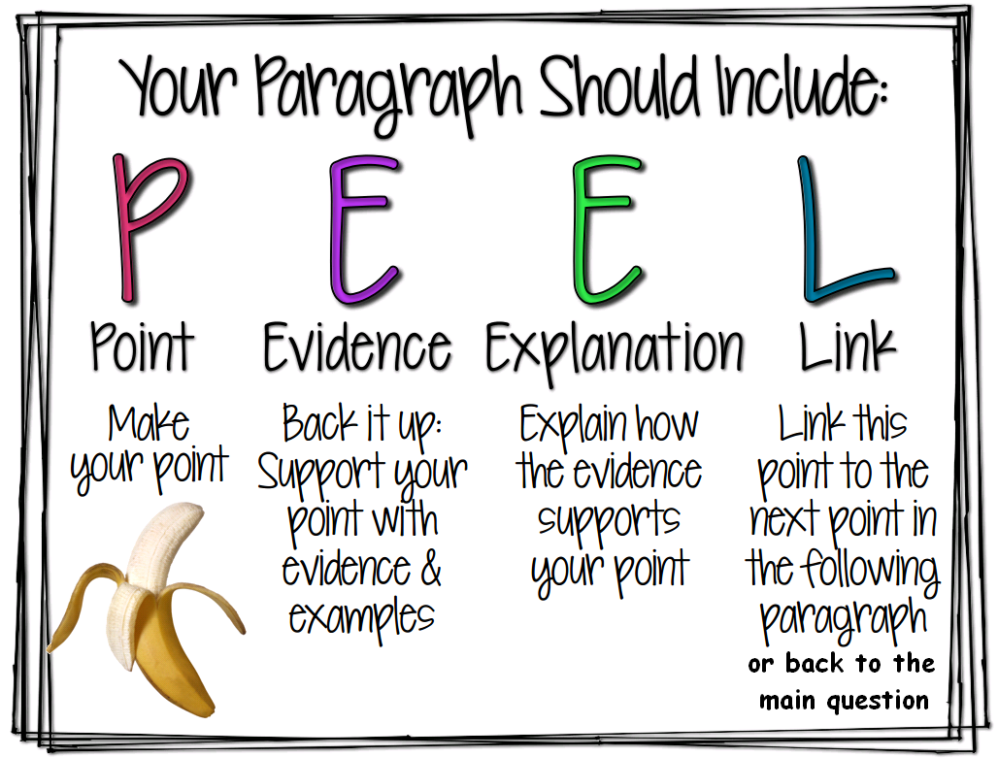
Paragraph structure
You could add ‘A’ for analysis. This is when you identify text structures (e.g. narrative structures) and language features (e.g. symbolism, narration, imagery etc.) then comment on the meaning (in relation to theme/s) and effect (positioning of reader) of each.
The thesis should be supported by arguments and evidence in the form of analysis of particular textual features of a literary text and how these position the reader. QCAA

Slide 6
Refocus on essay structure
Carefully construct introductory and concluding paragraphs
Systematically build each PEEAL paragraph. (point, expand/explain, evidence/analysis, conclude/link)
Systematic planning will aid essay structure – know what you are going to write before you write it.
Each topic sentences must refer to one of the ideas in your introduction.
Topic sentences should also mention a key reading strategy. E.g. binaries, narration, symbol, representation, ideology, cultural ideas
Include evidence from the text, in the form of quotes, in the middle of each body paragraph.

Slide 7
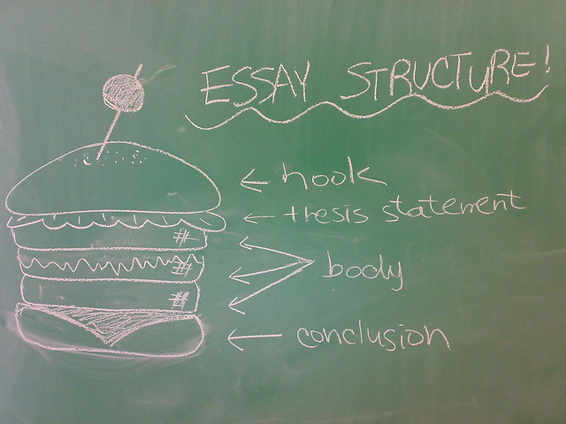
Refocus on essay structure
Signal your intention in introduction – say what your going to say: thesis statement, supporting ideas
Say it in body – topic sentences tease out ideas one by one
Say it again in conclusion

Slide 8

Pause to re-read “The Butterfly”

Slide 9
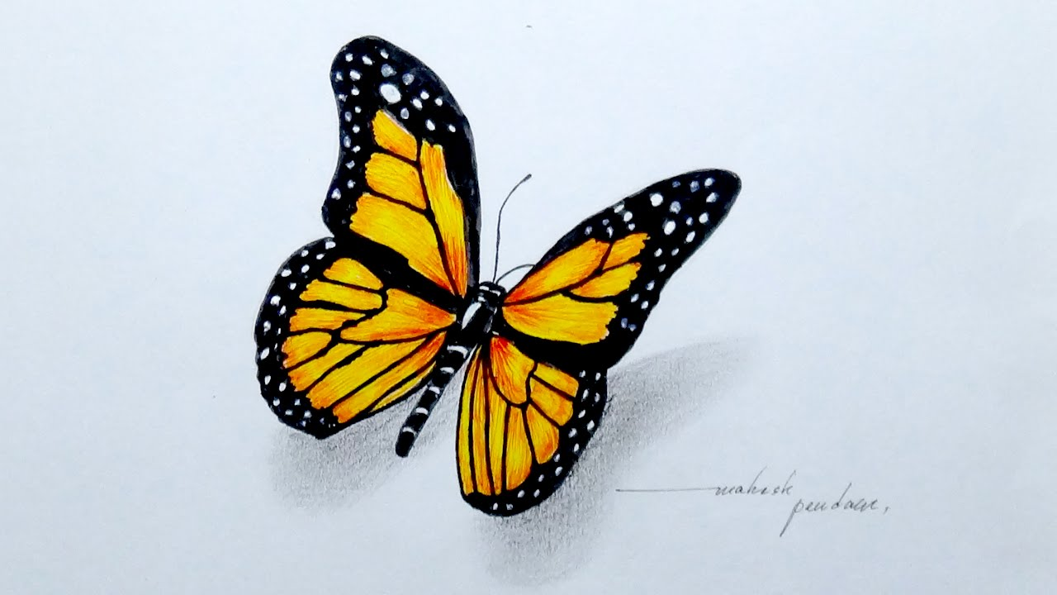
Planning: Think Aloud (I do)
“The Butterfly”
Annotate the story and/or take notes as you listen.
1. Consider the title:
Make predictions from title
Possible meaning of title? (mini brainstorm)
Could the title be symbolic?
Are the words of the title mentioned in the text? (ask after reading text)
How does the title enhance the meaning of the text? (ask after reading text)
Tip – it is clever to refer to meaning of title in conclusion
2. Read the text (first reading) in order to begin to form ideas about genre, characters, groups, places, concepts and ideas.
What is the specific genre? How do you know?
Who or what am I positioned to sympathize with/admire?
What concepts are explored?
What idea/s am I being positioned to accept/reject?
What is a BIG idea, a universal idea?
What are some supporting ideas?

Slide 10
Planning: Think Aloud
“The Butterfly”
3. Read the text again, annotating as you read. E.g.
G = genre features and conventions
BO = binary oppositions (ideology)
N = narration and focalization (positioning)
S and M = symbol and metaphor
SF = Stylistic features and literary techniques
D = dialogue
I = imagery
C = characterization (representation)
T = text structures (relate to genre)
R = rhetorical devices (e.g. hyperbole, repetition, alliteration, irony)
This annotation will allow you to quickly see the evidence for the strategies you wish to apply in your body paragraphs.

Slide 11
Planning: Think Aloud
“The Butterfly”
4. Consider the concepts explored again:
Which are most significant?
What are some synonyms for these concepts?
5. What ideas are you being positioned to accept?
These ideas will inform the topic sentences of body paragraphs.
Please refresh knowledge of ideologies!
Look for a BIG, universal idea and 1-3 supporting ideas. E.g. “The Butterfly” Humanism is a preferable ideology to materialism, individual happiness is more important that money, human beings deserve to be self-determining when choosing a spouse, parents should allow their adult children to make their own important life decisions, women deserve to be independent of male domination, patriarchal ideology is unjust, unjust ideologies may be challenged and even changed over time.

Slide 12
Planning: Think Aloud
“The Butterfly”
Synonyms for abstract nouns:
Free will: self-determination, autonomy, independence, emancipation, self-reliance
Submission: oppression, obedience, conformity
Power: patriarchy, domination, tyranny, authority, command, maltreat
“The Butterfly”, promotes the idea that extreme and controlling patriarchal ideology is unacceptable and likely to be challenged by young women just emerging into adulthood.”
Explain genre and content of text in middle of introduction.
“The text suggests that freewill and self-determination are preferable to submission to the unreasonable expectations of a tyrannical parent and that humanism is a preferable ideology to materialism.”
These opening paragraph ideas inform topic sentences in the body of your essay.

Slide 13
Planning Think Aloud
“The Butterfly”
How will I plan my essay structure?
I need four body paragraphs.
Para 1:
Idea - unequal and adversarial child/parent relationship, tyrannical parent
T-C strategy – binary oppositions
W-C-C strategy – ideology (humanism/libertarianism/freewill v materialism)
Para 2:
Idea –importance of free will and self-determination
T-C strategy – symbolism, imagery, characterization of daughter
W-C-C strategy - representation
Para 3:
Idea – positioned to view domineering father unfavorably
T-C strategy – narration, focalisation, characterization of father, dialogue
W-C-C strategy – representation

Slide 14
Planning Think Aloud
“The Butterfly”
Para 4:
Idea: patriarchal ideology is unacceptable
T-C strategy: ideology, cultural ideas, irony
Conclusion:
Back to big ideas/sum up e.g.
Patriarchal ideology will be challenged; values, attitudes and beliefs change over time
Feminist ideology – self-determination, equality, mutualism.
Humanism vs materialism

Slide 15
Positioning of reader is a key consideration
The thesis should be supported by arguments and evidence in the form of analysis of particular textual features of a literary text and how these position the reader. QCAA
Note the verbs used in the QCAA strategies document:
genre: conform or challenge conventions of the genre;
binaries: underpin, privileged, marginalized, stabilize, undermine (privilege certain ideology which can be challenged);
narration: position audience;
symbols and metaphors: significantly contribute to meaning;
stylistic features and literary techniques: shape meaning.
Try to use these verbs in your analyses.

Slide 16
Other possible interpretive ideas
Compare and contrast the representations and ideologies (values, attitudes and beliefs) of Edward and Mr. Burberry
and
Edward and Mr. Bancroft
Similarities between Mr. Burberry and Mr. Bancroft
More emphasis of coldness/objectivity of science and warmth of art
Explore the archetypal nature of character representations e.g. unyielding, dominating father; accepted suitor; spurned suitor; girl and/or rebellious child
Explain how narrative structure (orientation, complication, rising action, climax, resolution OR equilibrium, disequilibrium, equilibrium) shapes meaning, especially the twist at the end.
More emphasis on feminism

Slide 17
Read the model essay on “The Butterfly”
Place a back slash after every sentence as you silently read the essay.
Each student to read one paragraph aloud (take turns). Other students take turns to evaluate the paragraph, one at a time, using the Say Something strategy. Work through the PEEL structure of the paragraph, sentence by sentence, in your verbal responses to these questions:
What has been done? E.g. what is in the topic sentence?
Why has this been done? E.g. why is the topic sentence worded/structured in this way? How does it relate to the theme statements and supporting ideas in the introduction?
How well has this been done? How could it be improved?

Slide 18
Spider and Fly (We do)
Consider the title before reading text: (Use circular questioning technique)
Make predictions from title
Possible meaning of title? (mini brainstorm)
Could the title be symbolic?
Are the words of the title mentioned in the text? (ask after reading text)
How does the title enhance the meaning of the text? (ask after reading text)

Slide 19
Spider and Fly (We do)
Read the text (first reading) in order to begin to form ideas about genre, characters, groups, places, concepts and ideas.
What is the specific genre? How do you know?
Who or what am I positioned to sympathize with/admire?
What concepts are explored? E.g. poverty, capitalism, ambition, urbanization, social justice
What idea/s am I being positioned to accept/reject?
What is a BIG idea, a universal idea?
What are some supporting ideas?

Slide 20
Spider and Fly (We do)
Read the text again, annotating as you read. E.g.
G = genre features and conventions
BO = binary oppositions (ideology) e.g. wealth/poverty, hunter/prey
N = narration and focalization (positioning)
S and M = symbol and metaphor
SF = Stylistic features and literary techniques

Slide 21
Spider and Fly (We do)
D = dialogue - none
I = imagery
C = characterization (representation) – no name, everyman
T = text structures (relate to genre) – framed narrative
R = rhetorical devices (e.g. hyperbole, repetition, alliteration, irony)
This annotation will allow you to quickly see the evidence for the strategies you wish to apply.

Slide 22

Spider and Fly
Synonyms for abstract nouns in theme statement and supporting ideas statements?
Consider the concepts explored again:
Which are most significant?
What are some synonyms for these concepts
What ideas are you being positioned to accept?
These ideas will inform the topic sentences of
body paragraphs.

Slide 23
Spider and Fly (We do)
Look for a BIG, universal idea and 1-3 supporting ideas.
These ideas will inform the topic sentences of body paragraphs.
Ideas: e.g. life can be cruel
Relevant ideology: e.g. humanism, capitalism

Slide 24

Spider and Fly (We do)
Essay Relay
Jointly compose your draft introduction:
Big idea/title/genre
Synopsis/genre conventions
Supporting ideas
3 minutes to plan, 5 minutes to write, 2 minutes to edit.

Slide 25
Introduction leg of relay
Theme statement/main interpretation including text title and genre
Expand on theme statement
Provide relevant synopsis
Comment on genre features by using relevant words in synopsis e.g. climax, resolution
Introduce 2-3 supporting ideas.

Slide 26
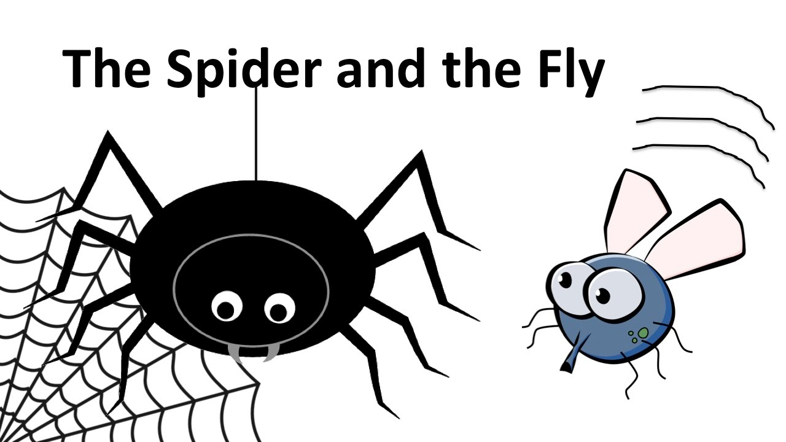
Spider and Fly Essay Structure
Five paragraph essay structure
Intro: thesis statement/main interpretation, genre, relevant synopsis, 2-3 supporting ideas,
Four PEEaL paragraphs
Conclusion – reiterate thesis statement, end with a bang

Slide 27
The Spider and the Fly
Write the body of the essay in teams using a Relay Writing strategy: 3 minutes to plan, 5 minutes to write, 2 minutes to edit per paragraph
Teams of 2-3
Share each paragraph at conclusion of each leg of the relay. Extra points for inclusion of suggested words:
Words you should use: representation, position/ing, ideology, relevant cultural ideas e.g. class, values, attitudes and beliefs, binary opposition, symbolism, archetypal, allegory, class, imagery, focalization, genre
Use the scaffold that was emailed to you as a guide.

Slide 28
Para 1: Binaries
Topic sentence: choose idea from introduction to pop in this sentence; you could also identify 1-2 binaries.
Expand on the idea in the topic sentence, further explain the idea.
Provide evidence in the form of well-chosen, well-integrated short quotes.
Analyse meaning and effect of language features and evaluate positioning of reader.
Conclude by reiterating idea in topic sentence and then subtly link to next paragraph.

Slide 29
Para 2: Narration and Representation
Topic sentence: choose idea from introduction to pop in this sentence; identify narrative perspective* and focalisation*. Comment on how these position the reader.
Expand on the idea in the topic sentence, further explain the idea.
Provide evidence to support the idea in the form of well-chosen, well-integrated short quotes.
Analyse meaning and effect of language features, further evaluate positioning of reader.
Conclude by reiterating idea in topic sentence and then subtly link to next paragraph.

Slide 30
Para 3: Symbol and Metaphor
Topic sentence: choose idea from introduction to pop in this sentence; identify the symbol/s and link it to the idea you are focusing on.
Expand on the idea in the topic sentence, further explain the idea. Link to ideology, if possible.
Provide evidence to support the idea in the form of well-chosen, well-integrated short quotes.
Analyse meaning and effect of language features, especially symbolism, further evaluate positioning of reader.
Conclude by reiterating idea in topic sentence and then subtly link to next paragraph.

Slide 31
Para 4: Ideology
Topic sentence: choose idea from introduction to pop in this sentence; link this idea to an ideology
Expand on the idea in the topic sentence, further explain the idea and ideology. Cultural ideas could also be mentioned if relevant. E.g. feminism
Provide evidence to support the idea in the form of well-chosen, well-integrated short quotes.
Evaluate positioning of reader in relation to ideologies of character/s and text.
Conclude by reiterating idea in topic sentence using synonyms.

Slide 32
Conclusion
Reiterate the theme statement using synonyms in 1-2 sentences.
Discuss ideology/cultural ideas in universal terms – big ideas.
Relate back to the text, especially meaning of title and the way it ends.
End with a conclusion, a bang, and a short sharp sentence.

