Slide 1
Constructing a reading using text-centred reading strategies and Information on the External Assessment
Finding the ‘theme’, establishing a ‘central idea’.
What sort of insight or perspective does the text give on life/the world/human nature?

Slide 2
The External Exam
The external assessment requires students to select one unseen short text from a selection of three short texts of comparable complexity that are provided in the external examination.
Students then apply aspects of text-centred and world-context-centred theoretical approaches to this text to explore it in depth and produce a theorised close reading of it. (Note the use of ‘a’ – not plural! Not readings.)
Students will support their reading of the text with close reference to the text and the theoretical underpinnings of their reading.
(Note – their reading – singular)

Slide 3
The external exam
So basically, you need to come up with one unified reading, not a range of different readings.
You have to construct meaning that is supported by the text structures and language features of the text.
You will mainly use text-centred reading strategies but must also consider world-context-centred strategies such as considering representation and positioning, unpacking ideology and issues of race, class, gender etc.
Judging from the sample answer provided by QCAA, which will be used soon in class, you will not have to name specific theories or theorists but you may mention terms and concepts such as binary opposition, myth, discourse, ideology, representation etc. You may also draw on the knowledge of specific theories used in IA3. It’s up to you.
You may produce an invited, alternative or resistant reading.
There is a list of reading strategies you will need to be very familiar with. These can be found in
QCAA Unit 4: Text-centred and world-context-centred strategies for short literary texts
You must familiarise yourself with the nature of these reading strategies. Learn the lists!
PS You should already taken study notes from this document. Find definitions for any terms you do not understand.

Slide 4
YOU DO NOT NEED TO EVALUATE THEORIES OR STRATEGIES used to construct meaning.

Slide 5
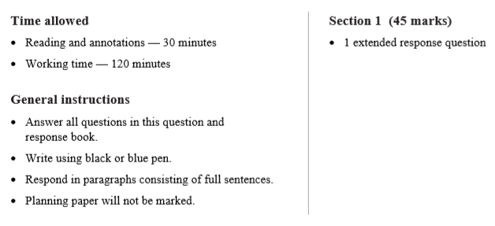
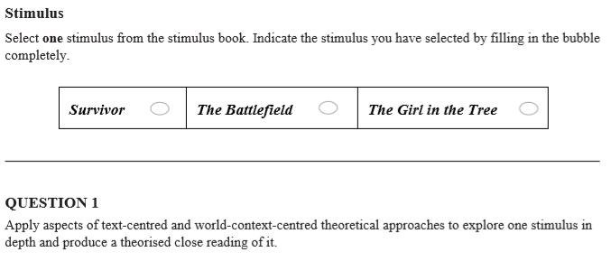
EA Overview
These are the conditions under which you will sit the External Assessment (EA) for English and Literature Extension
We will use the same conditions when you sit a Mock EA. This Mock EA will not contribute towards your ATAR; it is used to provide you with an opportunity to practice this task, and familiarize yourself with the conditions.

Slide 6

Planning time
There is 30 minutes allocated to planning in the assessment.
Students may take notes but may not commence responding to the assessment in the response space/booklet.
Notes made during planning are not collected; nor are they graded or used as evidence of achievement.
This is when you will do the brain work; this is where you will plan your response.
Once the response is mapped out, all you need to do is shape your interpretation and supporting evidence into an essay.

Slide 7
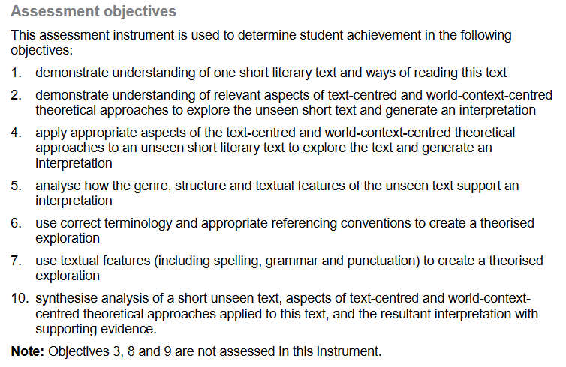
The EAMG

Slide 8

Syllabus Objectives 3, 8 and 9 are not assessed in this instrument
3. demonstrate understanding of the relationships among theoretical approaches
8. evaluate theoretical approaches used to explore different interpretations of literary texts
9. evaluate interpretations of literary texts, making explicit the theoretical approaches that underpin them
Yay!

Slide 9

Preparing for the EA
“Students apply aspects of text-centred and world-context-centred theoretical approaches to this text to explore it in depth and produce a theorised close reading of it.” How might you do this? What strategies could you employ?
It will make sense for the text-centred close reading to precede the world-centred close reading, with the TC reading informing/supporting/justifying/leading to the WC reading. In the WC reading, you could refer back to the TC reading.
You may, however, predominantly construct a world-context centred reading but this must, of course, include the application of text-centred reading strategies.

Slide 10
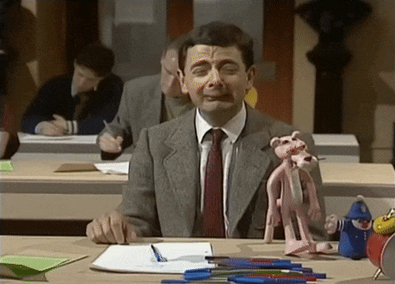
Preparing for the External Exam
The QCAA identifies the following text-centred reading strategies:
Generic conventions
Binary oppositions
Method of narration
Symbols and metaphors
Stylistic features and literary techniques
How do these contribute to the meaning of the text? How do they position the reader? How can we construct a unified meaning that is supported by these textual features? (Note – you only use the strategies that are most relevant in the construction of your interpretation. You do not need to employ all the listed strategies.)
Let’s look at these in more detail as we apply each strategy to “Caged” by Geoffrey Goodfellow.
LEARN THIS LIST!

Slide 11
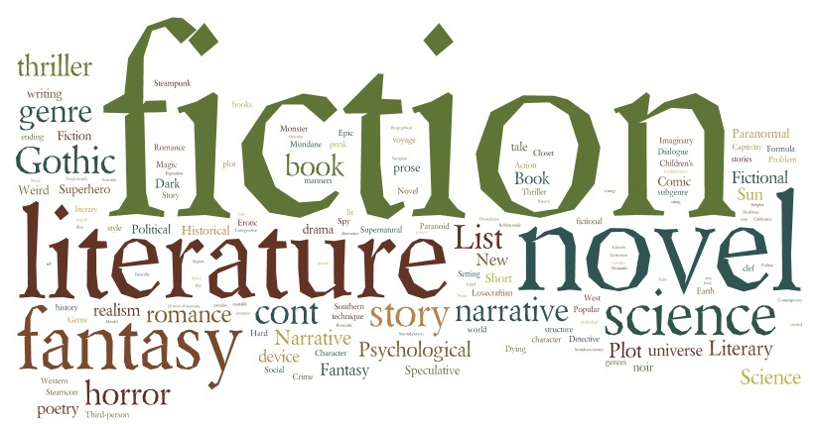
identify the Literary Text Genre (who can name the most Literary Genres?)

Slide 12
Literary genres: Fiction
Realistic fiction
Gothic
Science Fiction
Romance
Fantasy
Mystery
Magic realism
Historical
Contemporary
Folktale
Myth
Legend
Horror/terror
Satire
Tall tale
Suspense
Comedy
Tragicomedy
Tragedy
Western
Apocalyptic
Bildungsroman (coming of age)
Travel literature
Speculative fiction
Supernatural
Splatterpunk
Dystopian
Psychological thriller
Chicklit
Matron literature
Paranormal romance

Slide 13

Poetry
Sonnet
Ode
Haiku
Ballad
Lyric poem
Blank verse
Free verse
Epic
Soliloquy

Slide 14
Genre
— How does the text conform to or challenge the conventions associated with its genre to communicate key ideas or themes? QCAA
What are the conventions associated with lyric poetry?
The lyric poem, “Caged”, which expresses strong thoughts and feelings, uses evaluative language, symbolism, imagery and figurative language, thus conforming to poetic conventions. It is also organised into short verses.
The poem challenges traditional poetic conventions through the lack of a rhyme scheme or punctuation. This type of poetry is called free verse.

Slide 15
What is the purpose of the genre? What is the specific purpose of this text?
To entertain? E.g. narrative
To provoke thought? E.g. narrative, essay, persuasive speech
To expose injustice etc. through the construction of invited meaning?
To persuade? E.g. political speech, advertisement, propaganda
To argue? To give reasons for and against
To reflect? To analyse and examine an event, memory, or observation.
To record?
To recount? The retelling of an event or experience.
To explain and inform? (expository writing)
To describe?
To review?
To evaluate?
To satirize? (criticize and ridicule)
How would you explain the purpose of “Caged”? (There may be more than one purpose.)

Slide 16
Purpose
The purposes of narratives:
The basic purpose of narrative is to entertain, to gain and hold a readers' interest. However narratives can also be written to teach or inform, to change attitudes / social opinions.
The purpose of some narratives is to expose the injustice, social inequality and prejudicial attitudes underpinning dominant race, gender and class discourses. For example, a story written from a feminist perspective might seek to expose the misuse of patriarchal power in the relationships between men and women. E.g. between father and daughter, husband and wife.
PS When the invited meaning of a narrative supports dominant discourses in society, seeking to naturalise power imbalances, the resistant reader may reveal the sexist/classist/racist ideology underpinning the narrative.

Slide 17
Reveal or Conceal?
VIP Know the difference between a text that exposes power imbalances and one that conceals and naturalizes/normalises racism, classism and sexism.
TIP: ASK- DOES THE TEXT REVEAL OR CONCEAL????
Does “Caged” reveal or conceal harmful ideology? How do you know?
Pst…”Caged reveals harmful masculinist ideology but does it conceal a sexist ideology that is biased against men?

Slide 18
Recalling
What are the five broad text-centred strategies listed in the QCAA document? (write - 1 minute)
Generic conventions
Binary oppositions
Narration
Symbols and metaphors
Stylistic features and literary techniques
Who can list the five stylistic features and literary techniques categories? (write - 1 minute)
dialogue
imagery and figurative devices
characterization
text structures
rhetorical devices.
Learn these lists!

Slide 19
Recalling
Who can remember the three world-context-centred categories from the QCAA document? (write - 1 minute)
Representation - How does the text construct representations of people, groups, places or ideas?
Ideology - What cultural beliefs, values and attitudes that reinforce particular power structures in society underpin the text? How does the text challenge or reinforce dominant worldviews?
Cultural ideas – race, gender, class, sexuality, age, the environment

Slide 20


Slide 21

Questions and thought processes
What is my interpretation of this text? How am I being positioned in relation to ideas?
Which strategies (t-c and w-c-c) will most assist me in constructing meaning?
Which quotes from the text will best support me in applying those strategies?
How can I use significant evidence to best present my case but without needless repetition?
How can I fashion my paragraphs into a cohesive essay, using topic and (subtle) linking sentences?
How can I order my sentences into well-structured paragraphs?
How can I express my ideas in clearly and concisely expressed sentences?
How can I choose and use precise vocabulary?
How can I integrate technical terms from theory?

Slide 22
Binary Oppositions (VIP)
Are there key binary oppositions that underpin and structure the text?
Who or what is privileged and marginalised?
How do these binary oppositions underpin representations and ideologies reinforced in the text?
A binary opposition can be treated as a structuring principle that stabilises meaning in the text, or as a false dichotomy whose instability undermines the unity of the text.
From QCAA Unit 4: Text-centred and world-context-centred strategies for short literary texts

Slide 23
Binary Opposition (stable)
A binary opposition is a pair of related terms or concepts that are opposite in meaning. e.g. man/woman civilisation/wilderness city/country mind/body rational/emotional free/imprisoned youth/experience powerful/weak active/passive
You will need to construct your own notes on binary oppositions in this exam prep unit. You need to understand how binary oppositions construct meaning in texts, how they are underpinned by ideology. No text is neutral.
As applying the concept of binary oppositions is applicable to all literary texts, you must know how to analyse binaries.

Slide 24
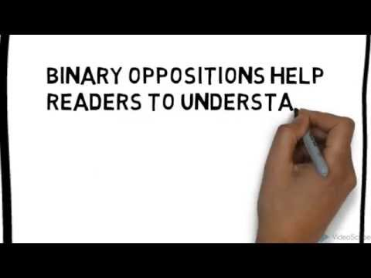
Analyzing Binary Oppositions – ASK:
What pairs of opposing forces can you identify in the text?
What key conflicts are suggested by the binary oppositions?
Does one half of a pair seem more powerful than the other?
How is the reader intended to respond to the opposing forces? i.e. How is the reader positioned?
Do the binary oppositions suggest any ideological messages?
Apply these questions to “Caged”.

Slide 25
“CAGED” by Geoffrey Goodfellow
On whiteboard, in pairs:
1. List relevant binaries.
2. Underline and explain evidence for these binaries in the text.
3. Which half of the binary is privileged?
4. What ideological message does this binary suggest?
at 38 his youth’s tattooed over him like a roadmap and the eagle on his chest has its claws dug in hard on her there’s no flying away wings clipped by two kids and the worry of that .38 in the top drawer all I can do is hug the kids in tight when he gets home she sobs I don’t think he’d belt THEM | and its dewdrops on the nostrils hayfever eyes for all seasons there’s no new horizons and no place far enough away she’s caged to a life of aspirins and empties - watches late night tattoos sees HATE blueprinted into both claws.

Slide 26
Binary oppositions
Identifying binary oppositions (pairs of opposed forces) can suggest the ideology of a text.
Although the woman is the victim and is powerless in real life, hers is the privileged term in the poem as the ideology underpinning the binaries favours her values and attitudes.
Privileged term | Marginalised term
woman | man
free | caged
kind | cruel
protective | harmful
love | hate
The cultural setting a reader is a part of may influence their interpretation of a work of literature; only one concept, from the binary opposition, is ready, in our mind, to be privileged and the other one is usually put aside as having the second priority. E.g. We live in an age where feminist, pro-woman ideology is mainstream, thus our ready acceptance of the woman as being morally privileged even though she is physically weaker than the male.

Slide 27
Binary Oppositions
How do these binary oppositions underpin representations and ideologies reinforced in the text? (possible essay para 2)
Obviously, the binary oppositions woman/man, love/hate, protective/harmful and free/imprisoned position the reader to sympathise with the woman rather than the man, while also structuring the idea that domestic violence is to be abhorred. The woman’s care and kindness for her children, who she hugs “in tight”, is in strong contrast to a father who has no qualms about bashing the mother of his children in his quest to maintain power. “The eagle on his chest has its claws dug in hard on her.” It is clear that the woman desires the freedom to live without fear, to escape the metaphorical cage and the threat of “that .38 in his top draw”. The poem is thus underpinned by values of love and protection for children and the value of individual freedom whilst it views domestic violence and toxic masculinity as abominations. The reader readily accepts that the woman is in the morally privileged position, despite her comparative physical weakness.

Slide 28
Narrative Voice
Narrative voice tells whose eyes the reader sees a story through. When identifying the narrative voice in literature, it is important to consider the point of view and the narrator's degrees of omniscience, objectivity and reliability.
How does the use of first person (I), second person (you) or third person (he, she, they) distance or involve the audience?
Use of ‘I’ may lead reader to identify and sympathize with the narrator but the audience may be equally repelled by a first person narrator or question their reliability.
The use of the second person ‘you’ is uncommon in literature as the narrating voice is addressed directly at the reader. This is more common in persuasive texts.
A third person narrator may be ‘limited’ to focalizing on one character or be ‘omniscient’.

Slide 29
Focalization
Gerard Genette introduced the term "focalization" as a replacement for "perspective" and "point of view" .
This is a term the QCAA EA support document uses. It covers zero focalisation (omniscient), internal focalisation (narrator only knows what the character knows), and external focalisation (the narrator says less than the character knows).
Which type of focalisation is used in “Caged”?

Slide 30
Narrative Voice
Narration — How is the text narrated to position the audience? Consider how point of view (e.g. first person vs. third person), focalisation and voice position the reader in relation to perspectives, ideas and reliability of the characters or narrator in the text.
QCAA Unit 4: Text-centred and world-context-centred strategies for short literary texts
Tip: You need to consider how you are positioned as a reader by the narrative voice. You must employ this strategy in your reading of your chosen exam text as narration is common to all literary texts.

Slide 31
Application of Text-Centred Approaches
How is the text narrated to position the audience in relation to the characters?
at 38 his youth’s tattooed over him like a roadmap and the eagle on his chest has its claws dug in hard on her there’s no flying away wings clipped by two kids and the worry of that .38 in the top drawer all I can do is hug the kids in tight when he gets home she sobs I don’t think he’d belt THEM | and its dewdrops on the nostrils hayfever eyes for all seasons there’s no new horizons and no place far enough away she’s caged to a life of aspirins and empties - watches late night tattoos sees HATE blueprinted into both claws.

Slide 32
Symbolism
Symbolism is the practice of using an object or a word to represent an abstract idea. An action, person, place, word, or object can all have a symbolic meaning. E.g. symbolic colours, objects (e.g. chain, ladder, mirror, water), animals (e.g lion, ant), weather (e.g. storm, calm, sunshine)
In literature, symbolism can take many forms, including:
A figure of speech where an object, person, or situation has another meaning other than its literal meaning e.g. to wash blood from one’s hands
The actions of a character, word, action, or event that have a deeper meaning in the context of the whole story.
Tip: Know how to spot symbolism. Read up on symbols.

Slide 33
Metaphors
Metaphor: A type of comparison which does not use like or as e.g. “she’s caged to a life of aspirins and empties”
Extended metaphor: A comparison between two unlike things that continues throughout a series of sentences in a paragraph or lines in a poem. This is a significant language feature in “Caged”.
Metaphors are ways of thinking—and also ways of shaping the thoughts of others.

Slide 34
Application of Text-Centred Approaches
Can you identify the extended metaphor in “Caged”? How does the extended metaphor in the poem position the reader to view each of the characters? Which particular evaluative words and phrases have most impact?
at 38 his youth’s tattooed over him like a roadmap and the eagle on his chest has its claws dug in hard on her there’s no flying away wings clipped by two kids and the worry of that .38 in the top drawer all I can do is hug the kids in tight when he gets home she sobs I don’t think he’d belt THEM | and its dewdrops on the nostrils hayfever eyes for all seasons there’s no new horizons and no place far enough away she’s caged to a life of aspirins and empties - watches late night tattoos sees HATE blueprinted into both claws.

Slide 35
Symbolism and Metaphors
Symbols and metaphors —
What are some key symbols and/or metaphors that significantly contribute to meaning in the text?
Consider symbols and metaphors that are repeated and/or developed in a text to shape representations and ideas in the text.
From QCAA Unit 4: Text-centred and world-context-centred strategies for short literary texts

Slide 36
Application of Text-Centred Approaches
Are there any symbols used in “Caged”? How do they contribute to the meaning of the poem? How do they position the reader in relation to characters?
at 38 his youth’s tattooed over him like a roadmap and the eagle on his chest has its claws dug in hard on her there’s no flying away wings clipped by two kids and the worry of that .38 in the top drawer all I can do is hug the kids in tight when he gets home she sobs I don’t think he’d belt THEM | and its dewdrops on the nostrils hayfever eyes for all seasons there’s no new horizons and no place far enough away she’s caged to a life of aspirins and empties - watches late night tattoos sees HATE blueprinted into both claws.

Slide 37
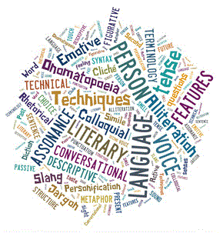
Stylistic features and literary techniques
How are stylistic features and literary techniques used to shape meaning?
Consider how the author has used:
dialogue
imagery and figurative devices
characterisation
text structures
rhetorical devices.
QCAA Unit 4: Text-centred and world-context-centred strategies for short literary texts
You could add setting, mood and atmosphere.
Memorize this list!

Slide 38
Dialogue
Dialogue may:
Reveal characters' personality traits, feelings, thoughts, and/or motives.
Move the plot forward by motivating characters to make decisions or take action.
Reveal important details or secrets.
How does the character speak? Do they show empathy, warmth or compassion? Are they cold, cruel, bullying, lacking in empathy? Are they reliable or unreliable in their telling of their version of events?
What values, attitudes and beliefs are exposed through speech?
What kinds of ideologies underpin the way they speak and what they say?
How does a character’s speech position the reader to respond to the representation?
How is dialogue employed to position the reader in “Caged”?

Slide 39

Imagery and Figurative Devices
Identify imagery that contributes to meaning.
Imagery is descriptive language that appeals to the senses of sight, hearing, smell, taste and touch.
Imagery also falls into the broader category of evaluative language.
How does the imagery used position the reader to adopt the invited meaning?
Figurative language is any figure of speech which depends on a non-literal meaning of some or all of the words used.
The most commonly used forms of figurative language are: (you predict)
Simile – comparison using like or as
Metaphor – does not use like or as
Personification – attributing human characteristics
Hyperbole - exaggeration
Oxymoron – contradictory terms e.g bitter sweet

Slide 40
Application of Text-Centred Approaches
Identify imagery, evaluative language and figurative devices in “Caged”. How do these position the reader?
Identify the following:
simile,
extended metaphor,
visual image, evaluative language.
at 38 his youth’s tattooed over him like a roadmap and the eagle on his chest has its claws dug in hard on her there’s no flying away wings clipped by two kids and the worry of that .38 in the top drawer all I can do is hug the kids in tight when he gets home she sobs I don’t think he’d belt THEM | and its dewdrops on the nostrils hayfever eyes for all seasons there’s no new horizons and no place far enough away she’s caged to a life of aspirins and empties - watches late night tattoos sees HATE blueprinted into both claws.

Slide 41
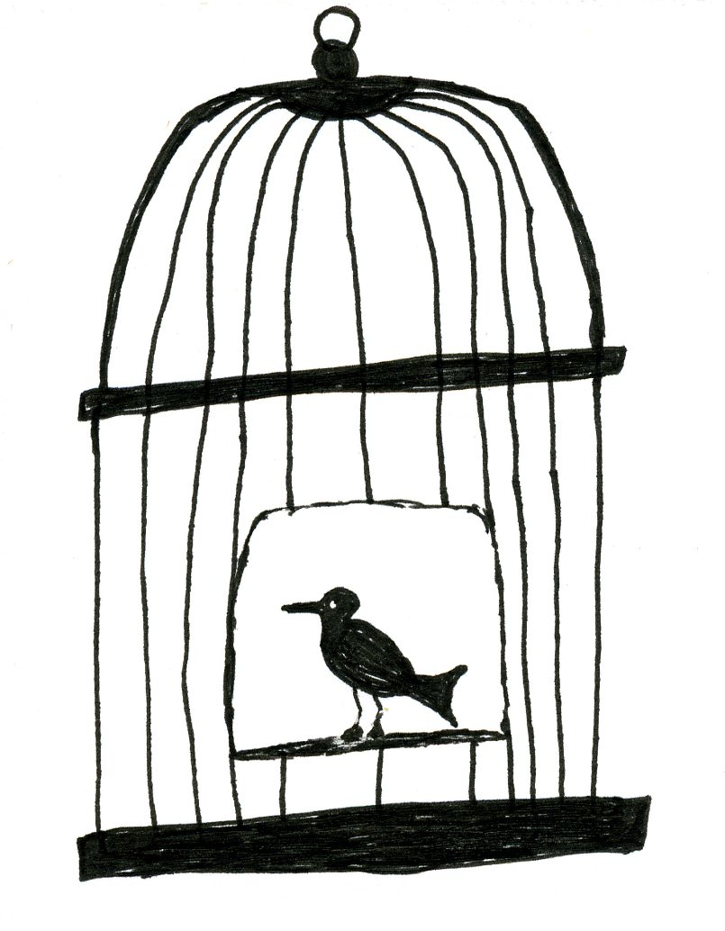
Characterization and setting
How does the setting contribute to the mood and atmosphere of the text?
What part does the setting play in the events that unfold?
Is setting used symbolically?
How are characters represented?
How are readers positioned to view each character? What speech, actions and evaluative language position the reader to view each character this way?

Slide 42
Application of Text-Centred Approaches
How are characters represented? Readers positioned? Evidence?
at 38 his youth’s tattooed over him like a roadmap and the eagle on his chest has its claws dug in hard on her there’s no flying away wings clipped by two kids and the worry of that .38 in the top drawer all I can do is hug the kids in tight when he gets home she sobs I don’t think he’d belt THEM | and its dewdrops on the nostrils hayfever eyes for all seasons there’s no new horizons and no place far enough away she’s caged to a life of aspirins and empties - watches late night tattoos sees HATE blueprinted into both claws.

Slide 43
Text structures
If interpreting a narrative text, consider the structure the text. What kind of different textual structures are you aware of?
Is it a conventional structure with orientation, complication, rising action, climax, resolution and denouement?
Does it begin in medias res? (in the middle of the action)
Are flashbacks employed?
Are the events in chronological order i.e linear?
Is a stream of consciousness technique employed? E.g. “Porphyria’s Lover”
Is there a framed narrative? E.g. the narrative begins with a first person narrator but the bulk of the story is told through letters or diary entries that the narrator reads.
Is the narrative circular? Does it end where it began?
Is it an open or a closed text? (open leaves much to the reader’s imagination – multiple meanings)
Learn this list!

Slide 44
Rhetorical devices
Who can remember some of these?
Repetition: the repeating of a word or phrase. It is a common rhetorical device used to add emphasis.
Contrast: means difference especially when that difference is very noticeable. Consider the way husband and wife are contrasted in “Caged”
Analogy: explains one thing in terms of another to highlight the ways in which they are alike. “the eagle on his chest has its claws dug in hard on her”
Allusion: is basically a reference to something else outside the text. Literary texts often allude other literary texts including the works of Shakespeare, the Bible and Greek mythology.
Hyperbole: exaggeration
Learn this list!

Slide 45
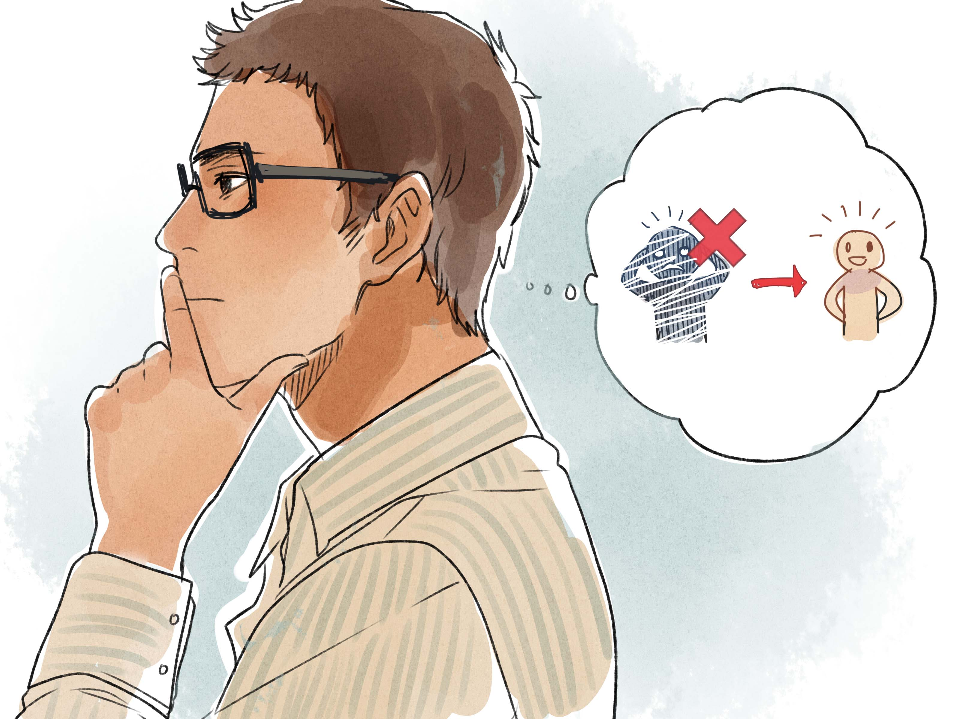
Positioning
What does this mean?
What might we be positioned in relation to?
Positioning… the battle for your mind!

Slide 46
Positioning
Positioning refers to the shaping of a reader's point of view or perspective.
Writers shape their texts using a range of techniques designed to encourage readers to endorse their ideas, values and attitudes, and engage sympathetically and unsympathetically with the characters and action of their stories.
Texts offer invited reading positions — angles for viewing which make sense of the world represented in the text.
Some readers align themselves with ideologies in texts that are congruent with their own. (invited reading)
Others do not find their world view represented adequately if at all. These marginalised readers may read against the grain of those texts that advocate world views different from their own. (resistant reading)
Tip: When constructing either an invited or resistant reading you MUST mention how the reader is positioned in relation to characters and ideas.

Slide 47
Positioning
READERS WILL BE POSITIONED IN RELATION TO :
PLOT Will we become engaged, grabbed, held, suspended? Will we question, accept, be required to predict, be given hints, required to think for ourselves? What will our responses be to the events and action? Which of these are relevant to “Caged”?
CHARACTERS are constructed using a range of techniques encouraging readers to find them sympathetic, believable, identifiable or otherwise, thus endorsing or challenging the attitudes these characters possess and the values they stand for. How are we positioned to view the two characters in “Caged”? Which words and phrases position us to react to the characters in this way?
IDEAS put forward by the writer through the characters and the action will manipulate and shape the reader’s perceptions, positioning readers to respond in certain ways, agreeing with or disputing the ideas arising from the text. In essence, this is the most significant, generally the larger purpose behind the writer creating the story. What ideas are conveyed in “Caged”?

Slide 48
Central Idea
How would you explain the theme (invited reading) conveyed in “Caged”? Your identification of meaning will inform your central idea. Post a theme statement on “Caged” on Padlet.
https://padlet.com/ejwoolaston/kd34aru8yj89zg49
Failing that, snowball it.

Slide 49
Central Idea
Invited Reading
The poem “Caged” conveys the idea that domestic violence is abhorrent through the sympathetic depiction of a battered woman who lives in fear of her partner.
Or
The poem “Caged” is about the destructive effect of domestic violence within marriage and the lack of affectionate communication between men and women.
Resistant Reading – how could you read this poem resistantly by reversing the binaries? E.g.
Who is silenced in this poem? What might the husband say in his defence?
Is the husband mythologised as a brutish husband? Is this archetype fair to men and husbands in general?
You could mention possible resistant reading but then debunk it in order to champion your own reading of the text.

Slide 50
Central idea
Note the word idea. What you are looking for is a theme/central idea or (invited, alternative or resistant) meaning.
What is the difference between content and meaning?
Content: the poem is about the abuse of a wife and mother by a violent partner.
Theme: The poem “Caged” conveys the idea that domestic violence is abhorrent through the sympathetic depiction of a battered woman who lives in fear of her partner.
Conveys the idea….is a safe way to explain theme but make sure you are presenting an idea, not just comprehension of content.
QCAA Students then apply aspects of text-centred and world-context-centred theoretical approaches to this text to explore it in depth and produce a theorised close reading of it.

Slide 51
Opening paragraph
Sentence 1 Idea | Name text, name author, identify genre, broad theme statement.
Sentence 2 Concept/content | Concept, content matter, generic conventions
Sentence 3 Idea | Re-affirm idea, vary vocabulary.
Write your own 3 sentence opening paragraph to an analytical essay on “Caged”.
Post to Padlet. (5 minutes)
https://padlet.com/ejwoolaston/bxvjawq1820lowvk

Slide 52
Opening paragraph example
Establish idea: The central idea conveyed in the free form lyric poem “Caged” by Geoffrey Goodfellow is that family violence is abhorrent.
Concept/generic conventions: The poem examines the concept of domestic violence predominantly through the use of poetic devices such as symbol, metaphor and imagery, depicting the miserable predicament of a mother living with an abusive partner, emphasizing the entrapment of the woman and her children.
Reaffirm idea: The poem exposes the injustice of an overwhelming power imbalance in this intimate domestic relationship with the aim of changing attitudes and social opinions.

Slide 53
Use this PowerPoint presentation as a study aid.

Slide 54
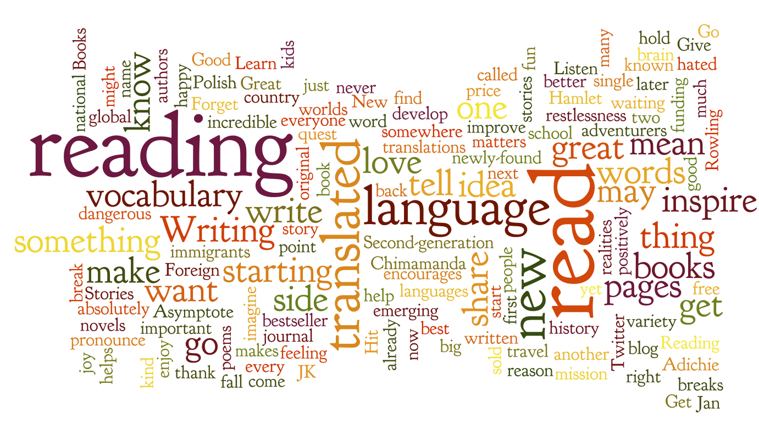
Homework
You need to practise interpreting and writing analytically.
It is very important in terms of exam preparation that you complete weekly writing and studying exercises to the best of your ability.

