Slide 1
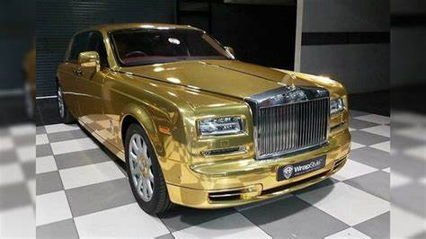
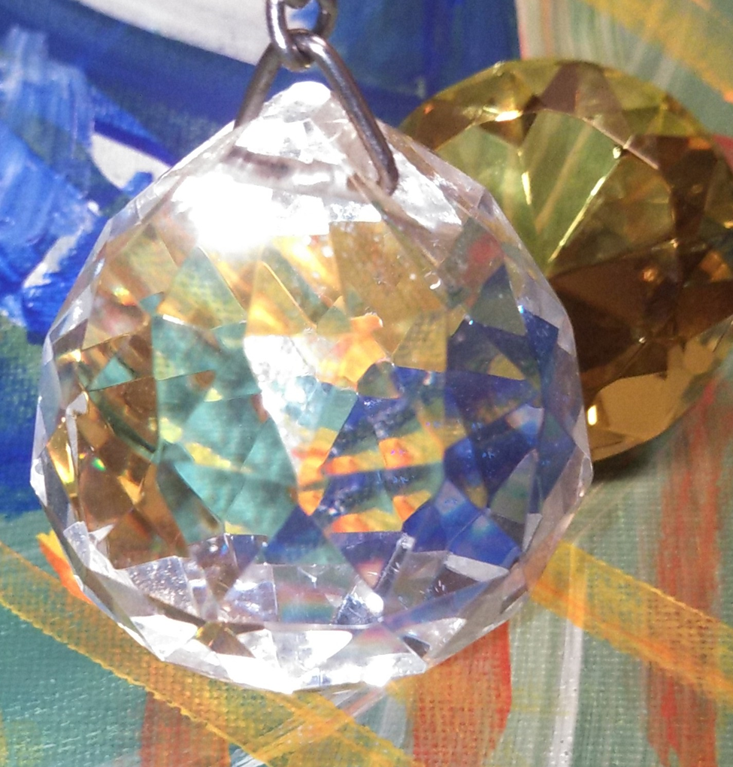
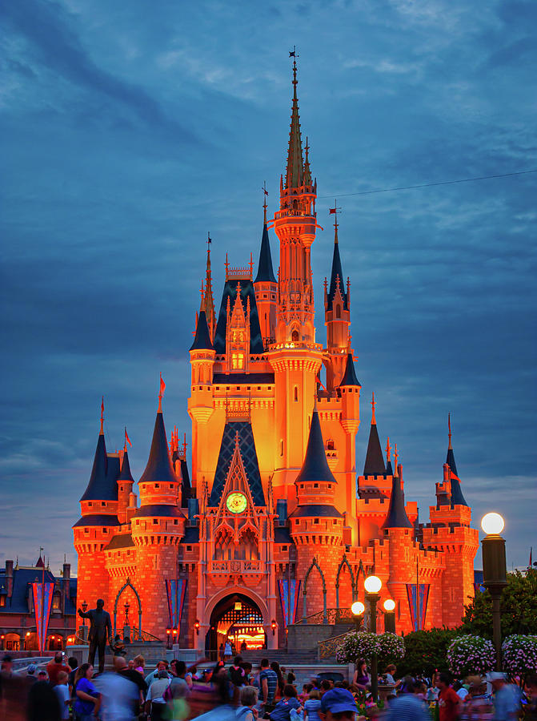
The Best Gift in the Whole Wide World is Jesus
Jesus is Greater in value than the best Gifts of House and Vehicles of all the earth. Jesus is more than the only way to Heaven but also carries the best Gift of all, the Holy Spirt. Jesus broke barriers to not make it a requirement to worship Him on a mountain or go through a priest. People can worship Jesus anywhere and have access to the Most Holy Place through Jesus. If you knew the Gift of God and who it is who asks to cast all your Crowns and Gift to Jesus, you would ask Him and he would give you a Great assignment in Heaven. All the promises of Heaven are yours when you get to Heaven but what about Now? NOW in John chapter 16 a mother gives birth and forgets the anguish of birth pains because a Baby is born into the world. Now someone Greater than a baby being born is among you, it is the love of the Father and the Power of Salvation. Being Born again and saved is a greater Gift than a newborn baby. If you knew the Gift of God and who it is that asks you to suffer for Christ, you would realize it will be more than worth it.
Based on the following scripture
John 3
John 14
Deuteronomy 33
Acts 1
John 4
John 16

