Slide 1
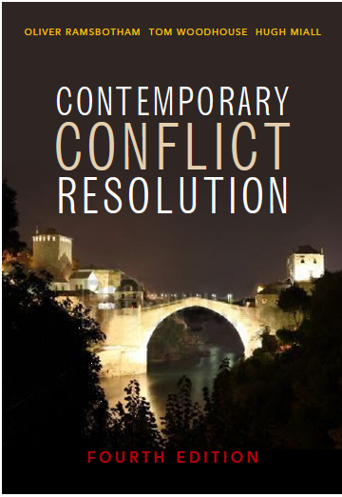
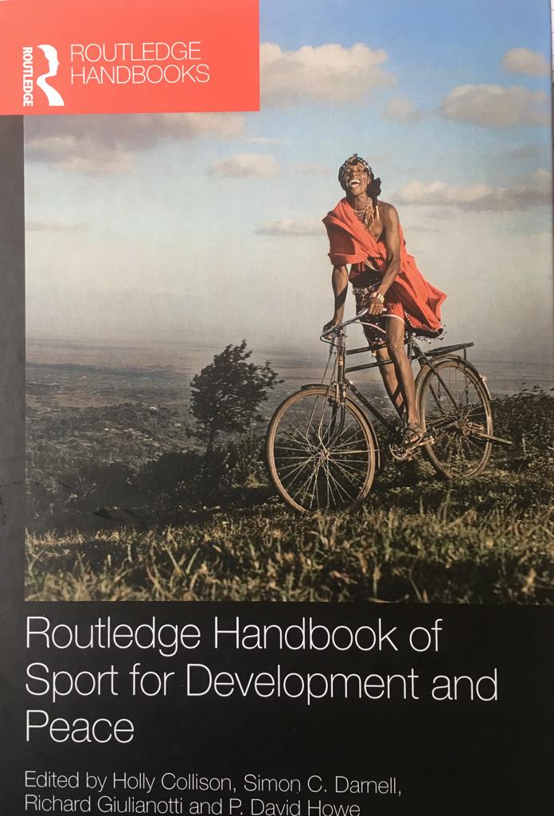
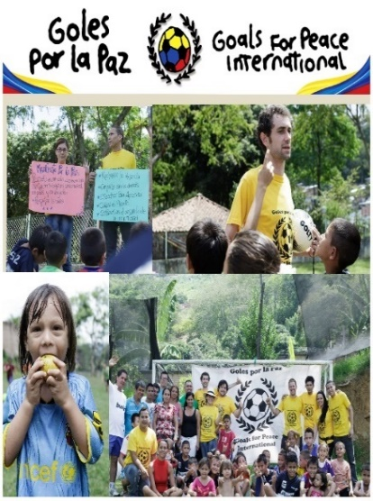
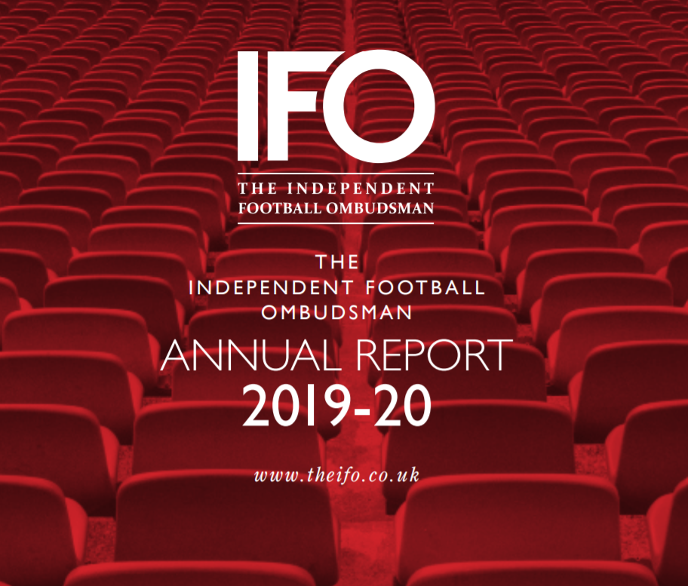
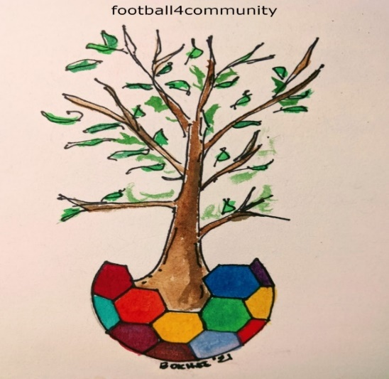
More than a game – football for community development and conflict resolution
Presentation to King Prajadipok Institute, Bangkok
Professor Tom Woodhouse and Professor Surichai Wungaeo
Notes:
Building Bridges. Sport for community development and conflict resolution
Clearly sport, and particularly football, the world’s most popular game, can have negative as well as positive impacts on communities. It can be an exercise in big power politics and a drive for aggression and competitive division. It can deepen racism and ethnic rivalries, it can exclude minorities and people with disability, and it can concentrate wealth and power in a small number of privileged individuals and corporations. These negative aspects are well known and well reported in the mass media. What is perhaps less well known, or at least less well reported, is the power of sport to unite, to build bridges between divided communities, to motivate marginalized young people who might otherwise join violent gangs or engage in criminal activity, and generally to inspire people to use the convening power of sport to strive for the higher goals of conflict resolution and peacemaking. In the early years of the 21st century, the role of sport in peacemaking has evolved so much that it can now be labelled as a distinctive sector for peacemaking, as many organizations, from the United Nations though to a wide variety of local grass roots projects, have used sport as a conflict resolution tool. This range of activity is now commonly referred to as the sport development and peace (SDP) sector. Engagement with this sector, now developed as a vital global network involving thousands of civil society organisations and hundreds of thousands of young people, is a vibrant opportunity to re-energise and innovate in the work of peacebuilding and conflict resolution. In this lecture, drawing on their experiences as academics and practitioners, Yolanda Antin and Tom Woodhouse will provide case studies and examples of how sport and football in particular promotes the cause of social inclusion, development and the building of bridges between divided communities.

Slide 2
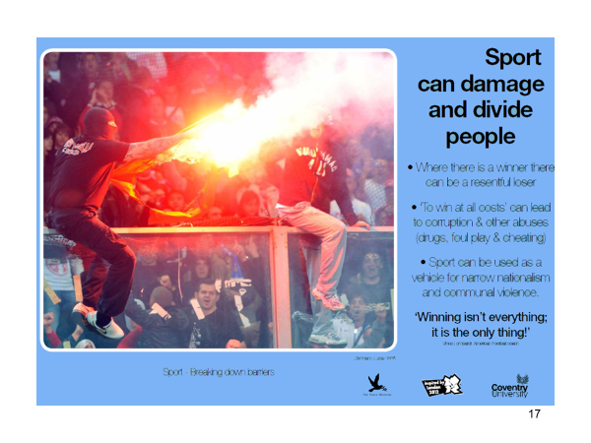
Negatives - Social Dividers
Gang violence (hooliganism) around some of the big games
Aggressive male centered inter-communal rivalry
Proxy civil wars? Real Madrid Barcelona, Glasgow Rangers Glasgow Celtic Scotland … Wars of the Roses, Leeds Manchester United …
Corruption – fixing of match results by betting syndicates
Gross overpayment of elite players – very questionable in recession/crisis/COVID
Corporate control - Ownership taken away from the locality by billionaire individuals and corporations –
European Super League – breaking club community connection
Debt levels high - £3 billion in EPL and La Liga
Not enough money generated at the top reaches the communities.

Slide 3
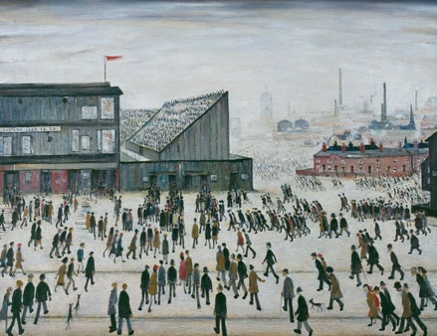
POSITIVES Social connectors and bonding power – the UN calls this ‘convening power – the power to bring large groups of people together in sporting mega events
Powerful identification with place
Ability to promote inclusion and sense of belonging and identity
Ability to use economic power and resources to facilitate community development and social cohesion
Ability to bond people to the club and the community and to counter marginalisation
EPL and EFL - 92 clubs all with Community Foundations
Spanish clubs are amongst the most socially responsible in Europe. Spain’s la Liga (29.49%) scores sixth in the responsiball ranking table led by Denmark’s Superliga (46.88%) and England’s Premier League (41.01%) Responsiball is an initiative funded by Schwery Consulting, see http://responsiball.org/ranking/

Slide 4
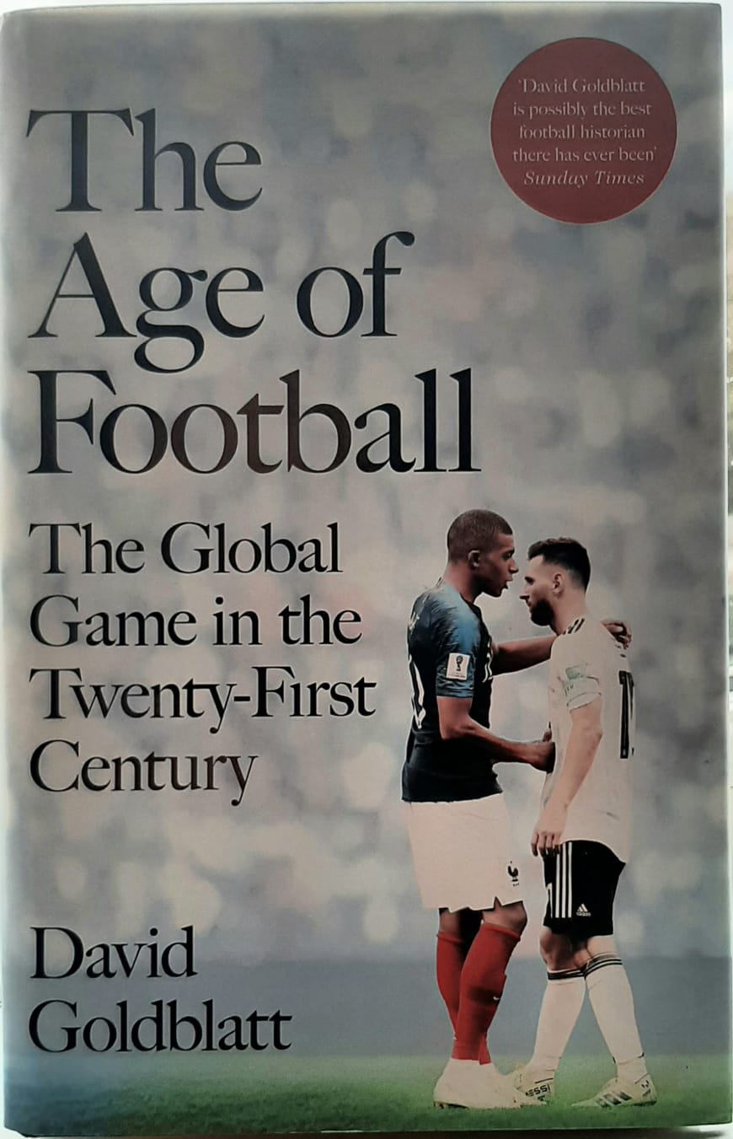
Convening Power
October 1863 in London – Foundation of the English FA and Rules of the Game defined. These rules still unify the game globally
265 million people play the worldwide
With more than three billion fans, football is the largest social phenomenon on the planet. No other sport boasts such wealth. Or such reach. Or such cultural significance.
.
David Goldblatt argues in The Age of Football that the modern game is the most pervasive and universal cultural mode that has ever existed
Notes:
The Ball is Round David Goldblatt

Slide 5
Football is potentially more powerful as a peacebuilding mechanism than we have recognised:
it can help strengthen BONDING within communities
and BRIDGING between communities in conflict.
We emphasise the negatives too much
We can address the negatives and accentuate and learn from the positives
BONDING
+
BRIDGING
+
SYSTEMIC PEACEBUILIDING
= POSITIVE PEACE

Slide 6
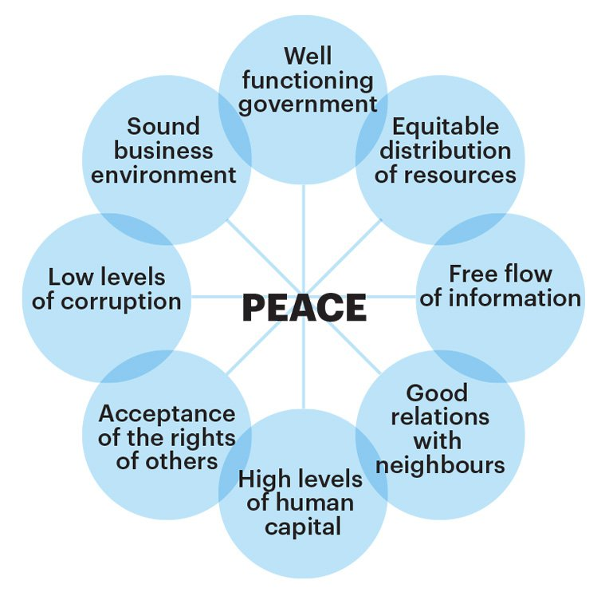
Connecting Sport/Football with the Values of Positive Peace
Positive peace - the attitudes, institutions and structures that create the optimum environment for human potential to flourish

Slide 7

Systemic Peacebuilding through Football – the Four Spaces Model - The relationships which produce peace or violence are formed in four “spaces”
    1 The global space – international politics
    2 The social space - culture, politics, economy
    3 Personal relationships (the human space)
4 The ecological space - the relationship of people to the planet

Slide 8
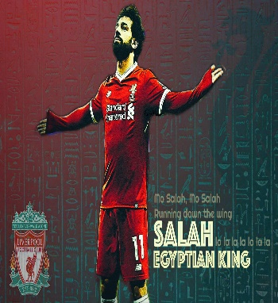

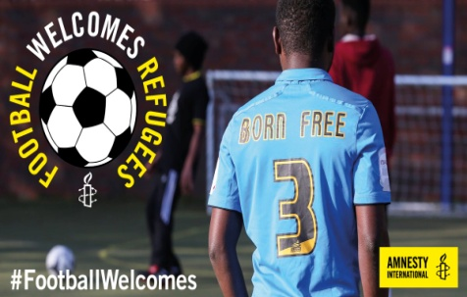





    2 The social space - culture, politics, economy
Power of the game to reach into all communities
Ability to promote inclusion and sense of belonging and identity
Powerful identification with place
Potential to use economic power and resources to facilitate community development and social cohesion

Slide 9
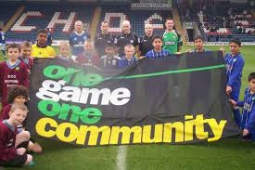
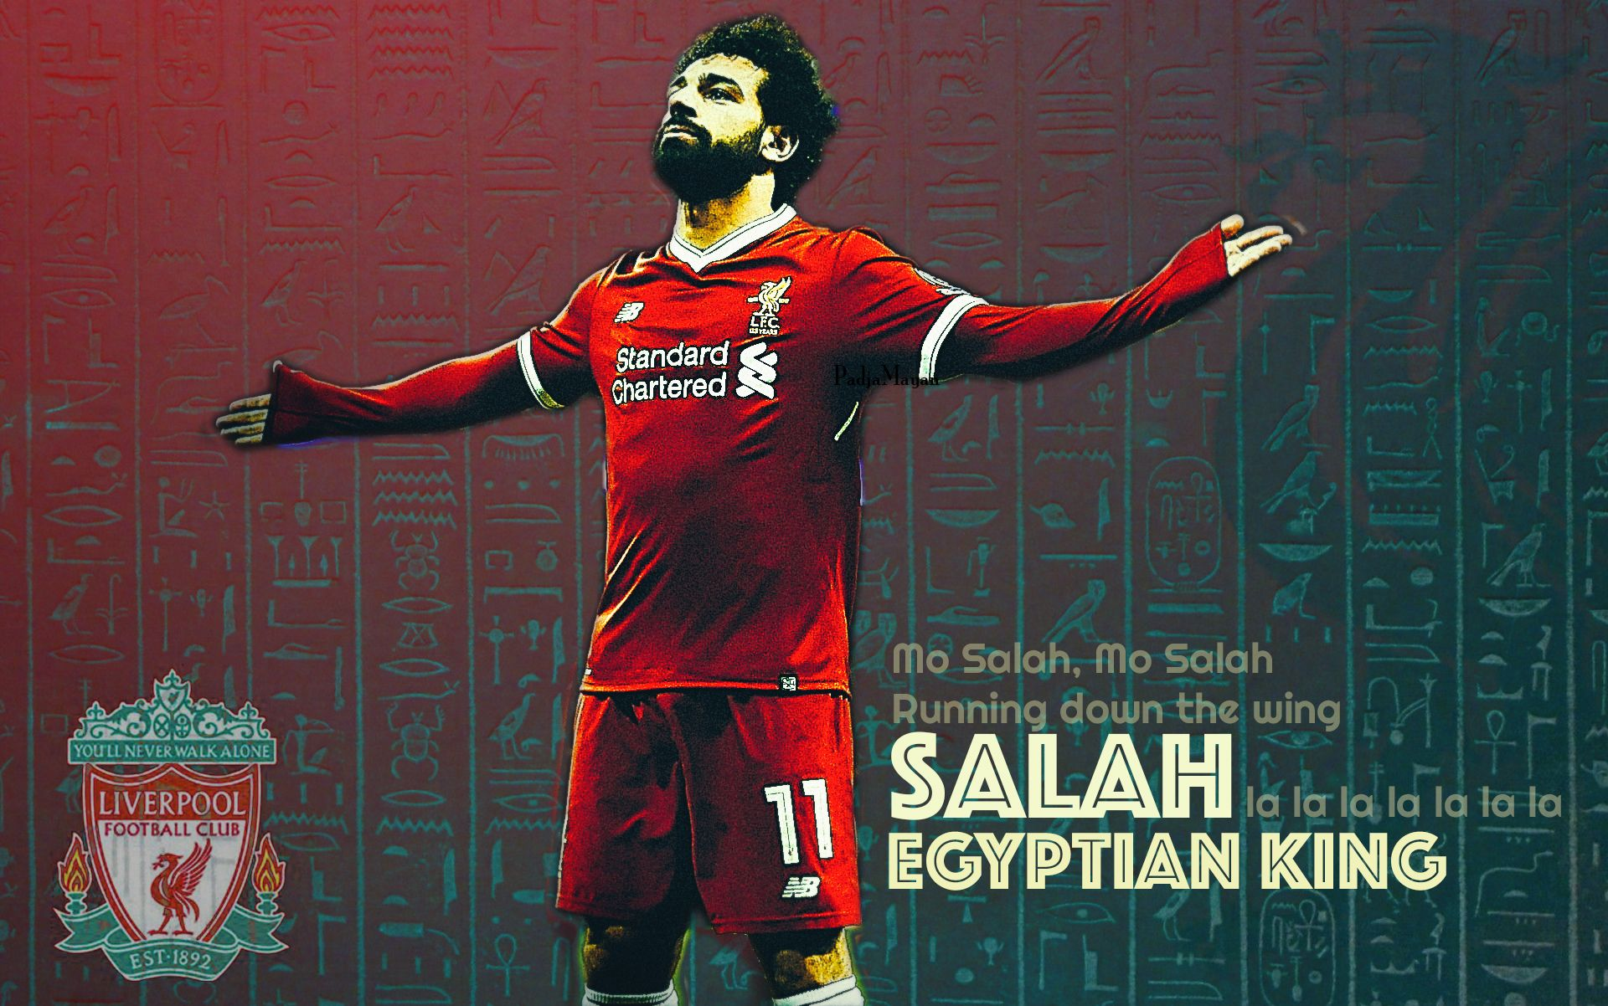
Liverpool FC and Mohammad Salah – Countering Islamophobia and Racism – Case Study in English Premier League
This Photo by Unknown Author is licensed under CC BY-NC

Slide 10

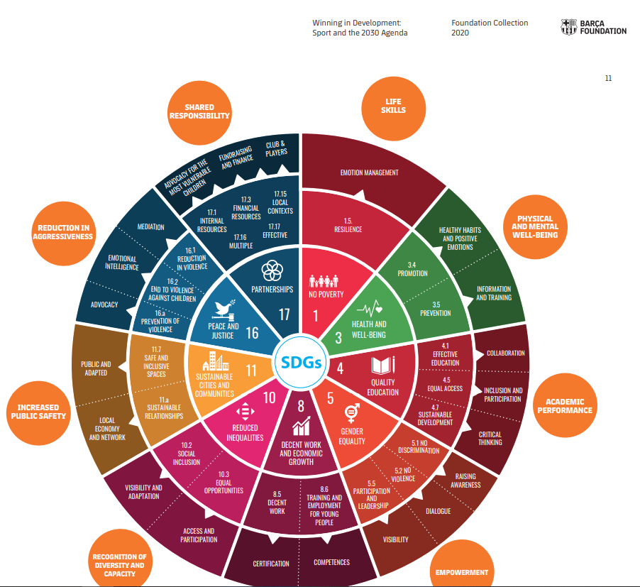
FOOTBALL SUPPORTING SDGs: Case Study 1 FC BARCELONA Spain
SDGs

Slide 11
FOOTBALL SUPPORTING SDGs - Case Study 2 English Premier League
CLUBS SDG Goals Addressed
Clubs
Arsenal FC 1, 3, 4, 5, 10, 11, 17
Aston Villa 1, 3, 4, 8,10, 11
Brighton 3, 4, 5, 10, 11
Burnley 3, 4, 5, 10, 16, 17
Chelsea 4, 5, 8, 10, 11, 16, 17
Crystal Palace 3, 4, 8, 10, 11,16
Everton 1,3,4,8, 11, 16, 17
Fulham 3, 4, 8, 10, 11
Leeds United 3, 4, 8, 10, 11
Leicester 11
Liverpool FC 1, 3, 4, 5, 8, 10, 16, 17
Manchester City 3, 4, 5, 8, 10, 11, 16, 17
Manchester United 1, 3, 4, 5, 8, 10, 11, 17
Newcastle United 3, 4, 5, 8, 10, 11, 16
Sheffield United 3, 4, 8, 10, 11, 16
Southampton 3, 4, 8, 10, 11
Tottenham Hotspur 3, 4, 8, 10, 11, 17
West Bromwich Albion 3, 4, 8, 10, 11
West Ham United 1, 3, 4, 7, 10, 11, 16
Wolverhampton Wanderers 3, 4, 8, 1
Number of clubs addressing each goal
1: NO POVERTY 6
2: ZERO HUNGER 0
3: HEALTH & WELLBEING 18
4: QUALITY EDUCATION 19
5: GENDER EQUALITY 7
6: CLEAN WATER & SANITATION 0
7: AFFORDABLE CLEAN ENERGY 1
8: DECENT WORK & ECONOMIC GROWTH 15
9: INDUSTRY INNOVATION INFRASTRUCTURE 0
10: REDUCED INEQUALITIES 17
11: SUSTAINABLE CITIES AND COMMUNITIES 15
12: RESPONSIBLE PRODUCTION & CONSUMPTION 0
13: CLIMATE ACTION 0
14: LIFE BELOW WATER 0
15: LIFE ON LAND 0
16: PEACE JUSTICE STRONG INSTITUTIONS 9
17: PARTNERSHIPS FOR THE GOALS 8

Slide 12
3. The personal space – human relationships – values based football
Barcelona Foundation Case Study
Club embedded in the history of the city of Barcelona and Catalonia
Focal point for symbolic resistance to fascism and the dictatorship of Franco
2006 - The Fundació and FC Barcelona signed a global alliance with Unicef in order to make a contribution over five years to the Millennium Development Goals (MDGs), to support the United Nations Organisation’s humanitarian aid projects around the world, and currently 2030 Agenda for Sustainable Development – the Sustainable Development Goals
FIVE VALUES GUIDE THE APPRPROACH OF THE FOUNDATION AND OF THE CLUB
TEAM WORK
RESPECT
EFFORT
AMBITION
HUMILITY

Slide 13

Discussion – how does this apply to Thailand
Thailand has collective experiences of the “positive” role of football,
The case of 13 Wild Boars – the football team rescued from the cave
Regionally, the 2002 World Cup, co- hosted by Japan and Korea- a very unique event
The ASEAN bid for the 2034 World Cup
The existence of organised football in most of the 77 provinces of Thailand – football is the most popular sport in Thailand. Thai FA founded by King Rama VI in 1916 and Thailand has been a member of FIFA since 1925
The general widespread popularity of football among young people in Thailand and in the Deep South provinces. See the programmes of FootballPlus teaching values based training in Pattani

Slide 14
Total Number for Each Goal - all clubs
4: QUALITY EDUCATION 19
3: HEALTH & WELLBEING 18
10: REDUCED INEQUALITIES 17
8: DECENT WORK & ECONOMIC GROWTH 15
11: SUSTAINABLE CITIES AND COMMUNITIES 15
16: PEACE JUSTICE STRONG INSTITUTIONS 9
17: PARTNERSHIPS FOR THE GOALS 8
5: GENDER EQUALITY 7
1: NO POVERTY 6
7: AFFORDABLE CLEAN ENERGY 1
2: ZERO HUNGER 0
6: CLEAN WATER & SANITATION 0
9: INDUSTRY INNOVATION INFRASTRUCTURE 0
12: RESPONSIBLE PRODUCTION & CONSUMPTION 0
13: CLIMATE ACTION 0
14: LIFE BELOW WATER 0
15: LIFE ON LAND 0

Slide 15
Group Discussion
Social inclusion, diversity, equality
Gender equality
LGBTQ+ issues
Refugees Asylum Seekers IDPs
Child trafficking through football
Environment Climate Change
Training in Conflict Resolution Skills (preventing conflict)
Training is skills for positive peacebuilding (building peace)
Tackling Poverty Inequality Deprivation
Anti racism and inclusion of ethnic minorities
Religious discrimination
Gang formation, youth offending, knife crime
Training in Positive Peace
Disability rights
Racism and abuse in social media
Vulnerable children and bullying
Fan inclusion in club governance
International outreach and support for UN SDGs
Training in skills for employment
Mental health and well-being
Physical fitness
Choose FIVE of the projects in the list on the left which you would prioritise if you were placed in charge a major Sports Foundation in Bangkok. You can add to and choose topics not on the list if you wish.
In feedback, explain which you selected, and, briefly, why.

Slide 16
