Slide 1
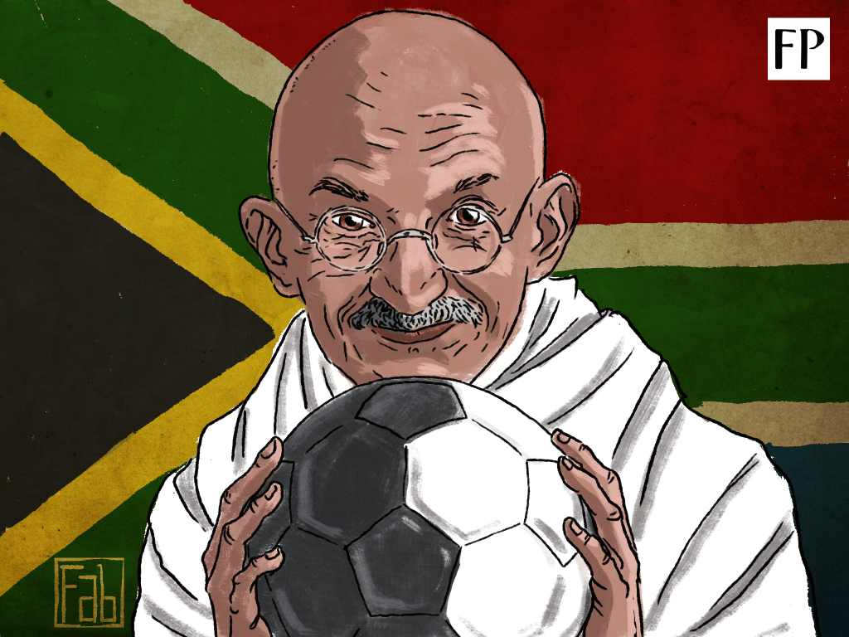


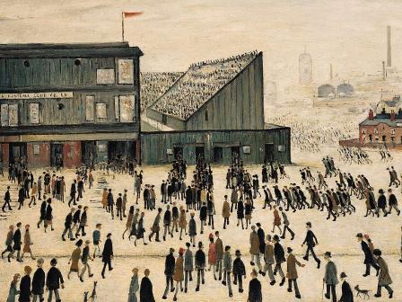
MORE THAN A GAME FOOTBALL & PEACEBUILDING
Click image to watch video
Professor Tom Woodhouse & Beatriz Carvalho (Incoming Rotary Peace Fellow Class 25)
Click image to visit footballpeaceacademy.com

Slide 2



MORE THAN A GAME
Football & Peacebuilding in Spaces From the Local to the Global
1. The Global Space:
International politics
4. The Ecological Space
3. The Human Space
2. The Social Space

Slide 3
MORE THAN A GAME
Football & Peacebuilding in Spaces From the Local to the Global
4. The Ecological Space
1. The Global Space
2. The Social Space:
Culture, politics, economy
3. The Human Space

Slide 4
MORE THAN A GAME
Football & Peacebuilding in Spaces From the Local to the Global
4. The Ecological Space
1. The Global Space
3. The Human Space:
Personal relationships
2. The Social Space

Slide 5


MORE THAN A GAME
Football & Peacebuilding in Spaces From the Local to the Global
4. The Ecological Space:
The relationship of people to the planet
1. The Global Space
3. The Human Space
2. The Social Space

Slide 6
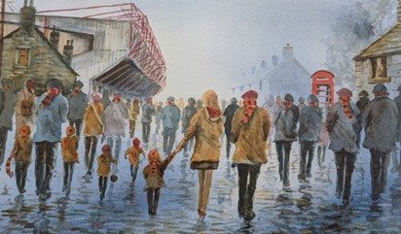
2. The Social Space - Culture, Politics, Economy
Generating SROI
The capacity to use economic power and resources to generate positive social benefits, facilitate community development, social cohesion, protection of the vulnerable
What is SROI? The amount of social good generated for every £1 spent on foundation programmes.
Bradford City Community Foundation generated £13.2 million in social value in 2025 – mental and physical health, community resilience cohesion, and positive environmental impact.
Click image to visit footballpeaceacademy.com
92 clubs in the 4 English Leagues – Power of the game to reach into all communities

Slide 7



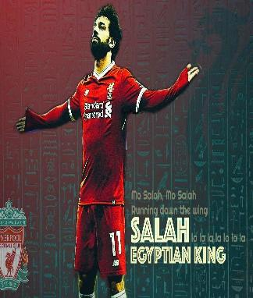
2. The Social Space - Culture, Politics, Economy
Two Case Studies: Bradford City and Liverpool
Click image to watch video
Click image to watch video
Visit the website: footballpeaceacademy.com

Slide 8

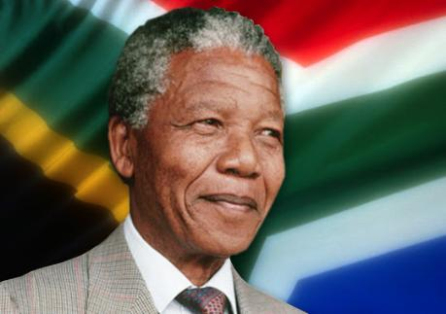
Gandhi established three football clubs in Durban, Pretoria and Johannesburg 1890s –the Passive Resisters Soccer Club
“Sport has the power to change the world.
It has the power to inspire.
It has the power to unite people in a way that little else does.
It speaks to youth in a language they understand.
Sport can create hope where once there was only despair.
It is more powerful than government in breaking down racial barriers.”
Nelson Mandela
Click image to watch video

Slide 9
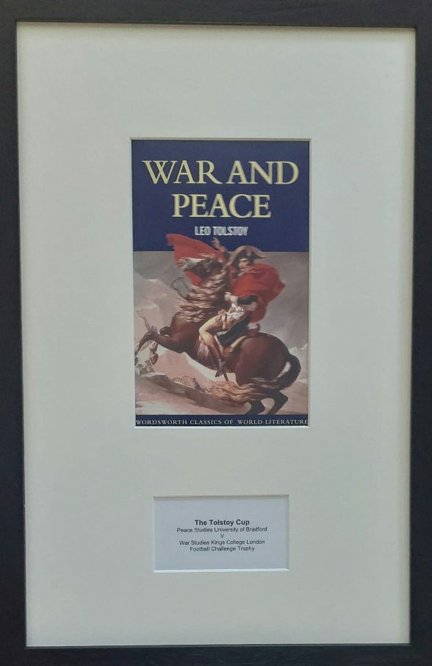
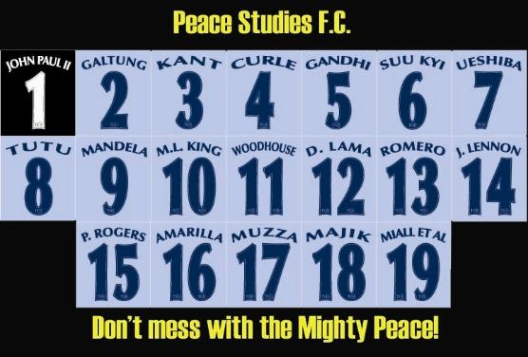

Click image to visit footballpeaceacademy.com
Click to listen

Slide 10
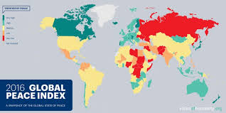

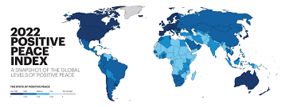
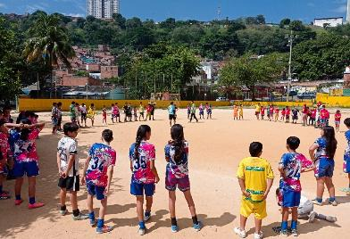
Through an innovative methodology, youth gain global knowledge localise the SDGs and create a peace model.
Click image to see latest GPI
The 8 Pillars of Positive Peace
The 17 Sustainable Development Goals
Socio-emotional Learning
Sport for Development and Peace
Click image to visit footballpeaceacademy.com

Slide 11
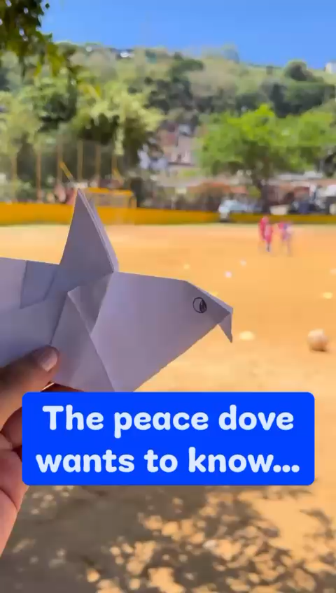
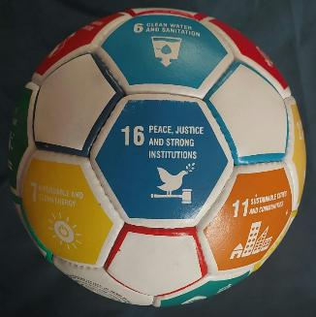
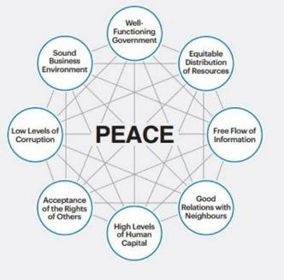
Learn more at footballpeaceacademy.com/bucaramanga

Slide 12


Slide 13
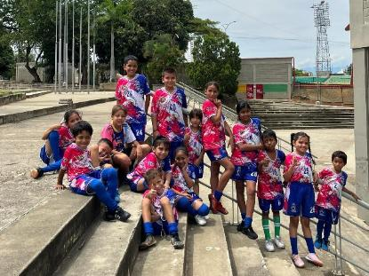

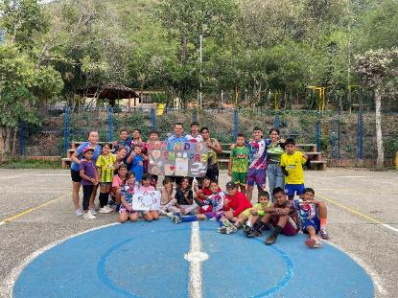
Learn more at:
footballpeaceacademy.com
golesporlapaz.org
golesporlapaz.org/volunteer
/golesporlapazbga
/golesporlapaz
/fundación-goles-por-la-paz

