Slide 1
CANADA
This is my project about
I have never been to Canada, but we have learned many things
Notes:
© Copyright PresentationGo.com – The free PowerPoint template library

Slide 2

This is the flag of CANADA
Notes:
© Copyright PresentationGo.com – The free PowerPoint template library

Slide 3
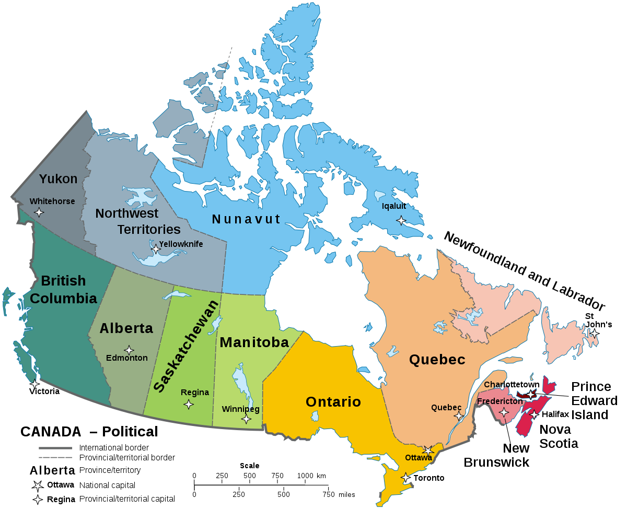
This is the map of CANADA

Slide 4
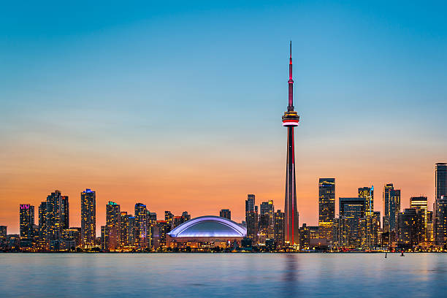
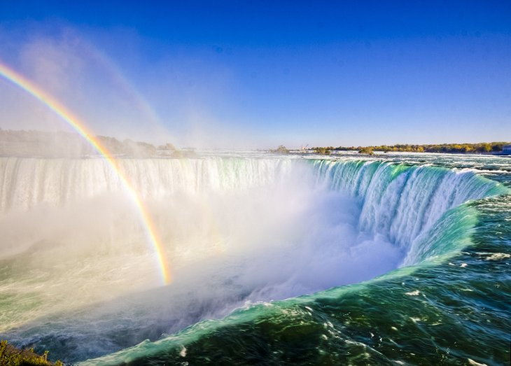
When you go to CANADA, you can visit
Niagara Falls is located just over an hour's drive from Toronto

Slide 5
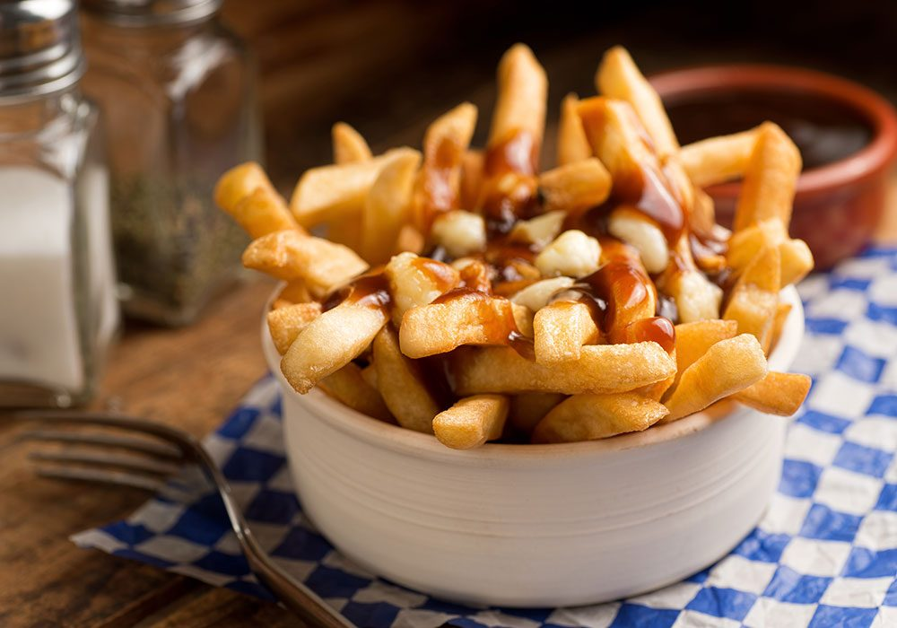
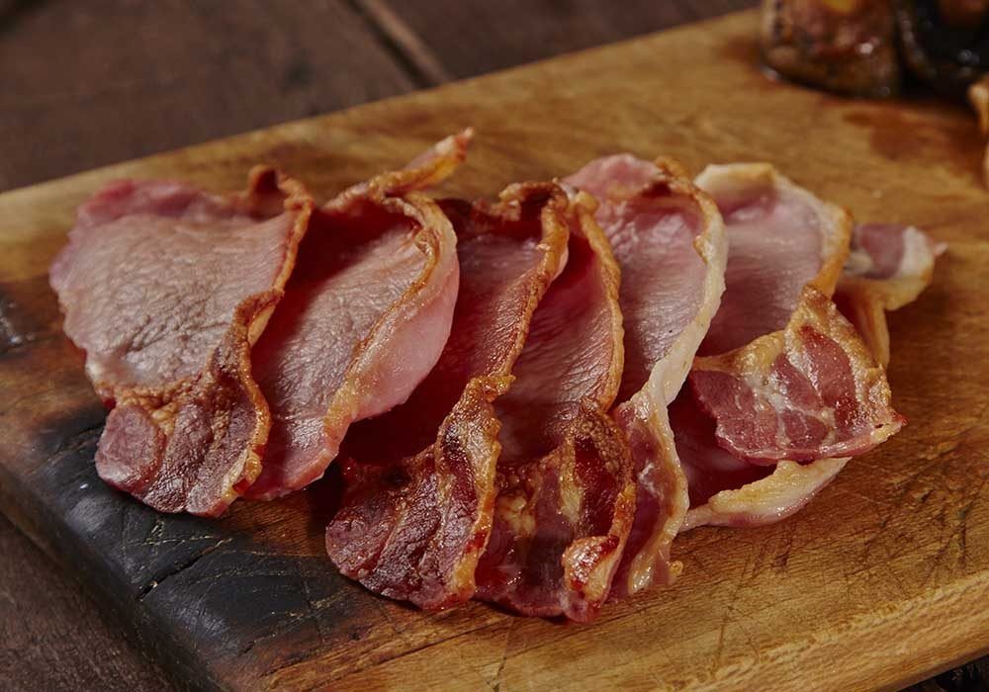

When you go to CANADA, you can eat
Canadian Bacon
Canadian Pizza

Slide 6

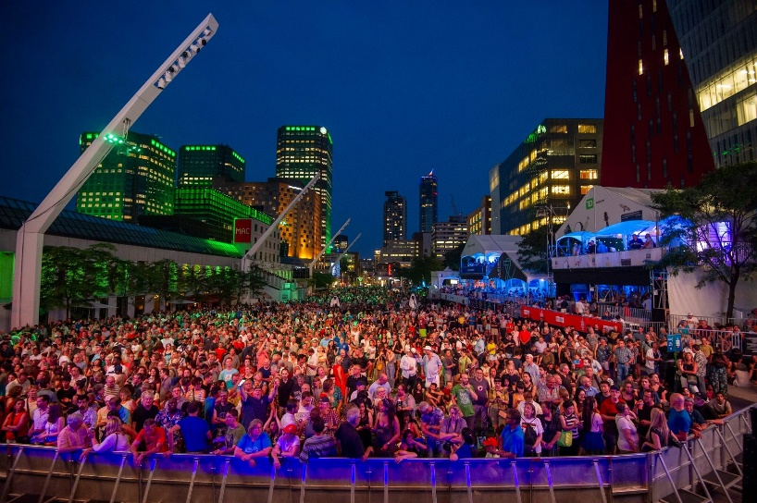
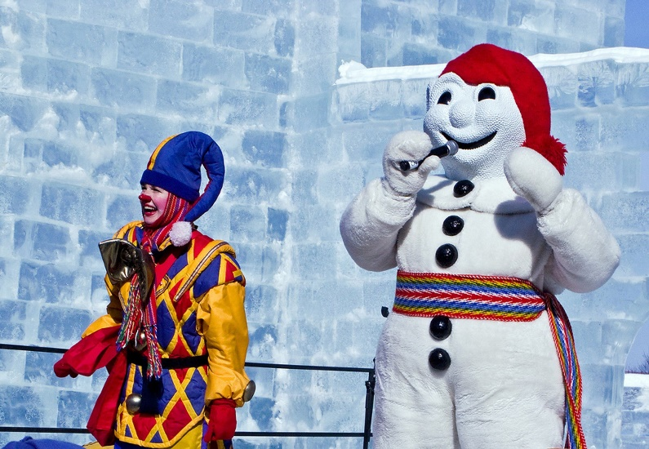
These are famous celebrations in CANADA
8-18 May
Quebec Winter Carnival
Canadian Tulip Festival
Montreal International Jazz Festival
7-16 February
June 25 – July 4

Slide 7


I hope you enjoyed our visit to
CANADA

