Slide 1
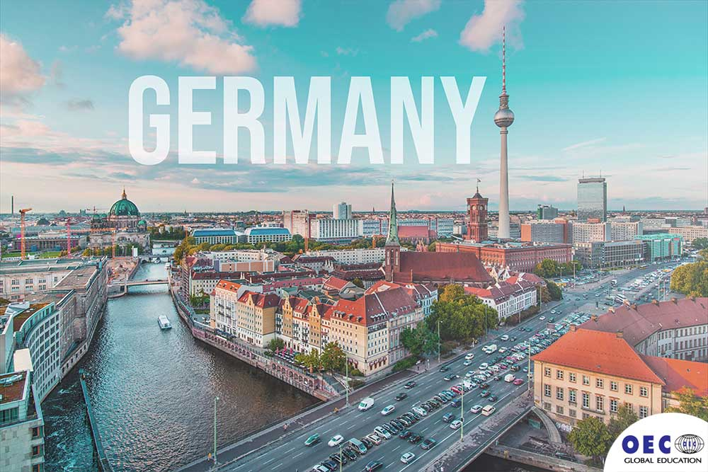
This is my project about
I’ve learned many things about Germany

Slide 2
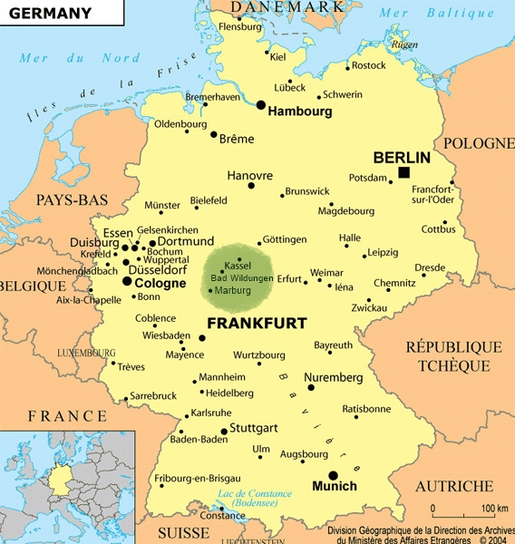
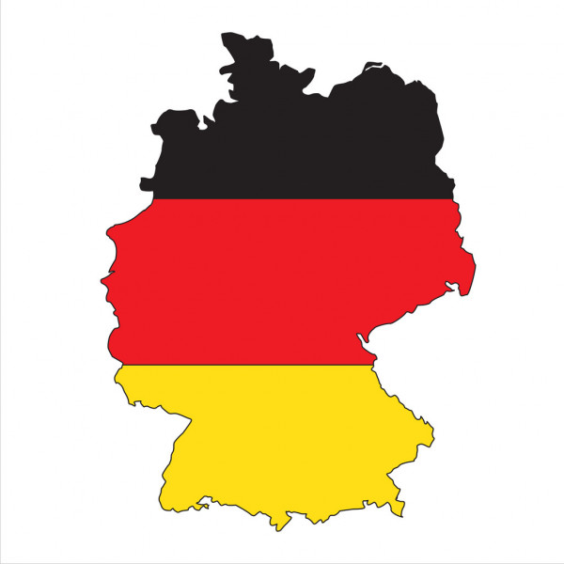
This is the map of Germany
Germany is in Central Europe

Slide 3
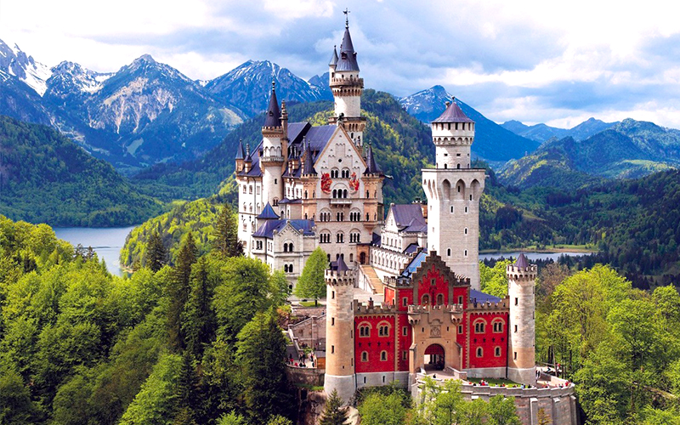
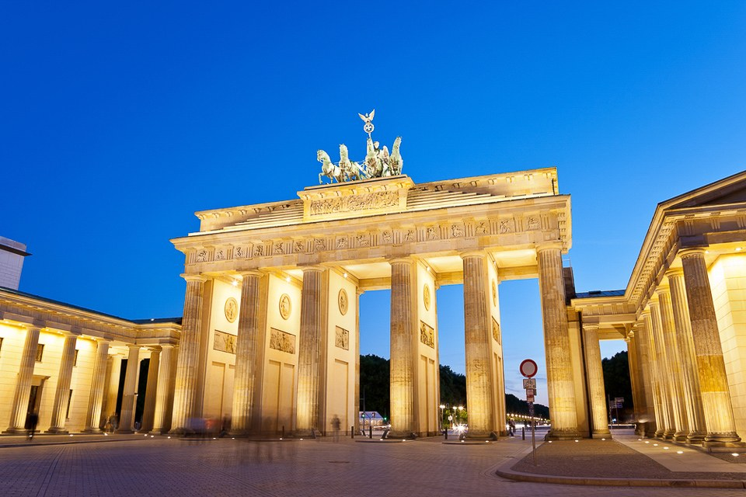
When you go to Germany, you can visit
Neuschwanstein Castle
Brandenburg Gate

Slide 4
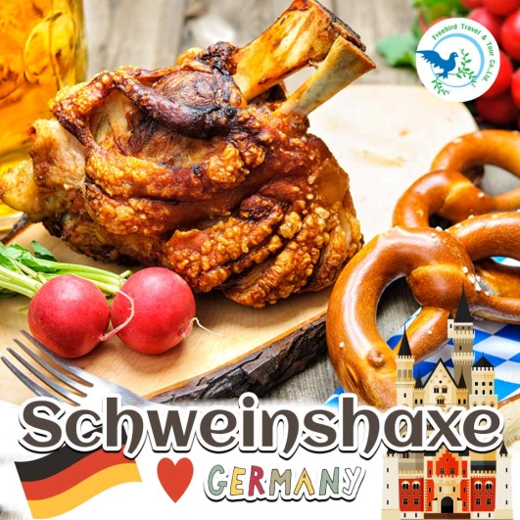


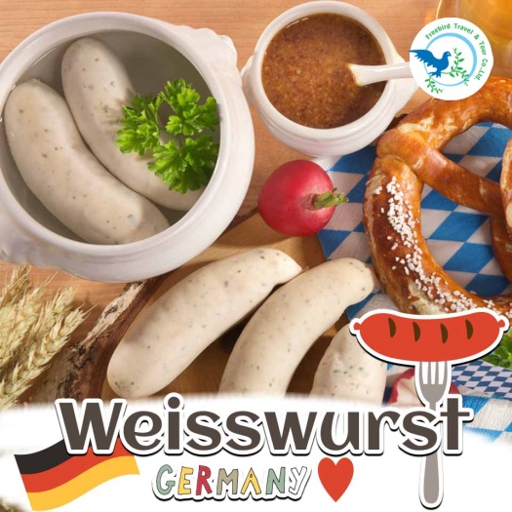
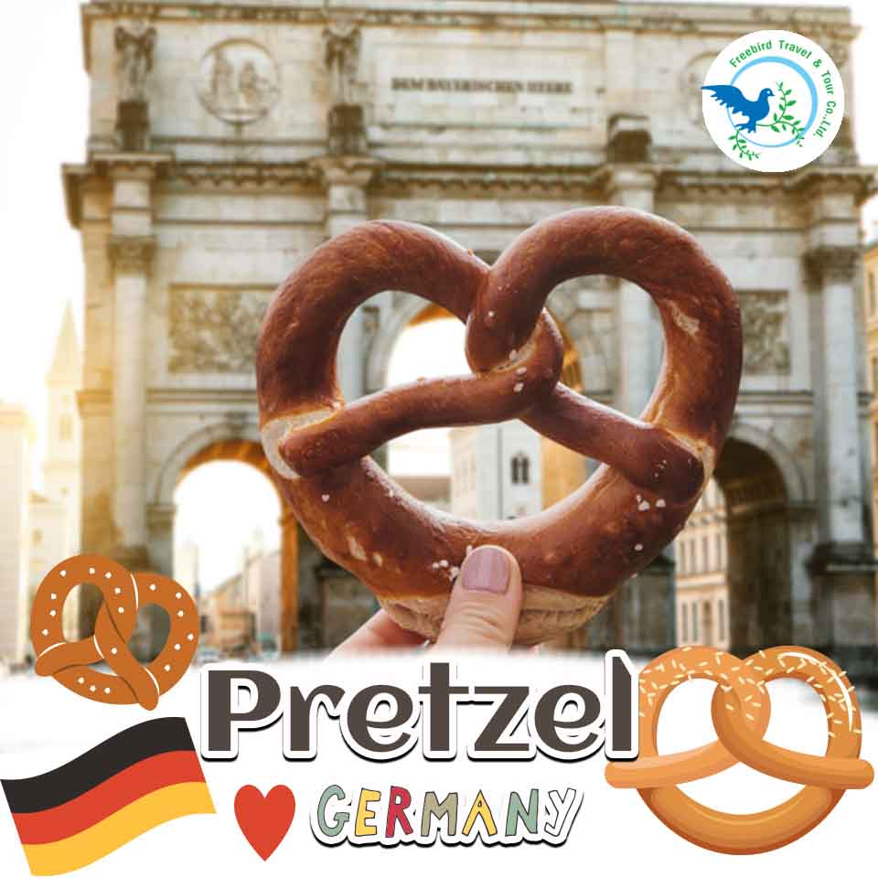
When you go to Germany, you can eat
and many more…

Slide 5
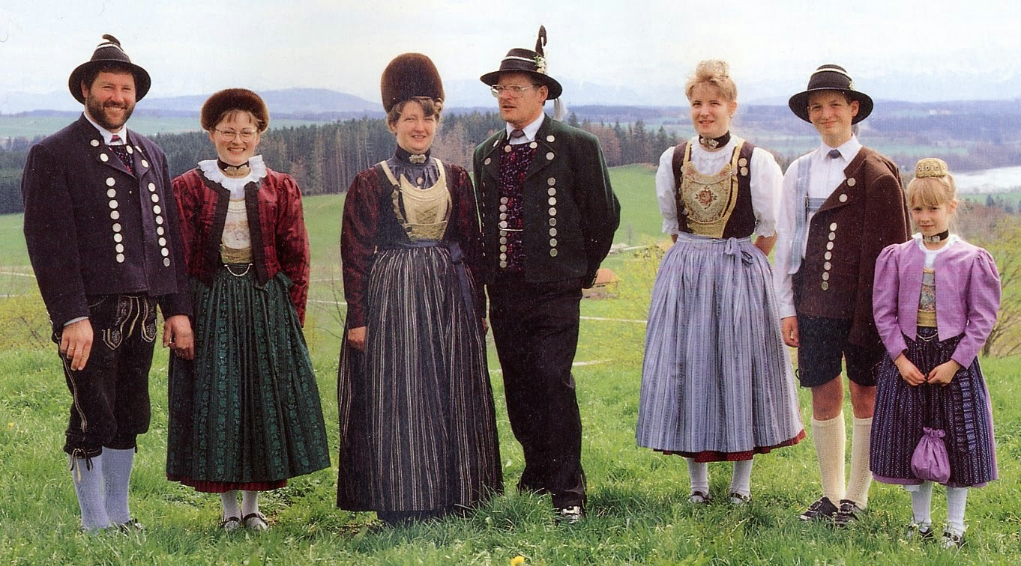
These are the traditional clothes of Germany

Slide 6
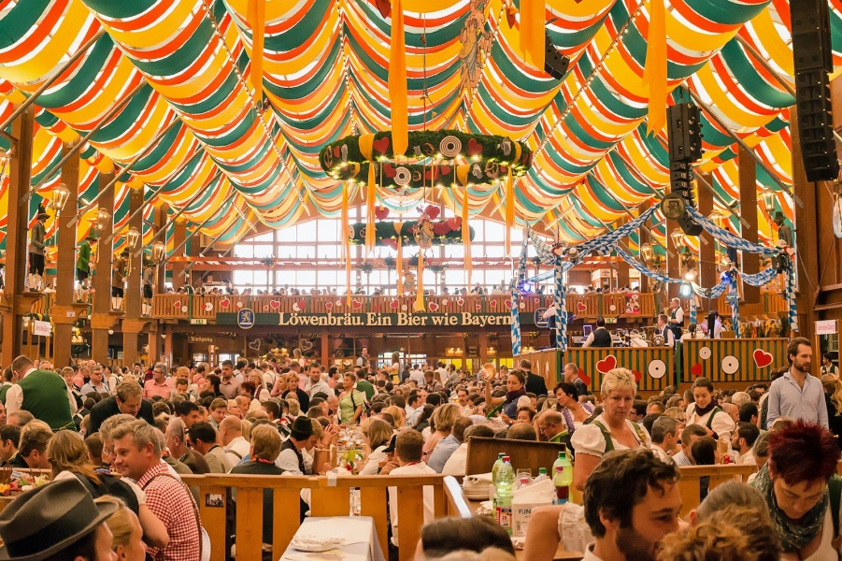
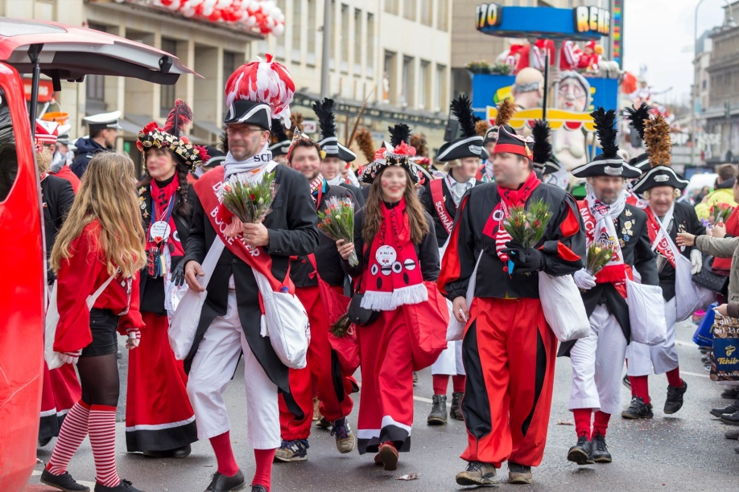
These are famous celebrations in Germany
Oktoberfest in Munich
September - early October: Experience the ultimate celebration of Bavarian beer, culture, and music
Karneval in Cologne
February: Dress up in wacky costumes during one of Germany’s most colourful festivals

Slide 7
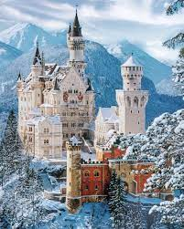
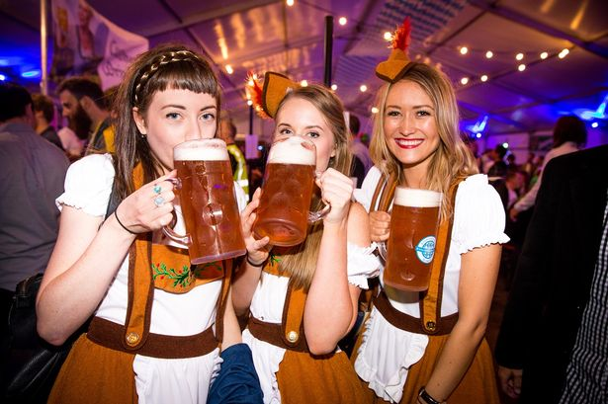



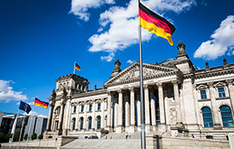
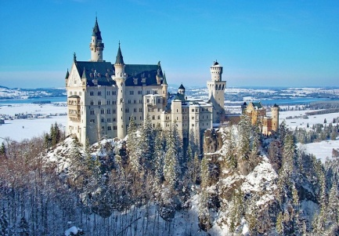
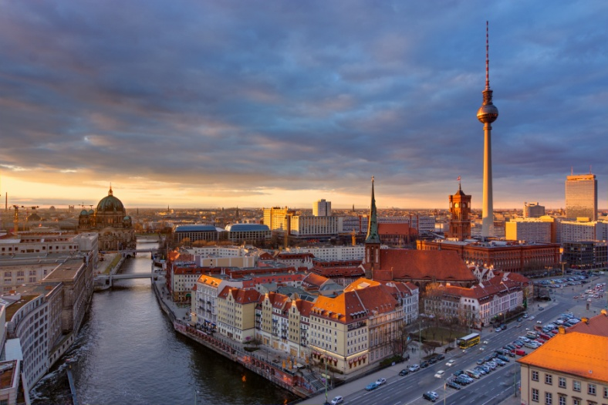

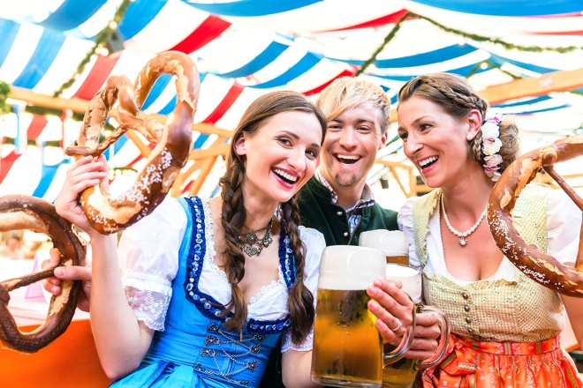

I hope you enjoyed our visit to Germany

Slide 8

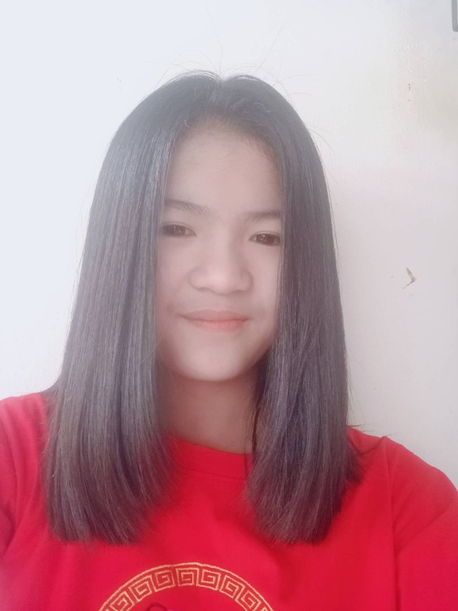
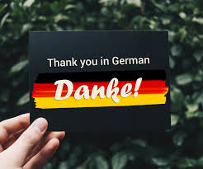
Miss Fahsi Jitchum P.5/1 #20

