Slide 1
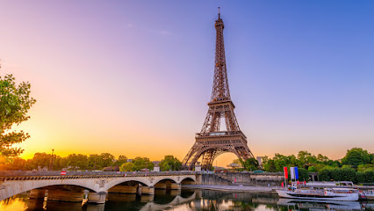
This is our project about
We’ve learned many things about France.

Slide 2

This is the flag of France

Slide 3
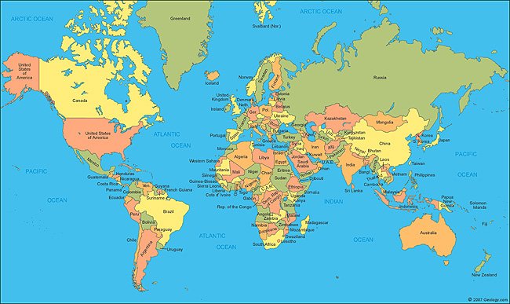

This is the map of France
France is in Western Europe.

Slide 4
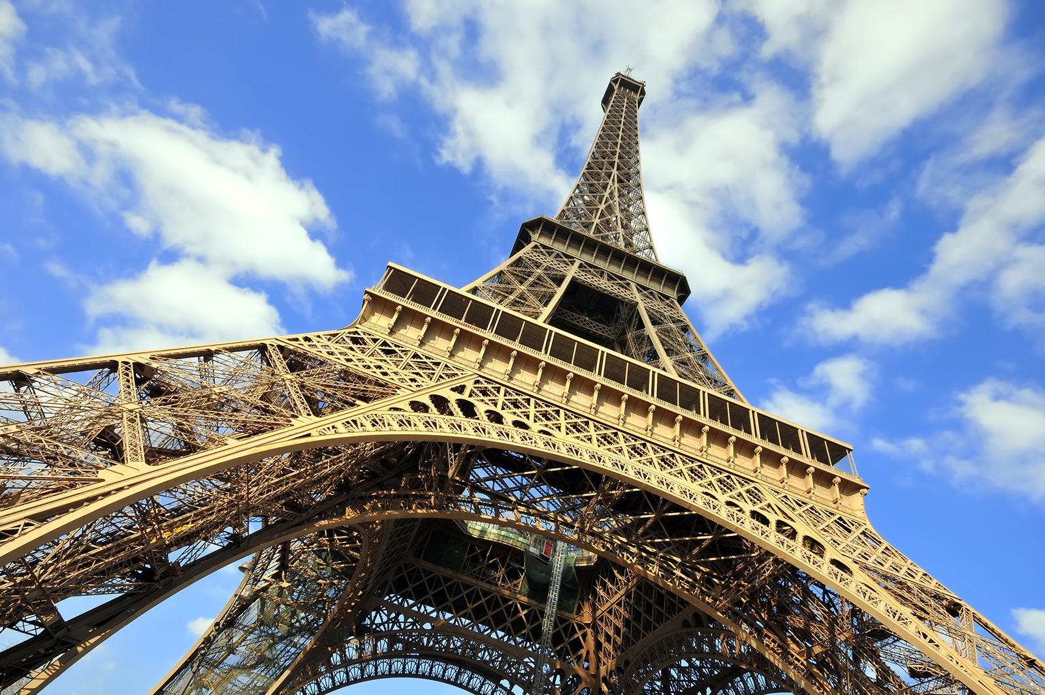
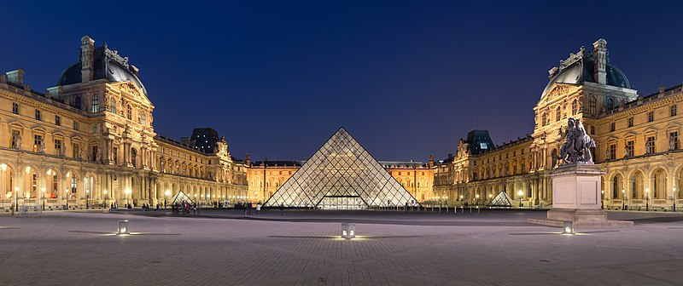
When you go to France, you can visit
Eiffel Tower in Paris.
Louvre in Paris

Slide 5
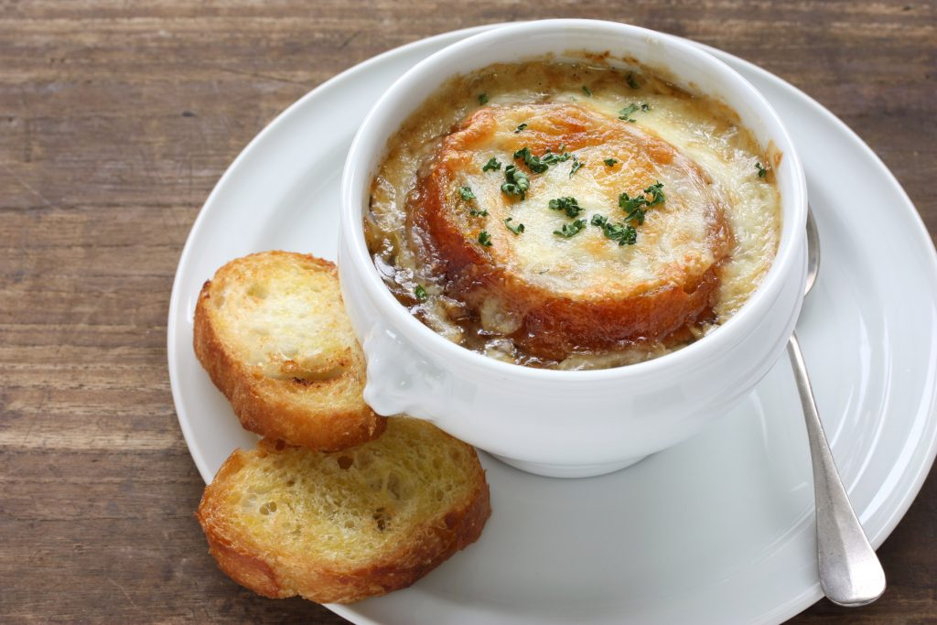
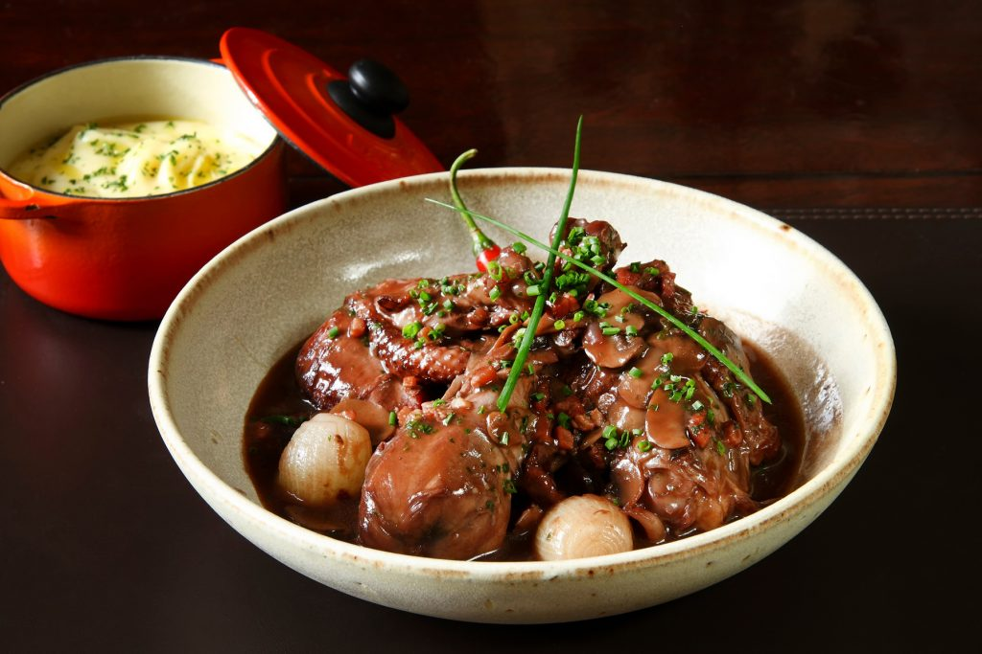
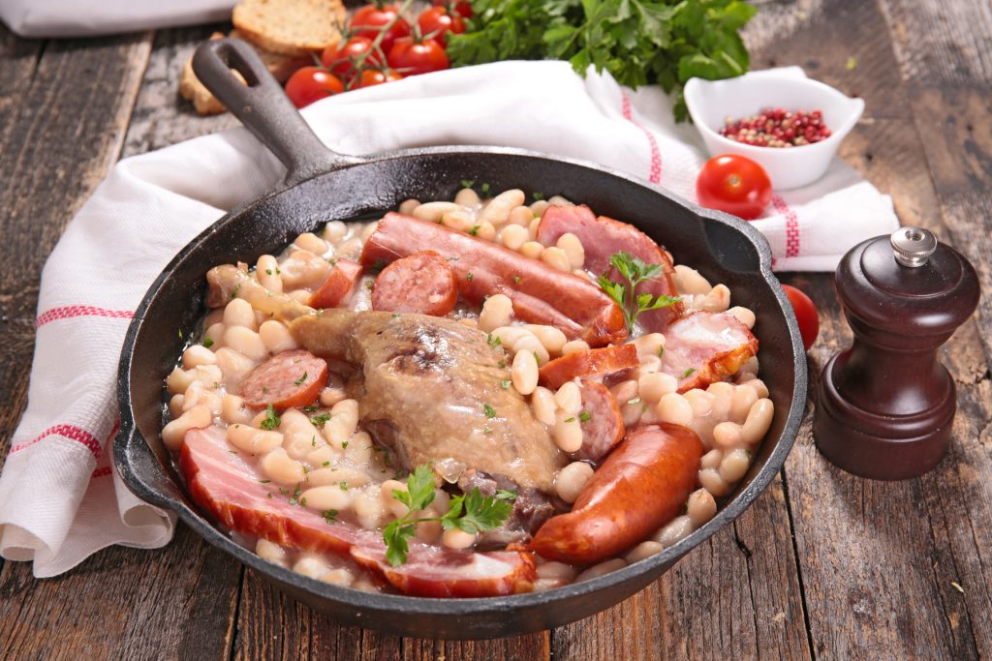
When you go to France, you can eat
Onion soup.
Rooster in wine.
Cassoulet.
and many more…

Slide 6
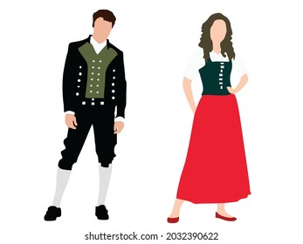
These are the traditional clothes of France

Slide 7
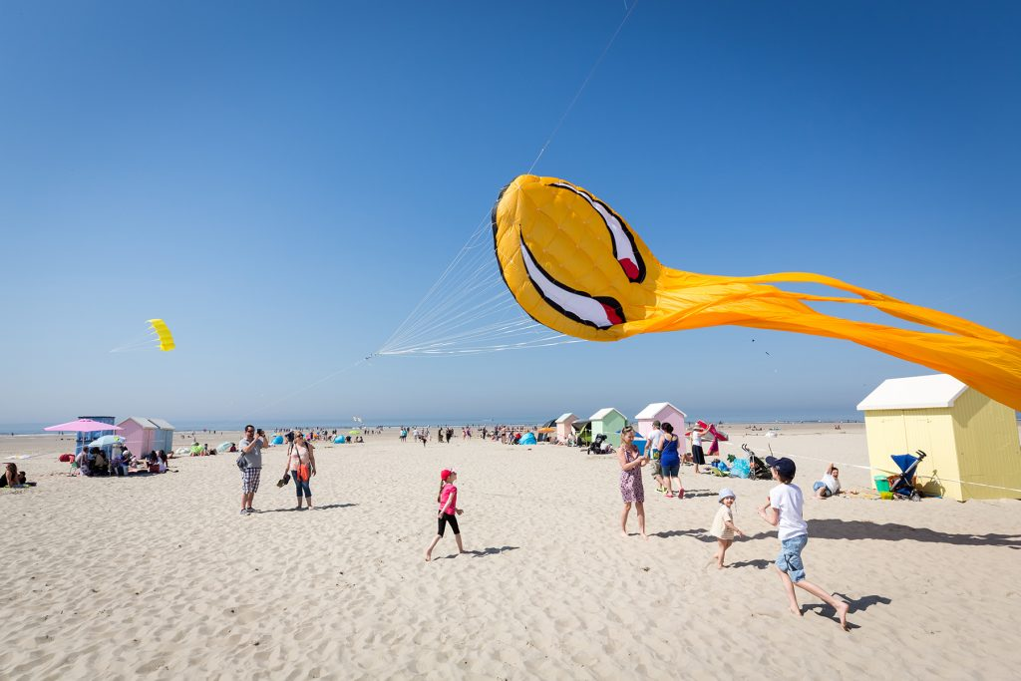
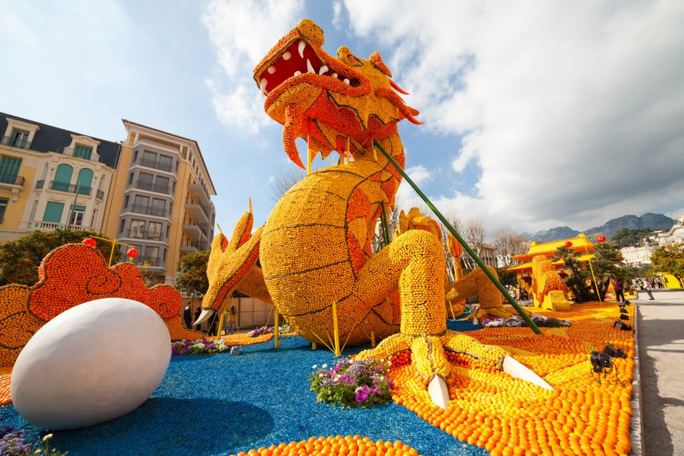
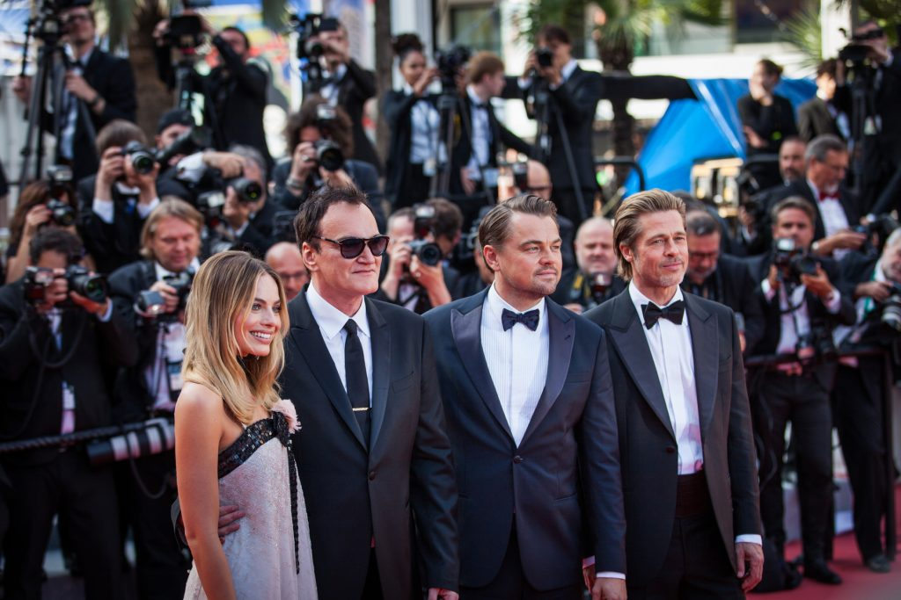
These are famous celebrations in France
Berck-sur-Mer Kite Festival
23 April – 1 May
Menton Lemon Festival
12 Feb - 27 Feb
Cannes Film Festival
6 July – 17 July

Slide 8
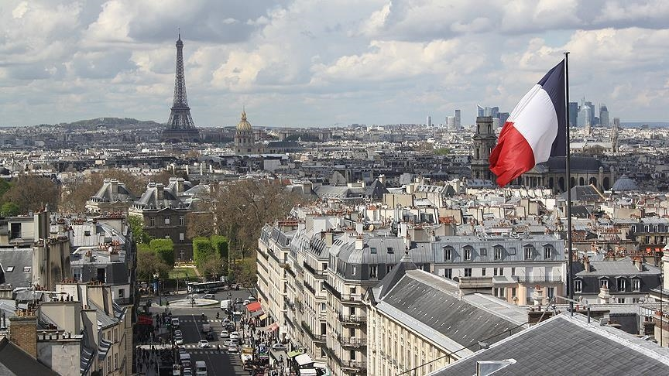
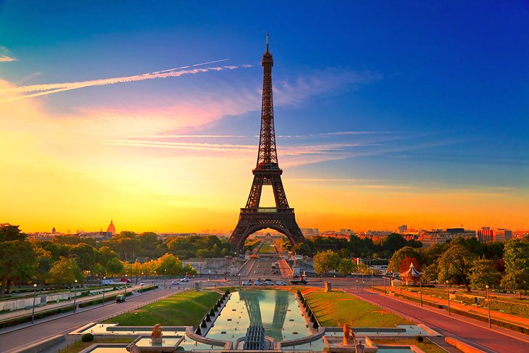
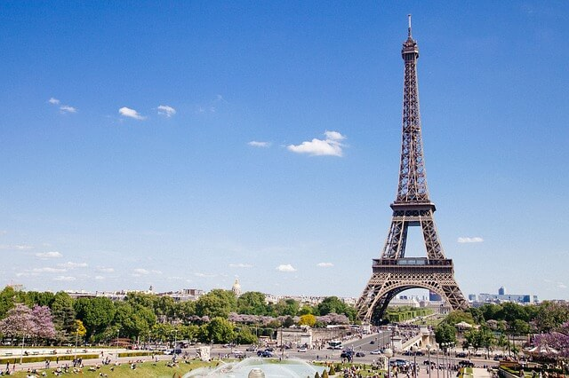
We hope you enjoyed our visit to France

Slide 9


