Slide 1
I’ve learned many thing about New Zealand
This is my project about
NEW ZEALAND

Slide 2
This is the map of New Zealand

Slide 3
This is the flag of New Zealand

Slide 4
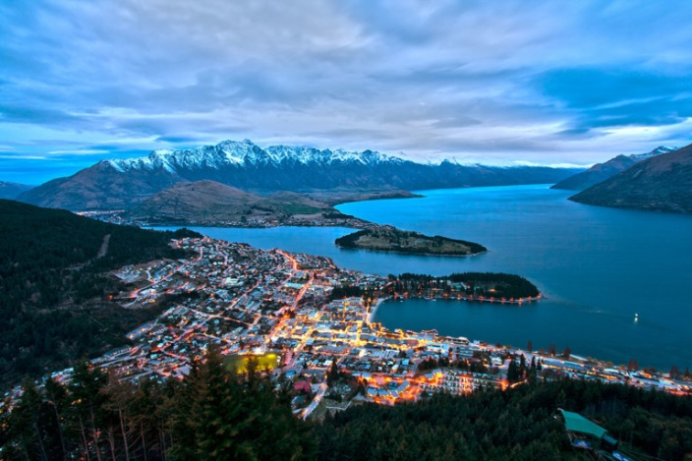
When you go to New Zealand you can visit
Lake Tekapo
Queenstown

Slide 5
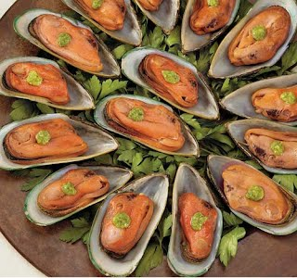
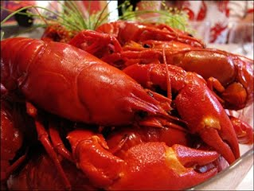
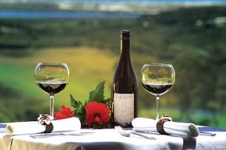
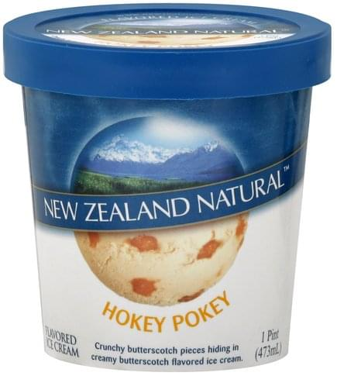
When you go to New Zealand, you can eat
Pavlova
Greenshell Mussel
Crayfish
Hokey Pokey Ice Cream
Marlborough

Slide 6
This is the traditional cloth of New Zealand
national costume New Zealand

Slide 7
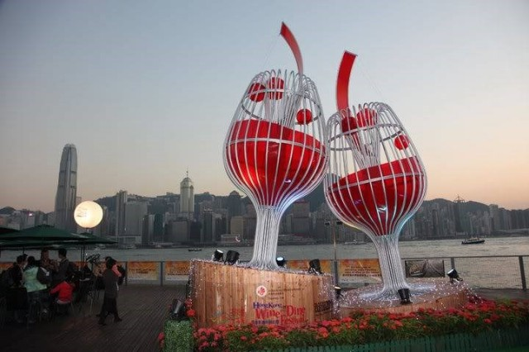
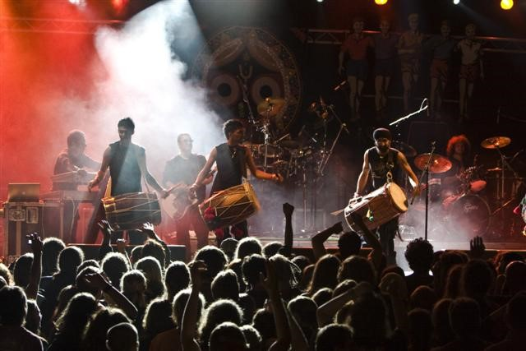
These are Famous celebrations in New Zealand
Food and Wine Festivals Nationwide
(New Zealand in summer and fall)
Otago Festival of the Arts)
(in October)
Golden Cheers Festival
(every March)

Slide 8
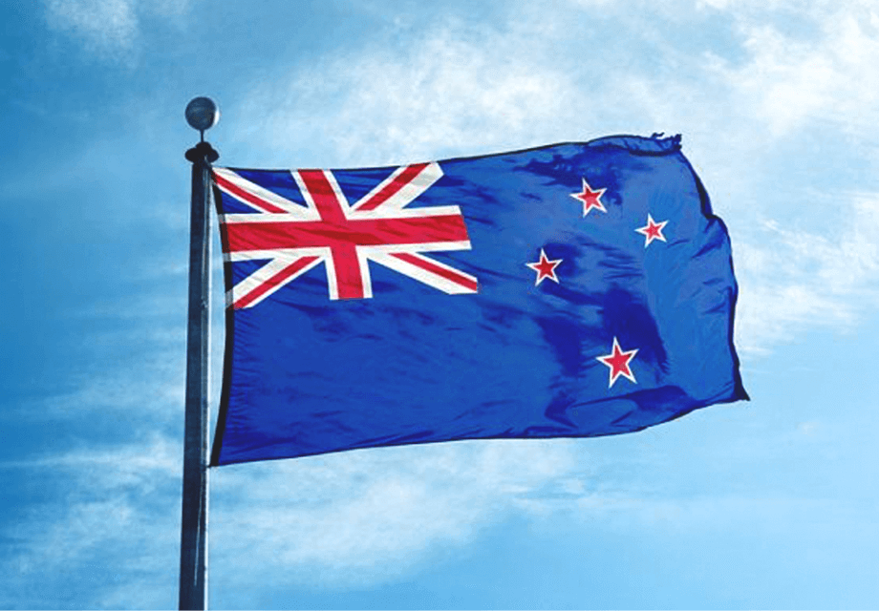
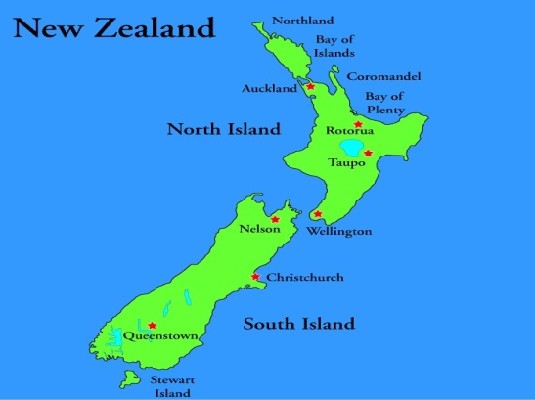
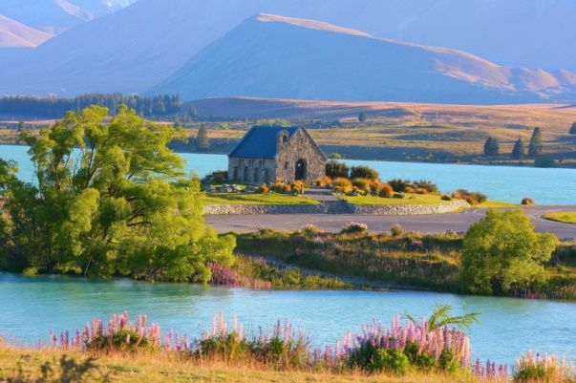
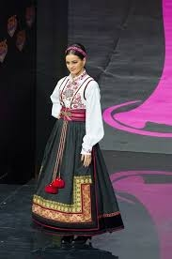
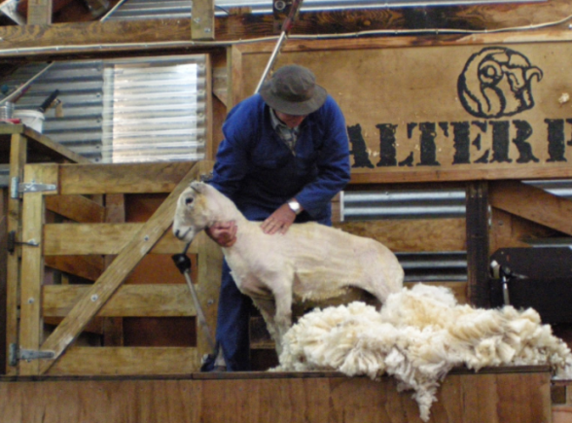
I hope you enjoyed our visit to New Zealand

