Slide 1
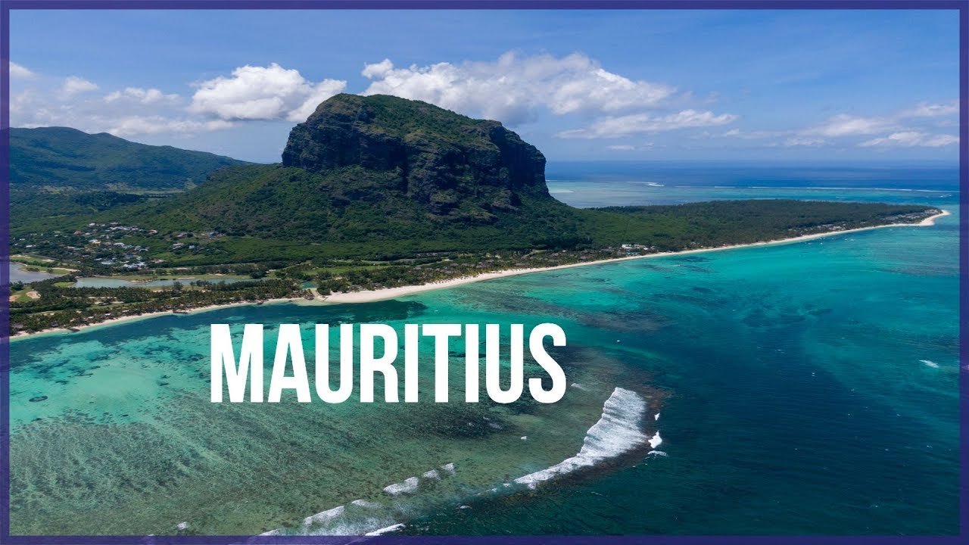

This is my project about
I’ve learned many things Mauritius.

Slide 2

This is the flag of Mauritius.

Slide 3
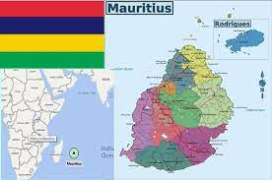
This is the map of Mauritius.

Slide 4
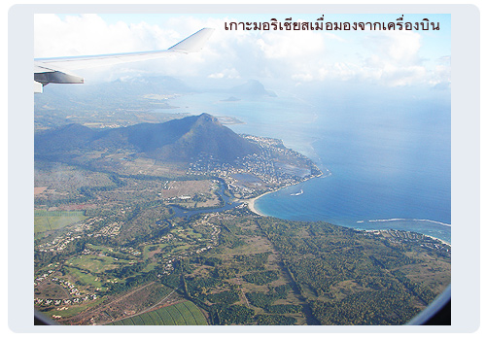

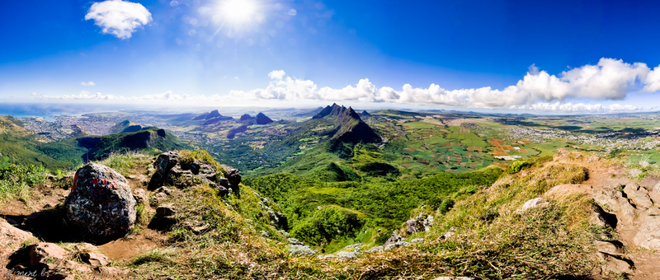
When you go to Mauritius, you can visit

Slide 5
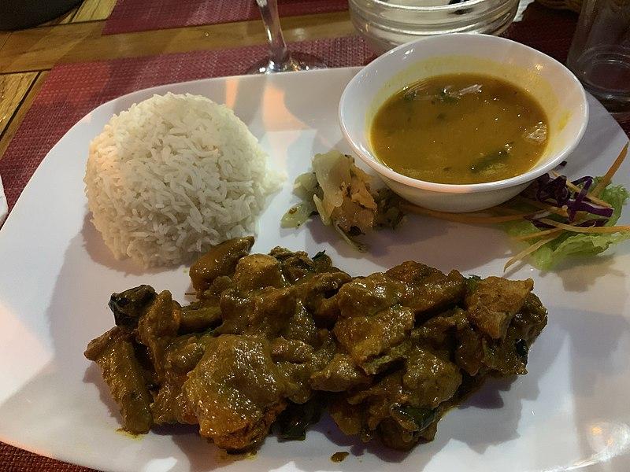
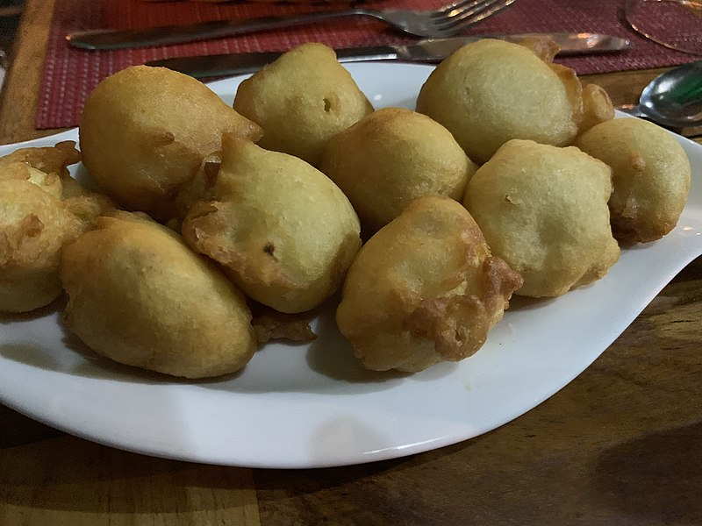
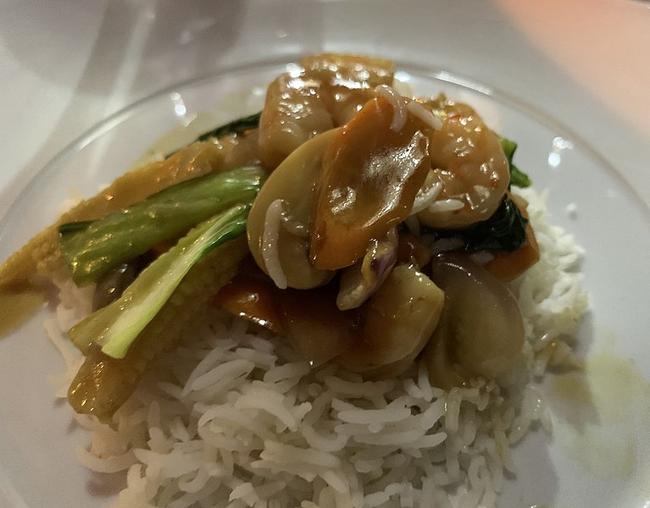
When you go to Mauritius, you can eat
and many more…

Slide 6
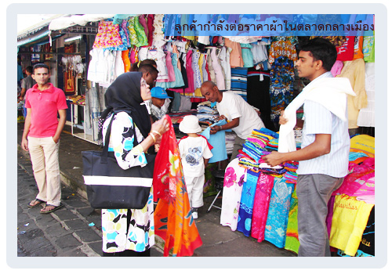
These are the traditional clothes of Mauritius.

Slide 7
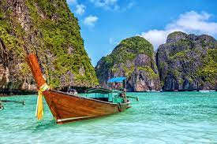
I hope you enjoyed our visit to Mauritius.

Slide 8
