Slide 1

This is my project about
I’ve learned many things about The Netherlands.

Slide 2

This is the flag of The Netherlands

Slide 3
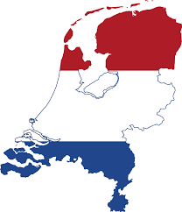
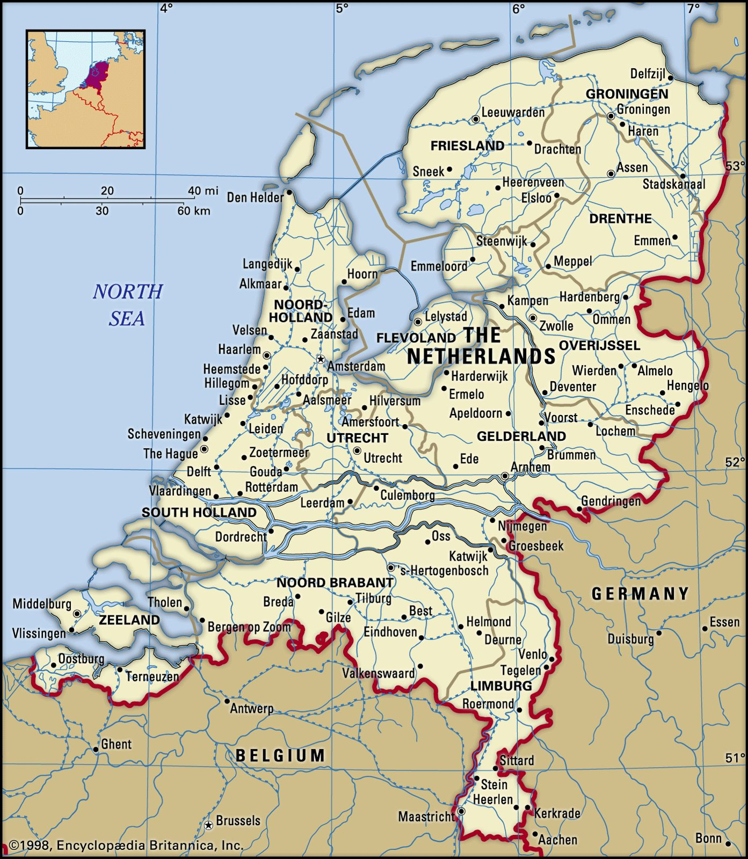
This is the map of The Netherlands
The Netherlands is in Europe.

Slide 4
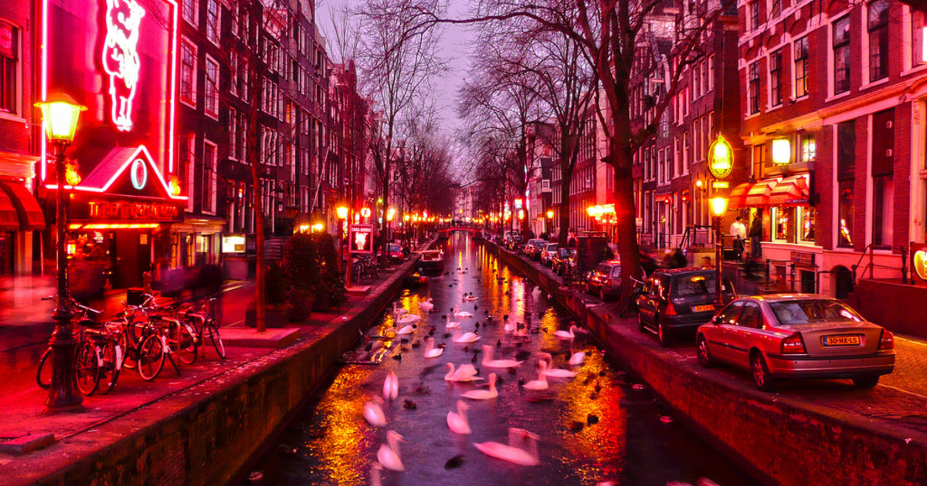
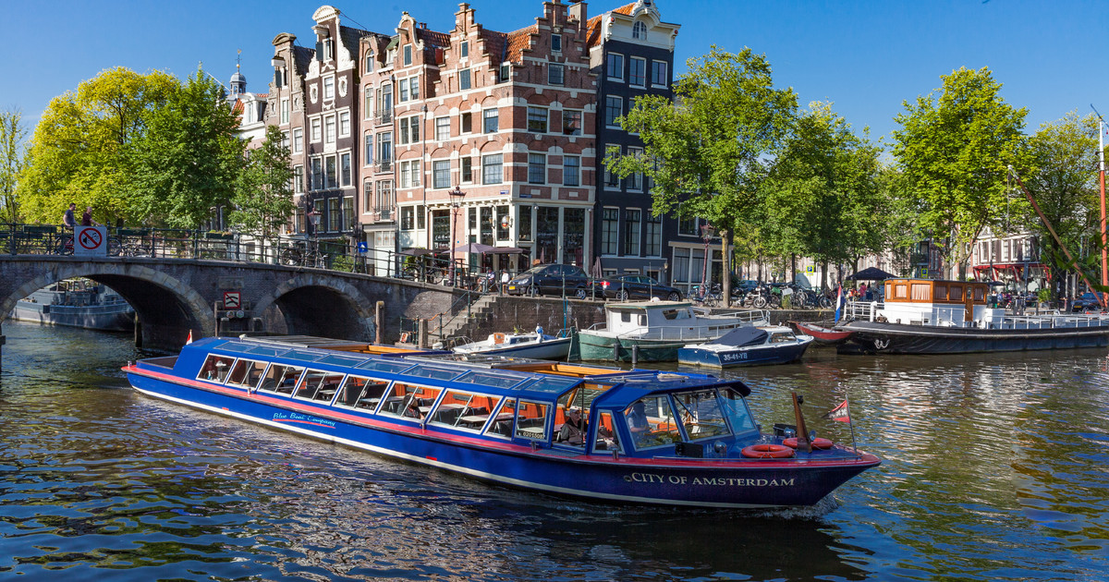
When you go to The Netherlands, you can visit
Canal Cruise in Amsterdam.
Red light District in Amsterdam.

Slide 5
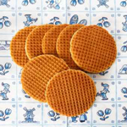
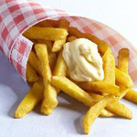
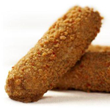
When you go to The Netherlands, you can eat
Patat
Stroopwafel
Kroket
and many more…

Slide 6
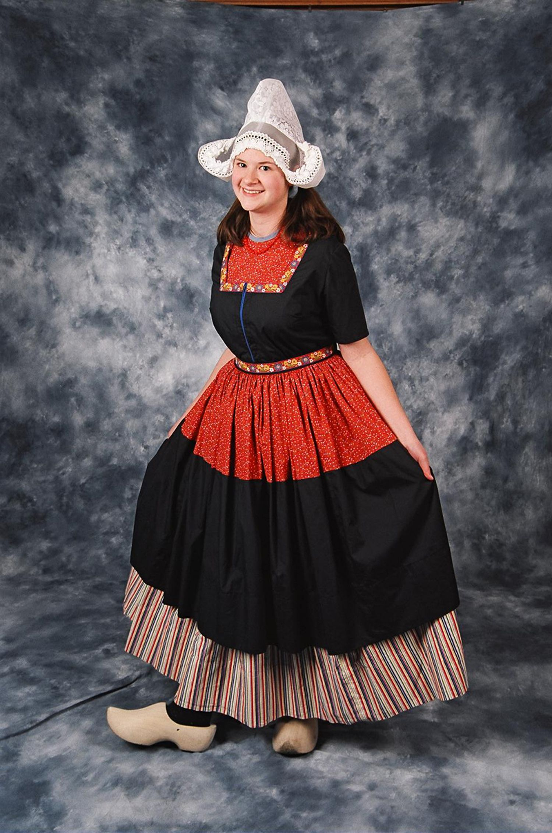
These are the traditional clothes of The Netherlands

Slide 7
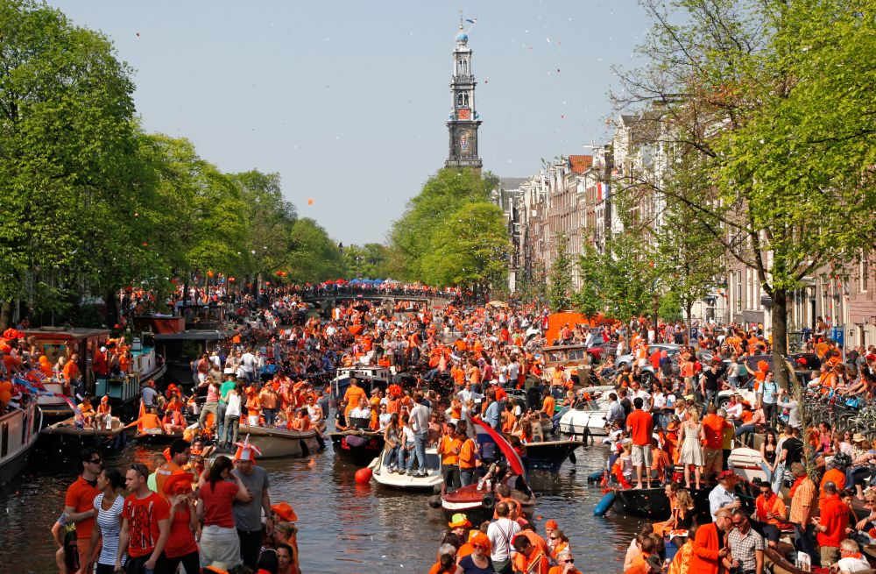
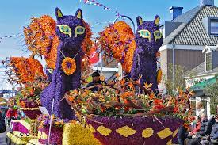
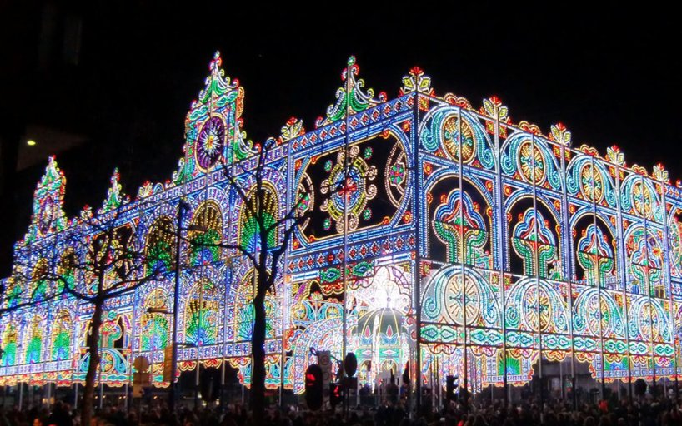
These are famous celebrations in The Netherlands
King Day April 27
Glow Festival
in November
Flower Parade
in April

Slide 8
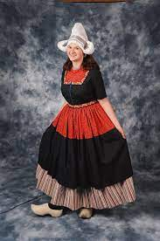
We hope you enjoyed our visit to The Netherlands

Slide 9


