Slide 1
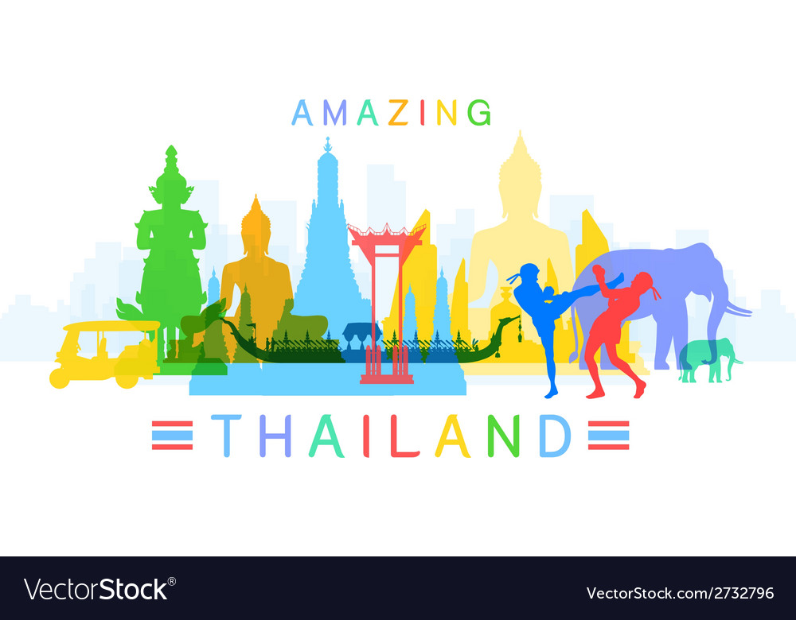
This is my project about
I’ve learned many things about Thailand.

Slide 2

This is the flag of Thailand

Slide 3
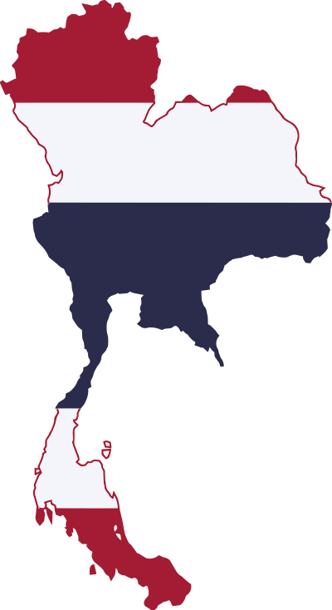
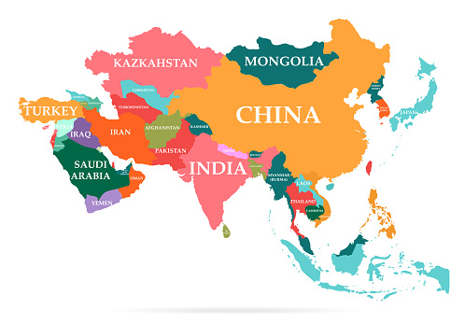
This is the map of Thailand
Thailand is in Southeast Asia.

Slide 4

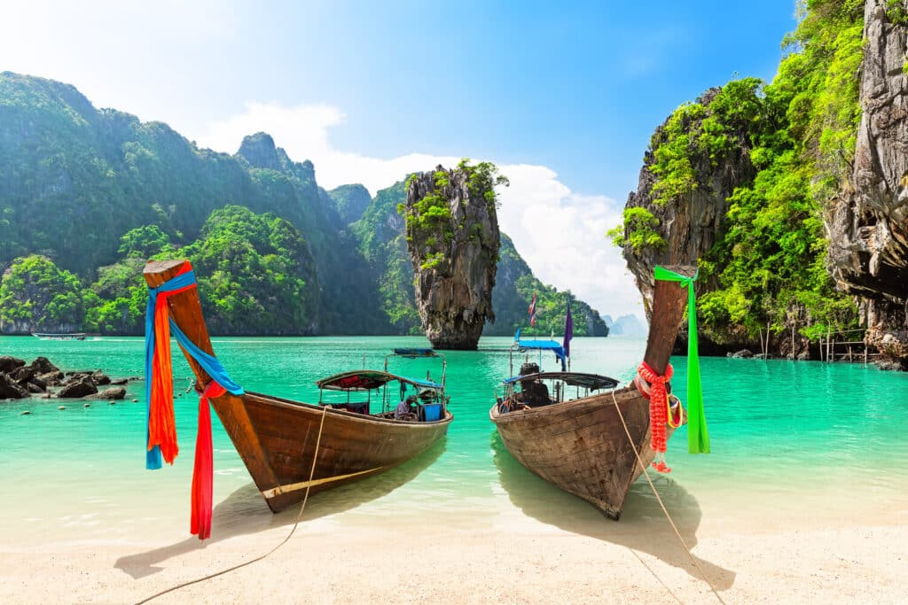
When you go to Thailand, you can visit
The Grand Palace in Bangkok.
White sand beaches and islands in Phuket

Slide 5
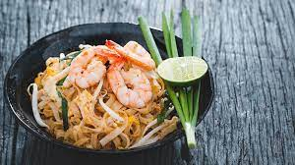
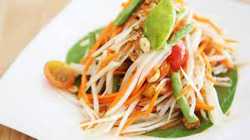
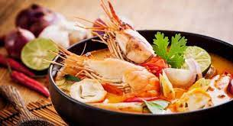
When you go to Thailand, you can eat
Papaya salad
Padthai.
Tom Yum
and many more…

Slide 6
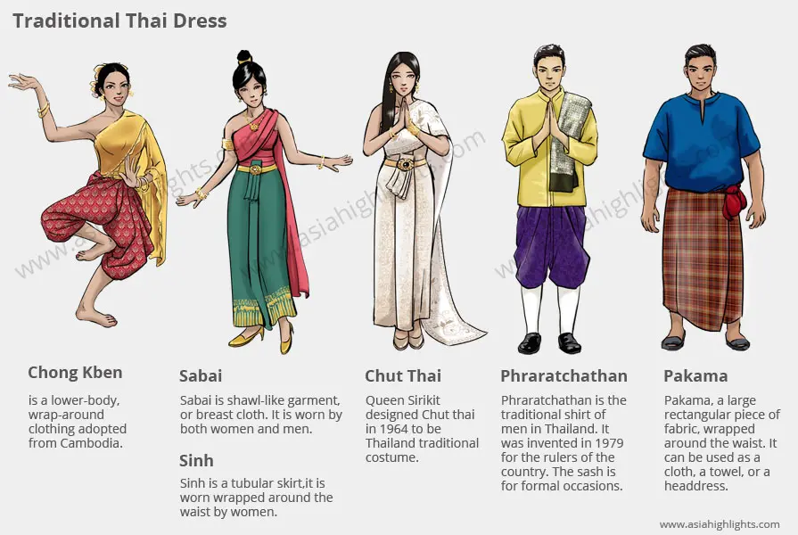
These are the traditional clothes of Thailand

Slide 7
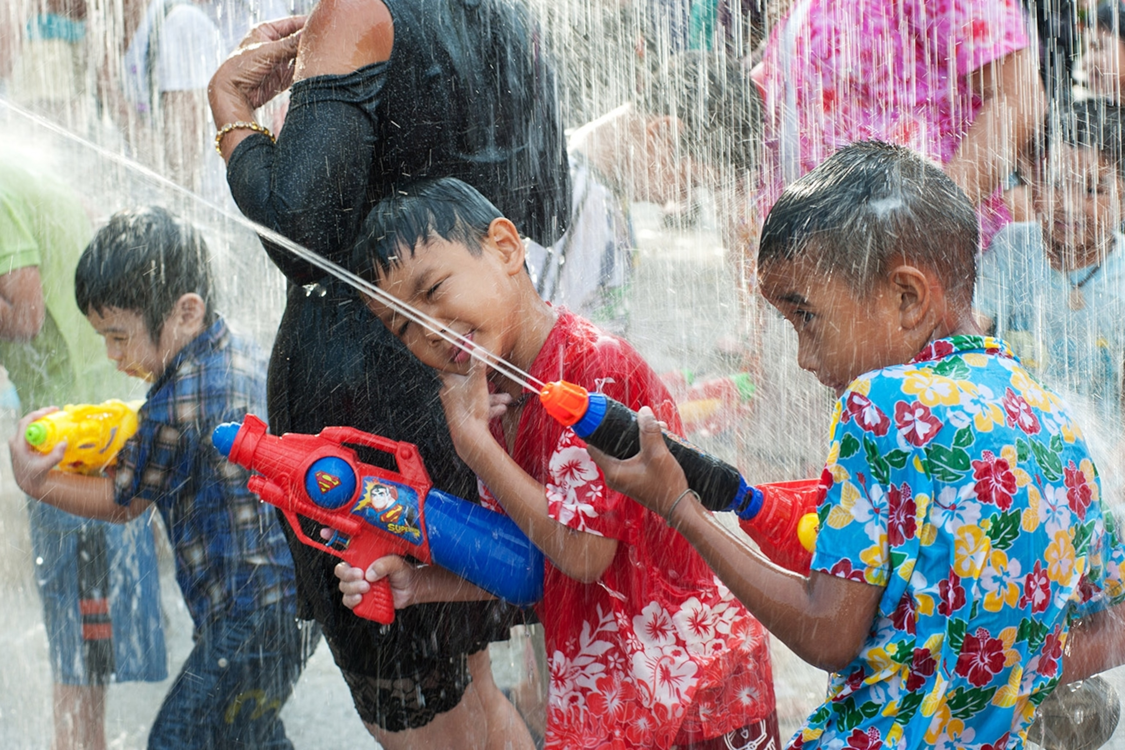
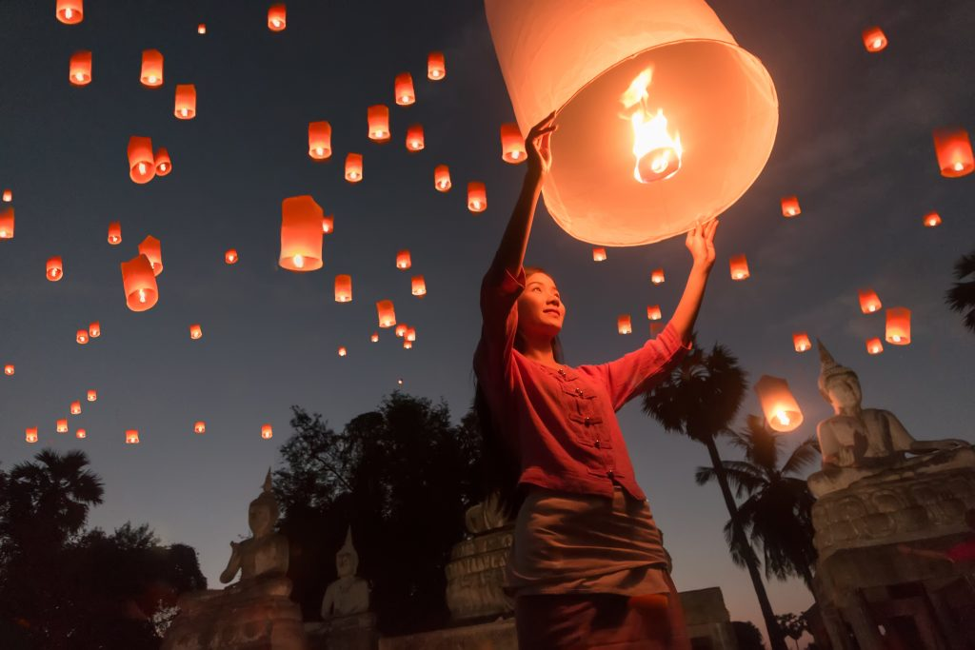
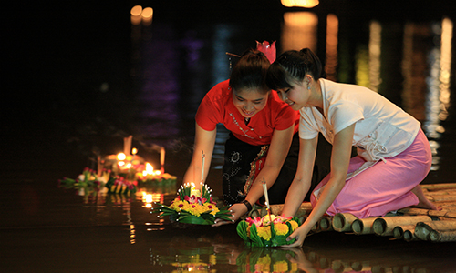
These are famous celebrations in Thailand
Songkran
April 13-15
Chiang Mai Lantern Festival
in November
Loy Kratong
in November

Slide 8
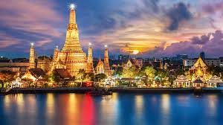
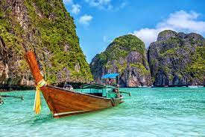
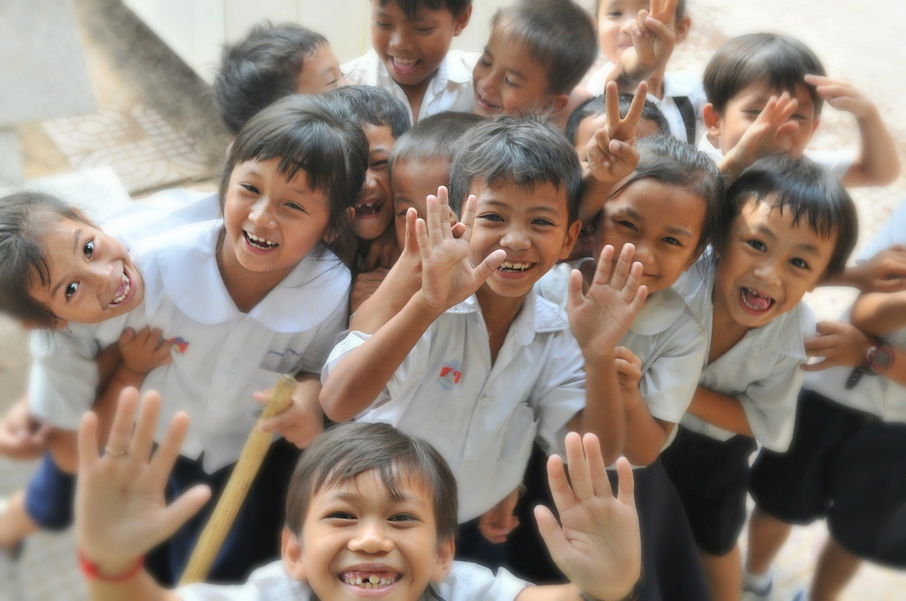
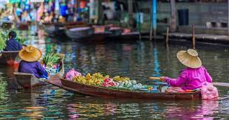
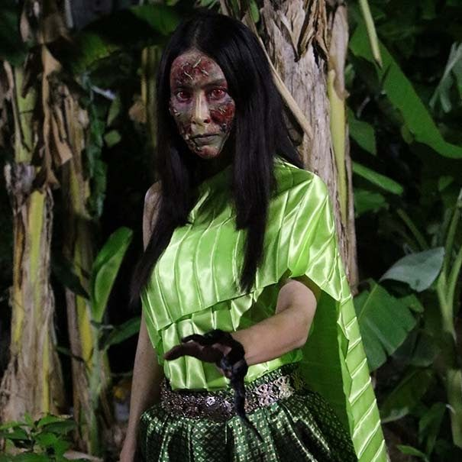
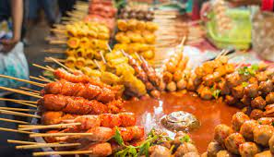
I hope you enjoyed our visit to Thailand

Slide 9



