Slide 1
New Brand
MEMZ

Slide 2
Brand concept:
Egyptians always convert anything into a comedy, even if it's a black comedy. They always dig deep to bring a laugh to life and make it related to every situation. This appears in the comics, humor and their preferences.
Actually, even the ancient Egyptians had a goddess of humor and they made her married to the goddess of Wisdom.
Isn't that telling you something about our DNA?
Fast forward to recent times, you'll find this fact rising and appearing in the form of the tons of comics Egyptians share on Social media and in their everyday life events, moreover, If you search for any significant event related to the Egyptians on google and add the "Comics/memes" word you will be flooded with different memes.
We came up with that concept from here, linking the sense of humor with our love of FOOD.

Slide 3
What we gonna call him?
We came up with the most forward name for our concept from the concept we've mentioned but with a little twist.
Worldwide comedy comics is called "Memes," but you know how the Egyptian accent twist most of the words….the S in memes can be Z
and also the pronunciation.
So here is the Egyptian version of it…MEMZ

Slide 4
MEMZ ميمز

Slide 5
Brand persona and characteristic:
*Funny – Casual – Friendly – Meme lord – Hyper - Generous.
*Always engage with others in a funny way
*Always excited to announce new ideas and happy to do anything and embarks to adventure with ease

Slide 6
Decoration and execution inside the restaurant:

Slide 7
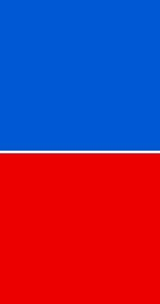
Option 1
Option 2
Magenta: The Magenta color refers to kindness and cooperation. Yellow: refer to laughter, happiness, Youth and energy
Red: the red color gives the feeling of energy, action and excitement.
Blue: the blue color gives the feeling of freedom (as the freedom of choosing your own sandwich)

Slide 8
Decoration and execution inside the restaurant: * 2 main portions (fast food/customized sandwiches) *wooden tables * Memes and funny movie scenes will be drawn in the walls and played on the screens inside the restaurant.

Slide 9
Samples for art work and videos inside the place

Slide 10
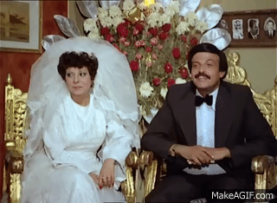
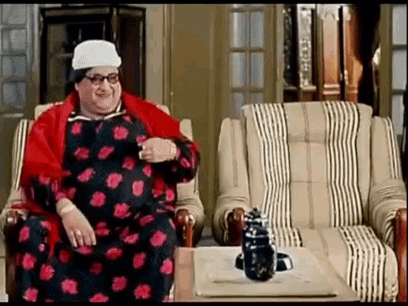
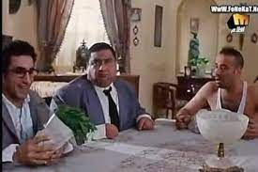
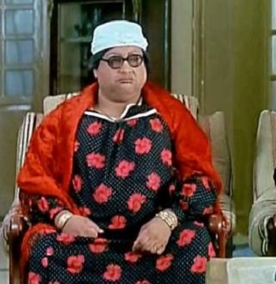
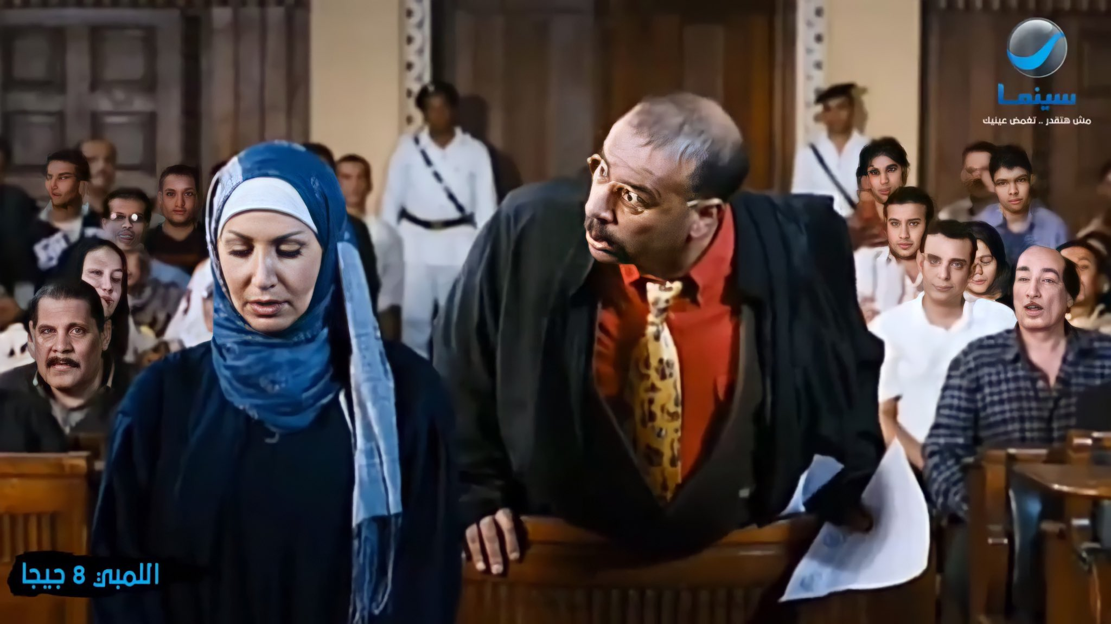
On the counter screen while preparing the order
On the counter screen when an order is done
Art work on the wall
Art work on the wall الاوردر اتأخر؟
مالكش نفس تاكل؟

Slide 11
Content Guideline

Slide 12
Language: Arabic
Tone of voice: Friendly, casual and funny
Visuals: -Funny -Mix between memes and our items (Collage art)
-For sales posts: Real photos
-Include human elements in most of the real shoots that reflect our brand identity
Key messages:
ساندوتشات على كيفك - اللي تعوزه - كل اللي بتدور عليه - ساندوتشات كتيير
- واكلين، شاربين - نهزر -ضاحكين

Slide 13
Digital execution

Slide 14
Tagline: واكلين_شاربين_مع_بعض
This tagline is generated from the place's main concept and name.The tagline will be used for the first quarter and changed after that to another one with the same spirit of the place.

Slide 15
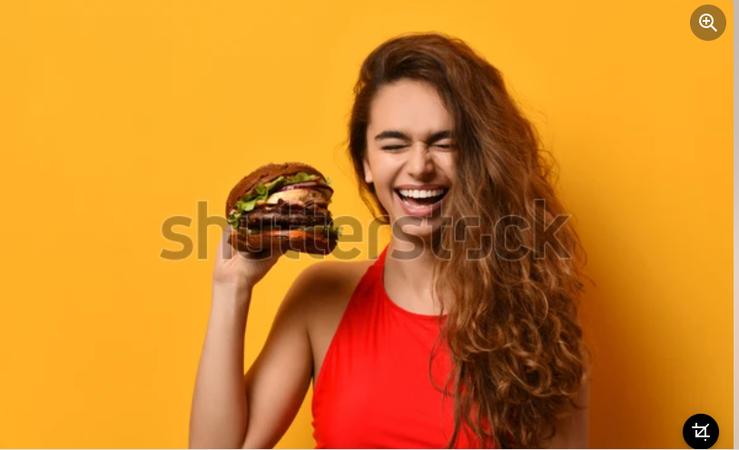
Sample post
Design
Caption: واكلين، شاربين، ضاحكين مع بعض!! في ميمز كل اللي بتدور عليه من خروجة وأكلة وتصوير هتلاقيه. ولو بتاع اختراعات، عملنالك قسم اختراع الساندوتش بنفسك. تعالوا في: #ميمز #واكلين_شاربين
https://www.shutterstock.com/image-photo/woman-hold-big-barbecue-burger-sandwich-1186428082
TOV: واكلين شاربين مع بعض

Slide 16
Thank YOU

