Slide 1

Matrices Arithmetic
Past Exam Q’s

Slide 2
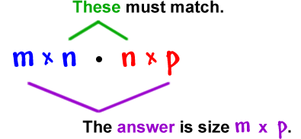





2017 NHT Exam 1 Q8
Matrix A is an n × n matrix where n > 1.
Matrix R is a row matrix.
Matrix C is a column matrix.
Which one of the matrix products below could result in a 1 × 1 matrix?
A. ACR
B. ARC
C. CAR
D. RAC
E. RCA
$$\begin{matrix}A C R \\ n×n n×1 1×n\end{matrix}$$
1 × n
n × 1
$$\begin{matrix}A R C \\ n×n 1×n n×1\end{matrix}$$
$$\begin{matrix}C A R \\ n×1 n×n 1×n\end{matrix}$$
$$\begin{matrix}R A C \\ 1×n n×n n×1\end{matrix}$$
$$\begin{matrix}R C A \\ 1×n n×1 n×n\end{matrix}$$

Slide 3
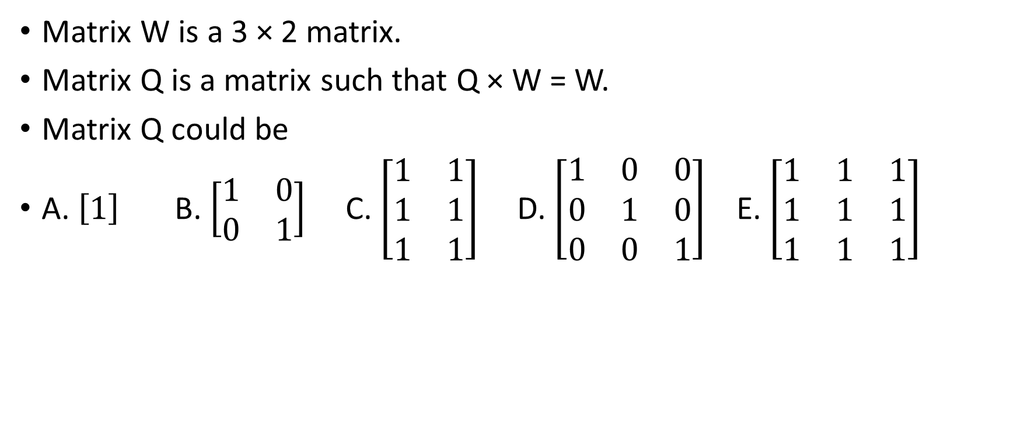

2019 NHT Exam 1 Q6
Matrix W is a 3 × 2 matrix.
Matrix Q is a matrix such that Q × W = W.
Matrix Q could be
A. $\left[1\right]$ B. $\left[\begin{matrix}1 & 0 \\ 0 & 1\end{matrix}\right]$ C. $\left[\begin{matrix}1 & 1 \\ 1 & 1 \\ 1 & 1\end{matrix}\right]$ D. $\left[\begin{matrix}1 & 0 & 0 \\ 0 & 1 & 0 \\ 0 & 0 & 1\end{matrix}\right]$ E. $\left[\begin{matrix}1 & 1 & 1 \\ 1 & 1 & 1 \\ 1 & 1 & 1\end{matrix}\right]$
1 × 1
2× 2
3 × 2
3 × 3
3 × 3
$$\begin{matrix}Q W =W \\ 3×3 3×2 3×2\end{matrix}$$
$\left[\begin{matrix}1 & 0 & 0 \\ 0 & 1 & 0 \\ 0 & 0 & 1\end{matrix}\right]$ $×$ $\left[\begin{matrix}1 & 1 \\ 1 & 1 \\ 1 & 1\end{matrix}\right]$=$\left[\begin{matrix}1×1+0×1+0×1 & 1×1+0×1+0×1 \\ 0×1+1×1+0×1 & 0×1+1×1+0×1 \\ 0×1+0×1+1×1 & 0×1+0×1+1×1\end{matrix}\right]$= $\left[\begin{matrix}1 & 1 \\ 1 & 1 \\ 1 & 1\end{matrix}\right]$

