Slide 1
Maximum flow Minimum Spanning Trees.
Past Exam Q’s

Slide 2
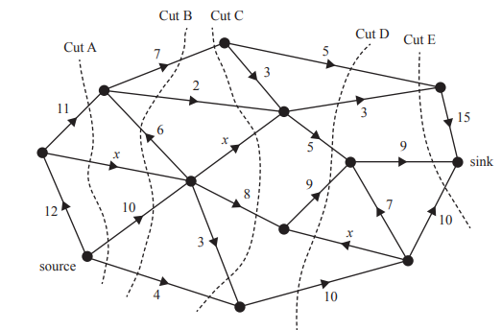
2017 Exam 1 Q8
The flow of oil through a series of pipelines, in litres per minute, is shown in the network below.
The weightings of three of the edges are labelled x.
Five cuts labelled A–E are shown on the network.
The maximum flow of oil from the source to the sink, in litres per minute, is given by the capacity of
A. Cut A if x = 1
B. Cut B if x = 2
C. Cut C if x = 2
D. Cut D if x = 3
E. Cut E if x = 3
x
1
1
1
27
26
24
25
32

Slide 3
2017 Exam 1 Q8
The flow of oil through a series of pipelines, in litres per minute, is shown in the network below.
The weightings of three of the edges are labelled x.
Five cuts labelled A–E are shown on the network.
The maximum flow of oil from the source to the sink, in litres per minute, is given by the capacity of
A. Cut A if x = 1
B. Cut B if x = 2
C. Cut C if x = 2
D. Cut D if x = 3
E. Cut E if x = 3
x
v
2
2
2
27
26
25
26
32

Slide 4
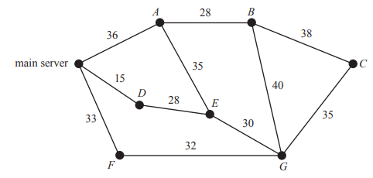
2019 Exam 1 Q5
The following diagram shows the distances, in metres, along a series of cables connecting a main server to seven points, A to G, in a computer network.
The minimum length of cable, in metres, required to ensure that each of the seven points is connected to the main server directly or via another point is
A. 175
B. 203
C. 208
D. 221
E. 236
15+28+30+32+35+35+28=203

Slide 5
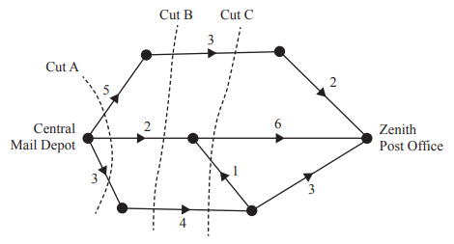
2018 Exam 2 Q1a
The graph below shows the possible number of postal deliveries each day between the Central Mail Depot and the Zenith Post Office.
The unmarked vertices represent other depots in the region.
The weighting of each edge represents the maximum number of deliveries that can be made each day.
a. Cut A, shown on the graph, has a capacity of 10.
Two other cuts are labelled as Cut B and Cut C.
i. Write down the capacity of Cut B.
ii. Write down the capacity of Cut C.
3+2+4=9
3+6+0+4=13

