Slide 1
Graphs Euler Hamilton
Past Exam Q’s

Slide 2
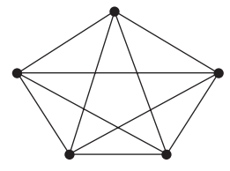
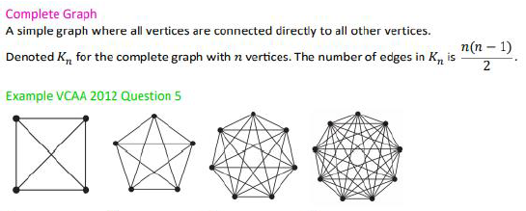
2016 Exam 1 Q3
The following graph with five vertices is a complete graph.
Edges are removed so that the graph will have the minimum number of edges to remain connected.
The number of edges that are removed is
A. 4
B. 5
C. 6
D. 9
E. 10
5 vertices → 4 edges needed
Complete graph with 5 vertices → $\frac{5×\left(5−1\right)}{2}=\frac{5×4}{2}=5×2=10 edges$
Remove 6 edges

Slide 3
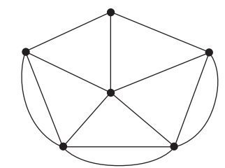
2017 Exam 1 Q6
An Eulerian trail for the graph above will be possible if only one edge is removed.
In how many different ways could this be done?
A. 1
B. 2
C. 3
D. 4
E. 5
3
4
4
5
5
5

Slide 4
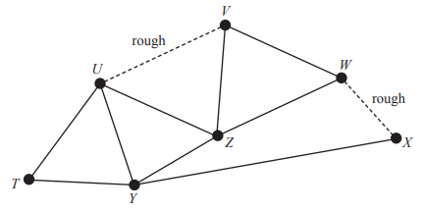
2016 Exam 2 Q2c
The suburb of Alooma has a skateboard park with seven ramps.
The ramps are shown as vertices T, U, V, W, X, Y and Z on the graph below
The tracks between ramps U and V and between ramps W and X are rough, as shown on the graph above.
c. Birra can skate over any of the tracks, including the rough tracks.
He begins skating at ramp X and will complete a Hamiltonian cycle.
In how many ways could he do this?
• X – Y – T – U – Z – V – W – X
• X – W – V – Z – U – T – Y – X
• X – Y – T – U – V – Z – W – X
• X – W – Z – V – U – T – Y – X

Slide 5
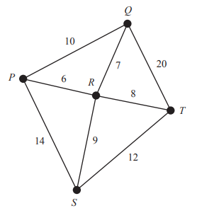
2018 Exam 2 Q4b
Parcel deliveries are made between five nearby towns, P to T.
The roads connecting these five towns are shown on the graph below. The distances, in kilometres, are also shown.
A road inspector will leave from town P to check all the roads and return to town P when the inspection is complete. He will travel the minimum distance possible.
b. Determine the minimum distance, in kilometres, that the inspector will travel.
Either repeat two red roads or two yellow roads to achieve Eulerian Circuit.
10+14+12+20+6+8+7+9=86, 86+10+12=108 km
3
4
3
3
3

Slide 6
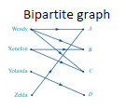
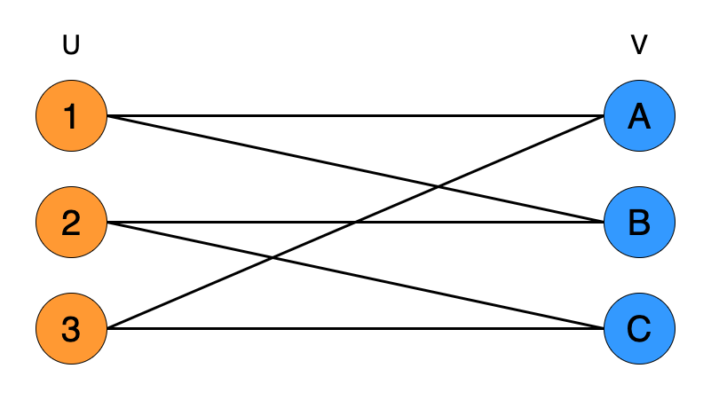
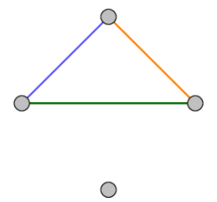
2017 Exam 1 Q7
A graph with six vertices has no loops or multiple edges.
Which one of the following statements about this graph is not true?
A. If the graph is a tree it has five edges.
B. If the graph is complete it has 15 edges.
C. If the graph has eight edges it may have an isolated vertex.
D. If the graph is bipartite it will have a minimum of nine edges.
E. If the graph has a cycle it will have a minimum of three edges.
˅
˅
˅
X
˅

Slide 7
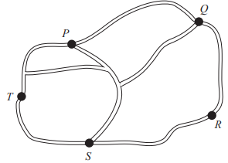
2019 Exam 1 Q6
The map below shows all the road connections between five towns, P, Q, R, S and T.
The road connections could be represented by the adjacency matrix
A. P Q R S T B. P Q R S T C. P Q R S T
0
$\begin{matrix}P \\ Q \\ R \\ S \\ T\end{matrix} \left[\begin{matrix}1 & 3 & 0 & 2 & 2 \\ 3 & 0 & 1 & 1 & 1 \\ 0 & 1 & 0 & 1 & 0 \\ \begin{aligned}2 \\ 2\end{aligned} & \begin{aligned}1 \\ 1\end{aligned} & \begin{aligned}1 \\ 0\end{aligned} & \begin{aligned}0 \\ 2\end{aligned} & \begin{aligned}2 \\ 0\end{aligned}\end{matrix}\right]$ $\begin{matrix}P \\ Q \\ R \\ S \\ T\end{matrix} \left[\begin{matrix}1 & 2 & 0 & 2 & 2 \\ 2 & 0 & 1 & 1 & 1 \\ 0 & 1 & 0 & 1 & 0 \\ \begin{aligned}2 \\ 2\end{aligned} & \begin{aligned}1 \\ 1\end{aligned} & \begin{aligned}1 \\ 0\end{aligned} & \begin{aligned}0 \\ 2\end{aligned} & \begin{aligned}2 \\ 0\end{aligned}\end{matrix}\right]$ $\begin{matrix}P \\ Q \\ R \\ S \\ T\end{matrix} \left[\begin{matrix}0 & 3 & 0 & 2 & 2 \\ 3 & 0 & 1 & 1 & 1 \\ 0 & 1 & 0 & 1 & 0 \\ \begin{aligned}2 \\ 2\end{aligned} & \begin{aligned}1 \\ 1\end{aligned} & \begin{aligned}1 \\ 0\end{aligned} & \begin{aligned}0 \\ 2\end{aligned} & \begin{aligned}2 \\ 0\end{aligned}\end{matrix}\right]$
D. P Q R S T E. P Q R S T
$\begin{matrix}P \\ Q \\ R \\ S \\ T\end{matrix} \left[\begin{matrix}0 & 2 & 0 & 2 & 2 \\ 2 & 0 & 1 & 1 & 1 \\ 0 & 1 & 0 & 1 & 0 \\ \begin{aligned}2 \\ 2\end{aligned} & \begin{aligned}1 \\ 1\end{aligned} & \begin{aligned}1 \\ 0\end{aligned} & \begin{aligned}1 \\ 2\end{aligned} & \begin{aligned}2 \\ 0\end{aligned}\end{matrix}\right]$ $\begin{matrix}P \\ Q \\ R \\ S \\ T\end{matrix} \left[\begin{matrix}1 & 2 & 0 & 2 & 2 \\ 2 & 0 & 1 & 1 & 1 \\ 0 & 1 & 0 & 1 & 0 \\ \begin{aligned}2 \\ 2\end{aligned} & \begin{aligned}1 \\ 1\end{aligned} & \begin{aligned}1 \\ 0\end{aligned} & \begin{aligned}1 \\ 1\end{aligned} & \begin{aligned}1 \\ 0\end{aligned}\end{matrix}\right]$

