Slide 1


Probability tables
9E

Slide 2
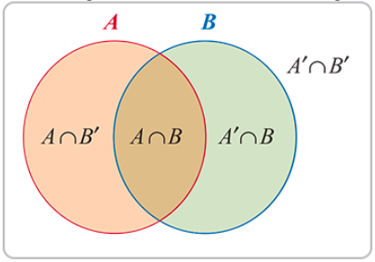

A probability table
A probability table is an alternative to a Venn diagram when illustrating a probability problem diagrammatically. Consider the Venn diagram which illustrates two intersecting sets 𝐴 and 𝐵.
From the Venn diagram it can be seen that the sample space is divided by the sets into four disjoint regions: 𝐴∩𝐵, 𝐴∩𝐵′, 𝐴′∩𝐵 and 𝐴′∩𝐵′. These regions may be represented in a table as follows. Such a table is sometimes referred to as a Karnaugh map.

Slide 3

A probability table
From the Venn diagram it can be seen that the sample space is divided by the sets into four disjoint regions: 𝐴∩𝐵, 𝐴∩𝐵′, 𝐴′∩𝐵 and 𝐴′∩𝐵′. These regions may be represented in a table as follows. Such a table is sometimes referred to as a Karnaugh map.

Slide 4
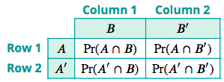
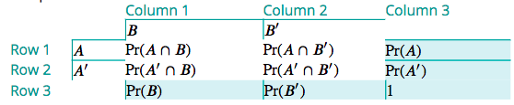
A probability table
In a probability table, the entries give the probabilities of each of these events occurring.
𝐴=(𝐴∩𝐵)∪(𝐴∩𝐵′)
The sets 𝐴∩𝐵 and 𝐴∩𝐵′ are mutually exclusive, so
Pr(𝐴∩𝐵)+Pr(𝐴∩𝐵′)=Pr(𝐴) (row 1)
and thus summing the probabilities in row 1 gives Pr(𝐴). Similarly:
Pr(𝐴′∩𝐵)+ Pr(𝐴′∩𝐵′)= Pr(𝐴′)(row 2)
Pr(𝐴∩𝐵)+ Pr(𝐴′∩𝐵) =Pr(𝐵) (column 1)
Pr(𝐴∩𝐵′)+ Pr(𝐴′∩𝐵′)=Pr(𝐵′)(column 2)
Finally, since Pr(𝐴)+Pr(𝐴′)=1 and Pr(𝐵)+Pr(𝐵′)=1, the totals for both column 3 and row 3 are equal to 1.

Slide 5
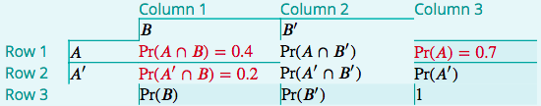
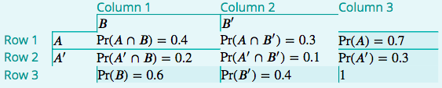
Example
If 𝐴 and 𝐵 are events such that Pr(𝐴)=0.7, Pr(𝐴∩𝐵)=0.4 and Pr(𝐴′∩𝐵)=0.2, find:
1. Pr(𝐴∩𝐵′)
2. Pr(𝐵)
3. Pr(𝐴′∩𝐵′)
4. Pr(𝐴∪𝐵)
1. From row 1: Pr(𝐴∩𝐵′)=Pr(𝐴)−Pr(𝐴∩𝐵)=0.7−0.4=0.3
2. From column 1: Pr(𝐵)=Pr(𝐴∩𝐵)+Pr(𝐴′∩𝐵)=0.4+0.2=0.6
3. From column 3: Pr(𝐴′)=1−Pr(𝐴)=1−0.7=0.3
4. From row 2: Pr(𝐴′∩𝐵′)=0.3−0.2=0.1
Using the addition rule:
Pr(𝐴∪𝐵)=Pr(𝐴)+Pr(𝐵)−Pr(𝐴∩𝐵)=0.7+0.6−0.4=0.9
The completed table is shown.

Slide 6
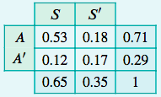
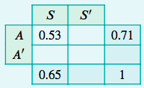
Example
Records indicate that, in Australia, 65% of secondary students participate in sport, and 71% of secondary students are Australian by birth. They also show that 53% of students are Australian by birth and participate in sport. Use this information to find:
1. the probability that a student selected at random is not Australian by birth
2. the probability that a student selected at random is not Australian by birth and does not participate in sport.
We use 𝐴 to represent ‘Australian by birth’ and 𝑆 to represent ‘participates in sport’.
All the empty cells in the table may now be filled in by subtraction.
In column 1: Pr(𝐴′∩𝑆)=0.65−0.53=0.12
In column 3: Pr(𝐴′)=1−0.71=0.29
In row 1: Pr(𝐴∩𝑆′)=0.71−0.53=0.18
In row 3: Pr(𝑆′)=1−0.65=0.35
In row 2: Pr(𝐴′∩𝑆′)=0.29−0.12=0.17
The probability that a student selected at random is not Australian by birth is given by Pr(𝐴′)=0.29.
The probability that a student selected at random is not Australian by birth and does not participate in sport is given by Pr(𝐴′∩𝑆′)=0.17.

