Slide 1
Solving probability problems using simulation
9H

Slide 2
Simulation
Simulation is a very powerful and widely used procedure which enables us to find approximate answers to difficult probability questions. It is a technique which imitates the operation of the real-world system being investigated. Some problems are not able to be solved directly and simulation allows a solution to be obtained where otherwise none would be possible.

Slide 3
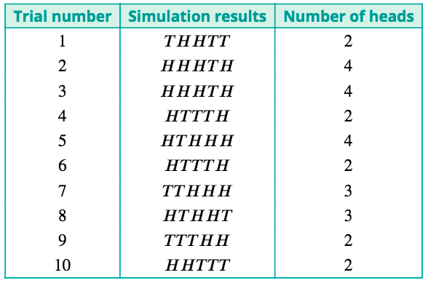
Simulation
For example, we would like to know the probability that a family of five children will include at least four girls. What we can do, however, is estimate the probability by simulation.
Firstly, we will assume:
There is a probability of 0.5 of each child being female.
The sex of each child is independent of the sex of the other children. That is, the probability of a female child is always 0.5.
Since the probability of a female child is 0.5, a suitable simulation model would be tossing a fair coin. Let a head represent a female child and a tail a male child.
An example of the results that might be obtained from 10 trials is:

Slide 4
Simulation
Continuing in this way, the following results were obtained for 50 trials:
The results in the table can be used to estimate the required probability. Since at least four heads were obtained in 11 trials, estimate the probability of at least four female children as $\frac{11}{50}$ or 0.22.
Of course, since this probability has been estimated experimentally, repeating the simulations would give a slightly different result, but we would expect to obtain approximately this value most of the time.

Slide 5
Example
A pizza shop is giving away football cards with each pizza bought. There are six different cards available, and a fan decides to continue buying the pizzas until all six are obtained. How many pizzas will need to be bought, on average, to obtain the complete set of cards?
Rolling the die and observing the outcome is equivalent to buying a pizza. This simulation model is based on the following assumptions:
The six cards all occur with equal frequency. The card obtained with one pizza is independent of the cards obtained with the other pizzas.
A trial would consist of rolling the die until all of the six numbers 1, 2, 3, 4, 5 and 6 have been observed, and the result of the trial is the number of rolls necessary to do this. The results of one trial are shown:
14 trials.
50 trials.
To estimate the number of pizzas that need to be bought, the average of the numbers obtained in these simulations is calculated. Thus we estimate that, in order to collect the complete set of cards, it would be necessary to buy approximately
$\frac{\text{14+8+12+11+16+⋯+16+21+22+8+9}}{50}$≈15 pizzas

Slide 6
Section summary
Simulation is a simple and legitimate method for finding solutions to problems when an exact solution is difficult, or impossible, to find.
In order to use simulation to solve a problem, a clear statement of the problem and the underlying assumptions must be made.
A model must be selected to generate outcomes for a simulation. Possible choices for physical simulation models are coins, dice and spinners. Random number tables, calculators and computers may also be used.
Each trial should be defined and repeated several times (at least 50).
The results from all the trials should be recorded and summarised appropriately to provide an answer to a problem.

