Slide 1
Graphs:Quadratics, hyperbolas, truncus, circles, semicircles
Methods Chapter3 Chapter4
Notes:
Nearpod Activity

Slide 2
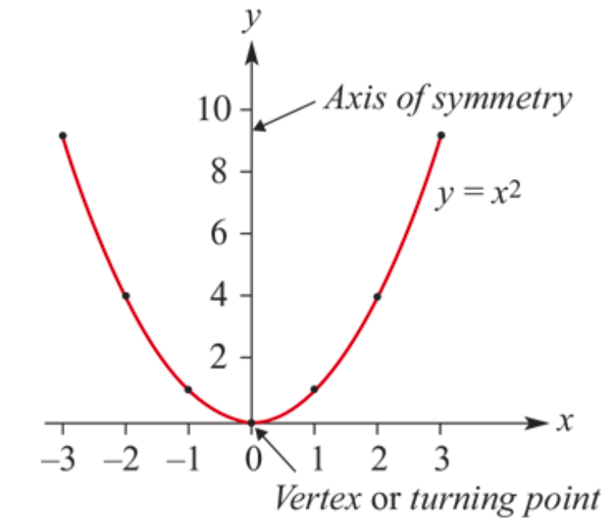
Features of the graph of 𝑦= $x^{2}$:
The graph is called a parabola.
The possible 𝑦-values are all positive real numbers and 0. (This is called the range of the quadratic.)
The graph is symmetrical about the 𝑦-axis. The line about which the graph is symmetrical is called the axis of symmetry.
The graph has a vertex or turning point at the origin (0,0).
The minimum value of 𝑦 is 0 and it occurs at the turning point.

Slide 3
Transformations of 𝑦= $x^{2}$
The turning point form:
𝑦=𝑎${\text{(}\text{x}\text{−}\text{h}\text{)}}^{2}$+𝑘
Turning point will be (h,k).
a>0, parabola open upwards.
a<0, parabola open downwards.

Slide 4
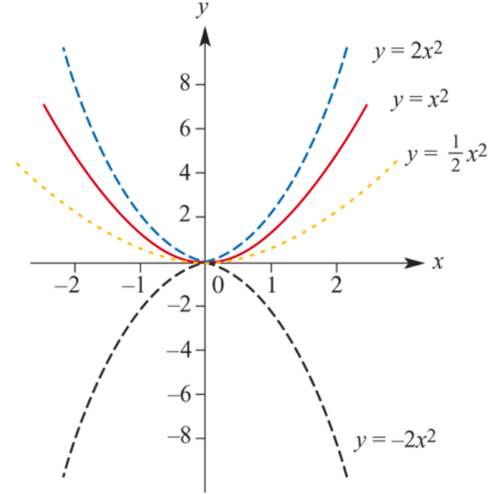
Graphs of 𝑦=𝑎$x^{2}$
a=2 If 𝑎>1, the graph is ‘narrower’. $x^{2}$Dilation of factor 2 from the 𝑥-axis.
a=$\frac{1}{2}$ If 0<𝑎<1, the graph is ‘broader’.
We first consider graphs of the form 𝑦=𝑎$x^{2}$. In this case both ℎ=0 and 𝑘=0. In the basic graph of 𝑦=$x^{2}$, the value of 𝑎 is 1.
a=$−$2, When 𝑎 is negative, the graph is a reflection in the 𝑥-axis from 𝑦=2$x^{2}$.
Notes:
The transformation which produces the graph of 𝑦=2𝑥^2 from the graph of 𝑦=𝑥^2 is called a dilation of factor 2 from the 𝑥x-axis.

Slide 5
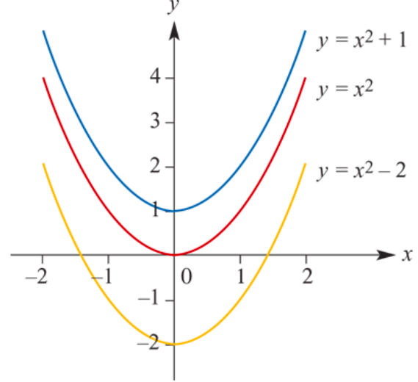
Graphs of 𝑦= $x^{2}$+𝑘
𝑘=1 Up1 unit of the 𝑦-axis. The vertex is (0,1) and the range ≥1.
𝑘=−2 Down 2 units of the 𝑦-axis. The vertex is (0,−2) and the range ≥−2.
𝑦=$x^{2}$
𝑦=$x^{2}$− 2 (𝑘=−2)
𝑦=$x^{2}+1$ (𝑘=1)
All other features of the graph are unchanged. The axis of symmetry is still the 𝑦-axis.
Notes:
The transformation which produces the graph of 𝑦=2𝑥^2 from the graph of 𝑦=𝑥^2 is called a dilation of factor 2 from the 𝑥x-axis.

Slide 6
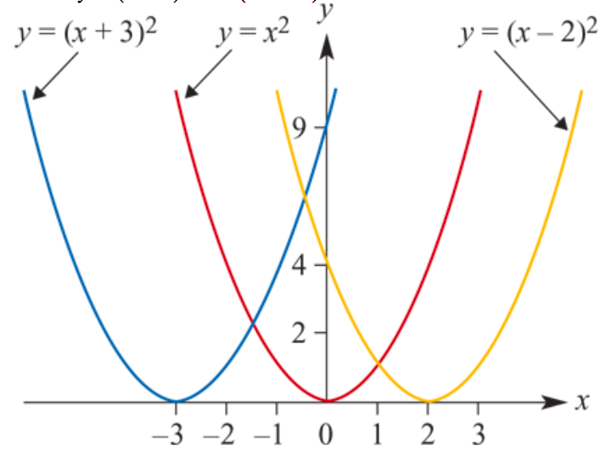
Graphs of 𝑦=${\text{(}\text{x}\text{−}\text{h}\text{)}}^{2}$
ℎ=−3 Vertex(−3,0) and the axis of symmetry → 𝑥=−3.
ℎ=2 Vertex (2,0) and the axis of symmetry →𝑥=2.
𝑦=$x^{2}$
𝑦=${(x\text{−}2)}^{2}$ (h=2)
𝑦=${(x\text{+3})}^{2}$ (h=$\text{−}$3)
In both cases, the range is unchanged and $≥0$.
Notes:
The transformation which produces the graph of 𝑦=2𝑥^2 from the graph of 𝑦=𝑥^2 is called a dilation of factor 2 from the 𝑥x-axis.

Slide 7
Quadratic rules
Three different families of quadratic polynomial functions for finding a quadratic rules.
1 𝑦=𝑎(𝑥−𝑒)(𝑥−𝑓) This can be used if two 𝑥-axis intercepts and the coordinates of one other point are known.
2 𝑦=𝑎${\text{(}\text{x}\text{−}\text{h}\text{)}}^{2}$+𝑘 This can be used if the coordinates of the turning point and one other point are known.
3 𝑦=𝑎$x^{2}$+𝑏𝑥+𝑐 This can be used if the coordinates of three points on the parabola are known.

Slide 8
Discriminant
In the previous section we found that the solutions to the quadratic equation 𝑎$x^{2}$+𝑏𝑥+𝑐=0 are given by
$x=\frac{−b±\sqrt{b^{2}−4ac}}{2a}$
The expression under the square root sign is called the discriminant. We write
Δ= $b^{2}−4ac$

Slide 9
Quadratic formula
$$x=−\frac{b}{2a}±\frac{\sqrt{b^{2}−4ac}}{2a}$$
Derived from this general formula:
The axis of symmetry is the line with equation 𝑥= $−\frac{b}{2a}$
If $b^{2}$−4𝑎𝑐 > 0, there are two solutions.
If $b^{2}$−4𝑎𝑐 = 0, there is one solution.
If $b^{2}$−4𝑎𝑐 < 0, there are no real solutions.

Slide 10
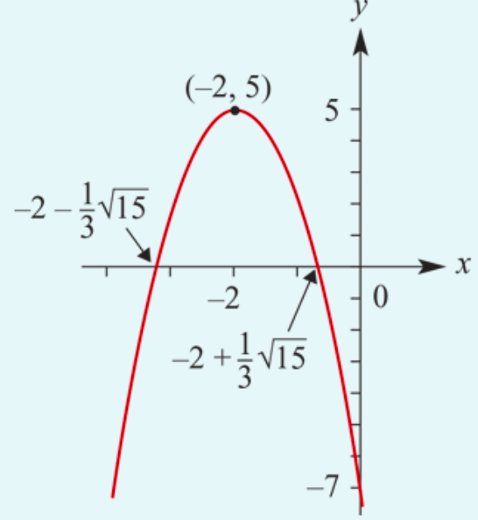
Sketch the graph of 𝑦=−3$x^{2}$−12𝑥−7. Use the quadratic formula to calculate the 𝑥-axis intercepts.
$$x=\frac{−b±\sqrt{b^{2}−4ac}}{2a}$$
Solution: a= −3, b= −12, c= −7
Since 𝑐=−7, the 𝑦-axis intercept is −7.
Axis of symmetry 𝑥= $−\frac{b}{2a}$
𝑥= $−\frac{b}{2a}$= $−\frac{−12}{2×(−3)}$=−2
Turning point
When 𝑥=−2, 𝑦=−3$×{\text{(−2)}}^{2}$−12$×$(−2)−7=5.
The turning point coordinates are (−2,5).
𝑥-axis intercepts
$x=\frac{−b±\sqrt{b^{2}−4ac}}{2a}$= $\frac{−(−12)±\sqrt{{(−12)}^{2}−4×(−3)×(−7)}}{2×(−3)}$
= $\frac{12±\sqrt{144−84}}{−6}$ = $\frac{12±2\sqrt{15}}{−6}$ = $−$2$∓\frac{1}{3}\sqrt{15}$
≈−3.29 or −0.71 (to two decimal places)

Slide 11
Rectangular hyperbolas
Using dilations, reflections and translations, we are now able to sketch the graphs of all rectangular hyperbolas of the form 𝑦=$\frac{a}{x−h}$+k.

Slide 12
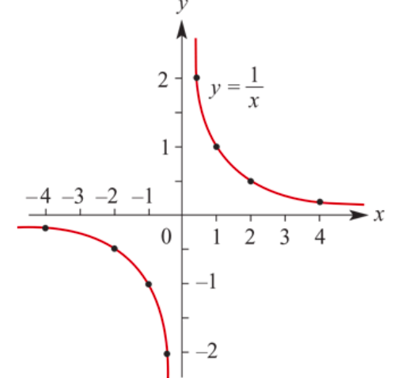
Asymptotes
There are two lines associated with this graph that help to describe its shape.
Horizontal asymptote
Vertical asymptote

Slide 13
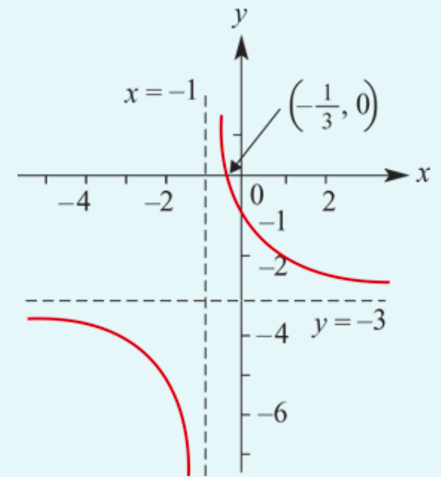
Sketch the graph of 𝑦=$\frac{2}{x+1}$−3.
The graph of 𝑦= $\frac{2}{x}$has been translated
1unit ← and 3 units
The asymptotes: 𝑥=−1 & 𝑦=−3.
When 𝑥=0, 𝑦= $\frac{2}{0+1}$−3 =−1.
∴ the 𝑦-axis intercept is −1.
When 𝑦=0, 0=$\frac{2}{x+1}$−3
→ $\frac{2}{x+1}$=3 → 3(𝑥+1) =2
→ 𝑥+1= $\frac{2}{3}$→ 𝑥 =−$\frac{1}{3}$
∴ the 𝑥-axis intercept is −$\frac{1}{3}$.

Slide 14
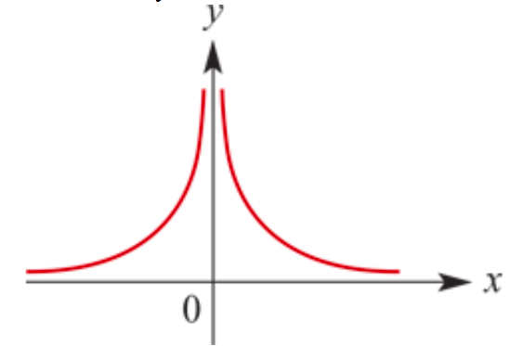
Truncus
𝑦=$\frac{1}{x^{2}}$=$x^{−2}$ for 𝑥≠0, Construct a table to sketch the graph.
As 𝑥→∞, 𝑦→$0^{+}$.
As 𝑥→−∞, 𝑦→ $0^{+}$.
As 𝑥→ $0^{+}$, 𝑦→∞.
As 𝑥→ $0^{−}$, 𝑦→∞.
The graph of 𝑦= $\frac{1}{x^{2}}$has asymptotes 𝑦=0 and 𝑥=0.
All graphs of the form 𝑦= $\frac{a}{{(x−h)}^{2}}$+𝑘 will have the same basic ‘truncus’ shape. The asymptotes: 𝑦=𝑘 & 𝑥=ℎ.

Slide 15
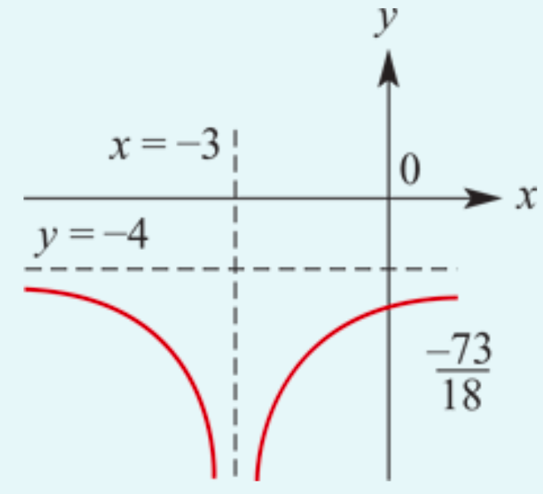
Sketch the graph of 𝑦= $\frac{−1}{{2(x+3)}^{2}}$−4.
The graph of 𝑦= $\frac{−1}{{2x}^{2}}$ is translated 3 units to the left and 4 units down.
The 𝑦-axis intercept is found by putting 𝑥=0; it is $\frac{−73}{18}$.

Slide 16
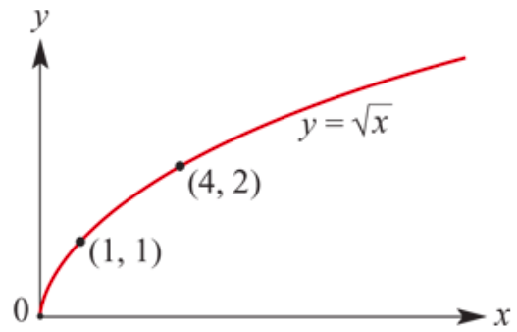
The graph of 𝑦=$\sqrt{x}$
Coordinates of points on the graph of 𝑦=$\sqrt{x}$include (0,0), (1,1), (4,2) and (9,3).
All graphs of the form
𝑦=$\text{a}\sqrt{x−h}$+𝑘
will have the same basic shape as the graph of 𝑦=$\sqrt{x}$.

Slide 17
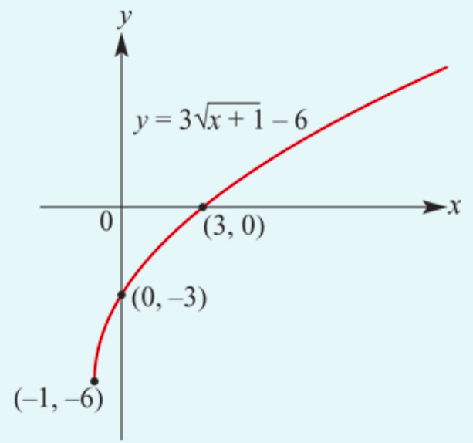
Sketch the graph of 𝑦=3$\sqrt{x+1}−6$.
The graph is formed by dilating the graph of 𝑦= $\sqrt{x}$from the 𝑥-axis by factor 3 and then translating 1 unit to the left and 6 units down.
The rule is defined for 𝑥≥−1.
The set of values the rule can take (the range) is all numbers greater than or equal to −6, i.e. 𝑦≥−6.
When 𝑥=0, 𝑦=−3
When 𝑦=0, 3$\sqrt{x+1}−6$=0
3$\sqrt{x+1}=6$
$\sqrt{x+1}=2$
$x$+1=4
$x$=3

Slide 18
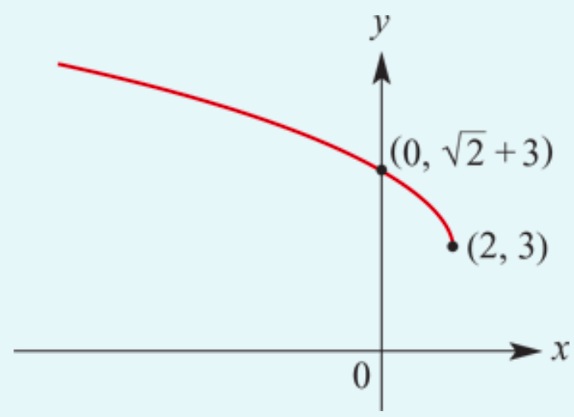
Sketch the graph of 𝑦=$\sqrt{2−x}+3$. Note: $\sqrt{2−x}$= $\sqrt{−(x−2)}$
We can write the rule as
𝑦=$\sqrt{−(x−2)}+3$
The rule is defined for 𝑥≤2.
The set of values the rule can take (the range) is all numbers greater than or equal to 3, i.e. 𝑦≥3.
When 𝑥=0, 𝑦= $\sqrt{2}$+3.

Slide 19
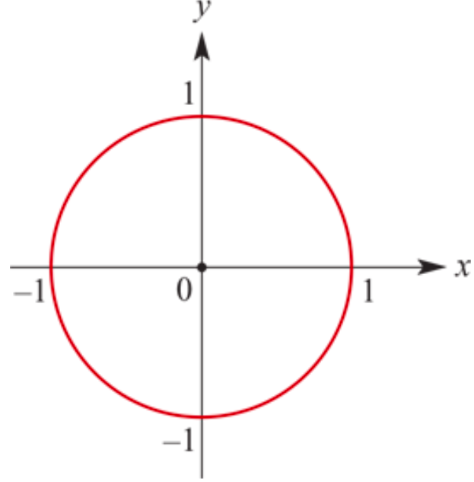
Equation of a Circle: ‘centre--radius’ form
Is 𝑥² + 𝑦² =𝑟²
Where
The circle has centre (0,0)
It’s radius is 𝑟

Slide 20
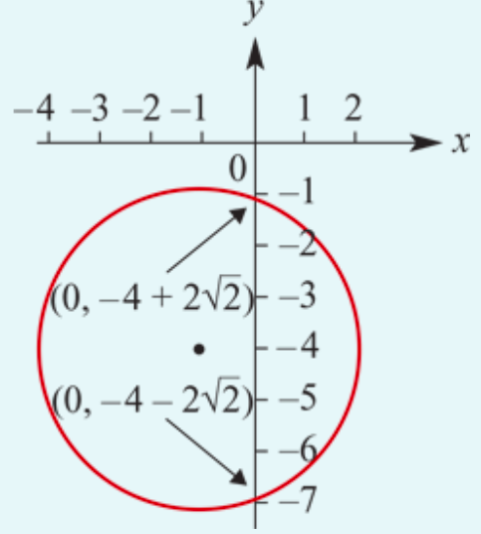
Sketch the graph of the circle
Sketch the graph of the circle (𝑥+1)² +(𝑦+4)² = 9
The circle has radius 3 and centre (−1,−4).
The 𝑦-axis intercepts → When 𝑥=0,
(0+1)² +(𝑦+4)² = 9
1+(𝑦+4)² = 9
(𝑦+4)² = 8
Hence 𝑦= −4±$\sqrt{8}$ = −4±$2\sqrt{2}$

Slide 21
Semicircles
Transposing the general equation of the circle 𝑥² + 𝑦² = 𝑟² to make 𝑦 the subject, we have
𝑦² = 𝑟² − 𝑥²
𝑦=±$\sqrt{\text{r}\text{2}\text{ − }\text{x}\text{2} }$
We can now consider two separate rules
𝑦=+$\sqrt{\text{r}\text{2}\text{ − }\text{x}\text{2} }$ & 𝑦= −$\sqrt{\text{r}\text{2}\text{ − }\text{x}\text{2} }$
Which correspond to the top half and bottom half of the circle respectively.
Similarly, solving for 𝑥 will give you the semicircles to the left and right of the 𝑦-axis:
𝑥=±$\sqrt{\text{r}\text{2}\text{ −}\text{y}\text{2} }$

Slide 22
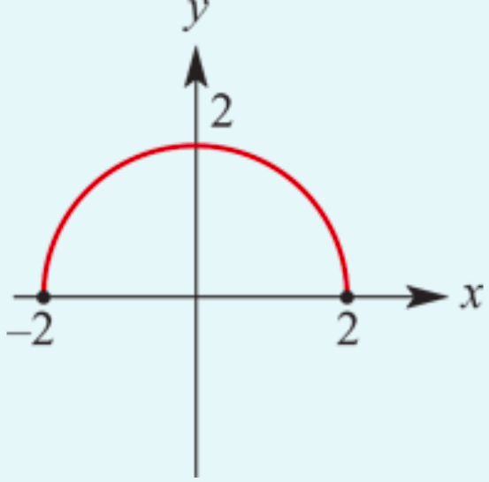
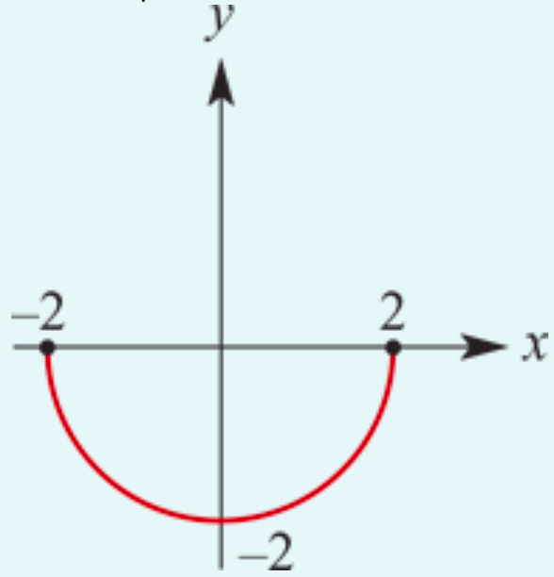
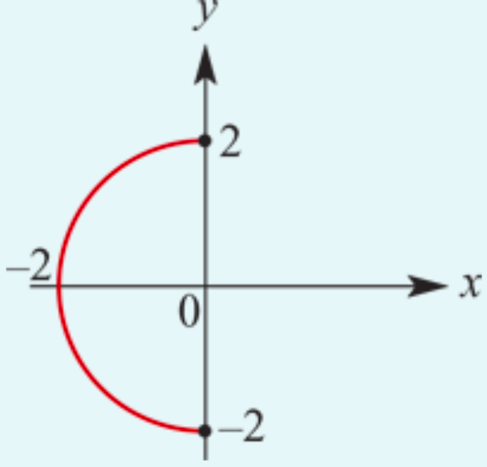
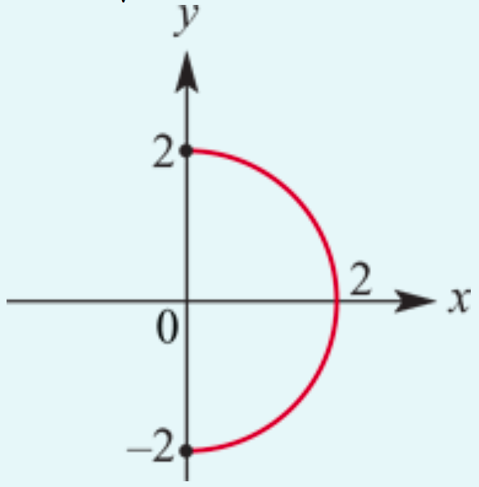
Sketch the graph of the semicircle
Sketch the graphs of:
𝑦 =+$\sqrt{\text{4}\text{− }\text{x}\text{2} }$
𝑥=− $\sqrt{\text{4}\text{−}\text{y}\text{2} }$
𝑦=− $\sqrt{\text{4}\text{− }\text{x}\text{2} }$
𝑥=+ $\sqrt{\text{4}\text{−}\text{y}\text{2} }$

Slide 23
Relations, Functions, One to One Functions?

