Slide 1
Differentiating $x^{n}$ where n is a negative integer
17C

Slide 2
Differentiating
We will consider functions which involve linear combinations of powers of x, where the indices may be negative integers.
e.g.
f:R∖{0}→R, f(x)=$x^{−1}$
f:R∖{0}→R, f(x)=2x+ $x^{−1}$
f:R∖{0}→R, f(x)=x+3+ $x^{−2}$
Note:
We have reintroduced function notation to emphasise the need to consider domains.

Slide 3
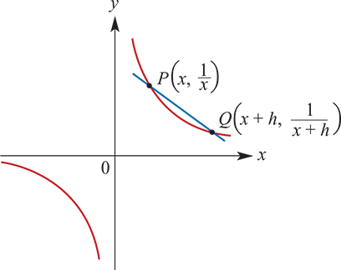
Example
Let f:R∖{0}→R, f(x)=$\frac{1}{x}$. Find f′(x) by first principles.
Solution
The gradient of secant PQ is given by
$\frac{f(x+h)−f(x)}{x+h−x}$=($\frac{1}{x+h}$− $\frac{1}{x}$)× $\frac{1}{h}$
= $\frac{x−(x+h)}{x(x+h)}$× $\frac{1}{h}$= $\frac{−h}{x(x+h)}$× $\frac{1}{h}$= $\frac{−1}{x(x+h)}$
So the gradient of the curve at P is
$\lim_{h→0}$ $\frac{−1}{\left(x+h\right)x}$=− $\frac{1}{x^{2}}$= − $x^{−2}$
Hence f′(x)=− $x^{−2}$.

Slide 4
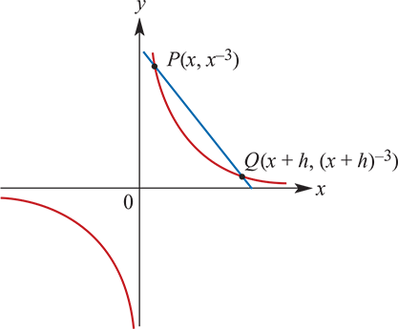
Example
Let f:R∖{0}→R, f(x)= $x^{−3}$. Find f′(x) by first principles.
Solution
The gradient of secant PQ is given by
$\frac{{(x+h)}^{−3}−x^{−3}}{h}$ = $\frac{x^{3}−{(x+h)}^{3}}{{(x+h)}^{3}x^{3}}$×$\frac{1}{h}$ = $\frac{x^{3}−(x^{3}+3x^{2}h+3xh^{2}+h^{3})}{{(x+h)}^{3}x^{3}}$× $\frac{1}{h}$ = $\frac{−3x^{2}h−3xh^{2}−h^{3}}{{(x+h)}^{3}x^{3}}$× $\frac{1}{h}$= $\frac{−3x^{2}−3xh−h^{2}}{{(x+h)}^{3}x^{3}}$
So the gradient of the curve at P is given by
$\lim_{h→0}$ $\frac{−3x^{2}−3xh−h^{2}}{{(x+h)}^{3}x^{3}}$= $\frac{−3x^{2}}{x^{6}}$=−3$x^{−4}$
Hence f′(x)=−3$x^{−4}$.

Slide 5
Differentiating
For f(x)= $x^{n}$, f′(x)=n$x^{n−1}$, where n is a non-zero integer.
For f(x)=c, f′(x)=0, where c is a constant.
When n is positive, we take the domain of f to be R, and when n is negative, we take the domain of f to be R∖{0}.
Notes:
This result can be proved by again using the binomial theorem.

Slide 6
Exmaple
Find the derivative of $x^{4}$−2$x^{−3}$+ $x^{−1}$ +2, x≠0.
Solution
If f(x) = $x^{4}$−2$x^{−3}$+ $x^{−1}$ +2 (for x≠0)
then f′(x) =4$x^{3}$−2(−3$x^{−4}$)+(− $x^{−2}$)+0 =4$x^{3}$+6$x^{−4}$− $x^{−2}$ (for x≠0)

Slide 7
Example
Find the derivative f′ of f:R∖{0}→R, f(x)=3$x^{2}$−6$x^{−2}$+1.
Solution
f′:R∖{0}→R,f′(x)=3(2x)−6(−2$x^{−3}$)+0=6x+12$x^{−3}$

Slide 8
Example
Find the gradient of the tangent to the curve determined by the function f:R∖{0}→R, f(x)= $x^{2}$+ $\frac{1}{x}$ at the point (1,2).
Solution
f′:R∖{0}→R,f′(x)=2x+(− $x^{−2}$)=2x− $x^{−2}$
Therefore f′(1)=2−1=1. The gradient of the curve is 1 at the point (1,2).

Slide 9
Example
Show that the derivative of the function f:R∖{0}→R, f(x)= $x^{−3}$ is always negative.
Solution
f′:R∖{0}→R,f′(x)=−3$x^{−4}$= $\frac{−3}{x^{4}}$
Since $x^{4}$ is positive for all x≠0, we have f′(x)<0 for all x≠0.

Slide 10
Section summary
For f(x)= $x^{n}$, f′(x)=n$x^{n−1}$, where n is a non-zero integer.
For f(x)=c, f′(x)=0, where c is a constant.

