Slide 1
Graphs of the derivative function
17D
https://kahoot.it/challenge/03232739?challenge-id=866b7e2c-3a48-4847-852c-88711d5afe08_1637011591521
https://kahoot.it/challenge/03925555?challenge-id=866b7e2c-3a48-4847-852c-88711d5afe08_1637011629613

Slide 2
Notes:
https://www.transum.org/Software/sw/Starter_of_the_day/Starter_June24.asp

Slide 3
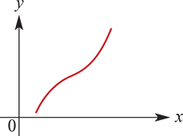
Increasing and decreasing functions
We say a function f is strictly increasing on an interval if $x_{2}$> $x_{1}$ implies f($x_{2}$)>f($x_{1}$).
For example:
The graph above shows a strictly increasing function.
A straight line with positive gradient is strictly increasing.
The function f:(0,∞)→R, f(x)=$x^{2}$ is strictly increasing.

Slide 4
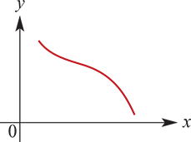
Increasing and decreasing functions
We say a function f is strictly decreasing on an interval if $x_{2}$> $x_{1}$ implies f($x_{2}$)<f($x_{1}$).
For example:
The graph above shows a strictly decreasing function.
A straight line with negative gradient is strictly decreasing.
The function f:(−∞,0)→R, f(x)= $x^{2}$ is strictly decreasing.
Note:
The word strictly refers to the use of the strict inequality signs <,> rather than ≤,≥.

Slide 5
Increasing and decreasing functions
If f′(x)>0, for all x in the interval, then the function is strictly increasing.
(Think of the tangents at each point − they each have positive gradient.)
If f′(x)<0, for all x in the interval, then the function is strictly decreasing.
(Think of the tangents at each point − they each have negative gradient.)

Slide 6
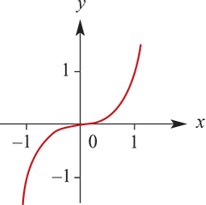
Increasing and decreasing functions
Warning: The function f:R→R, f(x)= $x^{3}$ is strictly increasing, but f′(0)=0. This means that strictly increasing does not imply f′(x)>0.
We can see that f(x)= $x^{3}$ is strictly increasing from its graph. Alternatively, consider
$a^{3}$− $b^{3}$=(a−b)($a^{2}$ +ab+ $b^{2}$ )
=(a−b)($a^{2}$+ab+ ${(\frac{1}{2}b)}^{2}$+ $b^{2}$ − ${(\frac{1}{2}b)}^{2}$)
=(a−b)(${(a+\frac{1}{2}b)}^{2}$+ $\frac{3}{4}b^{2}$)
Hence a>b implies $a^{3}$> $b^{3}$.

Slide 7
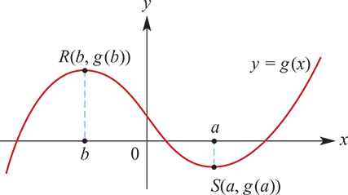
Sign of the derivative
Consider the graph of y=g(x) shown below.
At a point (a,g(a)) on the graph, the gradient is g′(a).
By noting whether the curve is sloping upwards or downwards at a particular point, we can tell the sign of the derivative at that point:
For x<b, g′(x)>0. This implies that g is strictly increasing on the interval (−∞,b).
For x=b, g′(b)=0.
For b<x<a, g′(x)<0. This implies that g is strictly decreasing on the interval (b,a).
For x=a, g′(a)=0.
For x>a, g′(x)>0. This implies that g is strictly increasing on the interval (a,∞).

Slide 8
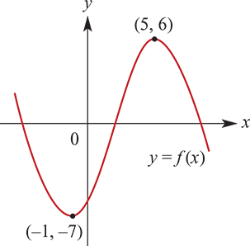
Example
For the graph of f:R→R, find:
{x:f′(x)>0}
{x:f′(x)<0}
{x:f′(x)=0}
Solution
{x:f′(x)>0}={x:−1<x<5}=(−1,5)
{x:f′(x)<0}={x:x<−1}∪{x:x>5}=(−∞,−1)∪(5,∞)
{x:f′(x)=0}={−1,5}

Slide 9
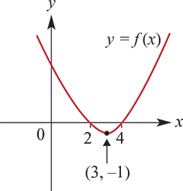
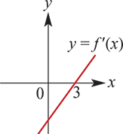
Example
Sketch the graph of y=f′(x) for each of the following. (It is impossible to determine all features.)
Solution
f′(x)>0 for x>3
f′(x)<0 for x<3
f′(x)=0 for x=3

Slide 10
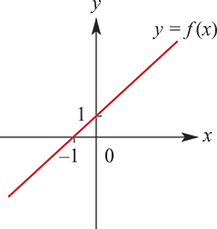
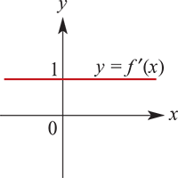
Example
Sketch the graph of y=f′(x) for each of the following. (It is impossible to determine all features.)
f′(x)=1 for all x

Slide 11
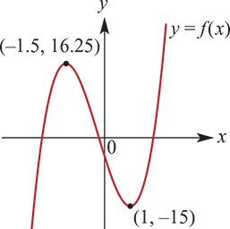
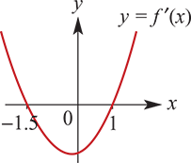
Example
Sketch the graph of y=f′(x) for each of the following. (It is impossible to determine all features.)
f′(x)>0 for x>1
f′(x)<0 for −1.5<x<1
f′(x)>0 for x<−1.5
f′(−1.5)=0 and f′(1)=0

Slide 12
An angle associated with the gradient of a curve at a point
The gradient of a curve at a point is the gradient of the tangent at that point. A straight line, the tangent, is associated with each point on the curve.
If α is the angle a straight line makes with the positive direction of the x-axis, then the gradient, m, of the straight line is equal to tan α. That is, m=tan α.
For example:
If α=${45}^{\text{∘}}$, then tan α=1 and the gradient is 1.
If α= ${20}^{\text{∘}}$, then the gradient of the straight line is tan ${20}^{\text{∘}}$.
If α= ${135}^{\text{∘}}$, then tan α=−1 and the gradient is −1.

Slide 13
Example
Find the coordinates of the points on the curve with equation y= $x^{2}$ −7$x$+8 at which the tangent line:
makes an angle of ${45}^{\text{∘}}$ with the positive direction of the x-axis
is parallel to the line y=−2$x$+6.
Solution
$\frac{dy}{dx}$ =2x−7 → 2x−7 =1(as tan${45}^{\text{∘}}$=1) → 2x =8 ∴ x =4
y = $4^{2}$ −7×4+8=−4
The coordinates are (4,−4).
The line y=−2x+6 has gradient −2.
2x−7 =−2 → 2x =5 → ∴ x = $\frac{5}{2}$
The coordinates are ($\frac{5}{2}$,− $\frac{13}{4}$).

Slide 14
Example
The planned path for a flying saucer leaving a planet is defined by the equation
y= $\frac{1}{4}x^{4}$ + $\frac{2}{3}x^{3}$for x>0 The units are kilometres. (The x-axis is horizontal and the y-axis vertical.)
Find the direction of motion when the x-value is:
a. 2
b. 3
Solution
$\frac{dy}{dx}$= $x^{3}$+2$x^{2}$
a. When x=2, $\frac{dy}{dx}$=8+8=16
$\tan^{−1}{16}$= ${86.42}^{\text{∘}}$ (to the x-axis)
b. When x=3, $\frac{dy}{dx}$=27+18=45
$\tan^{−1}{45}$= ${88.73}^{\text{∘}}$ (to the x-axis)

Slide 15
Example
The planned path for a flying saucer leaving a planet is defined by the equation
y= = $\frac{1}{4}x^{4}$ + $\frac{2}{3}x^{3}$for x>0 The units are kilometres. (The x-axis is horizontal and the y-axis vertical.)
c. Find a point on the flying saucer's path where the path is inclined at ${45}^{\text{∘}}$ to the positive x-axis (i.e. where the gradient of the path is 1).
d. Are there any other points on the path which satisfy the situation described in part c?
Solution
When the flying saucer is flying at ${45}^{\text{∘}}$ to the positive direction of the x-axis, the gradient of the curve of its path is given by tan ${45}^{\text{∘}}$ . Thus to find the point at which this happens we consider the equation
$\frac{dy}{dx}$ =tan ${45}^{\text{∘}}$ → $x^{3}$+2$x^{2}$ =1 → $x^{3}$+2$x^{2}$ −1 =0 → (x+1)($x^{2}$ +x−1) =0
∴ x=−1 or x=$\frac{−1±\sqrt{5}}{2}$−
The only acceptable solution is x= $\frac{−1+\sqrt{5}}{2}$≈0.62, as the other two possibilities give negative values for x and we are only considering positive values for x.

Slide 16
Section summary
A function f is strictly increasing on an interval if $x_{2}$> $x_{1}$ implies f($x_{2}$)>f($x_{1}$ ).
A function f is strictly decreasing on an interval if $x_{2}$> $x_{1}$ implies f($x_{2}$)<f($x_{1}$ ).
If f′(x)>0 for all x in the interval, then the function is strictly increasing.
If f′(x)<0 for all x in the interval, then the function is strictly decreasing.

