Slide 1
Limits and continuity
17F
https://create.kahoot.it/details/b6c48b6c-2c55-4d32-b57b-b7aa190cb090
https://create.kahoot.it/details/6fd6829d-4b4a-43be-8f76-51588aff64f5

Slide 2
Notes:
https://www.transum.org/Software/sw/Starter_of_the_day/Starter_January8.asp

Slide 3
Limits
The notation $\lim_{x→a}$f(x)=p says that the limit of f(x), as x approaches a, is p. We can also say: ‘As x approaches a, f(x) approaches p.’
This means that we can make the value of f(x) as close as we like to p, provided we choose x-values close enough to a.
For example, we have seen that $\lim_{x→\text{∞}}$f(x)=4 for the function with rule f(x)=$\frac{1}{x}$+4. The graph of y=f(x) can get as close as we like to the line y=4, just by taking larger and larger values of x.
As we will see, for many functions (in particular, for polynomial functions), the limit at a particular point is simply the value of the function at that point.

Slide 4
Example
Find $\lim_{x→2}$3$x^{2}$.
Solution
$\lim_{x→2}$3$x^{2}$= 3${(2)}^{2}$=12
As x gets closer and closer to 2, the value of 3$x^{2}$ gets closer and closer to 12.

Slide 5
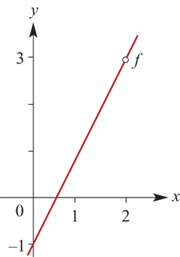
Example
For f(x)=$\frac{2x^{2}−5x+2}{x−2}$, x≠2, find $\lim_{x→2}$f(x).
Solution
Observe that
f(x)= $\frac{2x^{2}−5x+2}{x−2}$= $\frac{(2x−1)(x−2)}{x−2}$=2x−1 (for x≠2)
Hence $\lim_{x→2}$f(x)=3.
The graph of f:R∖{2}→R, f(x)=2x−1 is shown.

Slide 6
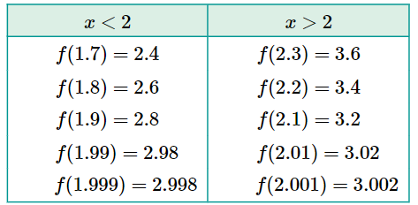
Example For f(x)=$\frac{2x^{2}−5x+2}{x−2}$, x≠2, find $\lim_{x→2}$f(x).
We can investigate this Example further by looking at the values of the function as we take x-values closer and closer to 2.
Observe that f(x) is defined for x∈R∖{2}.
Examine the behaviour of f(x) for values of x close to 2.
From the table, it is apparent that, as x takes values closer and closer to 2 (regardless of whether x approaches 2 from the left or from the right), the values of f(x) become closer and closer to 3. That is, $\lim_{x→2}$f(x)=3.
Note that the limit exists, but the function is not defined at x=2.

Slide 7
Algebra of limits
Suppose that f(x) and g(x) are functions and that a is a real number. Assume that both $\lim_{x→a}$f(x) and $\lim_{x→a}$g(x) exist.
Sum: $\lim_{x→a}$(f(x)+g(x))= $\lim_{x→a}$f(x)+$\lim_{x→a}$g(x)
That is, the limit of the sum is the sum of the limits.
Multiple: $\lim_{x→a}$kf(x)=k$\lim_{x→a}$f(x), where k is a given real number.
Product: $\lim_{x→a}$(f(x)g(x))=$\lim_{x→a}$f(x)$\lim_{x→a}$g(x)
That is, the limit of the product is the product of the limits.
Quotient: $\lim_{x→a} \frac{f(x)}{g(x)}$= $\frac{\lim_{x→a}f(x)}{\lim_{x→a}g(x)}$, provided $\lim_{x→a}$g(x)≠0.
That is, the limit of the quotient is the quotient of the limits.

Slide 8
Example
Find:
$\lim_{h→0}$(3h+4)
$\lim_{x→2}$4x(x+2)
$\lim_{x→3} \frac{5x+2}{x−2}$
Solution
$\lim_{h→0}$(3h+4)=$\lim_{h→0}$(3h)+$\lim_{h→0}$(4)=0+4=4
$\lim_{x→2}$4x(x+2)=$\lim_{x→2}$(4x)$\lim_{x→2}$(x+2)=8×4=32
$\lim_{x→3} \frac{5x+2}{x−2}$=$\lim_{x→3}$(5x+2)÷ $\lim_{x→3}$(x−2)=17÷1=17

Slide 9
Example
Find:
$\lim_{x→3} \frac{x^{2}−3x}{x−3}$
$\lim_{x→2} \frac{x^{2}−x−2}{x−2}$
$\lim_{x→3} \frac{x^{2}−7x+10}{x^{2}−25}$
Solution
$\lim_{x→3} \frac{x^{2}−3x}{x−3}$= $\lim_{x→3} \frac{x(x−3)}{x−3}$= $\lim_{x→3}$x=3
$\lim_{x→2} \frac{x^{2}−x−2}{x−2}$= $\lim_{x→2} \frac{(x−2)(x+1)}{x−2}$= $\lim_{x→2}$(x+1)=3
$\lim_{x→3} \frac{x^{2}−7x+10}{x^{2}−25}$=$\lim_{x→3} \frac{(x−2)(x−5)}{(x+5)(x−5)}$= $\frac{\lim_{x→3}(x−2)}{\lim_{x→3}(x+5)}$= $\frac{1}{8}$

Slide 10
Left and right limits
If the value of f(x) approaches the number p as x approaches a from the right-hand side, then it is written as $\lim_{x→a^{+}}$f(x)=p.
If the value of f(x) approaches the number p as x approaches a from the left-hand side, then it is written as $\lim_{x→a^{−}}$f(x)=p.
The limit as x approaches a exists only if both the limit from the left and the limit from the right exist and are equal. Then $\lim_{x→a}$f(x)=p.

Slide 11
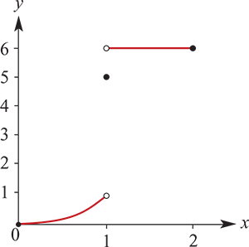
Piecewise-defined function
The following is an example of a piecewise-defined function where the limit does not exist for a particular value.
Let
f(x)=⎧
$x^{3}$ if 0≤x<1
⎨ 5 if x=1
⎩ 6 if 1<x≤2
It is clear from the graph of f that $\lim_{x→1}$f(x) does not exist. However, if x is allowed to approach 1 from the left, then f(x) approaches 1. On the other hand, if x is allowed to approach 1 from the right, then f(x) approaches 6. Also note that f(1)=5.

Slide 12
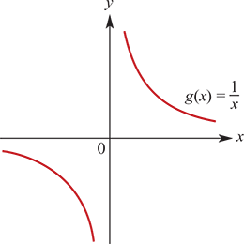
Rectangular hyperbola
First consider f:R∖{0}→R, f(x)=$\frac{1}{x^{2}}$. Observe that, as x approaches 0 both from the left and from the right, f(x) increases without bound. The limit notation for this is $\lim_{x→0}$f(x)=$∞$.
Now consider g:R∖{0}→R, g(x)=$\frac{1}{x}$. The behaviour of g(x) as x approaches 0 from the left is different from the behaviour as x approaches 0 from the right.
With limit notation this is written as: $\lim_{x→0^{−}}$g(x)=− $∞$and $\lim_{x→0^{+}}$g(x)= $∞$
Now examine this function as the magnitude of x becomes very large. It can be seen that, as x increases without bound through positive values, the corresponding values of g(x) approach zero. Likewise, as x decreases without bound through negative values, the corresponding values of g(x) also approach zero.
Symbolically this is written as: $\lim_{x→∞}$g(x)= $0^{+}$ and $\lim_{x→− ∞}$g(x)= $0^{−}$
Many functions approach a limiting value or limit as x approaches ± $∞$.

Slide 13
Continuity at a point
A function with rule f(x) is said to be continuous at x=a if the graph of y=f(x) can be drawn through the point with coordinates (a,f(a)) without a break. Otherwise, there is said to be a discontinuity at x=a.
We can give a more formal definition of continuity using limits. A function f is continuous at the point x=a provided f(a), $\lim_{x→a^{+}}$f(x) and $\lim_{x→a^{−}}$f(x) all exist and are equal.
We can state this equivalently as follows:
A function f is continuous at the point x=a if the following conditions are met:
f(x) is defined at x=a → $\lim_{x→a}$f(x)=f(a)
The function is discontinuous at a point if it is not continuous at that point.
A function is said to be continuous everywhere if it is continuous for all real numbers. All the polynomial functions are continuous everywhere. In contrast, the function
f(x)=⎧
$x^{3}$ if 0≤x<1
⎨ 5 if x=1
⎩ 6 if 1<x≤2
is defined for all real numbers but is not continuous at x=1.

Slide 14
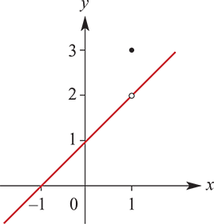
Example
State the values for x for which the functions shown below have a discontinuity:
Solution
There is a discontinuity at x=1, since f(1)=3 but $\lim_{x→1^{+}}$f(x)= $\lim_{x→1^{−}}$f(x)=2.

Slide 15
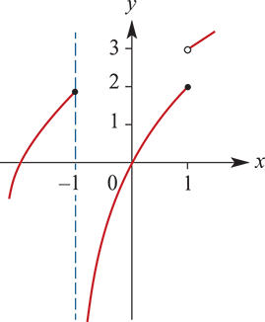
Example
State the values for x for which the functions shown below have a discontinuity:
Solution
There is a discontinuity at x=1, since f(1)=2 and $\lim_{x→1^{−}}$f(x)=2 but $\lim_{x→1^{+}}$f(x)=3.
There is also a discontinuity at x=−1, since f(−1)=2 and $\lim_{x→{−1}^{−}}$f(x)=2 but $\lim_{x→{−1}^{+}}$f(x)= −$∞$.

Slide 16
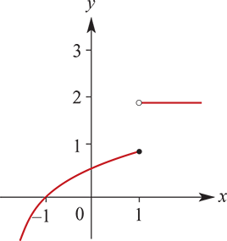
Example
State the values for x for which the functions shown below have a discontinuity:
Solution
There is a discontinuity at x=1, since f(1)=1 and $\lim_{x→1^{−}}$f(x)=1 but $\lim_{x→1^{+}}$f(x)=2.

Slide 17
Example
For each function, state the values of x for which there is a discontinuity, and use the definition of continuity in terms of f(a), $\lim_{x→a^{+}}$f(x) and $\lim_{x→a^{−}}$f(x) to explain why:
$f\left(x\right)={\text{\{}}_{−2x+1 \text{if} \text{x}\text{<0}}^{2x \text{if} \text{x}\text{≥0}}$
$f\left(x\right)={\text{\{}}_{−2x+1 \text{if} \text{x}\text{<0}}^{x^{2} \text{if} \text{x}\text{≥0}}$
f(x)= $\left\{\begin{matrix}x \text{if} \text{x}\text{≤−1} \\ { x}^{2} \text{if}\text{ −1≤}\text{x}\text{<0} \\ −2x+1 \text{if} \text{x}\text{≥0}\end{matrix}\right.$
$f\left(x\right)={\text{\{}}_{−2x+1 \text{if} \text{x}\text{<0}}^{x^{2} \text{+1} \text{if} \text{x}\text{≥0}}$
$f\left(x\right)={\text{\{}}_{−2x \text{if} \text{x}\text{<0}}^{x \text{if} \text{x}\text{≥0}}$
Solution
f(0)=0 but $\lim_{x→0^{−}}$f(x)=1, therefore there is a discontinuity at x=0.
f(0)=0 but $\lim_{x→0^{−}}$f(x)=1, therefore there is a discontinuity at x=0.
f(−1)=−1 but $\lim_{x→{−1}^{+}}$f(x)=1, therefore there is a discontinuity at x=−1.
f(0)=1 but $\lim_{x→0^{−}}$f(x)=0, therefore there is a discontinuity at x=0.
No discontinuity.
No discontinuity.

Slide 18
Section summary
A function f is continuous at the point x=a if the following conditions are met:
f(x) is defined at x=a
$\lim_{x→a}$f(x)=f(a)
The function is discontinuous at a point if it is not continuous at that point.
A function is said to be continuous everywhere if it is continuous for all real numbers.
All the polynomial functions are continuous everywhere.
Algebra of limits Suppose that f(x) and g(x) are functions and that a is a real number. Assume that both $\lim_{x→a}$f(x) and $\lim_{x→a}$g(x) exist.
$\lim_{x→a}$(f(x)+g(x))=$\lim_{x→a}$f(x)+$\lim_{x→a}$g(x)
That is, the limit of the sum is the sum of the limits.
$\lim_{x→a}$kf(x)=k$\lim_{x→a}$f(x), where k is a given real number.
$\lim_{x→a}$(f(x)g(x))=$\lim_{x→a}$f(x) $\lim_{x→a}$g(x)
That is, the limit of the product is the product of the limits.
$\lim_{x→a} \frac{f(x)}{g(x)}$= $\frac{\lim_{x→a}f(x)}{\lim_{x→a}g(x)}$, provided $\lim_{x→a}$g(x)≠0.
That is, the limit of the quotient is the quotient of the limits.

