Slide 1
When is a function differentiable
17G

Slide 2
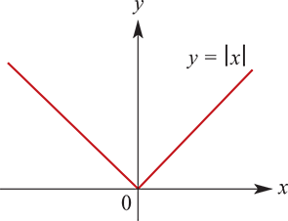
Differentiable
A function f is said to be differentiable at x=a if $\lim_{h→0}\frac{f\left(a+h\right)−f\left(a\right)}{h}$ exists.
The polynomial functions considered in this chapter are differentiable for all real numbers. However, this is not true for all functions.
Let f:R→R,
f(x)= $\left\{\begin{matrix}x \text{if} \text{x}\text{≥0} \\ −x \text{if} \text{x}\text{<0 }\end{matrix}\right.$
This function is called the modulus function (or the absolute-value function) and is denoted by f(x)=|x|.
The function f is not differentiable at x=0, because
$\frac{f\left(0+h\right)−f\left(0\right)}{h}$= $\frac{f\left(h\right)}{h}$= $\left\{\begin{matrix}1 \text{if} \text{h}\text{>0} \\ −1 \text{if} \text{h}\text{<0 }\end{matrix}\right.$
and so $\lim_{h→0}$f(0+h)−f(0)h does not exist.
Note:
To the left of 0 the gradient is −1, and to the right of 0 the gradient is 1.

Slide 3
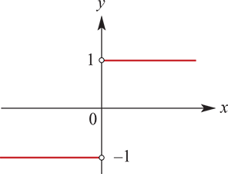
Example
Let f:R→R, f(x)= $\left\{\begin{matrix}x \text{if} \text{x}\text{≥0} \\ −x \text{if} \text{x}\text{<0 }\end{matrix}\right.$
(That is, f(x)=|x|.) Sketch the graph of the derivative for a suitable domain.
Solution
f′(x)= $\left\{\begin{matrix}1 \text{if} \text{x}\text{>}\text{0} \\ −1 \text{if} \text{x}\text{<0 }\end{matrix}\right.$
f′(x) is not defined at x=0

Slide 4
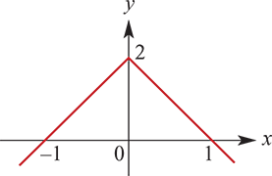
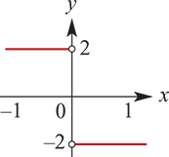
Example
Draw a sketch graph of f′ where the graph of f is as illustrated. Indicate where f′ is not defined.
Solution
The derivative does not exist at x=0, i.e. the function is not differentiable at x=0.

Slide 5
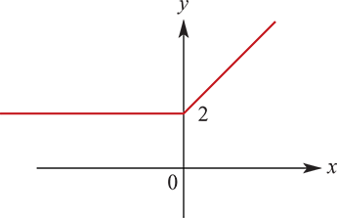
Example
For the function with following rule, find f′(x) and sketch the graph of y=f′(x):
f(x)= $\left\{\begin{matrix}x^{2}+2x+1 \text{if} \text{x}\text{≥0} \\ 2x+1 \text{if} \text{x}\text{<0 }\end{matrix}\right.$
Solution
f′(x)= $\left\{\begin{matrix}2x+2 \text{if} \text{x}\text{≥0} \\ 2 \text{if} \text{x}\text{<0 }\end{matrix}\right.$
In particular, f′(0) is defined and is equal to 2. The two sections of the graph of y=f(x) join smoothly at the point (0,1).

Slide 6
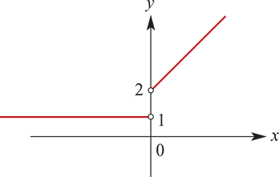
Example
For the function with rule
f(x)= $\left\{\begin{matrix}x^{2}+2x+1 \text{if} \text{x}\text{≥0} \\ x+1 \text{if} \text{x}\text{<0 }\end{matrix}\right.$
state the set of values for which the derivative is defined, find f′(x) for this set of values and sketch the graph of y=f′(x).
Solution
f′(x)= $\left\{\begin{matrix}2x+2 \text{if} \text{x}\text{>}\text{0} \\ 1 \text{if} \text{x}\text{<0 }\end{matrix}\right.$
f′(0) is not defined as the limits from the left and right are not equal.
The function f is differentiable for R∖{0}.

Slide 7
Proofs of two results for derivatives
Derivative of a constant function
If f is a constant function, f(x)=c, then f′(a)=0 for all real numbers a.
Proof
f′(a)= $\lim_{h→0}\frac{f\left(a+h\right)−f\left(a\right)}{h}$= $\lim_{h→0}\frac{c−c}{h}$=0
Derivative of a sum
If f and g are differentiable at a, then f+g is also differentiable at a, and
(f+g)′(a)=f′(a)+g′(a)
Proof
(f+g)′(a)= $\lim_{h→0}\frac{(f+g)\left(a+h\right)−(f+g)\left(a\right)}{h}=\lim_{h→0}\frac{f\left(a+h\right)+g\left(a+h\right)−f\left(a\right)−g(a)}{h}$
$=$ $\lim_{h→0}\frac{f\left(a+h\right)−f\left(a\right)+g\left(a+h\right)−g(a)}{h}$
= $\lim_{h→0}\frac{f\left(a+h\right)−f\left(a\right)}{h}+\lim_{h→0}\frac{g\left(a+h\right)−g(a)}{h}$=f′(a)+g′(a)

Slide 8
Section summary
A function f is said to be differentiable at x=a if $\lim_{h→0}\frac{f\left(a+h\right)−f\left(a\right)}{h}$ exists.

