Slide 1
Chapter 17 Differentiation and antidifferentiation of polynomials
Revision

Slide 2
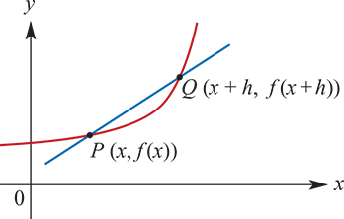
Notation
The notation for the limit as h approaches 0 is $\lim_{h→0}$.

Slide 3
Secant
For the graph of y=f(x):
The gradient of the secant PQ is given by
$\frac{f\left(x+h\right)−f\left(x\right)}{h}$
The gradient of the tangent to the graph at the point P is given by
$\lim_{h→0} \frac{f\left(x+h\right)−f\left(x\right)}{h}$

Slide 4
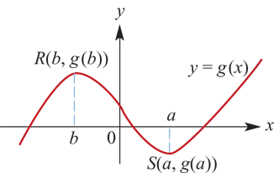
Derivative of the function
The derivative of the function of the function f is denoted f′ and is defined by
f′(x)= $\lim_{h→0} \frac{f\left(x+h\right)−f\left(x\right)}{h}$

Slide 5
Derivative of the function
At a point (a,g(a)) on the curve y=g(x), the gradient is g′(a).
For the graph shown:
g′(x)>0 for x<b and for x>a
g′(x)<0 for b<x<a
g′(x)=0 for x=b and for x=a.

Slide 6
Rules for differentiation
For f(x)=c, f′(x)=0. That is, the derivative of a constant function is zero.
For example:
f(x)=1, f′(x)=0
f(x)=27.3, f′(x)=0

Slide 7
Rules for differentiation
For f(x)=$x^{n}$, f′(x)=n$x^{n−1}$, where n is a non-zero integer.
For example:
f(x)= $x^{2}$, f′(x)=2x
f(x)= $x^{4}$, f′(x)=4$x^{3}$
f(x)= $x^{−1}$, f′(x)=− $x^{−2}$
f(x)= $x^{−3}$, f′(x)=−3$x^{−4}$

Slide 8
Rules for differentiation
For f(x)=kg(x), where k is a constant, f′(x)=kg′(x).
That is, the derivative of a number multiple is the multiple of the derivative.
For example:
f(x)=3$x^{2}$, f′(x)=3(2x)=6x

Slide 9
Rules for differentiation
For f(x)=g(x)+h(x), f′(x)=g′(x)+h′(x).
That is, the derivative of a sum is the sum of the derivatives.
For example:
f(x)= $x^{2}$+ $x^{3}$, f′(x)=2x+3$x^{2}$
g(x)=3$x^{2}$+4$x^{3}$, g′(x)=3(2x)+4(3$x^{2}$)=6x+12$x^{2}$

Slide 10
Antiderivatives
If F′(x)=f(x), then $\int{\text{f}\text{(}\text{x}\text{)}\text{dx}}$=F(x)+c, where c is an arbitrary real number.
$\int{x^{n}\text{dx}}$=$\frac{x^{n+1}}{n+1}$ +c, where n∈N∪{0}
$\int{\text{f}\text{(}\text{x}\text{)+}\text{g}\text{(}\text{x}\text{)}\text{dx}}$= $\int{\text{f}\text{(}\text{x}\text{)}\text{dx}}$+ $\int{\text{g}\text{(}\text{x}\text{)}\text{dx}}$
$\int{\text{k}\text{f}\text{(}\text{x}\text{)}\text{dx}}$=k$\int{\text{f}\text{(}\text{x}\text{)}\text{dx}}$, where k is a real number.

Slide 11
Algebra of limits
$\lim_{x→a}$(f(x)+g(x))= $\lim_{x→a}$f(x)+$\lim_{x→a}$g(x)
That is, the limit of the sum is the sum of the limits.
$\lim_{x→a}$kf(x)=k$\lim_{x→a}$f(x), where k is a real number.
$\lim_{x→a}$(f(x)g(x))=$\lim_{x→a}$f(x)$\lim_{x→a}$g(x)
That is, the limit of the product is the product of the limits.
$\lim_{x→a}\frac{f\left(x\right)}{g\left(x\right)}$= $\frac{\lim_{x→a}f\left(x\right)}{\lim_{x→a}g\left(x\right)}$, provided $\lim_{x→a}g\left(x\right)$≠0.
That is, the limit of the quotient is the quotient of the limits.

Slide 12
Continuity
A function f is continuous at the point x=a if:
f(x) is defined at x=a
$\lim_{x→a}$f(x)=f(a)
The function is discontinuous at a point if it is not continuous at that point.

