Slide 1
Algebra I
Chapter 1 Revision

Slide 2
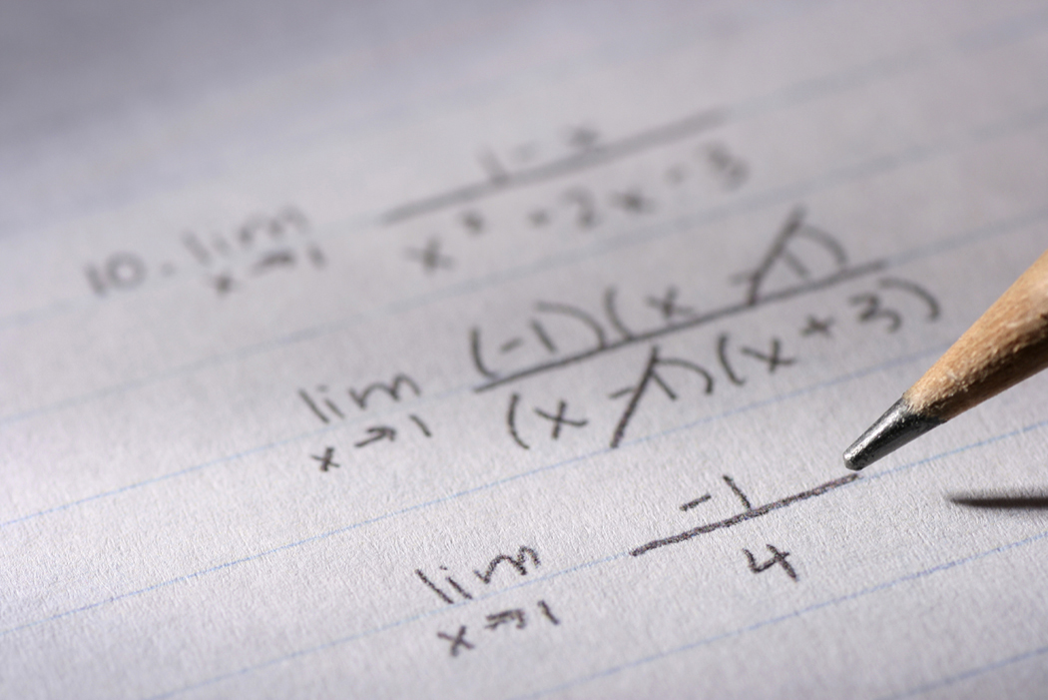
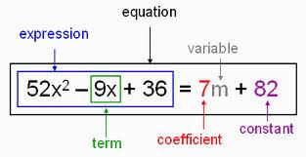
Coefficient: slope
Constant: y-intercept
Variable 1
Variable 2
y=mx+b
Linear Equation: slope y-intercept form
https://www.youtube.com/watch?v=BouqkWYlfzg
How to say maths signs in English?

Slide 3
standard form or scientific notation
A number is expressed in standard form or scientific notation when written as a product of a number between 1 and 10 and an integer power of 10; e.g. 1.5×${10}^{8}$
For example: 6547=6.457× ${10}^{3}$ and 0.789=7.89× ${10}^{−1}$

Slide 4
Significant figures
Writing a number in scientific notation makes it clear how many significant figures have been recorded.
When rounding off to a given number of significant figures, first identify the last significant digit and then:
if the next digit is 0, 1, 2, 3 or 4, round down
if the next digit is 5, 6, 7, 8 or 9, round up.
0.00123 3 sig. fig.
123000 3 sig. fig.
1.200 4 sig. fig.

Slide 5
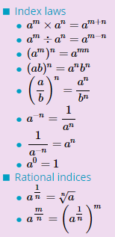
Indices

Slide 6
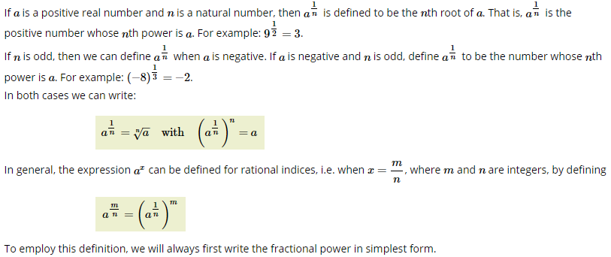
Rational indices

Slide 7
Linear equations
e.g.: Solve 3x+4=16 for x.
Note that x has been multiplied by 3 and then 4 has been added.
Subtract 4 from both sides:
3x=12
Divide both sides by 3:
x=4

Slide 8
Formula
An equation that states a relationship between two or more qantities is called a formula; e.g. the area of a circle is given by A=π $r^{2}$. The value of A, the subject of the formula, may be found by substituting a given value of r and the value of π.
A formula can be transposed to make a different variable the subject by using a similar procedure to solving linear equations, i.e. whatever has been done to the variable required is ‘undone’.
To calculate the value of a variable which is not the subject of a formula:
Method 1 Substitute the values for the known variables, then solve the resulting equation for the unknown variable.
Method 2 Rearrange to make the required variable the subject, then substitute values.

Slide 9
A literal equation
An equation for the variable x in which all the coefficients of x, including the constants, are pronumerals is known as a literal equations.
The methods for solving linear literal equations or simultaneous linear literal equations are exactly the same as when the coefficients are given numbers.

Slide 10
simultaneous linear equations
Read the question carefully and write down the known information clearly.
Identify the two unknown quantities that are to be found.
Assign variables to these two quantities.
Form expressions in terms of x and y (or other suitable variables) and use the other relevant information to form the two equations.
Solve the system of equations.
Write a sentence answering the initial question.

Slide 11
Algebraic fractions
Simplifying algebraic fractions
First factorise the numerator and denominator.
Then cancel any factors common to the numerator and denominator.
Adding and subtracting algebraic fractions
First obtain a common denominator and then add or subtract.
Multiplying and dividing algebraic fractions
First factorise each numerator and denominator completely.
Then complete the calculation by cancelling common factors.

