Slide 1
Sets of numbers
2B

Slide 2
Numbers

Slide 3
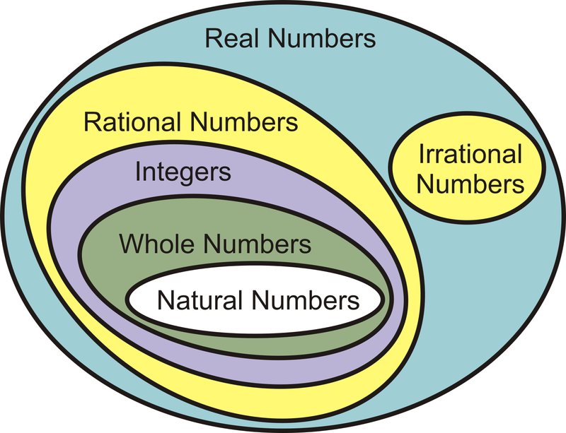
Numbers
Recall that the elements of {1,2,3,4,…} are called natural numbers, and the elements of {…,−2,−1,0,1,2,…} are called integers.
The numbers of the form $\frac{p}{\text{q}}$, with 𝑝 and 𝑞 integers, 𝑞≠0, are called rational numbers.
The real numbers which are not rational are called irrational. Some examples of irrational numbers are $\sqrt{2}$, $\sqrt{3}$, 𝜋, 𝜋+2 and $\sqrt{6}$+$\sqrt{7}$. These numbers cannot be written in the form $\frac{p}{\text{q}}$, for integers 𝑝,𝑞; the decimal representations of these numbers do not terminate or repeat.

Slide 4
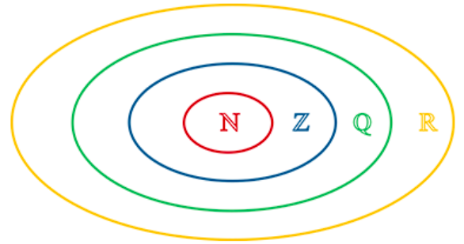
Numbers
The set of real numbers is denoted by ℝ.
The set of rational numbers is denoted by ℚ.
The set of integers is denoted by ℤ.
The set of natural numbers is denoted by ℕ.
It is clear that ℕ⊆ℤ⊆ℚ⊆ℝ, and this may be represented by the diagram on the right.

Slide 5
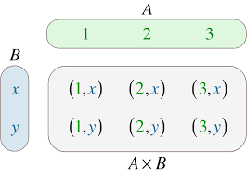
Cartesian product
We can use set notation to describe subsets of the real numbers.
For example:
{𝑥: 0<𝑥<1} is the set of all real numbers strictly between 0 and 1
{𝑥: 𝑥>0, 𝑥∈ℚ} is the set of all positive rational numbers
{2𝑛: 𝑛=0,1,2,…} is the set of all non-negative even numbers.
The set of all ordered pairs of real numbers is denoted by ${\text{ℝ}}^{2}$. That is,
${\text{ℝ}}^{2}$ ={(𝑥,𝑦): 𝑥,𝑦∈ℝ}
This set is known as the Cartesian product of ℝ with itself.

Slide 6
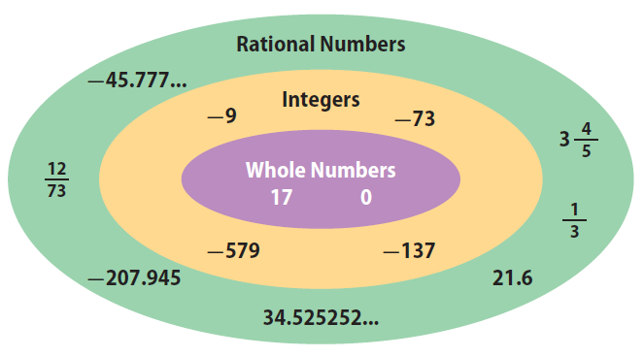
Rational numbers
Every rational number can be expressed as a terminating or recurring decimal.
To find the decimal representation of a rational number $\frac{m}{n}$, perform the division 𝑚÷𝑛.
For example, to find the decimal representation of $\frac{3}{7}$, divide 3.0000000… by 7.
Therefore $\frac{3}{7}$=0.$\dot{\text{4}}$2857$\dot{\text{1}}$.

Slide 7
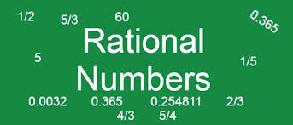
Proof
Consider any two natural numbers 𝑚 and 𝑛. At each step in the division of 𝑚 by 𝑛, there is a remainder. If the remainder is 0, then the division algorithm stops and the decimal is a terminating decimal.
If the remainder is never 0, then it must be one of the numbers 1,2,3,…,𝑛−1. (In the above example, 𝑛=7 and the remainders can only be 1, 2, 3, 4, 5 and 6.) Hence the remainder must repeat after at most 𝑛−1 steps.
Further examples:
$\frac{1}{2}$=0.5, $\frac{1}{5}$ =0.2, $\frac{1}{10}$ =0.1, $\frac{1}{3}$=0. $\dot{\text{3}}$, $\frac{1}{7}$=0. $\dot{\text{1}}$4285$\dot{\text{7}}$

Slide 8
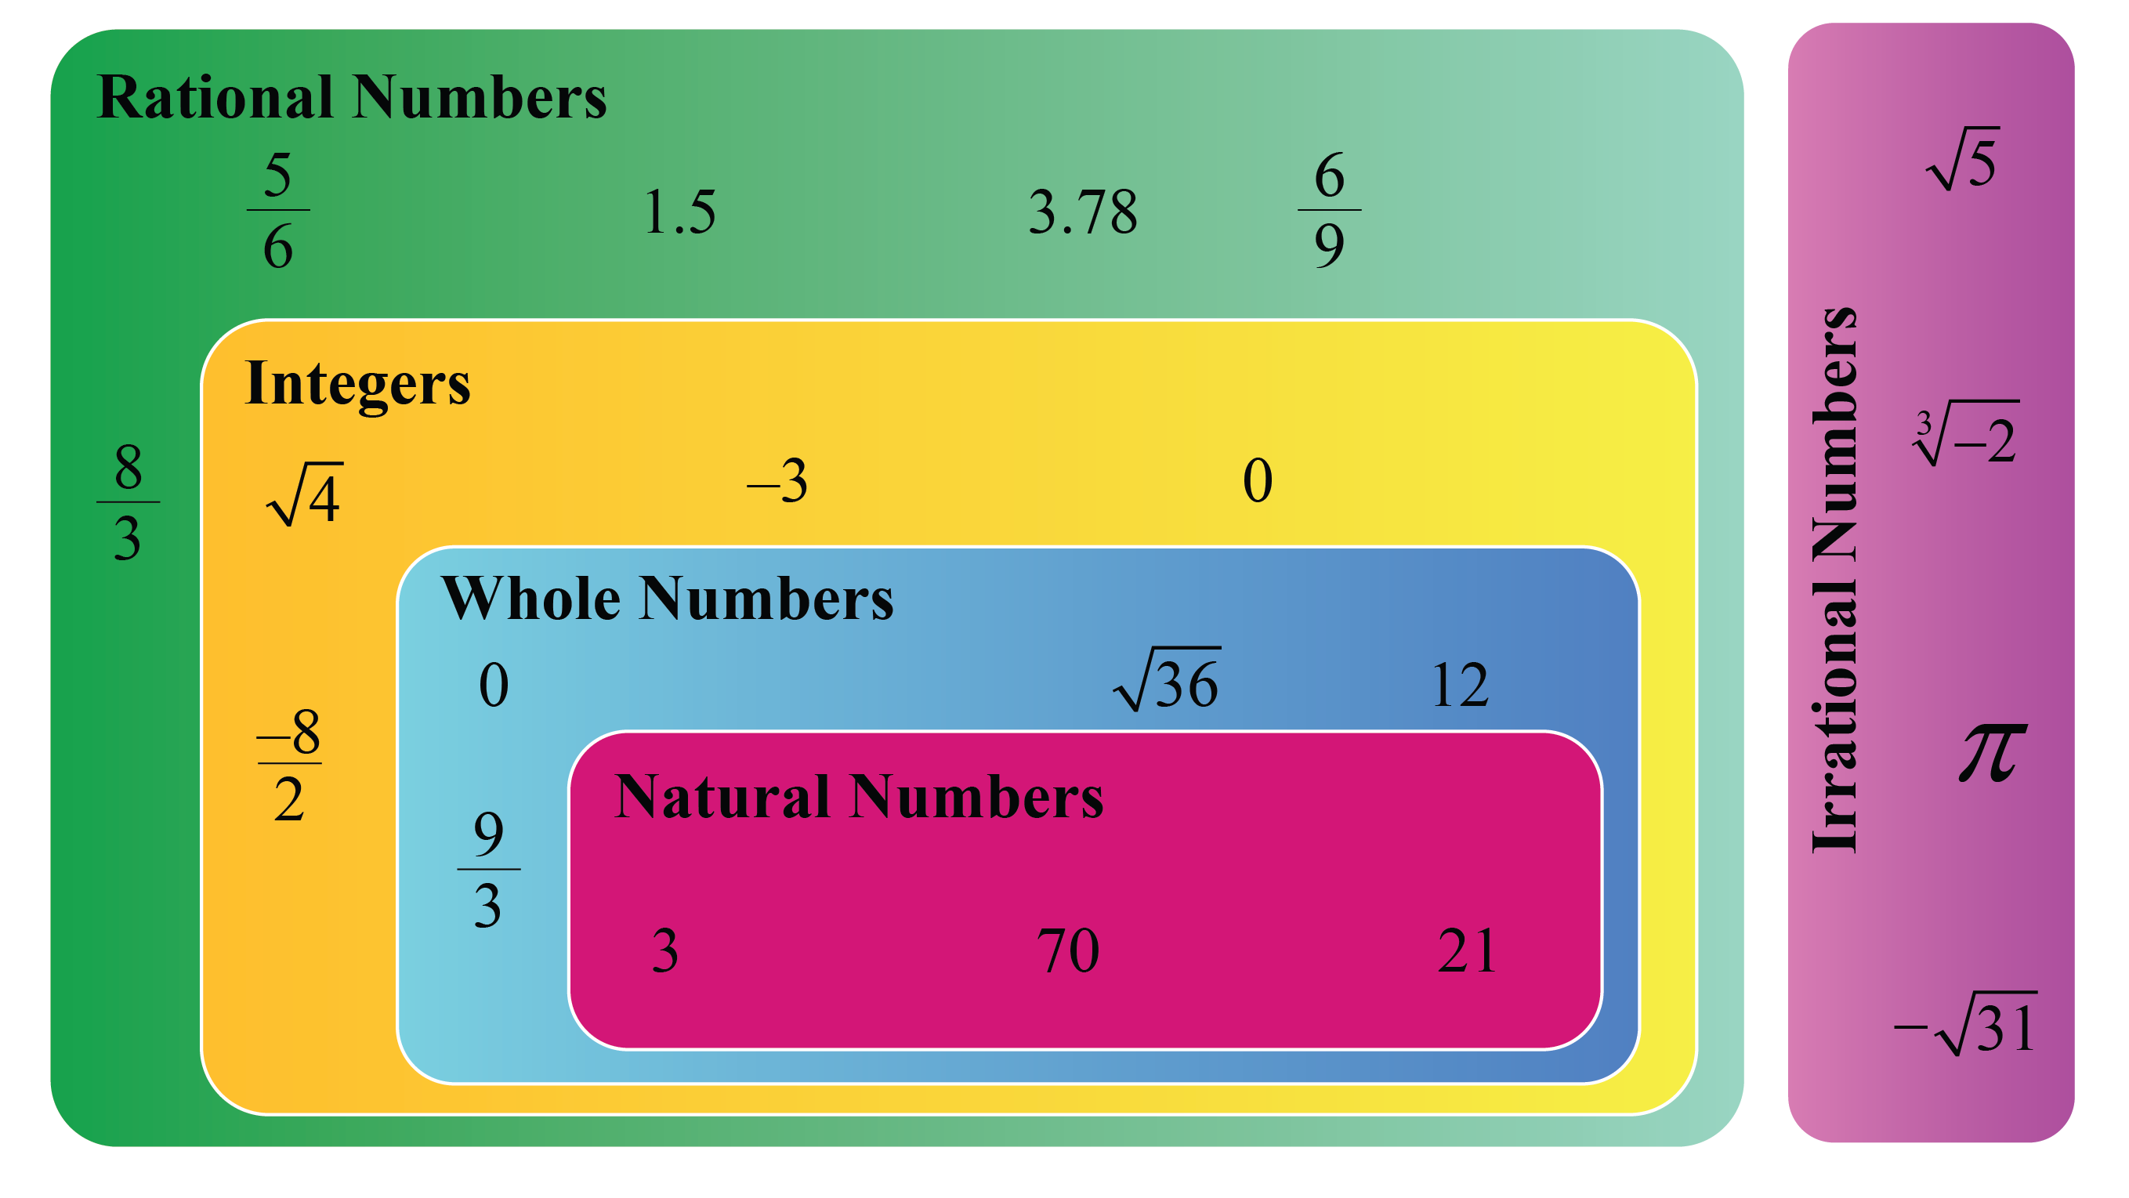
Proof
Assume that 𝑥=$\frac{m}{2^{α}{×5}^{β}}$ with 𝛼≥𝛽. Multiply the numerator and denominator by $5^{α−β}$. Then
𝑥= $\frac{m×5^{α−β}}{2^{α}{×5}^{β}×5^{α−β}}$= $\frac{m×5^{α−β}}{2^{α}{×5}^{α}}$= $\frac{m×5^{α−β}}{{10}^{α}}$
and so 𝑥 can be written as a terminating decimal. The case 𝛼<𝛽 is similar.
Conversely, if 𝑥 can be written as a terminating decimal, then there is 𝑚∈ℤ and 𝛼∈ℕ∪{0} such that 𝑥= $\frac{m}{{10}^{α}}$= $\frac{m}{2^{α}{×5}^{α}}$.

Slide 9
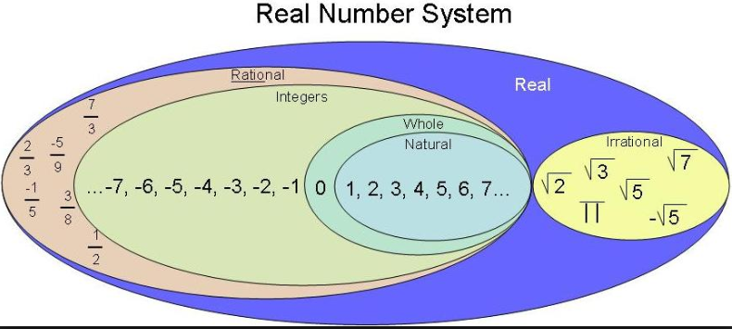
Example: Write each of the following in the form $\frac{m}{n}$, where 𝑚 and 𝑛 are integers:
0.05
0.$\dot{\text{4}}$2857$\dot{\text{1}}$
0.05= $\frac{5}{100}$= $\frac{1}{20}$
0.$\dot{\text{4}}$2857$\dot{\text{1}}$=0.428571428571428571…(1)
Multiply both sides by ${10}^{6}$:
0.$\dot{\text{4}}$2857$\dot{\text{1}}$× ${10}^{6}$=428571.428571428571…(2)
Subtract (1) from (2): → 0.$\dot{\text{4}}$2857$\dot{\text{1}}$×(${10}^{6}$−1)=428571
∴0.$\dot{\text{4}}$2857$\dot{\text{1}}$= $\frac{\text{428571}}{{10}^{6}\text{−1}}$= $\frac{3}{7}$

Slide 10
Real numbers
The set of real numbers is made up of two important subsets: the algebraic numbers and the transcendental numbers.
An algebraic number is a solution to a polynomial equation of the form
$a_{n}x^{n}$+ $a_{n−1}x^{n−1}$+⋯+ $a_{1}$𝑥+ $a_{0}$=0, where $a_{0}$, $a_{1}$,…, $a_{n}$ are integers
Every rational number is algebraic. The irrational number $\sqrt{2}$ is algebraic, as it is a solution of the equation
$x^{2}$−2=0
It can be shown that 𝜋 is not an algebraic number; it is a transcendental number. The proof is too difficult to be given here.

Slide 11
Real numbers

Slide 12
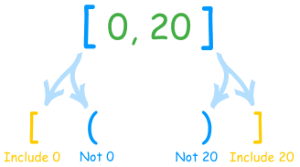
Interval notations
Closed interval: [a,b] is the set of all numbers not smaller than a and not bigger than b
[a,b] = {x: a≤x≤b}
Example:
[-1,3]
-1
3
x

Slide 13
Interval notations
Open intervals: (a,b) is the set of all numbers bigger than a and smaller than b
(a,b) = {x: a<x<b}
Example:
(-1,3)
-1
3
x

Slide 14
Interval notations
Half-Open (half-closed) intervals: (a,b] is the set of all numbers bigger than a and smaller than or equal to b
(a,b] = {x: a<x≤b}
Example:
(-1,3]
The interval [a,b) is defined similarly
-1
3
x

Slide 15
Infinite intervals
[a,∞) = {x: a≤x}
(a, ∞) = {x: a<x}
(-∞,a] = {x: x≤a}
(-∞,a) = {x: x<a}
The whole real line R = (-∞, ∞)
a
a
a
a
Note: ∞ is not a number!

Slide 16
Interval notation
Among the most important subsets of ℝ are the intervals. We suppose that 𝑎 and 𝑏 are real numbers with 𝑎<𝑏.
(a, b) = {x: a < x < b} [a, b] = {x: a ≤ x ≤ b}
(a, b] = {x: a < x ≤ b}. [a, b) = {x: a ≤ x < b}
(a, ∞) = {x: a < x} [a, ∞) = {x: a ≤ x}
(-∞, a) = {x: x < a} (-∞, a] = {x: x ≤ a}
The ‘closed’ circle (∙) indicates that the number is included.
The ‘open’ circle (∘) indicates that the number is not included.
The following are subsets of the real numbers for which we have special notation:
Positive real numbers: ${\text{ℝ}}^{+}$ ={𝑥: 𝑥 > 0}
Negative real numbers: ${\text{ℝ}}^{−}$ ={𝑥: 𝑥 < 0}
Real numbers excluding zero: ℝ∖ {0}

Slide 17
Illustrate each of the following intervals of real numbers:
[−2,3]
(−3,4]
(−∞,2]
(−2,4)
(−3,∞)

Slide 18
Section summary
Sets of numbers:
Real numbers: ℝ
Rational numbers: ℚ
Integers: ℤ
Natural numbers: ℕ
For real numbers 𝑎 and 𝑏 with 𝑎<𝑏, we can consider the following intervals:
(a, b) = {x: a < x < b} [a, b] = {x: a ≤ x ≤ b}
(a, b] = {x: a < x ≤ b}. [a, b) = {x: a ≤ x < b}
(a, ∞) = {x: a < x} [a, ∞) = {x: a ≤ x}
(-∞, a) = {x: x < a} (-∞, a] = {x: x ≤ a}

