Slide 1
The modulus function
2C

Slide 2
The modulus or absolute value
The modulus or absolute value of a real number 𝑥 is denoted by |𝑥| and is defined by
|𝑥|= {
It may also be defined as |𝑥|=$\sqrt{x^{2}}$. For example: |5|=5 and |−5|=5.
𝑥 if 𝑥≥0
−𝑥 if 𝑥<0

Slide 3
Evaluate each of the following:
|−3×2|
|−3|×|2|
$\frac{\left|−4\right|}{\left|2\right|}$
$\left|\frac{−4}{2}\right|$
|−6+2|
|−6|+|2|
=|−6|=6
=3×2=6
Note: |−3×2|=|−3|×|2|
= $\frac{4}{2}$ =2
=$\left|−2\right|$=2
Note: $\frac{\left|−4\right|}{\left|2\right|}$ = $\left|\frac{−4}{2}\right|$
=|−4|=4
=6+2=8
Note: |−6+2|$≠$|−6|+|2|

Slide 4
The modulus function as a measure of distance
Consider two points 𝐴 and 𝐵 on a number line:
On a number line, the distance between points 𝐴 and 𝐵 is |𝑎−𝑏|=|𝑏−𝑎|.
|𝑥−2|≤3 can be read as ‘on the number line, the distance of 𝑥 from 2 is less than or equal to 3’
|𝑥|≤3 can be read as ‘on the number line, the distance of 𝑥 from the origin is less than or equal to 3’.
Note that |𝑥|≤3 is equivalent to −3≤𝑥≤3 or 𝑥∈[−3,3].

Slide 5
Illustrate each of the following sets on a number line and represent the sets using interval notation:
{𝑥:|𝑥|<4}
{𝑥:|𝑥|≥4}
{𝑥:|𝑥−1|≤4}

Slide 6
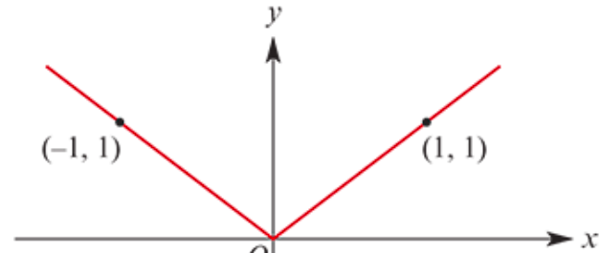
The graph of 𝑦=|𝑥|
The graph of the function 𝑓:ℝ→ℝ, 𝑓(𝑥)=|𝑥| is shown here.
This graph is symmetric about the 𝑦-axis, since |𝑥|=|−𝑥|.

Slide 7
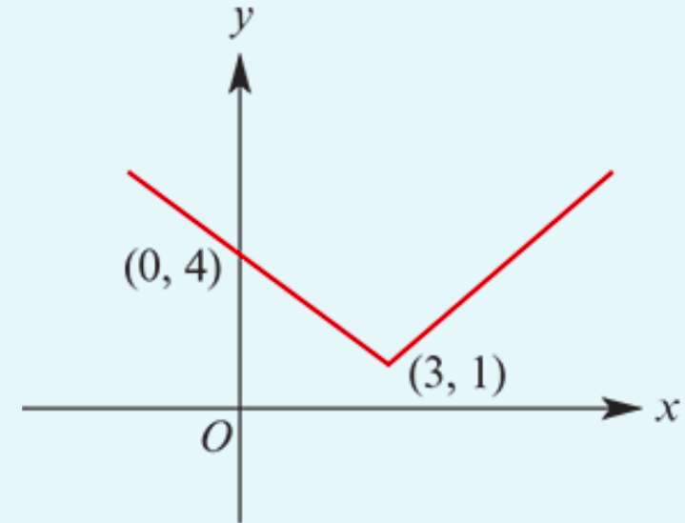
Sketch the graph and state the range:
Note that |𝑎−𝑏|=𝑎−𝑏 if 𝑎≥𝑏, and |𝑎−𝑏|=𝑏−𝑎 if 𝑏≥𝑎.
𝑓(𝑥)=|𝑥−3|+1
𝑓(𝑥)=|𝑥−3|+1={ ={
Range=[1,∞)
𝑥−3+1 if 𝑥≥3
3−𝑥+1 if 𝑥<3
𝑥−2 if 𝑥≥3
4−𝑥 if 𝑥<3

Slide 8
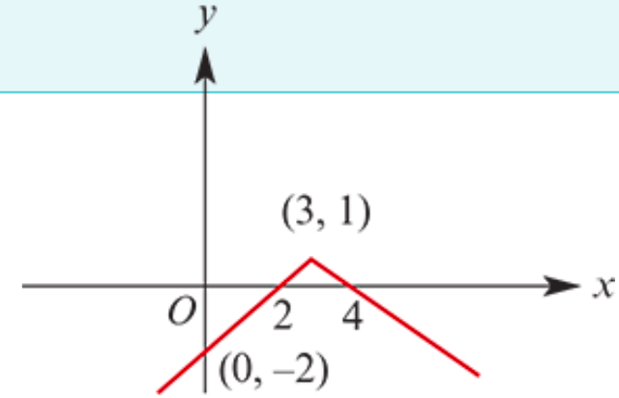
Sketch the graph and state the range:
Note that |𝑎−𝑏|=𝑎−𝑏 if 𝑎≥𝑏, and |𝑎−𝑏|=𝑏−𝑎 if 𝑏≥𝑎.
𝑓(𝑥)=−|𝑥−3|+1
𝑓(𝑥)= − |𝑥−3|+1={ ={
Range(−∞,1]
−(𝑥−3)+1 if 𝑥≥3
−(3−𝑥)+1 if 𝑥<3
−𝑥+4 if 𝑥≥3
−2+𝑥 if 𝑥<3

