Slide 1
Linear Diophantine equations
2F

Slide 3
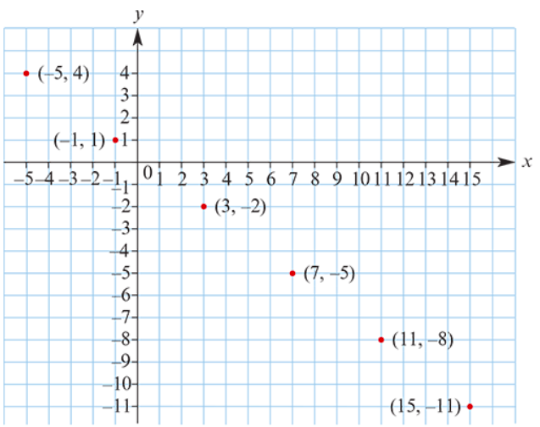
A Diophantine equation
An equation of the form 𝑎𝑥+𝑏𝑦=𝑐, where the coefficients 𝑎,𝑏,𝑐 are integers, is called a linear Diophantine equation when the intention is to find integer solutions for 𝑥,𝑦.
A family of integer solutions to 3𝑥+4𝑦=1 .
𝑥 | 𝑦
−1+1×4 | 1−1×3
−1+2×4 | 1−2×3
−1+3×4 | 1−3×3
𝑥 | 𝑦
3 | −2
7 | −5
11 | −8
4
3
The family of solutions may be described as
𝑥=−1+4𝑡, 𝑦=1−3𝑡 for 𝑡∈ℤ
The solution set is
{(𝑥,𝑦): 𝑥=−1+4𝑡, 𝑦=1−3𝑡, 𝑡∈ℤ}

Slide 4
Linear Diophantine Theorem
If 𝑎𝑥+𝑏𝑦=𝑐 is a linear Diophantine equation and ($x_{0}$, $y_{0}$) is found to be one solution, then the general solution is given by
𝑥= $x_{0}$+$\frac{b}{d}$𝑡, 𝑦= $y_{0}$− $\frac{a}{d}$𝑡 for 𝑡∈ℤ
where 𝑑 is the highest common factor of 𝑎 and 𝑏.
A linear Diophantine equation 𝑎𝑥+𝑏𝑦=𝑐 has integer solutions if and only if HCF(𝑎,𝑏) divides 𝑐.
There are no integer solutions to 2𝑥+6𝑦=3

Slide 5
A man has $200 in his wallet, made up of $50 and $20 notes. What are the possible numbers of each of these types of notes?
Let 𝑥 and 𝑦 be the numbers of $50 and $20 notes respectively.
The linear Diophantine equation is
50𝑥+20𝑦 =200 → 5𝑥+2𝑦 =20
By inspection, a solution is. 𝑥=4, 𝑦=0
∴ The general solution is 𝑥=4+2𝑡, 𝑦=0−5𝑡,for 𝑡∈ℤ
$∵$𝑥≥0 and 𝑦≥0, that is, 4+2𝑡≥0 and −5𝑡≥0.
Hence −2≤𝑡≤0.
For 𝑡=−2: 𝑥=0, 𝑦=10
For 𝑡=−1: 𝑥=2, 𝑦=5
For 𝑡=0: 𝑥=4, 𝑦=0
The man could have ten $20 notes, or two $50 notes and five $20 notes, or four $50 notes.

Slide 6
Section summary
A Diophantine equation is an equation in which only integer solutions are allowed.
An equation of the form 𝑎𝑥+𝑏𝑦=𝑐, where the coefficients 𝑎,𝑏,𝑐 are integers, is called a linear Diophantine equation when the intention is to find integer solutions for 𝑥,𝑦.
If a linear Diophantine equation has one solution, then it has infinitely many:
If 𝑎𝑥+𝑏𝑦=𝑐 is a linear Diophantine equation and (𝑥_0, 𝑦_0) is found to be one solution, then the general solution is given by
𝑥= $x_{0}$+$\frac{b}{d}$𝑡, 𝑦= $y_{0}$− $\frac{a}{d}$𝑡 for 𝑡∈ℤ
where 𝑑 is the highest common factor of 𝑎 and 𝑏.

