Slide 1
Problems involving sets
2H

Slide 2
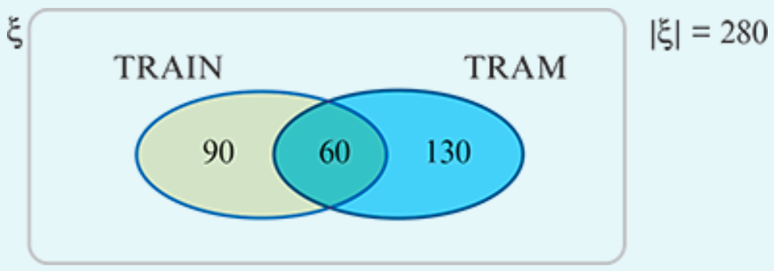
Example 1
Two hundred and eighty students each travel to school by either train or tram or both. Of these students, 150 travel by train, and 60 travel by both train and tram.
Show this information on a Venn diagram.
Hence find the number of students who travel by:
$1$. tram 2. train but not tram 3. just one of these modes of transport.
1. |TRAM|=130+60=190
2. |TRAIN∩(TRAM)′|=90
3. |TRAIN∩(TRAM)′|+|(TRAIN)′∩TRAM|=90+130=220

Slide 3
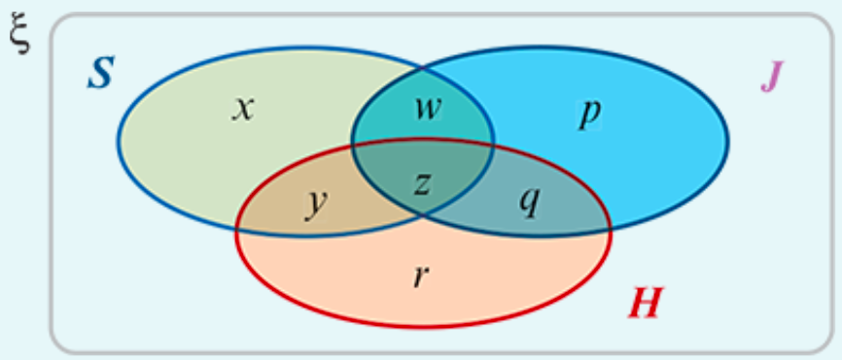
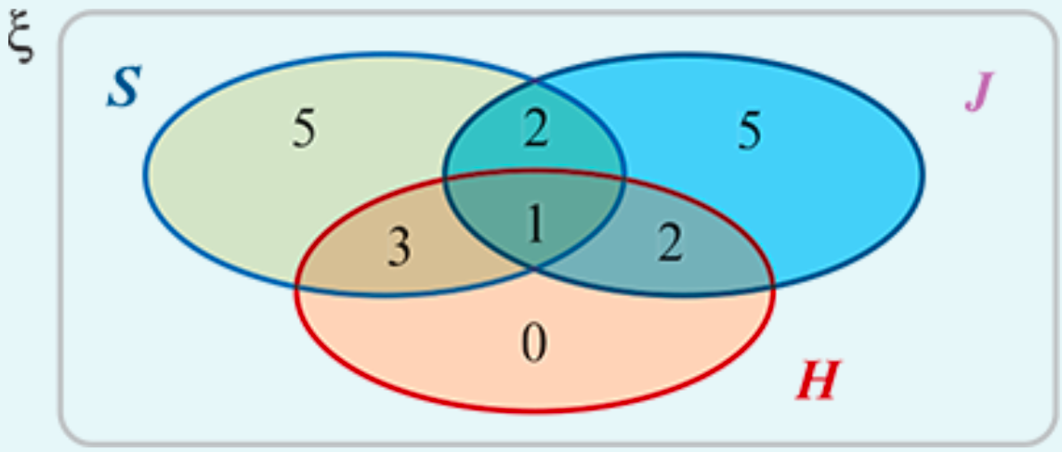
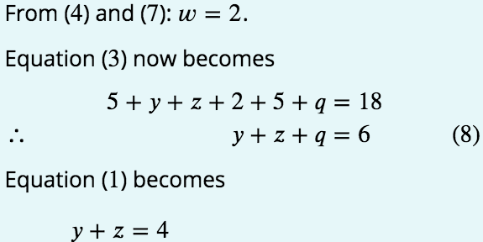
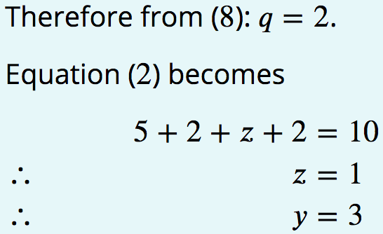
Example 2
An athletics team has 18 members. Each member competes in at least one of three events: sprints (𝑆), jumps (𝐽) and hurdles (𝐻). Every hurdler also jumps or sprints. The following additional information is available:
|𝑆|=11, |𝐽|=10, |𝐽∩𝐻′∩𝑆′|=5, |𝐽′∩𝐻′∩𝑆|=5 and |𝐽∩𝐻′|=7
Draw a Venn diagram.

Slide 4
Example 2
An athletics team has 18 members. Each member competes in at least one of three events: sprints (𝑆), jumps (𝐽) and hurdles (𝐻). Every hurdler also jumps or sprints. The following additional information is available:
|𝑆|=11, |𝐽|=10, |𝐽∩𝐻′∩𝑆′|=5, |𝐽′∩𝐻′∩𝑆|=5 and |𝐽∩𝐻′|=7
Draw a Venn diagram.
Find:
1. |𝐻|
2. |𝑆∩𝐻∩𝐽|
3. |𝑆∪𝐽|
4. |𝑆∩𝐽∩𝐻′|
1. |𝐻|=6
2. |𝑆∩𝐻∩𝐽|=1
3. |𝑆∪𝐽|=18
4. |𝑆∩𝐽∩𝐻′|=2

