Slide 1
Number systems and sets
Chapter 2

Slide 2
Set notation
2A

Slide 3
What is a set?
In maths, it’s often useful to represent a collection of items.
We use curly braces to indicate a set of items...
!
𝐴={−3,3}={𝑥:$x^{2}$=9}
A set is a collection of items with 2 properties:
a. It doesn’t contain duplicates.
?
b. The order of the elements does not matter. (but we usually write the items in ascending order)
?
Note: {𝑥:…} is read as ‘the set of all 𝑥 such that …’.
Notes:
Note: {𝑥:…}{x:…} is read as ‘the set of all 𝑥 such that …’.

Slide 4
Elements of a set
a ∊ A means that element a is in the set A
Example: A = the set of all odd integers bigger than 2 but less than or equal to 11
3 ∊ A
4 ∉ A
15 ∉ A

Slide 5
Empty set & universal
Empty set ∅: The set with no elements.
The universal set 𝜉: the set of all elements which are being considered.
Notes:
𝜉 zai

Slide 6
Subsets
Set B is called a subset of the set A if any element of B is also an element of A
B⊆A
Example
If A = [0,10] and B={1,3,5} then B⊆A
If A = [0,10] and C = [-1,3), C is not a subset of A
𝐴⊆𝐴 & ∅⊆𝐴
A
B

Slide 7
Union
The union of two sets A and B is the set of all elements x such that x is in A OR x is in B
Notation: A ∪ B = { x | x ∊ A or x ∊ B}
A
B
A ∪ B

Slide 8
Intersection
The intersection of two sets A and B is the set of all elements x such that x is in A AND x is in B
Notation: A ∩ B = { x | x ∊ A and x ∊ B}
A
B
A ∩ B

Slide 9
The complement of a set
If 𝜉={1,2,3,4,5,6,7,8,9,10} and 𝐴={1,3,5,7,9}, then 𝐴′={2,4,6,8,10}.
𝜉

Slide 10
Sets of numbers
2B

Slide 11
Numbers

Slide 12
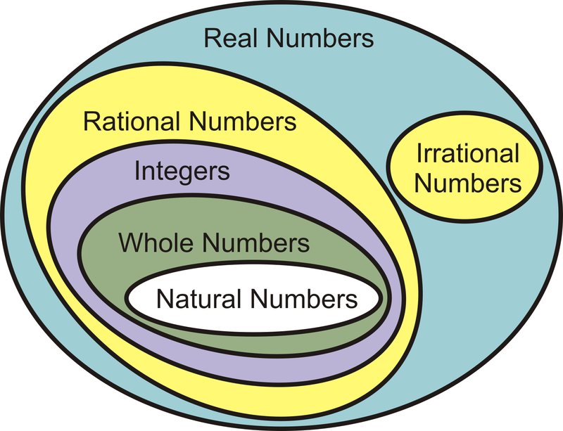
Numbers
Recall that the elements of {1,2,3,4,…} are called natural numbers, and the elements of {…,−2,−1,0,1,2,…} are called integers.
The numbers of the form $\frac{p}{\text{q}}$, with 𝑝 and 𝑞 integers, 𝑞≠0, are called rational numbers.
The real numbers which are not rational are called irrational. Some examples of irrational numbers are $\sqrt{2}$, $\sqrt{3}$, 𝜋, 𝜋+2 and $\sqrt{6}$+$\sqrt{7}$. These numbers cannot be written in the form $\frac{p}{\text{q}}$, for integers 𝑝,𝑞; the decimal representations of these numbers do not terminate or repeat.

Slide 13
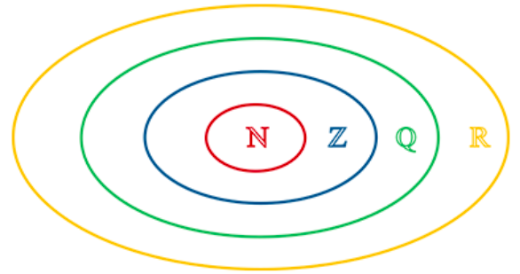
Numbers
The set of real numbers is denoted by ℝ.
The set of rational numbers is denoted by ℚ.
The set of integers is denoted by ℤ.
The set of natural numbers is denoted by ℕ.
It is clear that ℕ⊆ℤ⊆ℚ⊆ℝ, and this may be represented by the diagram on the right.

Slide 14
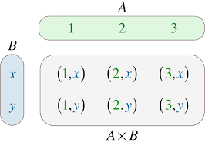
Cartesian product
We can use set notation to describe subsets of the real numbers.
For example:
{𝑥: 0<𝑥<1} is the set of all real numbers strictly between 0 and 1
{𝑥: 𝑥>0, 𝑥∈ℚ} is the set of all positive rational numbers
{2𝑛: 𝑛=0,1,2,…} is the set of all non-negative even numbers.
The set of all ordered pairs of real numbers is denoted by ${\text{ℝ}}^{2}$. That is,
${\text{ℝ}}^{2}$ ={(𝑥,𝑦): 𝑥,𝑦∈ℝ}
This set is known as the Cartesian product of ℝ with itself.

Slide 15
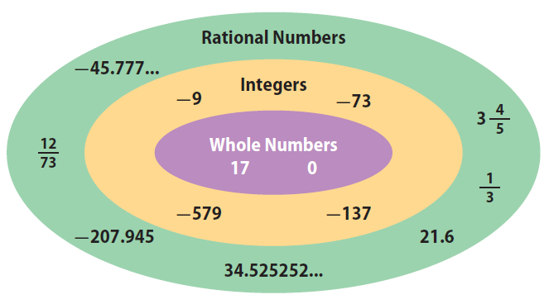
Rational numbers
Every rational number can be expressed as a terminating or recurring decimal.
To find the decimal representation of a rational number $\frac{m}{n}$, perform the division 𝑚÷𝑛.
For example, to find the decimal representation of $\frac{3}{7}$, divide 3.0000000… by 7.
Therefore $\frac{3}{7}$=0.$\dot{\text{4}}$2857$\dot{\text{1}}$.

Slide 16
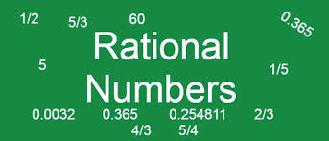
Proof
Consider any two natural numbers 𝑚 and 𝑛. At each step in the division of 𝑚 by 𝑛, there is a remainder. If the remainder is 0, then the division algorithm stops and the decimal is a terminating decimal.
If the remainder is never 0, then it must be one of the numbers 1,2,3,…,𝑛−1. (In the above example, 𝑛=7 and the remainders can only be 1, 2, 3, 4, 5 and 6.) Hence the remainder must repeat after at most 𝑛−1 steps.
Further examples:
$\frac{1}{2}$=0.5, $\frac{1}{5}$ =0.2, $\frac{1}{10}$ =0.1, $\frac{1}{3}$=0. $\dot{\text{3}}$, $\frac{1}{7}$=0. $\dot{\text{1}}$4285$\dot{\text{7}}$

Slide 17
Real numbers
The set of real numbers is made up of two important subsets: the algebraic numbers and the transcendental numbers.
An algebraic number is a solution to a polynomial equation of the form
$a_{n}x^{n}$+ $a_{n−1}x^{n−1}$+⋯+ $a_{1}$𝑥+ $a_{0}$=0, where $a_{0}$, $a_{1}$,…, $a_{n}$ are integers
Every rational number is algebraic. The irrational number $\sqrt{2}$ is algebraic, as it is a solution of the equation
$x^{2}$−2=0
It can be shown that 𝜋 is not an algebraic number; it is a transcendental number. The proof is too difficult to be given here.

Slide 18
Real numbers

Slide 19
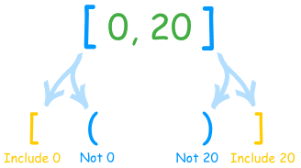
Interval notations
Closed interval: [a,b] is the set of all numbers not smaller than a and not bigger than b
[a,b] = {x: a≤x≤b}
Example:
[-1,3]
-1
3
x

Slide 20
Interval notations
Open intervals: (a,b) is the set of all numbers bigger than a and smaller than b
(a,b) = {x: a<x<b}
Example:
(-1,3)
-1
3
x

Slide 21
The modulus function
2C

Slide 22
The modulus or absolute value
The modulus or absolute value of a real number 𝑥 is denoted by |𝑥| and is defined by
|𝑥|= {
It may also be defined as |𝑥|=$\sqrt{x^{2}}$. For example: |5|=5 and |−5|=5.
𝑥 if 𝑥≥0
−𝑥 if 𝑥<0

Slide 23
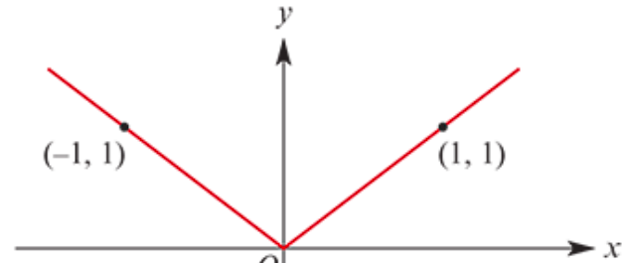
The graph of 𝑦=|𝑥|
The graph of the function 𝑓:ℝ→ℝ, 𝑓(𝑥)=|𝑥| is shown here.
This graph is symmetric about the 𝑦-axis, since |𝑥|=|−𝑥|.

Slide 24
introducing
Surds

Slide 25
A quadratic surd is a number of the form $\sqrt{a}$, where 𝑎 is a rational number which is not the square of another rational number.
In general, a surd of order 𝑛 is a number of the form $\sqrt[n]{a}$, where 𝑎 is a rational number which is not a perfect $n^{th}$ power.
Note: $\sqrt{a}$ is taken to mean the positive square root.
For example:
$\sqrt{7}$, $\sqrt{24}$, $\sqrt{\frac{9}{7}}$, $\sqrt{\frac{1}{2}}$ are quadratic surds
$\sqrt{9}$, $\sqrt{16}$, $\sqrt{\frac{9}{4}}$ are not surds
$\sqrt[3]{7}$, $\sqrt[3]{15}$ are surds of order 3
$\sqrt[4]{100}$, $\sqrt[4]{26}$ are surds of order 4
Surd of order n

Slide 26
The Properties of Roots and Surds
adding/subtracting:
Note
Although we are showing these rules with square roots, they work with all roots, i.e. cube roots, fourth roots etc

Slide 27
"reducing"
Surds
”Simplest form"

Slide 28
In higher level mathematics, we usually want the denominators of fractions surd-free.
Some of the reasons for this are:
Easier to add fractions with rational denominators
Easier to get a “feel” for the size of a fraction with a surd-free denominator
Looks!
Given a fraction with a surd appearing in the denominator, we can find another equivalent fraction with the denominator surd-free.
We are rationalising the denominator
Here are some of the “tricks” involved in this process:

Slide 29
Rationalising Denominators with simple Surds
Check!
Rationalise the denominator of
Check!
Rationalise the denominator of
Check!
Rationalise the denominator of
¥ → $×$

Slide 30
Rationalising Denominators with not so simple Surds
Check!
Rationalise the denominator of
Check!
Rationalise the denominator of
¥ → $×$

Slide 31
2E: Natural Numbers
Look at the list of keywords. Which words are familiar to you? Mark the words with a ✅
Odd Number
Even Number
Natural Number
Factor
Highest Common Factor
Multiple
Lowest Common Multiple
Prime Number
Composite Number
Prime decomposition

Slide 32
A Natural Number: A positive whole number. Natural numbers are denoted with the capital letter N
A natural number 𝑎 is a factor of a natural number 𝑏 if there exists a natural number 𝑘 such that 𝑏=𝑎𝑘.
Highlight the NATURAL NUMBERS on this number line.

Slide 33
1 | 2 | 3 | 4 | 5 | 6 | 7 | 8 | 9 | 10
11 | 12 | 13 | 14 | 15 | 16 | 17 | 18 | 19 | 20
21 | 22 | 23 | 24 | 25 | 26 | 27 | 28 | 29 | 30
31 | 32 | 33 | 34 | 35 | 36 | 37 | 38 | 39 | 40
41 | 42 | 43 | 44 | 45 | 46 | 47 | 48 | 49 | 50
51 | 52 | 53 | 54 | 55 | 56 | 57 | 58 | 59 | 60
61 | 62 | 63 | 64 | 65 | 66 | 67 | 68 | 69 | 70
71 | 72 | 73 | 74 | 75 | 76 | 77 | 78 | 79 | 80
81 | 82 | 83 | 84 | 85 | 86 | 87 | 88 | 89 | 90
91 | 92 | 93 | 94 | 95 | 96 | 97 | 98 | 99 | 100
PRIME NUMBERS
COMPOSITE NUMBERS
What is the ONLY even PRIME number between 1 - 100?

Slide 34
Prime decomposition Expressing a composite number as a product of powers of prime numbers is called prime decomposition.
3000=3×$2^{3}$×$5^{3}$
2294=2×31×37
This is useful for finding the factors of a number.
The prime decomposition of 12 is given by 12= $2^{2}$×3.
The factors of 12 are 1, 2, 3, 4, 6
1, 2, 3, $2^{2}$=4, 2×3=6 $∴2^{2}$×3=12
This property of natural numbers is described formally by the following theorem.
17248=$2^{5}$× $7^{2}$×11
Fundamental theorem of arithmetic
Every natural number greater than 1 either is a prime number or can be represented as a product of prime numbers. Furthermore, this representation is unique apart from rearrangement of the order of the prime factors.

Slide 35
Highest Common Factors
Using prime decomposition:
a = ${p_{1}}^{a_{1}}$ ${p_{2}}^{a_{2}}$ … ${p_{n}}^{a_{n}}$ , b = ${p_{1}}^{b_{1}}$ ${p_{2}}^{b_{2}}$ … ${p_{n}}^{b_{n}}$ ,
where${ p}_{1}$< $p_{2}$ < … < $p_{n}$ and $a_{i}$, $b_{i}$ ∈ N for 1 < i < n
HCF(a, b) = ${p_{1}}^{{min⁡(a}_{1, }b_{1})}$ ${p_{2}}^{{min⁡(a}_{2, }b_{2})}$ … ${p_{n}}^{{min⁡(a}_{n, }b_{n})}$
Example:
a=60=$2^{2}$∙$3^{1}$∙$5^{1}$
b=54=$2^{1}$∙$3^{3}$∙$5^{0}$
HCF(a, b)= $2^{1}$∙$3^{1}$∙$5^{0}$ =6

Slide 36
Least Common Multiples
Using prime decomposition:
a = ${p_{1}}^{a_{1}}$ ${p_{2}}^{a_{2}}$ … ${p_{n}}^{a_{n}}$ , b = ${p_{1}}^{b_{1}}$ ${p_{2}}^{b_{2}}$ … ${p_{n}}^{b_{n}}$ ,
where${ p}_{1}$< $p_{2}$ < … < $p_{n}$ and $a_{i}$, $b_{i}$ ∈ N for 1 < i < n
HCF(a, b) = ${p_{1}}^{{max⁡(a}_{1, }b_{1})}$ ${p_{2}}^{{max⁡(a}_{2, }b_{2})}$ … ${p_{n}}^{{max⁡(a}_{n, }b_{n})}$
Example:
a=60=$2^{2}$∙$3^{1}$∙$5^{1}$
b=54=$2^{1}$∙$3^{3}$∙$5^{0}$
LCM(a, b)= $2^{2}$∙$3^{3}$∙$5^{1}$ =4∙27∙5=540

Slide 37
HCF and LCM
a=60=$2^{2}$∙$3^{1}$∙$5^{1}$
b=54=$2^{1}$∙$3^{3}$∙$5^{0}$
HCF(a, b)= $2^{1}$∙$3^{1}$∙$5^{0}$ =6
LCM(a, b)= $2^{2}$∙$3^{3}$∙$5^{1}$ =540
Theorem: a∙b=HCF(a, b) ∙ LCM(a, b)

Slide 38
Linear Diophantine equations
2F

Slide 39
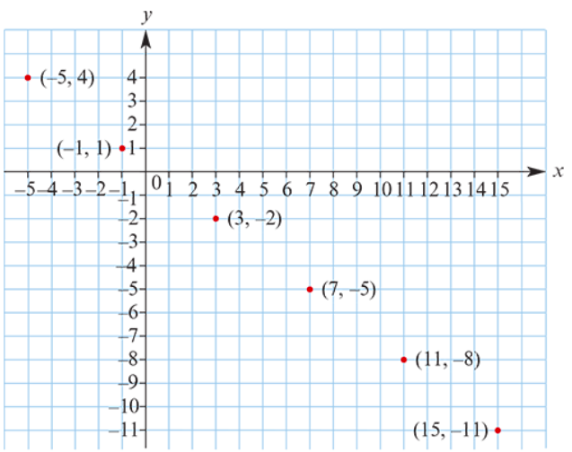
A Diophantine equation
An equation of the form 𝑎𝑥+𝑏𝑦=𝑐, where the coefficients 𝑎,𝑏,𝑐 are integers, is called a linear Diophantine equation when the intention is to find integer solutions for 𝑥,𝑦.
A family of integer solutions to 3𝑥+4𝑦=1 .
𝑥 | 𝑦
−1+1×4 | 1−1×3
−1+2×4 | 1−2×3
−1+3×4 | 1−3×3
𝑥 | 𝑦
3 | −2
7 | −5
11 | −8
4
3
The family of solutions may be described as
𝑥=−1+4𝑡, 𝑦=1−3𝑡 for 𝑡∈ℤ
The solution set is
{(𝑥,𝑦): 𝑥=−1+4𝑡, 𝑦=1−3𝑡, 𝑡∈ℤ}

Slide 40
Linear Diophantine Theorem
If 𝑎𝑥+𝑏𝑦=𝑐 is a linear Diophantine equation and ($x_{0}$, $y_{0}$) is found to be one solution, then the general solution is given by
𝑥= $x_{0}$+$\frac{b}{d}$𝑡, 𝑦= $y_{0}$− $\frac{a}{d}$𝑡 for 𝑡∈ℤ
where 𝑑 is the highest common factor of 𝑎 and 𝑏.
A linear Diophantine equation 𝑎𝑥+𝑏𝑦=𝑐 has integer solutions if and only if HCF(𝑎,𝑏) divides 𝑐.
There are no integer solutions to 2𝑥+6𝑦=3

Slide 41
Enough Mathematical Appetizers!
Let us look at something more interesting 2G:
The Euclidean Algorithms

Slide 42
Introduction to Number Theory
Number theory is about integers and their properties.
We will start with the basic principles of
Divisibility,
Highest Common Factors,
Least Common Multiples, and
and look at some relevant algorithms.

Slide 43
Division
If a and b are integers with a ≠ 0, we say that a divides b if there is an integer c so that b = ac.
When a divides b we say that a is a factor of b and that b is a multiple of a.
The notation a | b means that a divides b (b ÷ a).

Slide 44
Divisibility Theorems
For integers a, b, and c it is true that
if a | b and a | c, then a | (b + c)
Example: 3 | 6 and 3 | 9, so 3 | 15.
if a | b, then a | bc for all integers c
Example: 5 | 10, so 5 | 20, 5 | 30, 5 | 40, …
if a | b and b | c, then a | c
Example: 4 | 8 and 8 | 24, so 4 | 24.

Slide 45
The Division Algorithm
Let a be an integer and d a positive integer.
Then there are unique integers q and r, with 0 ≤ r < d, such that a = dq + r.
In the above equation,
d is called the divisor,
a is called the dividend,
q is called the quotient, and
r is called the remainder.

Slide 46
The Euclidean Algorithm
The Euclidean Algorithm finds the Highest Common Factor of two integers a and b.
For example, if we want to find HCF(287, 91), we divide 287 by 91:
287 = 91⋅3 + 14
We know that for integers a, b and c, if a | b and a | c, then a | (b + c).
Therefore, any divisor (including their HCF) of 287 and 91 must also be a divisor of 287 - 91⋅3 = 14.
Consequently, HCF(287, 91) = HCF(14, 91).

Slide 47
The Euclidean Algorithm
In the next step, we divide 91 by 14:
91 = 14⋅6 + 7
This means that HCF(14, 91) = HCF(14, 7).
So we divide 14 by 7:
14 = 7⋅2 + 0
We find that 7 | 14, and thus HCF(14, 7) = 7.
Therefore, HCF(287, 91) = 7.

Slide 48
Method for finding a solution of a linear Diophantine equation
Find 𝑎,𝑏∈ℤ such that 22𝑎+6𝑏=2.
Apply the Euclidean algorithm to 22 and 6:
22=3×6+4 (1)
6=1×4+2 (2)
4=2×2+0 (3)
Hence HCF(22,6)=2.
Now use these equations backwards:
2=6⎯1×4 from (2)
2=6⎯1×(22⎯3×6) from (1)
2=4×6⎯1×22
Therefore
−1×22+4×6=2
and so one solution is 𝑎=−1 and 𝑏=4.
The general solution is 𝑎=−1+3𝑡 and 𝑏=4−11𝑡, where 𝑡∈ℤ.

Slide 49
Method for finding a solution of a linear Diophantine equation
Find 𝑎,𝑏∈ℤ such that 125𝑎+90𝑏=5.
First divide by 5: 25𝑎+18𝑏=1
Apply the Euclidean algorithm to 25 and 18:
Hence HCF(25,18)=1.
Now use the equations backwards:
1=4⎯1×3 from (4)
1=4⎯1×(7⎯1×4) from (3)
1=2×4⎯1×7
1=2×(18⎯2×7)−1×7 from (2)
1=2×18⎯5×7
1=2×18⎯5×(25⎯1×18) from (1)
1=7×18⎯5×25
Therefore: −5×25+7×18=1
and so one solution is 𝑎=−5 and 𝑏=7.
The general solution is 𝑎=−5+18𝑡 and 𝑏=7−25𝑡, where 𝑡∈ℤ.
25=1×18+7 (1)
18=2×7+4 (2)
7=1×4+3 (3)
4=1×3+1 (4)
3=3×1+0 (5)

