Slide 1
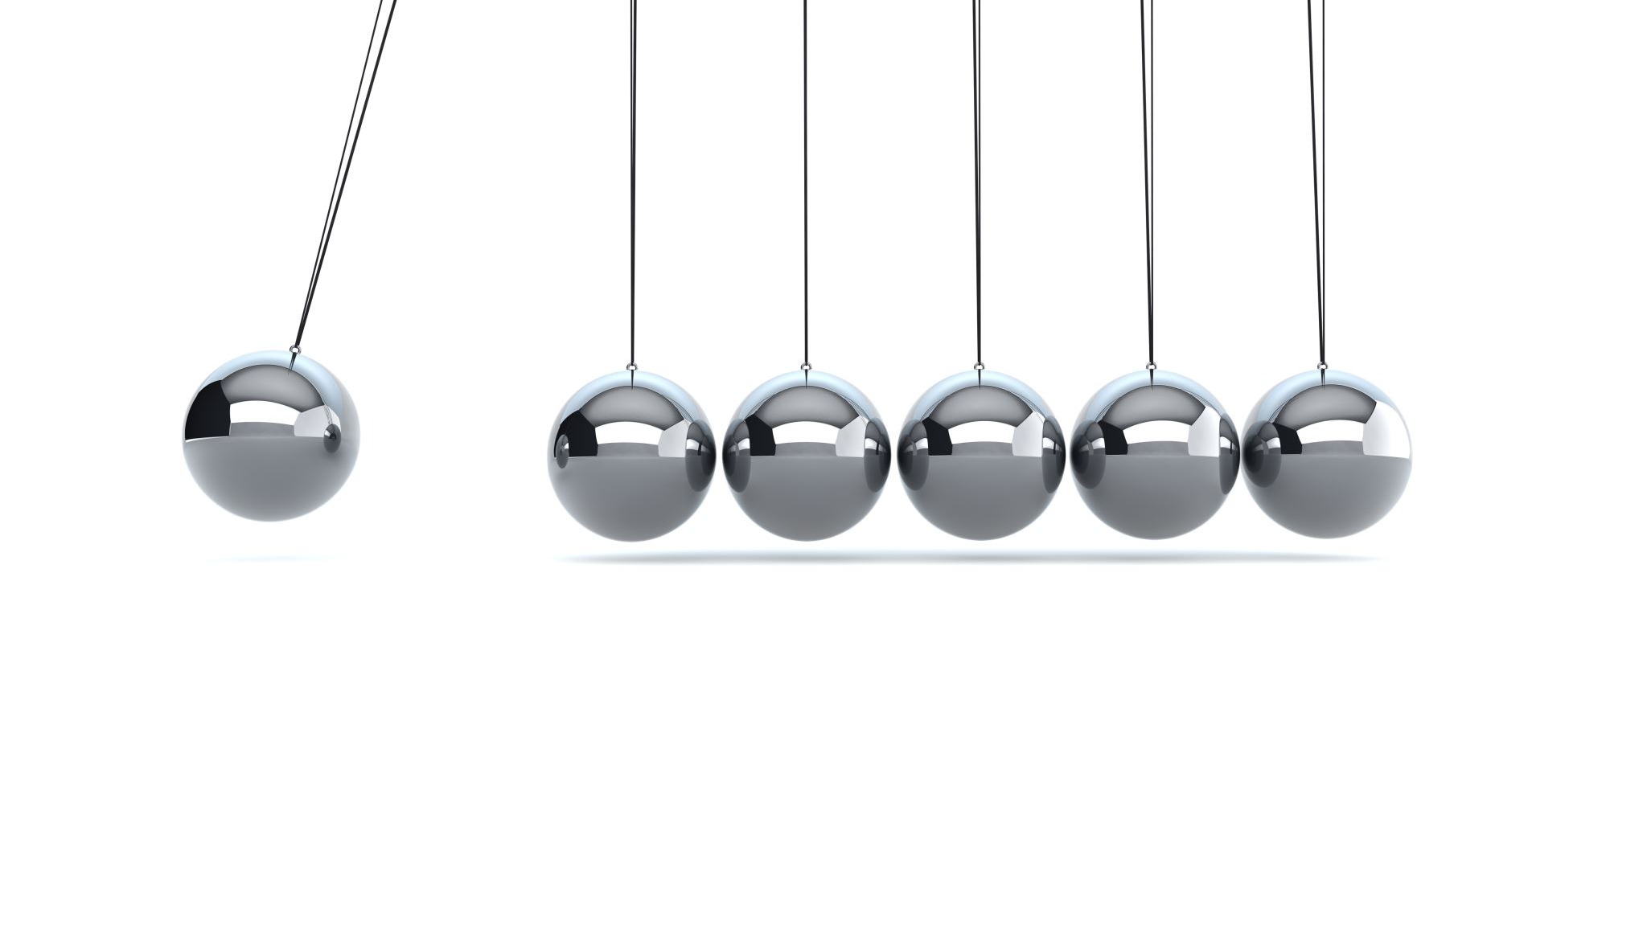
Zeno's paradox and infinite geometric series
4F

Slide 2
Zeno’s Paradox
A runner wants to go from point 𝐴 to point 𝐵. To do this, he would first have to run half the distance, then half the remaining distance, then half the remaining distance, and so on.
The Greek philosopher Zeno of Elea, who lived about 450 BC, argued that since the runner has to complete an infinite number of stages to get from 𝐴 to 𝐵, he cannot do this in a finite amount of time, and so he cannot reach 𝐵. In this section we see how to resolve this paradox.
How can an infinite number of things happen in a finite amount of time?

Slide 3
Infinite geometric series
If a geometric sequence has a common ratio with magnitude less than 1, that is, if −1<𝑟<1, then each successive term is closer to zero. For example, consider the sequence
$\frac{1}{3}$, $\frac{1}{9}$, $\frac{1}{27}$, $\frac{1}{81}$,…
$S_{9}$≈0.499975. $S_{20}$≈0.49999999986.
We might conjecture that, as we add more and more terms of the sequence, the sum will get closer and closer to 0.5, that is, $S_{n}$→0.5 as 𝑛→∞.
An infinite series $t_{1}$+ $t_{2}$+ $t_{3}$+⋯ is said to be convergent if the sum of the first 𝑛 terms, $S_{n}$, approaches a limiting value as 𝑛→∞. This limit is called the sum to infinity of the series.

Slide 4
The sum to infinity
If −1<𝑟<1, then the infinite geometric series 𝑎+𝑎𝑟+𝑎$r^{2}$+⋯ is convergent and the sum to infinity is given by
$S_{∞}$=$\frac{\text{a}}{\text{1−}\text{r}}$
Proof
We know that
$S_{n}$= $\frac{\text{a}\text{(}\text{1}\text{−}r^{n}\text{)} }{\text{1−}\text{r}}$= $\frac{\text{a} }{\text{1−}\text{r}}$− $\frac{\text{a}r^{n} }{\text{1−}\text{r}}$
As 𝑛→∞, we have $r^{n}$→0 and so $\frac{\text{a}r^{n} }{\text{1−}\text{r}}$→0. Hence $S_{n}$→ $\frac{\text{a} }{\text{1−}\text{r}}$ as 𝑛→∞.

Slide 5
Resolution of Zeno’s paradox
Assume that the runner is travelling at a constant speed and that he takes 1 minute to run half the distance from 𝐴 to 𝐵. Then he takes $\frac{1}{2}$ minute to run half the remaining distance, and so on. The total time taken is
1+$\frac{1}{2}$+ $\frac{1}{4}$+ $\frac{1}{8}$+ $\frac{1}{16}$+⋯
This is an infinite geometric series, and the formula gives
$S_{∞}$=$\frac{\text{a}}{\text{1−}\text{r}}$= $\frac{\text{1}}{\text{1−}\frac{\text{1}}{\text{2}}}$=2.
This fits with our common sense: If the runner takes 1 minute to cover half the distance, then he will take 2 minutes to cover the whole distance.

Slide 6
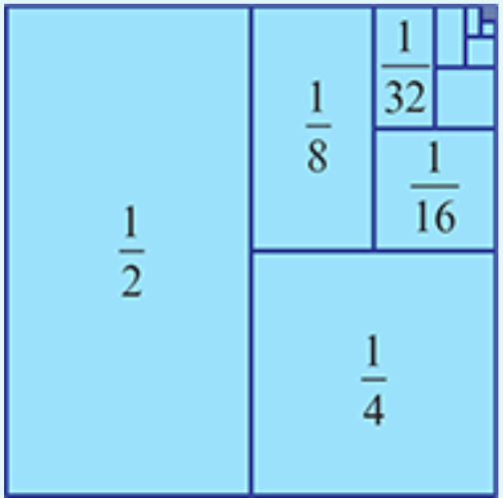
Example
Find the sum to infinity of the series $\frac{1}{2}$+ $\frac{1}{4}$+ $\frac{1}{8}$+⋯
𝑎= $\frac{1}{2}$, 𝑟= $\frac{1}{2}$
$S_{∞}$=$\frac{\text{a}}{\text{1−}\text{r}}$= $\frac{\frac{1}{2}}{\text{1−}\frac{1}{2}}$=1
Note: This result is illustrated by the unit square shown. Divide the square in two, then divide one of the resulting rectangles in two, and so on. The sum of the areas of the rectangles equals the area of the square.

Slide 7
Example
A square has a side length of 40 cm. A copy of the square is made so that the area of the copy is 80% of the original. The process is repeated so that each time the area of the new square is 80% of the previous one. If this process is repeated indefinitely, find the total area of all the squares.
The area of the first square is 402=1600 ${cm}^{2}$
We have 𝑎=1600 and 𝑟=0.8, giving
$S_{∞}$=$\frac{\text{a}}{\text{1−}\text{r}}$= $\frac{1600}{\text{1−}\text{0.8}}$=8000 ${cm}^{2}$

Slide 8
Example
Express the recurring decimal 0.$\dot{3}\dot{2}$as the ratio of two integers.
Solution
0.$\dot{3}\dot{2}$=0.32+0.0032+0.000032+⋯
We have 𝑎 =0.32 and 𝑟=0.01, giving
$S_{∞}$=$\frac{\text{a}}{\text{1−}\text{r}}$= $\frac{0.32}{1−0.01}$=$\frac{0.32}{0.99}$= $\frac{32}{99}$
$∴$0.$\dot{3}\dot{2}$= $\frac{32}{99}$

Slide 9
Convergent and Divergent
A series is convergent if the sequence of its partial sums tends to a limit;
Sequences for which $S_{∞}$ exists
and is finite are called convergent, other sequences are called divergent

Slide 10
For example...
The sequence
1, 1/2, 1/4, 1/8, 1/16, .... , 1/2 , ... is convergent since $S_{∞}$=2, whereas:
the sequence 1, 4, 9, 16, .…n , ... is divergent.
n

Slide 11
We conclude that...
$S_{∞}$= $\frac{\text{a}}{\text{1−}\text{r}}$ if $\left\lfloor r\right\rfloor <1,$
The geometric series converges precisely when $\left\lfloor r\right\rfloor <1$, and diverges otherwise.

