Slide 1
Basic counting methods
7A

Slide 2
Tree diagrams
Tree diagrams provide a systematic way of listing and then counting all the solutions.

Slide 3
Tree diagrams
A restaurant has a fixed menu, offering a choice of fish or beef for the main meal, and cake, pudding or ice-cream for dessert. How many different meals can be chosen?
This gives six different meals, which we can write as
FC,FP,FI,BC,BP,BI

Slide 4
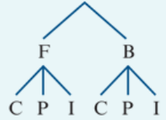
Multiplication principle
If there are m ways of performing one task and then there are n ways of performing another task, then there are m×n ways of performing both tasks.
2 × 3 =6

Slide 5
Example
Sandra has three different skirts, four different tops and five different pairs of shoes. How many choices does she have for a complete outfit?
3×4×5=60

Slide 6
Example
How many paths are there from point P to point R travelling from left to right?
4×3=12

Slide 7
Addition principle
Suppose there are m ways of performing one task and n ways of performing another task. If we cannot perform both tasks, then there are m+n ways to perform one of the tasks.

Slide 8
Example
To travel from Melbourne to Sydney tomorrow, Kara has a choice between three different flights and two different trains. How many choices does she have?
3+2=5
The addition principle applies because Kara cannot travel by both plane and train. Therefore, we add the number of ways of making each choice.

Slide 9
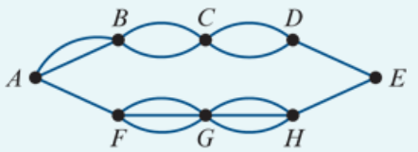
Example
How many paths are there from point A to point E travelling from left to right?
We can take either an upper path or a lower path:
Going from A to B to C to D to E there are 2×2×2×1=8 paths.
Going from A to F to G to H to E there are 1×3×3×1=9 paths.
Using the addition principle, there is a total of 8+9=17 paths from A to E.

Slide 10
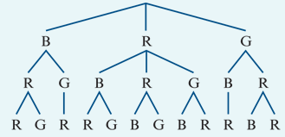
Harder problems involving tree diagrams
A bag contains one blue token, two red tokens and one green token. Three tokens are removed from the bag and placed in a row. How many arrangements are possible?
The complete set of possible arrangements can be read by tracing out each path from top to bottom of the diagram. This gives 12 different arrangements:
BRR, BRG, BGR, RBR, RBG, RRB, RRG, RGB, RGR, GBR, GRB, GRR

Slide 11
Section summary
Three useful approaches to solving simple counting problems:
Tree diagrams
These can be used to systematically list all solutions to a problem.
Multiplication principle
If there are m ways of performing one task and then there are n ways of performing another task, then there are m×n ways of performing both tasks.
Addition principle
Suppose there are m ways of performing one task and n ways of performing another task. If we cannot perform both tasks, there are m+n ways to perform one of the tasks.
Some problems require use of both the addition and the multiplication principles.

