Slide 1
Permutations with restrictions
7C

Slide 2
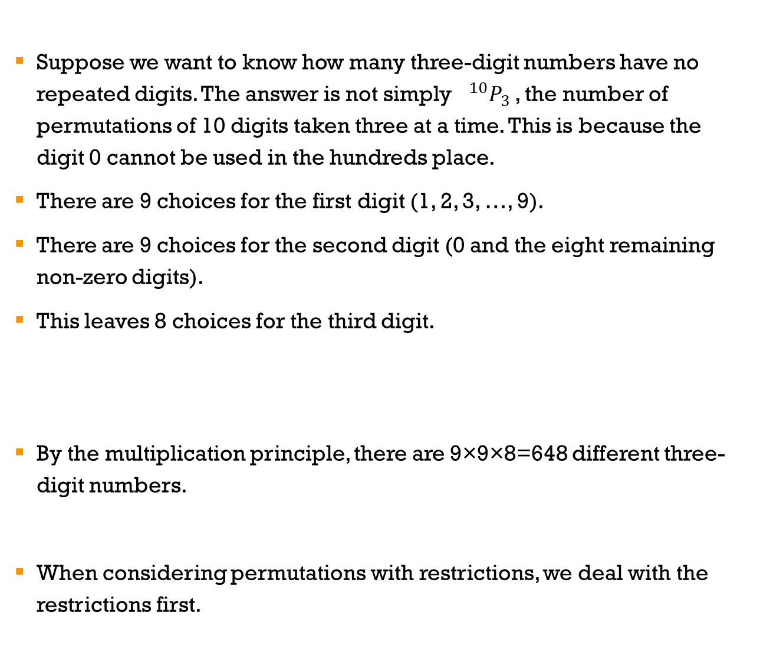
Permutations with restrictions
Suppose we want to know how many three-digit numbers have no repeated digits. The answer is not simply $0^{10}P_{3}$, the number of permutations of 10 digits taken three at a time. This is because the digit 0 cannot be used in the hundreds place.
There are 9 choices for the first digit (1, 2, 3, …, 9).
There are 9 choices for the second digit (0 and the eight remaining non-zero digits).
This leaves 8 choices for the third digit.
By the multiplication principle, there are 9×9×8=648 different three-digit numbers.
When considering permutations with restrictions, we deal with the restrictions first.
100s | 10s | Units
9 | 9 | 8

Slide 3
Examples
1. How many arrangements of the word DARWIN begin and end with a vowel?
2. Using the digits 0, 1, 2, 3, 4 and 5 without repetition, how many odd four-digit numbers can you form?
2×4×3×2×1×1=48
4×4×3×3=144
2 |  |  |  |  | 1
2 | 4 | 3 | 2 | 1 | 1
4 |  |  | 3
4 | 4 | 3 | 3

Slide 4
Permutations with items grouped together
1. How many arrangements of the word EQUALS are there if the vowels are kept together?
2. How many ways can two chemistry, four physics and five biology books be arranged on a shelf if the books of each subject are kept together?
Group: (E, U, A), Q, L, S. Arranged in 4! ways.
Three vowels: arranged in 3! ways.
We use the multiplication principle.
4!×3!=144
Three subject groups: arranged in 3! ways.
The two chemistry books: arranged in 2! ways,
the four physics books in 4! Ways,
the five biology books in 5! ways.
We use the multiplication principle.
3!×2!×4!×5!=34560

Slide 5
Section summary
To count permutations that are subject to restrictions, we draw a series of boxes. In each box, we write the number of choices we have for that position. We always consider the restrictions first.
When items are to be grouped together, we initially treat each group as a single object. We find the number of arrangements of the groups, and then multiply by the numbers of arrangements within each group.

