Slide 1
Permutations of like objects
7D

Slide 2
Permutations of like objects
The name for the Sydney suburb of WOOLLOOMOOLOO has the unusual distinction of having 13 letters in total, of which only four are different. Finding the number of permutations of the letters in this word is not as simple as evaluating 13!. This is because switching like letters does not result in a new permutation.
Our aim is to find an expression for P, where P is the number of permutations of the letters in the word WOOLLOOMOOLOO. First notice that the word has
1 letter W,1 letter M,3 letter Ls,8 letter Os

Slide 3
Permutations of like objects
Replace the three identical Ls with L1, L2 and L3. These three letters can be arranged in 3! different ways. Therefore, by the multiplication principle, there are now
P⋅3!
permutations. Likewise, replace the eight identical Os with O1, O2,…, O8. These eight letters can be arranged in 8! different ways. Therefore there are now
P⋅3!⋅8!
permutations.
On the other hand, notice that the 13 letters are now distinct, so there are 13! permutations of these letters. Therefore
P⋅3!⋅8!=13!and so P=$\frac{13!}{3!8!}$
We can easily generalise this procedure to give the following result.

Slide 4
Permutations of like objects
The number of permutations of n objects of which $n_{1}$ are alike, $n_{2}$ are alike, … and $n_{r}$ are alike is given by
$\frac{n!}{n_{1}\text{!}n_{2}\text{!⋯}n_{r}\text{!}}$

Slide 5
Examples
1. Find the number of permutations of the letters in the word RIFFRAFF.
2. There are four identical knives, three identical forks and two identical spoons in a drawer. They are taken out of the drawer and lined up in a row. How many ways can this be done?
Solution Explanation
$\frac{8!}{4!2!}$=840 There are 8 letters of which 4 are alike and 2 are alike.
$\frac{9!}{4!3!2!}$=1260 There are 9 items of which 4 are alike, 3 are alike and 2 are alike.

Slide 6
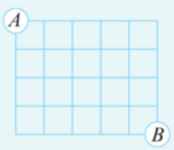
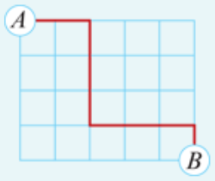
Example
The grid shown consists of unit squares. By travelling only right (R) or down (D) along the grid lines, how many paths are there from point A to point B?
Solution
Each path from A to B can be described by a sequence of four Ds and five Rs in some order. For example, the path shown can be described by the sequence RRDDDRRRD.
There are
$\frac{8!}{4!5!}$=126
permutations of these letters, since there are 9 letters of which 4 are alike and 5 are alike.

Slide 7
Section summary
Switching like objects does not give a new arrangement.
The number of permutations of n objects of which $n_{1}$ are alike, $n_{2}$ are alike, … and $n_{r}$ are alike is given by
$\frac{n!}{n_{1}\text{!}n_{2}\text{!⋯}n_{r}\text{!}}$

