Slide 1
Combinations
7E

Slide 2
Combinations
A combination is a selection made regardless of order. We use the notation $0^{n}P_{r}$to denote the number of permutations of n distinct objects taken r at a time. Similarly, we use the notation $0^{n}C_{r}$ to denote the number of combinations of n distinct objects taken r at a time.

Slide 3
How many ways can two letters be chosen from the set {A,B,C,D}?
Solution
The tree diagram below shows the ways that the first and second choices can be made.
This gives 12 arrangements. But there are only six selections, since
{A,B} is the same as {B,A},
{A,C} is the same as {C,A},
{A,D} is the same as {D,A},
{B,C} is the same as {C,B},
{B,D} is the same as {D,B}
{C,D} is the same as {D,C}

Slide 4
Number of combinations
Suppose we want to count the number of ways that three students can be chosen from a group of seven. Let’s label the students with the letters {A,B,C,D,E,F,G}. One such combination might be BDE. Note that this combination corresponds to 3! permutations:
BDE,BED,DBE,DEB,EBD,EDB
In fact, each combination of three items corresponds to 3! permutations, and so there are 3! times as many permutations as combinations. Therefore
$0^{7}P_{3}$=3!× $0^{7}C_{3}$ and so $0^{7}C_{3}$=$\frac{0^{7}P_{3}}{3!}$
Since we have already established that $0^{7}P_{3}$=$\frac{7!}{(7−3)!}$ we obtain
$0^{7}C_{3}$=$\frac{7!}{3!\left(7−3\right)!}$
This argument generalises easily so that we can establish a formula for $0^{n}C_{r}$ .

Slide 5
Number of combinations
The number of combinations of n objects taken r at a time is given by the formula
$0^{n}C_{r}$=$\frac{n!}{r!\left(n−r\right)!}$

Slide 6
A pizza can have three toppings chosen from nine options. How many different pizzas can be made? Examples How many subsets of {1,2,3,…,20} have exactly two elements?
A. Three objects are to be chosen from nine options. This can be done in ${0^{9}C}_{3}$ways, and
${0^{9}C}_{3}$=$\frac{9!}{3!\left(9−3\right)!}$ =$\frac{9!}{3!6!}$=$\frac{9!}{3!6!}$ = $\frac{9\text{⋅}8\text{⋅}7\text{⋅}6!}{3!6!}$ =$\frac{9\text{⋅}8\text{⋅}7}{\text{3}\text{⋅}2}$=84
Two objects are to be chosen from 20 options. This can be done in ${0^{20}C}_{2}$ ways, and
${0^{20}C}_{2}$=$\frac{20!}{2!\left(20−2\right)!}$ =$\frac{20!}{2!18!}$=$\frac{20\text{⋅}19\text{⋅}18!}{2!18!}$ =$\frac{20\text{⋅}19}{\text{2⋅1}}=190$

Slide 7
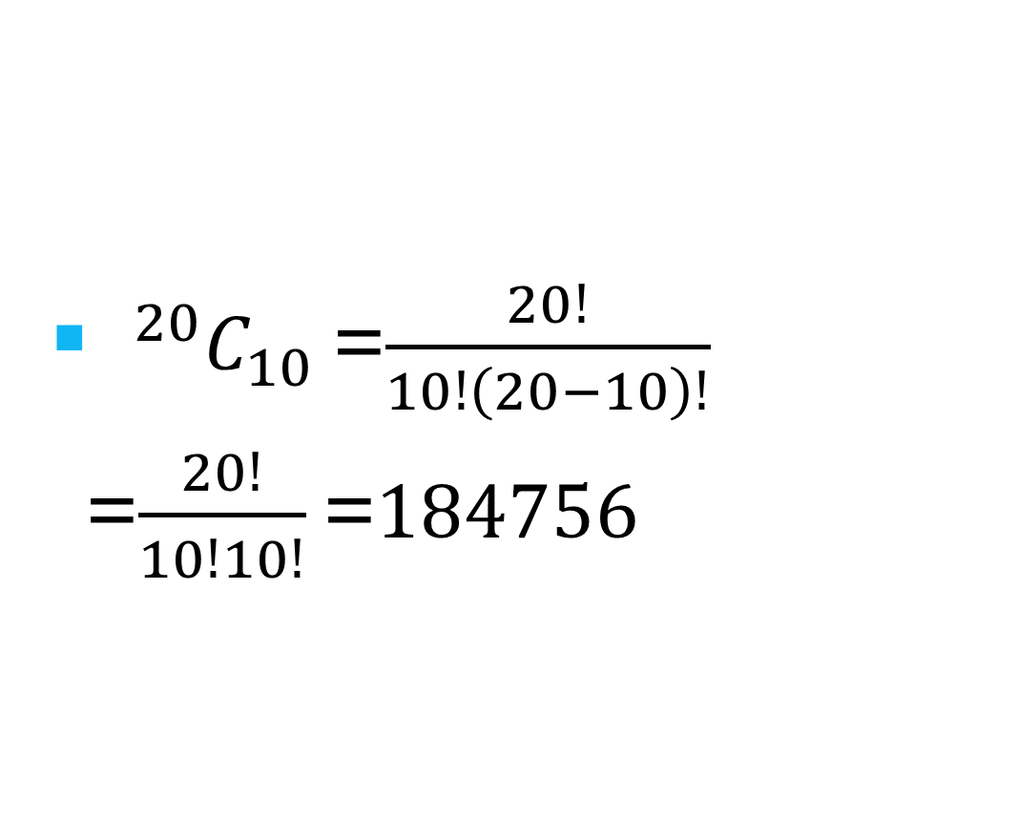
Find how many ways 10 students can be selected from a class of 20 students.
${0^{20}C}_{10}$=$\frac{20!}{10!\left(20−10\right)!}$ =$\frac{20!}{10!10!}$=$184756$

Slide 8

Consider a group of six students. In how many ways can a group of: a. two students be selected b. four students be selected
${0^{6}C}_{2}$=$\frac{6!}{2!\left(6−2\right)!}$ =$\frac{6!}{2!4!}$= $\frac{6\text{⋅}5\text{⋅}4!}{2!4!}$ =$\frac{6\text{⋅}5}{2\text{⋅}1}$=15
${0^{6}C}_{4}$=$\frac{6!}{4!\left(6−4\right)!}$ =$\frac{6!}{4!2!}$= $\frac{6\text{⋅}5\text{⋅}4!}{2!4!}$ =$\frac{6\text{⋅}5}{2\text{⋅}1}$=15

Slide 9
Quick calculations
Previous example: ${0^{6}C}_{2}$= ${0^{6}C}_{4}$.
More generally:
${0^{n}C}_{r}$= ${0^{n}C}_{n−r}$
${0^{n}C}_{0}$=1, since there is only one way to select no objects from n objects
${0^{n}C}_{n}$=1, since there is only one way to select n objects from n objects
${0^{n}C}_{1}$=n, since there are n ways to select one object from n objects
${0^{n}C}_{n−1}$=n, since this corresponds to the number of ways of not selecting one object from n objects.

Slide 10
Examples
Six points lie on a circle. How many triangles can you make using these points as the vertices?
Each of the 20 people at a party shakes hands with every other person. How many handshakes take place?
Solution
This is the same as asking how many ways three vertices can be chosen out of six.
${0^{6}C}_{3}$=20
This is the same as asking how many ways two people can be chosen to shake hands out of 20 people.
${0^{20}C}_{2}$=190

Slide 11
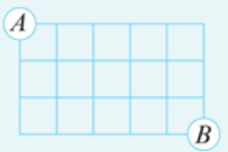
Example
The grid shown consists of unit squares. By travelling only right (R) or down (D) along the grid lines, how many paths are there from point A to point B?
Solution
Each path from A to B can be described by a sequence of three Ds and five Rs in some order. Therefore, the number of paths is equal to the number of ways of selecting three of the eight boxes below to be filled with the three Ds. (The rest will be Rs.) This can be done in ${0^{8}C}_{3}$ =56 ways.

Slide 12
Alternative notation
We will consistently use the notation ${0^{n}C}_{r}$ to denote the number of ways of selecting r objects from n objects, regardless of order. However, it is also common to denote this number by $\left(\begin{aligned}n \\ r\end{aligned}\right)$.
For example:
$\left(\begin{aligned}6 \\ 4\end{aligned}\right)$=$\frac{6!}{4!2!}$=15

Slide 13
Section summary
A combination is a selection made regardless of order.
The number of combinations of n objects taken r at a time is given by
$0^{n}C_{r}$=$\frac{n!}{r!\left(n−r\right)!}$

