Slide 1
Combinations with restrictions
7F

Slide 2
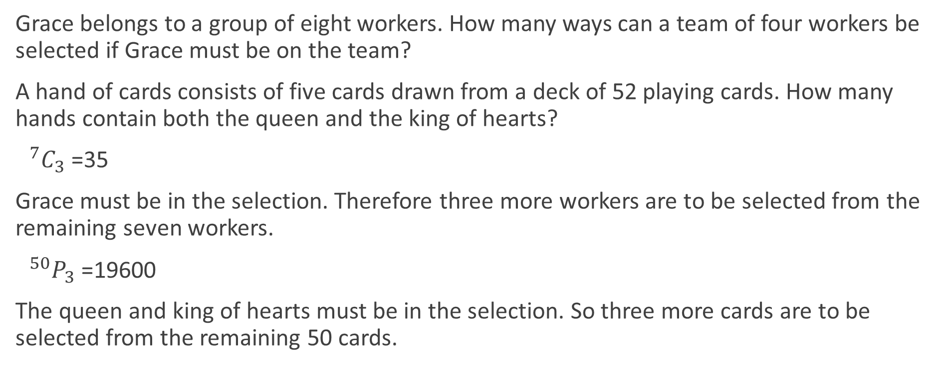
Combinations including specific items
Grace belongs to a group of eight workers. How many ways can a team of four workers be selected if Grace must be on the team?
A hand of cards consists of five cards drawn from a deck of 52 playing cards. How many hands contain both the queen and the king of hearts?
$0^{7}C_{3}$=35
Grace must be in the selection. Therefore three more workers are to be selected from the remaining seven workers.
$0^{50}P_{3}$=19600
The queen and king of hearts must be in the selection. So three more cards are to be selected from the remaining 50 cards.

Slide 3
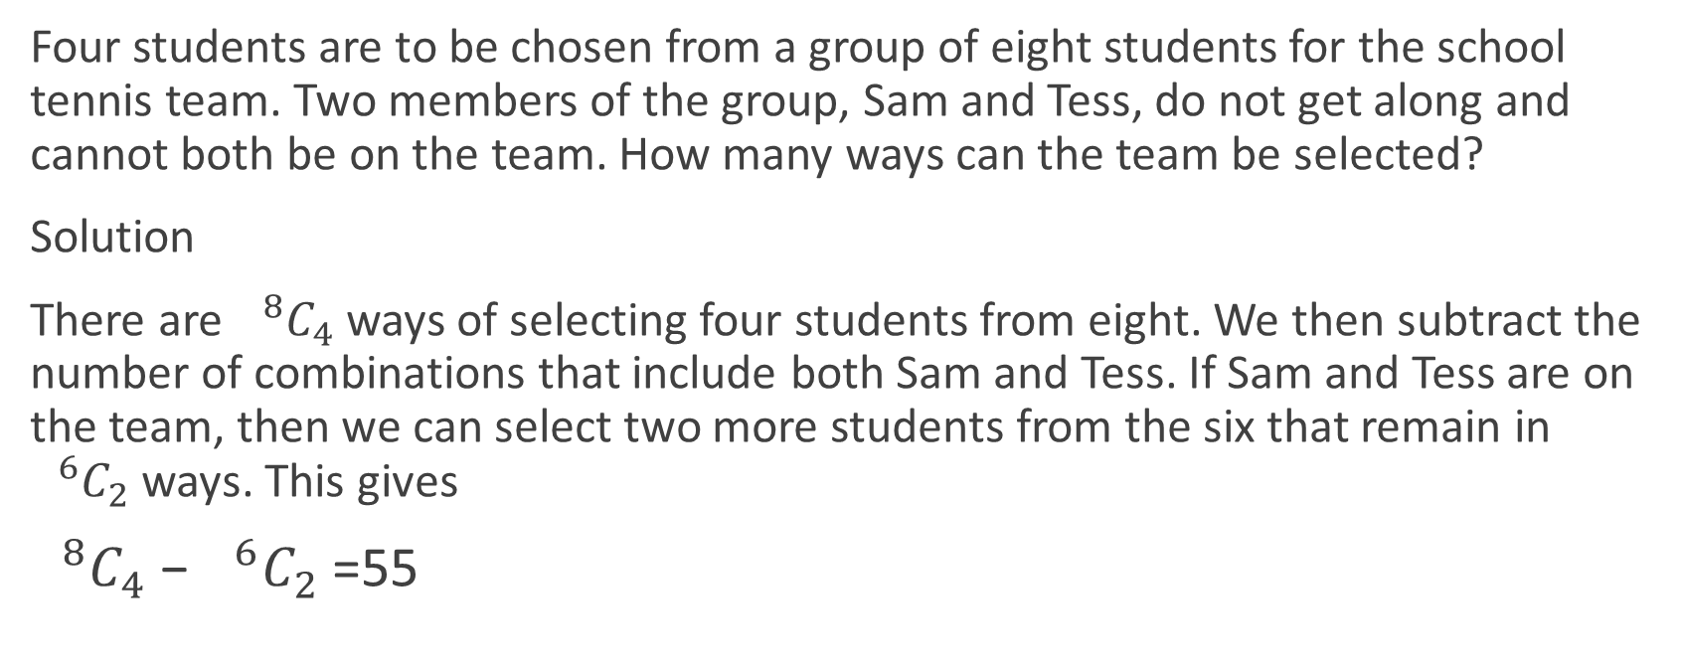
Combinations including specific items
Four students are to be chosen from a group of eight students for the school tennis team. Two members of the group, Sam and Tess, do not get along and cannot both be on the team. How many ways can the team be selected?
Solution
There are $0^{8}C_{4}$ ways of selecting four students from eight. We then subtract the number of combinations that include both Sam and Tess. If Sam and Tess are on the team, then we can select two more students from the six that remain in $0^{6}C_{2}$ ways. This gives
$0^{8}C_{4}$− $0^{6}C_{2}$=55

Slide 4
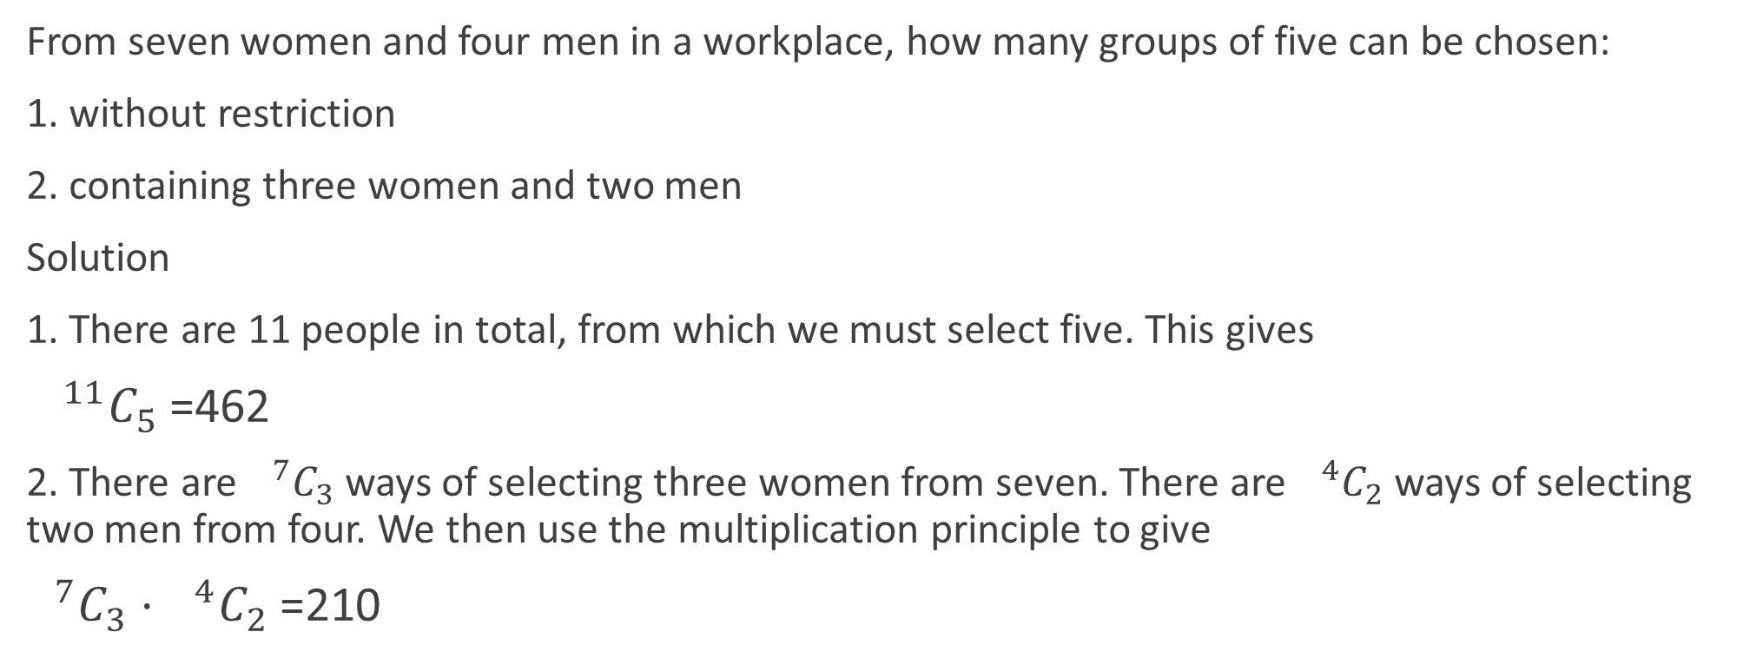
Combinations from multiple groups
From seven women and four men in a workplace, how many groups of five can be chosen:
1. without restriction
2. containing three women and two men
Solution
1. There are 11 people in total, from which we must select five. This gives
$0^{11}C_{5}$=462
2. There are $0^{7}C_{3}$ ways of selecting three women from seven. There are $0^{4}C_{2}$ways of selecting two men from four. We then use the multiplication principle to give
$0^{7}C_{3}$ ⋅ $0^{4}C_{2}$=210

Slide 5
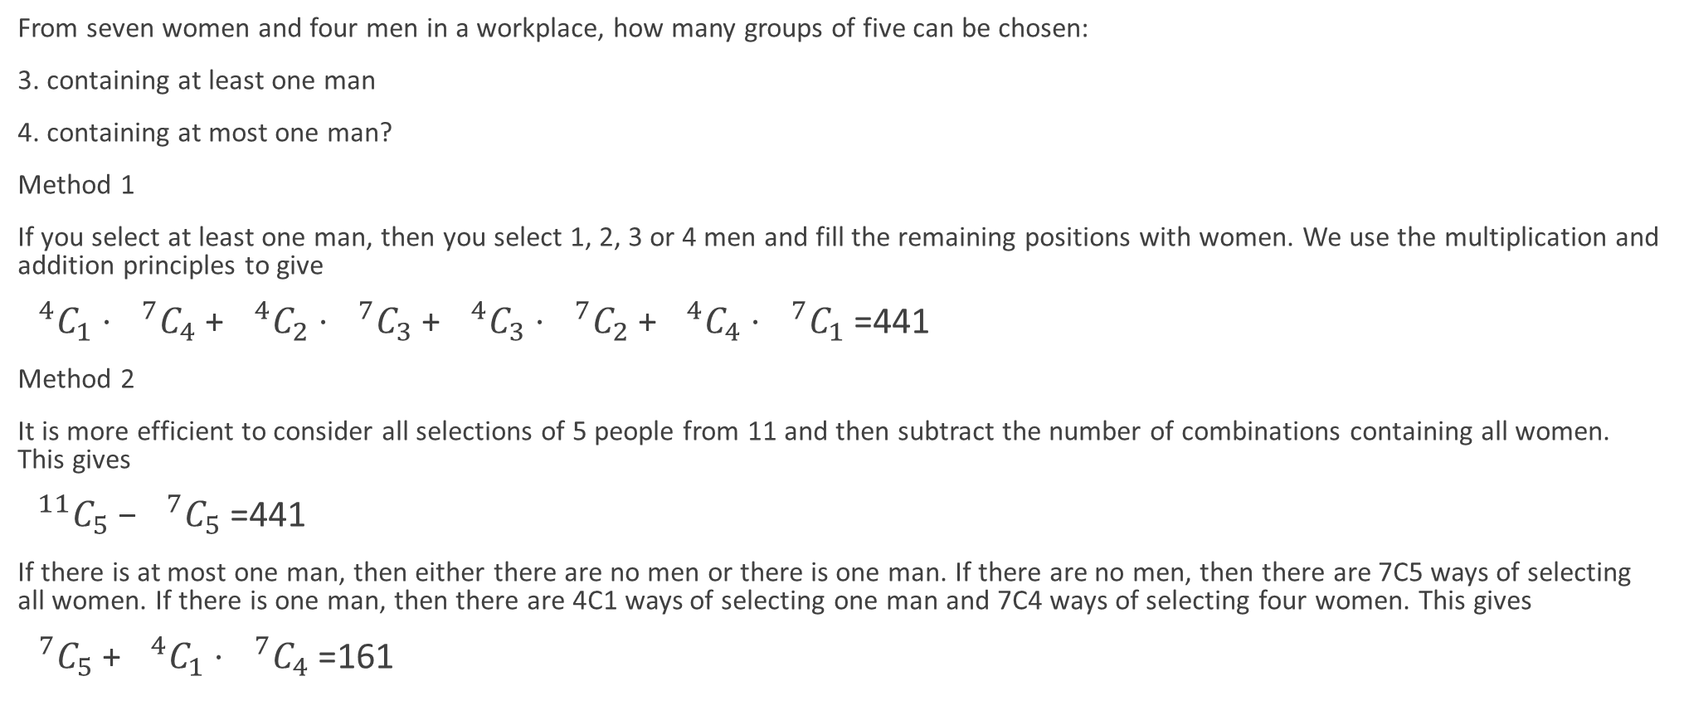
Combinations from multiple groups
From seven women and four men in a workplace, how many groups of five can be chosen:
3. containing at least one man
4. containing at most one man?
Method 1
If you select at least one man, then you select 1, 2, 3 or 4 men and fill the remaining positions with women. We use the multiplication and addition principles to give
$0^{4}C_{1}$⋅ $0^{7}C_{4}$+ $0^{4}C_{2}$⋅ $0^{7}C_{3}$+ $0^{4}C_{3}$⋅ $0^{7}C_{2}$+ $0^{4}C_{4}$⋅ $0^{7}C_{1}$=441
Method 2
It is more efficient to consider all selections of 5 people from 11 and then subtract the number of combinations containing all women. This gives
$0^{11}C_{5}$− $0^{7}C_{5}$=441
If there is at most one man, then either there are no men or there is one man. If there are no men, then there are 7C5 ways of selecting all women. If there is one man, then there are 4C1 ways of selecting one man and 7C4 ways of selecting four women. This gives
$0^{7}C_{5}$+ $0^{4}C_{1}$⋅ $0^{7}C_{4}$=161

Slide 6
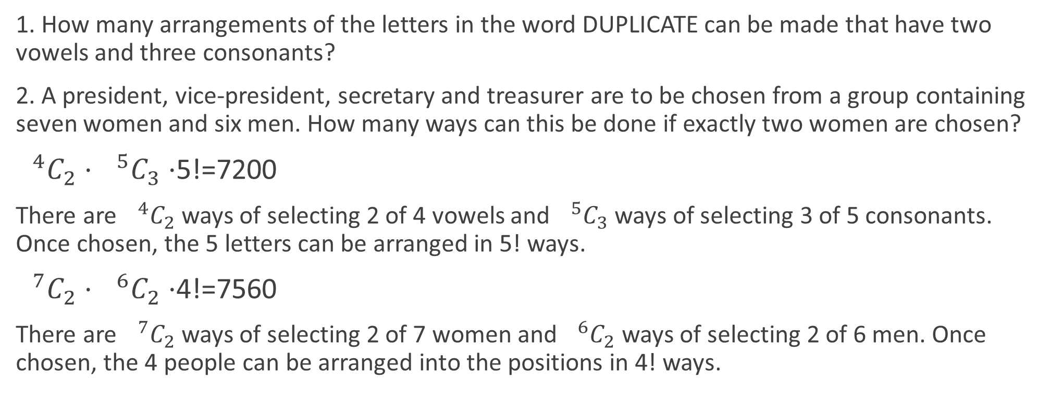
Permutations and combinations combined
1. How many arrangements of the letters in the word DUPLICATE can be made that have two vowels and three consonants?
2. A president, vice-president, secretary and treasurer are to be chosen from a group containing seven women and six men. How many ways can this be done if exactly two women are chosen?
$0^{4}C_{2}$⋅ $0^{5}C_{3}$⋅5!=7200
There are $0^{4}C_{2}$ ways of selecting 2 of 4 vowels and $0^{5}C_{3}$ ways of selecting 3 of 5 consonants. Once chosen, the 5 letters can be arranged in 5! ways.
$0^{7}C_{2}$⋅ $0^{6}C_{2}$⋅4!=7560
There are $0^{7}C_{2}$ ways of selecting 2 of 7 women and $0^{6}C_{2}$ ways of selecting 2 of 6 men. Once chosen, the 4 people can be arranged into the positions in 4! ways.

Slide 7
Section summary
If a selection must include specific items, then this reduces both the number of items that we have to select and the number of items that we select from.
If we are required to make multiple selections from separate groups, then we multiply the number of ways of performing each task.
Some problems will require us to select and then arrange objects.

